Slide 1


Neutron Optics
&
Instrumentation
Bill Hamilton
Neutron Instrument & Source Division
Oak Ridge National Laboratory
Sunday 22 June 2014
National School on Neutron and X-ray Scattering
14-28 June 2014

Slide 2
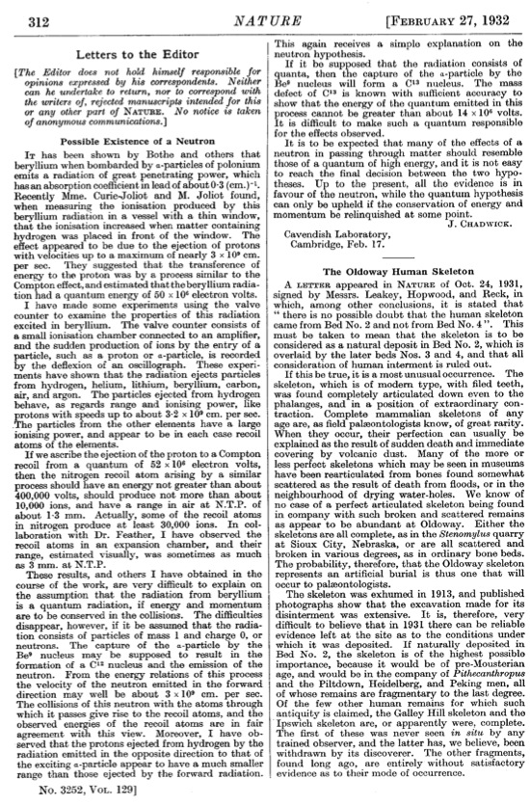
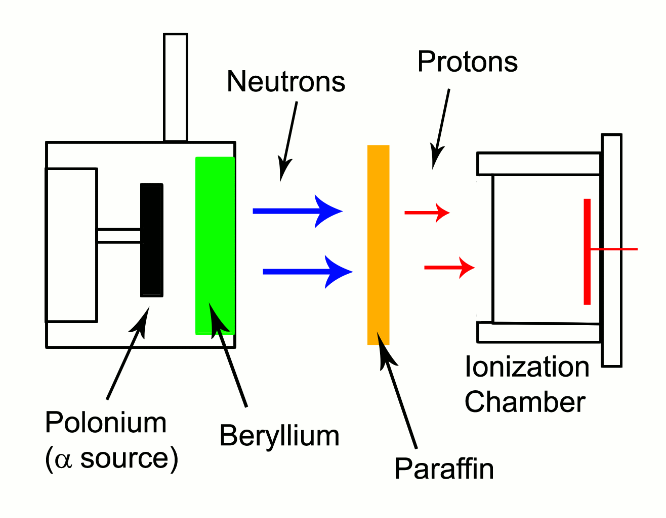
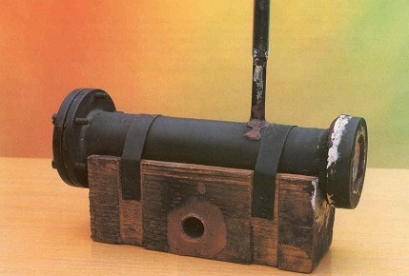
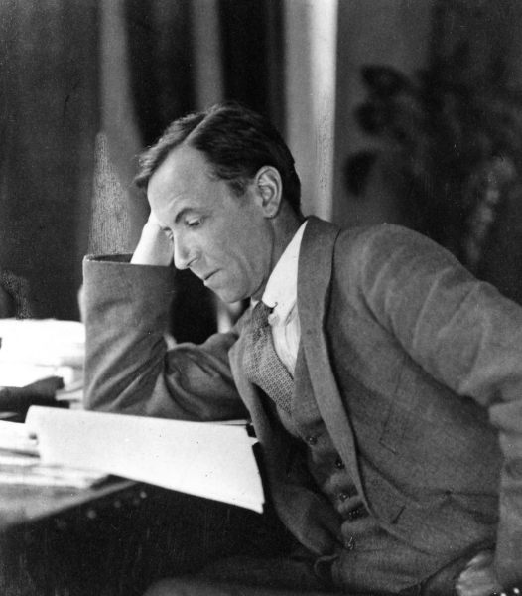
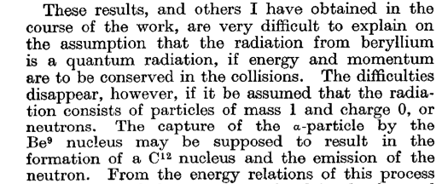
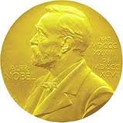
Chadwick identifies the neutron - 1932
1935 Nobel Prize in Physics "for the discovery of the neutron”
Notes:
The first neutron “scattering” instrument – or at least the first neutron scattering experiment to know that it was one …Chadwick’s problem and solutions are very much ours …
In similar experiments a few years earlier Irene Curie & Frederic Joliot and Bothe & Becker a few years earlier had misidentified the neutral particle in question as photon – well gamma ray. Ettore Majorana correctly deduced as Chadwick would later that the Joliot-Curie particle had to be a massive neutral particle coming out of the nucleus otherwise the knocking on of the protons would violate the conservation of energy and momentum (also it’s a huge gamma anyway, so why didn’t the ionization chamber see it?). Thus being the neutron, something of this sort having been expected for a while - Rutherford after all had suggested in 1920 that something of this sort was needed to stabilize all the positive charges he had found concentrated by protons in atomic nuclei and the name was suggested at that time - he was Chadwick’s boss at the time. Despite this being something of a big deal and despite encouragement (cajoling?) from Fermi, Majorana didn’t bother to publish since the result was in his opinion “banal”. Chadwick did a little more than this basic experiment and by mixing targets was able to estimate the mass of the neutral particle as 1.0067 proton masses and for this got the Physics Nobel in 1935. The J-C’s btw got the Chemistry Prize for artificially induced radioactivity which is what is going on in the Be. Majorana went missing during or soon after a ferry ride from Palermo to Naples in 1939.

Slide 3
Properties of the Neutron
Neutrons are NEUTRAL particles
They are highly penetrating:
can be used as nondestructive probes
can be used to study samples in severe environments
Neutrons have a MAGNETIC moment
They can be used to:
study microscopic magnetic structure
study magnetic fluctuations
develop magnetic materials
Neutrons have SPIN
They can be:
formed into polarized neutron beams
used to study nuclear (atomic) orientation
used for coherent and incoherent scattering.
The ENERGIES of thermal neutrons are similar to the energies of elementary excitations in solids.
The WAVELENGTHS of neutrons are similar to the distance between atoms:
They can determine
atomic structure
structural transitions
Neutrons "see" NUCLEI
They are
sensitive to light atoms,
can exploit isotopic substitution
contrast variation to differentiate
molecular (sub)structures.
*
“highly penetrating” ⬄ weakly interacting …
Notes:
They are neutral and nuclear (and that light atom sensitivity without the Paraffin Chadwick’s ionization chamber saw nothing we very little –so putting lots of them round a hgih atomic number nucleus electrons mostly don’t care …)

Slide 4
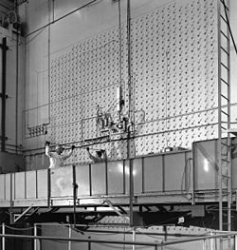
(Thermal) Neutron Bragg Diffraction
An obvious consequence of things already well known in 1932:
X-ray diffraction (1912 the Braggs, father and son)
& de Broglie wavelength hypothesis confirmation (1927 Davisson & Germer)
& Chadwick’s determination of the neutron mass (1.0067 m_{p})
1936 Mitchel & Powers and Halban & Preiswerk – Bragg diffraction demonstration
Early problems: source & interaction strengths, neutron energies & neutron detection
& WWII …
X-10 Graphite reactor 1943
(Clinton Engineering works)
….
E.O. Wollan and C. G. Shull
1945/1946 …
XRD
from
UC
1948
after n mods
"Scientists at Oak Ridge were very anxious to find real honest-to-goodness scientific uses for the information and technology that had been developed during the war at Oak Ridge and at other places associated with the wartime Manhattan Project.”
Clifford Shull speaking about arriving to work at “Clinton Laboratories” in 1946
Notes:
1936 – demonstration of quantum wave mechanics …
Weak interaction strength problem as a useful probe ?
Same sort of quasi-problems that Darwin’s formulation of XRD would affect x-ray Bragg, fortunately most crystals are as good as the one in his Darwin’s math – which is why we now have the phrase ideally imperfect …
Wollan was one of Fermi’s team on CP-1 the first “health physicist”, (he invented the pocket sized electroscope ionization chamber dosimeters that are still in use even today )
but may have been outside doing rad survey when the pile went critical and worrying whether his shielding calculations were correct …
Shull live long enough to share the Nobel Prize with Brockhouse (3X) in 1994, which is near a record 1946-1994=48yrs for work to prize (held by Emile Ruska electron microscope 1933-1986=53yrs)
In both cases I’d note that their techniques had enabled several Nobel Prizes well before thay got theirs (Flory – Gaussian polymer chain in melt confirmation definitely an argument, de Geenes also)
Take home lesson: if your ambition is to win a Nobel Prize there are quicker ways of doing it than developing particle scattering or optics techniques …
Also (maybe add later)
1946 - First observation of total external reflection of neutrons by Fermi and Zimm.
1947 - Fermi and Marshall performed detailed studies using monochromatic neutrons to measure scattering lengths of materials => scatt length/x-sections for thermal n (and was Bragging as well)
Neutron Reflection then continued to be used to study bulk scattering lengths.
But Shull and Wollan were the ones who really pioneered ns as a materials science technique Antiferromagnetism – spin matters for neutrons

Slide 5
What is a neutron scattering instrument ?
Neutron scattering measurements probe nuclear positions and motions in a sample from determinations of the wavevector change (Q) and the energy change (E) of the neutron - S(Q,E).
What do we need to accomplish this?
  1. A source of neutrons
  2. Selection of the wavevector of the incident neutrons (k_{i})
  3. a) An interesting & otherwise intractable question (n/$/t low)
  3. b) A “large” sample (n interactions are generally “weak”)
  3. c) An otherwise well characterized sample (n/$/t low)
  4. A neutron detector – or lots of them (… n/$/t low)
  5. A method for determining scattered n wavevectors (k_{f})
Detector
Scattered Wavevector
k_{f}
Incident Wavevector
Source
k_{i}
Sample
Notes:
Slecting Neutrons of the right wavelength / energy
Also nice to know as much as you can about your sample beforehand – neutrons are expensive and hard to get to … but needs must

Slide 6
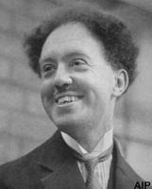
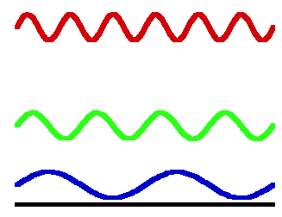
Wave-particle duality machine
de Broglie
Instrumentally
Paths, flight timing,
collimation, detection …
Sample interactions …
wave … mostly
particle … mostly
Notes:
Non-relativistic ….
Mostly for samples … we sometimes have recoil to consider in a way that we wouldn’t do for a ‘normal” wave, but not as it happens unlike Mossbauer …
Mostly for beams, well xtal analyzer interactions, detection is sorta quantum …. For ultracold neutrons diffraction at slits occurs/matters
This can make you feel cool – except for leading to neuty – Gatlinburg conference 1986

Slide 7
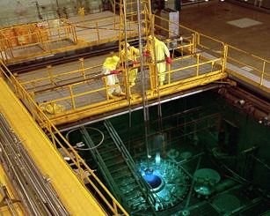
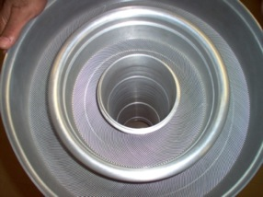
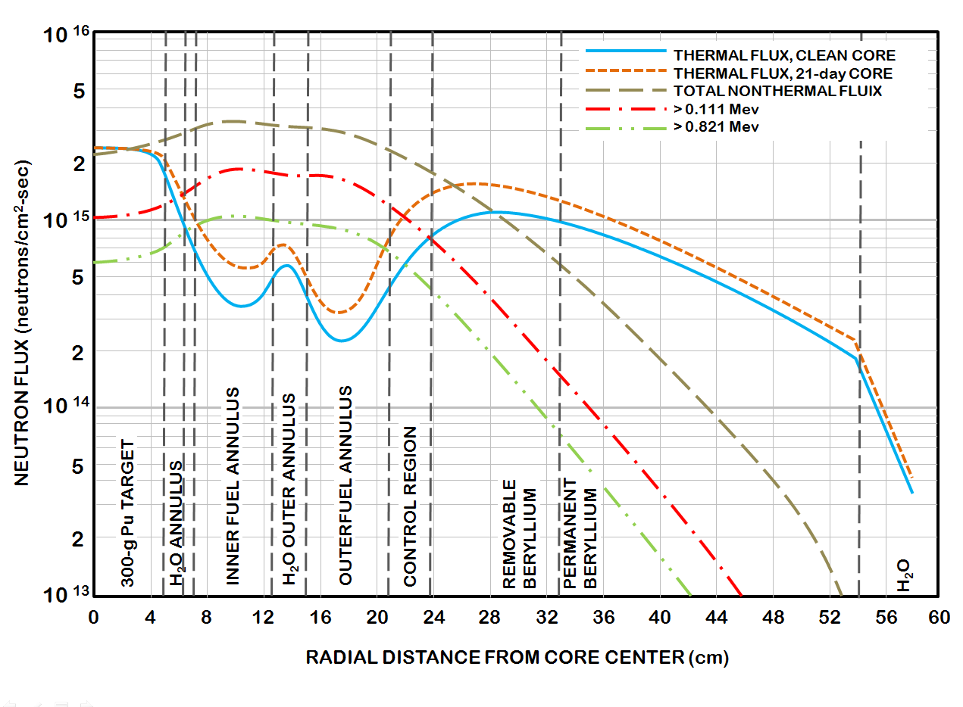
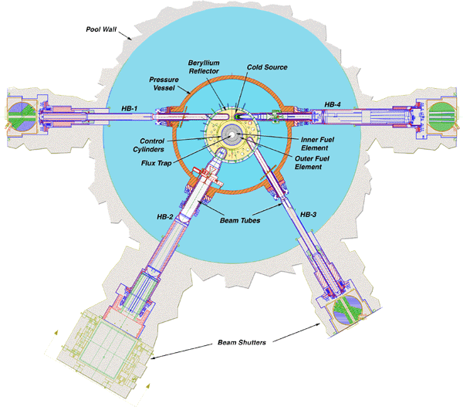
Nuclear Reactors – continuous
Neutrons produced by fission (usually ²³⁵U)
Fission requires moderation (~“thermal” neutrons)
Neutrons at a more or less constant rate
Very high neutron fluxes ~10¹⁵ n/cm²/s
High Flux
Isotope Reactor
(HFIR – ORNL)
Notes:
Neutrons generated in a volume of about 50litre
~10E9 fast n generated per Joule of heat

Slide 8
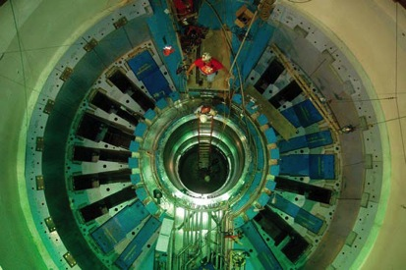
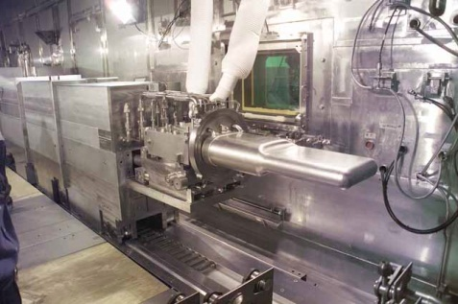
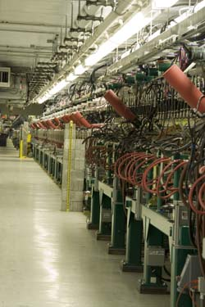
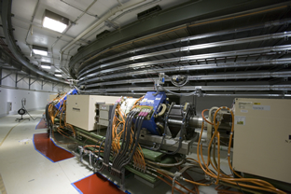
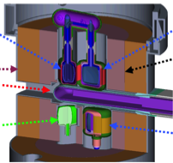
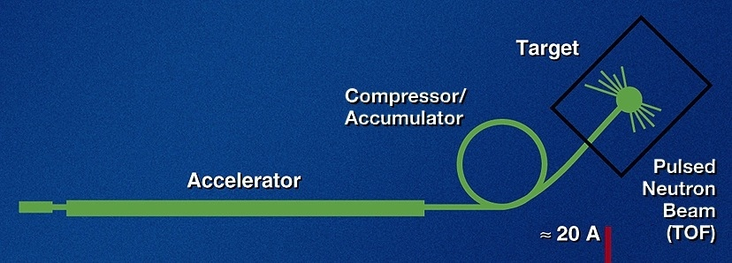

Spallation Sources – mostly pulsed
Neutrons produced by nuclear spallation
Accelerator beams usually pulsed => time structure
Neutron energies must be moderated (a lot)
Extremely high peak fluxes ~10¹⁶ n/cm²/s
Spallation Neutron
Source
SNS - ORNL
Notes:
Neutrons generated in a volume of about 2litre
~10E10 fast n generated per Joule of heat
So actually heat densities aren’t that different per neutron, but actually lower

Slide 9
Primary characteristics of the sources
SNS
Peak flux of the SNS is about 10x the flux of the HFIR
(60 accelerator proton pulses per second)
HFIR flux is about 15x the time averaged flux of the SNS
Flux n/cm²-s
HFIR
Time [μs]
Notes:
Look in the ms around an SNS pulse and the timei integrated neutrons are about the same Note next SNS pulse is nearly 16 graph (15.6) widths away …
After a half a ms or so SNS outputed has dwindled HFIR keeps on chugging

Slide 10
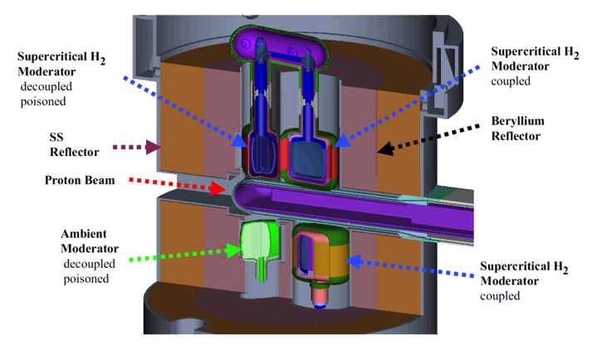
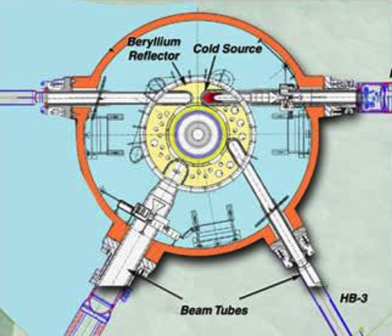
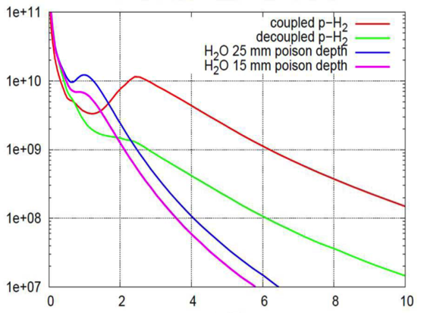
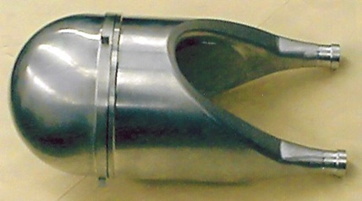

Neutron Moderation: GeV & MeV ➔ eV & meV
Neutrons bounce off something light (better energy transfer) maintained
at a temperature consistent with the energy/wavelength desired
Most HFIR instruments beam tubes
view water cooled Be reflector/moderator
or LH₂ Cold Source (T~20K)
SNS Moderators
“Thermal” 2 Å
k_{B}T ~ 25 meV
“Cold” 6 Å
k_{B}T ~ 2 meV
H₂O
Source Brightness
(n/cm²/sterad/Å/MW/pulse)
HFIR Cold Source
lH₂ flow head vessel
Neutron Wavelength (Å)
Notes:
Reactors have an “advantage” in that although they generate more heat per neutron the nature of sustained fission chain reactions means that the water and reflector design is already trying to cool the neutrons down to thermal energies
NB either way they have to deal with a lot of heat – these are flow through system … in pretty hot environments (radiation heating is a problem – must at least lN2 cool the HFIR cold source while the reactor is running lest its walls mel …)
HFIR moderator is small and thin (constrained to use a small beam tube, volume <1l)
Other reactor moderators tend to use tubs of lD2 ~20-30l circulated through of course
Not coupled moderatior lH2 spectrum lambda peak ~2.5-3A => E~10meV ⬄ T~ 290*10/25 ~100K (i.e. not fully moderated – tradeoff between getting them cold and getting them out)
Not really relevant to soft matter, but sometime studies need neutron higher energy neutron than reactor water a hot source 2400C Graphite – there is one at ILL for instance

Slide 11
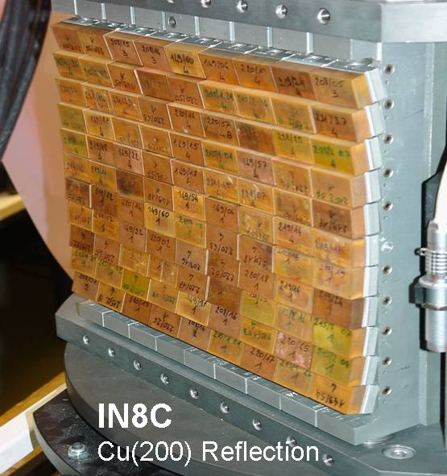
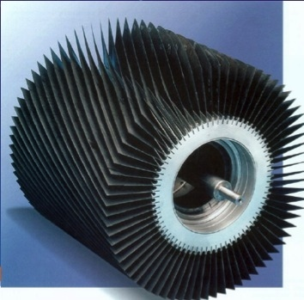
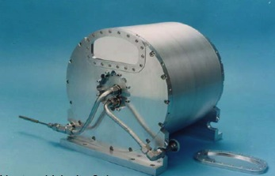
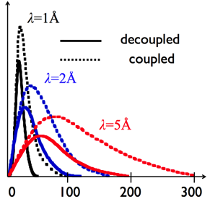
Determining the wavevectors: k_{i} & k_{f}
Diffraction and selectors – Reactors mainly
Time-of-flight & Choppers – Pulsed sources mainly
(Focusing)
Cu(200) crystal
monochromator
ILL France
Velocity Selector
Astrium GmbH
Time-of-flight
Time zero from pulse
TOF ~ 10 ms
ΔTOF ~ 100 μs
(moderator dependent)
Leakage time [μs]
Notes:
Bragg scattering …
Techniques that rely on the sped of the neutron
Velocity selector operates like a fan – fan analogy - blades here are 10BCarbide to eat neutrons
4A neutron travels at about a km/s … so effective fan speeds a little lower than this
And finally direct time of flight starting from spallation source pulse to when the netron is detected know path length source-sample-detector (or you can do it from a fast chopper obviously)

Slide 12
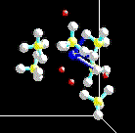
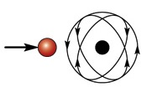
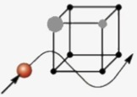
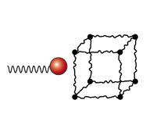


So, why neutrons ?
1. Neutrons (now) have the right wavelength
2. Neutrons see the Nuclei
3. Neutrons see light Atoms next to Heavy Ones
4. Neutrons measure the Velocity of Atoms
5. Neutrons penetrate deep into Matter
6. Neutrons see Elementary Magnets

Slide 13
“Liouville’s theorem” (Gibbs 1902)
“ … the phase space density of non-interacting particles
cannot be increased by conservative forces.”
To increase intensity at a given (Q,E) we must
increase the phase space volume
Simple Instrumental Implication:
It costs flux to increase resolution and it costs resolution to increase flux
~parallel
Small Δk³ ⬄high resolution
Need large sample V
converging optics
smaller sample V
Larger Δk³ ⬄lower res.
Thermodynamic limit, so in those terms you tend to “lose” more than you “gain”
Drives the multiplicity of neutron instruments
http://en.wikipedia.org/wiki/Liouville's_theorem_(Hamiltonian)
Notes:
Obviously the requirements of one measurement large scale structures small angles at reasonable resoultion SANS scattering may be smaller that the angular resolution width of a wide angle diffractometer
Also the range of handlles on neutrons structure & dynamics (Q and E) and different handles Xtal diffraction, TOF, spin precession to characterize and find out what interaction with sample did to an incident neutron

Slide 14
Steady state use of the neutron spectrum
(Elastic scattering example)
Continuous source
Moderated
“White” Beam
Velocity
Selector
Monochromatic
Beam
Cts
Source
Detectors
Sample
Scattering
Angle 2θ
Q = 4πsinθ / λ
uses narrow spectral band
Notes:
SANS the classic soft matter neutron instrument

Slide 15
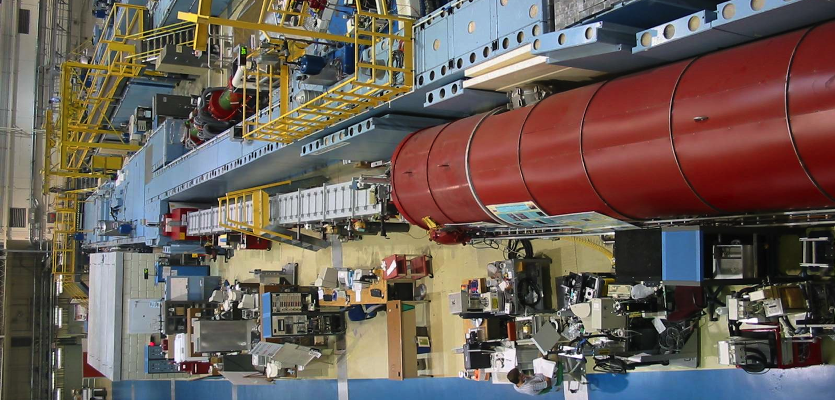
Steady state use of the neutron spectrum
(Elastic scattering example)
Continuous source
NG7-SANS NIST Center for Neutron Research
Moderated
“White” Beam
Velocity
Selector
Monochromatic
Beam
Cts
Source
Sample
Detectors
Scattering
Angle 2θ
Q = 4πsinθ / λ
uses narrow spectral band
Notes:
SANS the classic soft matter neutron instrument
Similar to that 2X widea angle x-ray instrument that Shulla nd Wollan adapted for neutrons at X-10,
But much bigger as interested in larger structures – longer wavelength cold neutron &l a 20m sample to detector distance to measure small scattering angles

Slide 16
TOF use of the neutron spectrum
(Elastic scattering example)
Pulsed source
T=0
Sample
Detectors
2θ
Know Time and Distance
Source-Sample-Detector
Q = 4πsinθ / λ[D,TOF]
uses a wide spectral band
Notes:
How does a spallation source instrument do that same job …
Source + frame chopper system… So called time of flight gain - caveats

Slide 17
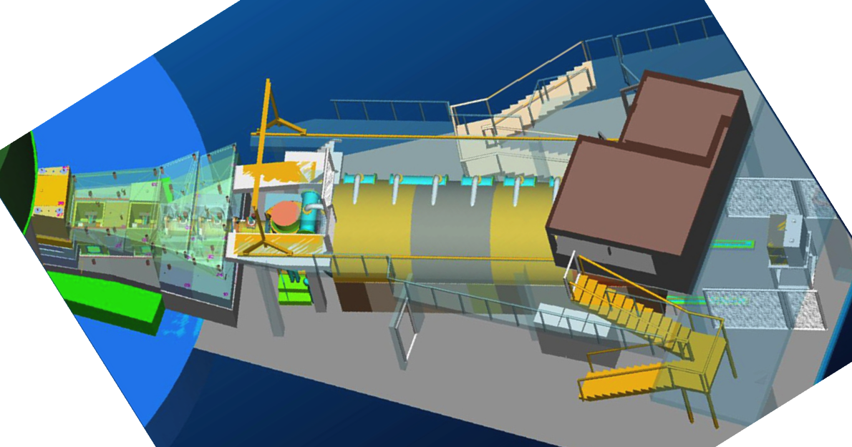
TOF use of the neutron spectrum
(Elastic scattering example)
Pulsed source
EQ-SANS Spallation Neutron Source
T=0
Sample
Detectors
2θ
Know Time and Distance
Source-Sample-Detector
Q = 4πsinθ / λ[D,TOF]
uses a wide spectral band
Notes:
How does a spallation source instrument do that same job …
Source + frame chopper system… So called time of flight gain - caveats

Slide 18
TOF use of the neutron spectrum
(Elastic scattering example)
Use of a wide spectral band allows a wider Q range to be accessed in “one shot”:
“Time of Flight Gain” which often makes up for that lower integrated flux in generally wider “survey” of Q (and E for inelastic)
Caveats:
“Frame overlap” – fast neutrons from later pulses catch slower ones from this solutions: frame choppers (usually a system thereof) and/or some long λ reflection filtering
- often also need to shield from unmoderated fast neutron and gamma flash of those succeeding pulses (“T-zero”)
Pulsed
Source
Sample
Detectors
T=0
Know Time and Distance
Source-Sample-Detector
Notes:
So called time of flight gain – caveats
Some times you only have one shot. This has been tried for neutron powder scattering from things that are essentially exploding. Not really an option for soft matter – pity.

Slide 19
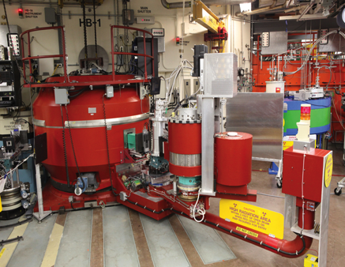
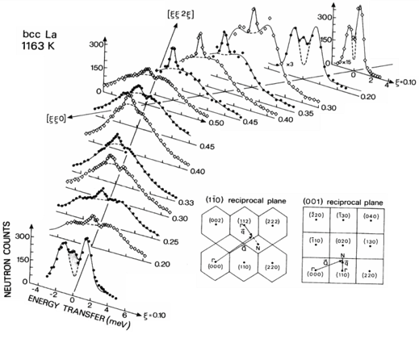
Inelastic: Classic Inelastic Reactor Instrument
“Triple Axis Spectrometer” (Brockhouse 1955 …)
HB1-3X HFIR ORNL
2X Clinton Pile
Bragg
Monochromator
Crystal
“White” Beam
Transmitted Beam
Source
k_{i}
Monochromatic Beam
Analyzer
Crystal
Transmitted
Beam
Scattered Beam
Guthoff et al., PRB (1993)
Sample
Detector
k_{f}
k_{f}
Scattering
Angle
Transmitted Beam
Momentum transfer Q = k_{i} – k_{f}
Energy transfer E = E_{i} - E_{f} = (h²/2m_{n})(k_{i}²– k_{f}²)
Looks at a spot in (Q,E) – but you can scan closely where you want …
Detector
Notes:
Basically you take the two axis design that is pretty much what Shull and Wollan and others were using for elastic scattering structural measurements, add another (monochromator) xtal, et voil – dynmaics!
Gave the definitive answer on the question of whether phonons as quantum excitations of the elastic interaction fields between (in crystals at least) really even existed …
Bertram Brockhouse shared the Nobel Prize with Cliff Shulll in 1994 because he invented this thing … at NRU in 1955/6 at NRX in Canada. Wollan had died some time before unfortunately.

Slide 20
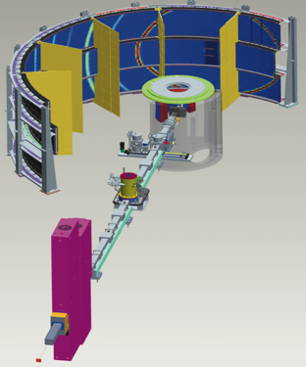
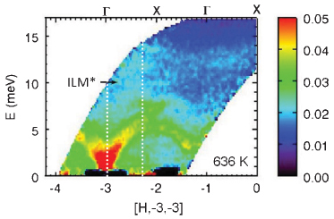
Inelastic example:
Simplified Pulsed Source Chopper Spectrometer
Fermi
Chopper
Source
Sample
Detectors
Monochromate
incident beam
(Constant k_{i})
TOF data reduction
Wide swath of (Q,E)
(data from ARCS-SNS)
Notes:
Fermi chopper is a faster version velocity selector
Helical slots through a vertical rotating drum, but same general principle … sychronize with pulse TOF gives you a ~monochromaticm pulsed beam
The cut you get through qE is the cut you get, whether you want all that info or not – remember we cant tune for everything – can take while, but gentleman’s instrumentation …
This was all rather general – the choppers are used on some instruments at reactors and this example is a so-called direct geometry TOF instrument – meaning that it determines incident wavelengths – in the next lecture by Ken Herwig will talk about an indirect or inverted TOF instrument where final wavelength/energies are determined by crystal diffraction which with TOF information is used to determine the incident emergy … essentially a lot of those interactions of neutrons with matter can be exploited to create instrument components – as my old supervisor used to say “Yesterday’s sensation is tomorrow’s calibration” and you should note a few of these emerging in the next few miniutes …

Slide 21
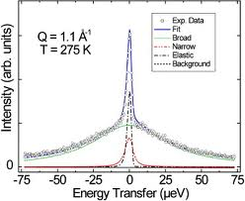
Inelastic example:
Simplified Pulsed Source Spectrometer
Indirect or Inverse
Geometry TOF
Analyzer
Crystals
k_{f}
Monochromate scattered beam (Constant k_{f})
Again TOF data reduction => S(Q,E)
Example: BASIS-SNS (Herwig lecture)
Sample
Detectors
T=0
Detectors
Notes:
Fermi chopper is a faster version velocity selector
Helical slots through a vertical rotating drum, but same general principle … sychronize with pulse TOF gives you a ~monochromaticm pulsed beam
The cut you get through qE is the cut you get, whether you want all that info or not – remember we cant tune for everything – can take while, but gentleman’s instrumentation …
This was all rather general – the choppers are used on some instruments at reactors and this example is a so-called direct geometry TOF instrument – meaning that it determines incident wavelengths – in the next lecture by Ken Herwig will talk about an indirect or inverted TOF instrument where final wavelength/energies are determined by crystal diffraction which with TOF information is used to determine the incident emergy … essentially a lot of those interactions of neutrons with matter can be exploited to create instrument components – as my old supervisor used to say “Yesterday’s sensation is tomorrow’s calibration” and you should note a few of these emerging in the next few miniutes …

Slide 22
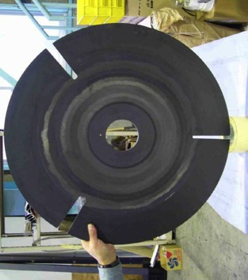
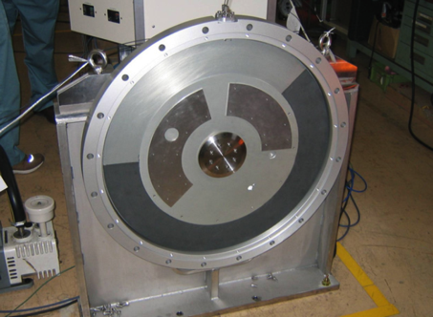
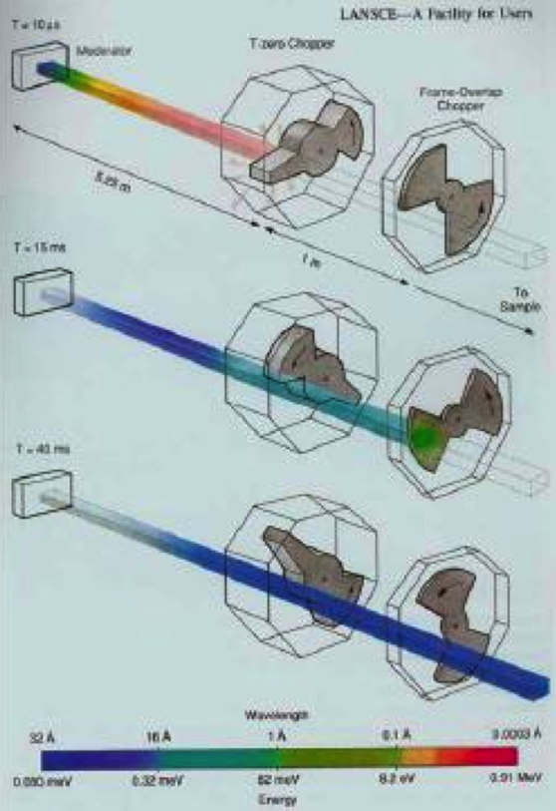
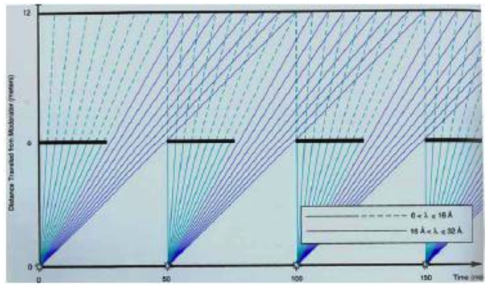
Other Choppers: pulse selection, frame & “T-zero”
T-zero choppers – Rotating heavy metal to supresss γ and fast neutron “flash” when accelerator proton beam hits spallation target
Pulse and frame disc
choppers - J-PARC
(Very Simple) TOF Path-Timing Diagram
Distance from source
Path-time graph for butterfly frame chopper choosing second frame (16-32Å) frame SPEAR reflectometer (12.38m, 20Hz)
LANSCE Spallation Source, Los Alamos
Notes:
Why TOF can get a bit complicated, but frame choice can give you a useful variety of wavelength range choices …

Slide 23
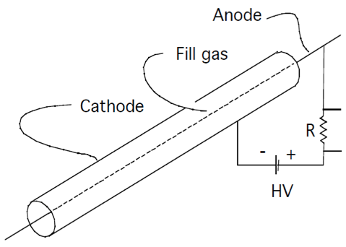
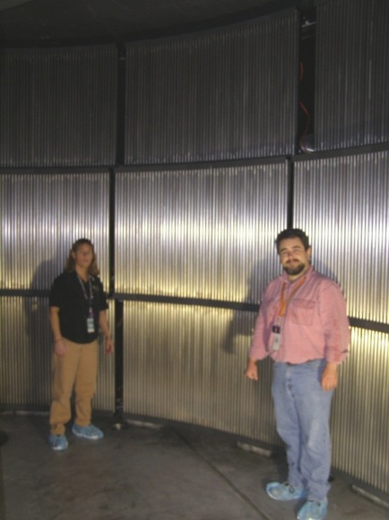
High pressure gas detectors
~75% of detectors for neutron scattering use ³He at ~3-20 atm (with something easier to ionize added).
“Proportional counter”: energetic particles from n reaction ionize gas, HV (few kV) cascades e charge signal to anode.
Usually cylindrical: collecting at V at
both ends of anode gives position sensitivity, limit resolution ~few mm (charge track cloud size).
These detectors are efficient (usually ~90%+), stable, low noise, and have excellent gamma discrimination, and good timing (~μs) … but they may soon become a thing of the past.
BF₃ (Shull and Wollan used it) or ¹⁰BF₃, timing and resolution problems ...
ARCS Area Array
930 ³He LPSD’s
Notes:
3He sources (enriched 235U reactors that bother to collect it) drying up
Other customers (anyone who might want to detect a suspicious source of neutrons …)
SNS has enough stockpiled to make maybe one or two more instruments like ARCS
That’s “linear Position Sensitive Detectors” cf MWPSDs many anode/cathode wires in a 3He volume
Hope if fusion gets going – if anyone has seen the movie “Monn” they may have picked up that the easiest fusion path involves 3He
BF3 cross-section lower so lower efficiency, gas horrible (HF is you break one)
ESS new long pulse spallation source is considering there use – instrument consequences, but they already sacrificed initial time resolution for extra intensity so longer instruments already …

Slide 24
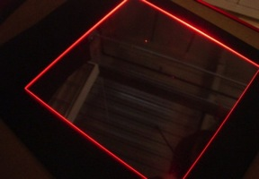
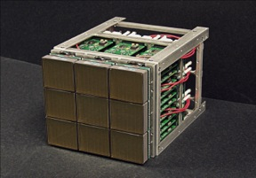
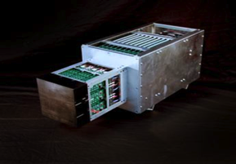
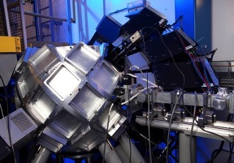
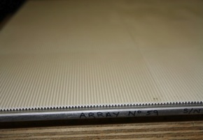
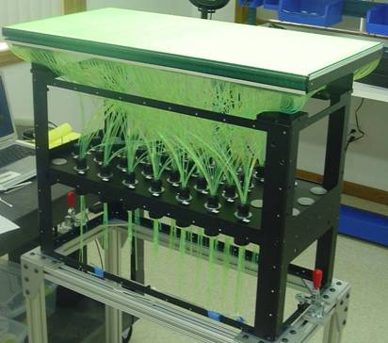


Neutron scintillator detectors – 1
Typically light is collected from a ⁶Li doped phosphor screens: ZnS (opaque) or GS20 (clear)
Can use traditional nuclear, HEP coincidence analysis technique: analysis of photomultiplier tube array signals (Anger Camera) 1mm x 1mm resolution & very fast. PM tubes gamma “sensitive”. Installed TOPAZ single xtal.
New technique on two SNS diffraction machines (POWGEN, VULCAN) crossed layers of light shifting optical fibres which collect ZnS blue light convert to green to carry to optical detectors. Resolution ~5mm x 60mm & fast. Efficiencies ~50-60%. Gamma rejection of screens deemed “fair” …
GS20\⁶LiF laser inspection
ZnS\⁶LiF screen

Slide 25




Neutron scintillator detectors – 2
M. Fleenor ORNL
N Instrument Group
Neutron Radiography & Imaging: CCD Camera views a phosphor screen – again usually ⁶Li/ZnS. Sub mm resolution, but CCD/high-speed video readout is slower than neutron TOF requires. Gamma sensitive (at right the camera views the ZnS screen through right angle mirror reflection), sensitivity is fairly low, linearity is a problem (cameras are developed to human sensitivity which is logarithmic). Tradeoff between resolution, efficiency, γ background and optics.
N vs X complementarity:
X-ray image
Neutron Image
High resolution imaging and very high resolution diffraction: BaFBr:Eu²⁺ “storage phosphor” material for radiation imaging either doped with Gd₂O₃ or a ⁶Li or ¹⁰B salt. Great resolution (<100μm), very slow readout (by laser scan: Photon Stimulated Luminescence). Dynamic range? And once again γ sensitivity is a problem.
IMAGINE - HFIR
Protein Xtal

Slide 26
Neutron shielding & beam shaping
For a good shielding, aperture, chopper, selector material we seek high cross section neutron nuclear reactions producing something more stoppable or less n detectorable: i.e. softer photons (weak γ or x-ray=>Pb, steel, concrete) or charged particles (best)
Some that have been used:
n + ³He → (⁴He)* → ¹H + ³H, Q=0.77MeV (³He~1.4x10⁻⁴%) σ_{a}= 5.33kb
n + ⁶Li → (⁷Li)* → ⁴He + ³H, Q = 4.8 MeV (⁶Li~7.5%) σ_{a}= 0.94kb
n + ¹⁰B → (¹¹B)* → (⁷Li)* + ⁴He, Q = 2.3 MeV 0.5MeV γ, 94% branch
→ 7Li + 4He, Q = 2.8 MeV, 6% branch (¹⁰B~20%) σ_{a}= 3.84kb
n + ¹¹³Cd → (¹¹⁴Cd)* → ¹¹⁴Cd + γ, Q~8MeV (¹¹³Cd~12%) σ_{a}= 21kb
n + ¹⁵⁷Gd → (¹⁵⁸Gd)* → ¹⁵⁸Gd + γ, Q~8MeV (¹⁵⁷Gd~16%) σ_{a}= 255kb
n + ²³⁵U → (²³⁶U)* → (fission fragments), Q~200 MeV (²³⁵U~0.7%) σ_{a}= 0.68kb
Cross sections better for slower/colder neutrons
So mixing in moderator can help, e.g. ⁶Li-poly,¹⁰B-poly, Borax
σ_{a} ~ 1/v ~ λ ∼ 1/√Τ
Also useful: sandwiching of “better” (high σ_{a} low γ but expensive) in front of
“worse” (lower σ_{a} higher γ but cheap or structurally convenient) – i.e. 6Li-poly//B-Al//Cd
Notes:
NOTE: These are ISOTOPE specific
1/v prop lambda – easier to detect a slower neutron (until it is so slow it can’t get into the detctor)
Charged particles are better because gammas tend to get away from you just like the neutron was going to
Don’t want a high cross-section for other rad esp x gamma – in many cases detector development has faltered because a lot of designers coming from the x-ray world haven’t realized how many photons there are in the world for every neutron and it is almost more important not to detect gammas rather than to detect neutrons
ASIDE Monitors low pressure 3He 235U and N (example N x-section – why neutrons are bad for your health QF~10)

Slide 27



Incident beam monitoring
When absolute scattering power matters (SANS, NReflectivity …)
or relative normalization between scans does (i.e. nearly always)
Low efficiency (<0.1%) transmission detectors in pre-sample path*
n + ³He →(⁴He)* → ³H + ¹H, Q=0.77MeV (³He~1.4x10⁻⁴%) σ_{a}= 5.33kb
n + ¹⁴N → (¹⁵N)* → ¹⁴C + ¹H, Q = 0.63 MeV (¹⁴N~99.6%) σ_{a}= 1.9 b
(so can just use normal He or N₂ in a gas detector …)
n + ²³⁵U → (²³⁶U)* → (fission fragments), Q~200 MeV (²³⁵U~0.7%) σ_{a}= 0.68kb
Reactor power stable ~%, but n flux rises as fuel burns. Accelerator operation is somewhat spottier:
Fission monitor
∗ γ insensitivity
a must here
He monitor ORDELA Inc.
SNS P&E vs t
Notes:
S can just use normal gas detector design and use normal He or less 3He enriched or N2.
I draw your attention to this second option which is actually a newish thing in monitors, because this reaction is the reason that neutrons radiation gets its 10-20 quality factor from health physicists
Low as it is it is very high for the stuff of which you are made (capture xsec in millib) and N is the N in DNA and _+ you also contain a lot of hydrogenous compounds that moderate neutrons so 1/v is not your friend there …
Flux goes up because 235U is a thermal neutron absorber. As it burns there is less in the way ~5-10% rise at HFIR dependending on what they are irradiating in the core an reflector …
Unlike reactor which are pretty much a few detectors coupled to control rod motors and a tub of water with a pump, accelerators are very complex beasts with thousands of components that have to work
In concert, so there is a lot of tweaking and aiming and the occasional dropout – short drops are the worst – I think the period on the chart is 15m …
Gamma rejection required because these are up front – close to the source and your primary shielding with a pretty good unshielded view

Slide 28



Neutron transport
The penetrating power of neutrons can make this relatively easy. Thermal neutrons can go a long way in dry air (<10% loss/m for 4Å neutrons). Long flight paths and “get lost” tubes for transmitted beams do require vacuum.
Windows: Aluminium, Quartz, Sapphire & Silicon all have good thermal neutron transmission. Single crystals of the last three can be used to avoid losses due to Bragg scattering. Diamond is also good, and soon affordable?
To transport neutrons a long way from the source (to lower background or just get space) we can use total external reflection in evacuated “neutron guides”:
2
R~2W/θ_{c}[λ_{min}]
Convention for guide mirror angles
m=0.1 deg/Å angle, i.e. relative to θ_{c} Ni
Guide Installation at ISIS UK
Multichannel Curved Guide
Fabricated by Swiss Neutronics
Notes:
Essentially just a reflecting pipe for neutrons – same principle as total internal reflection guiding light in an optical fibre … (external since neutron refractive index is <1)

Slide 29



Selecting/Analyzing & Manipulating Neutron Spin
Polarized neutrons, mirrors, interface reflectivity … (Majkrak and Gaulin)
Neutron spin polarizing Supermirrors:
B
with
Si
Fe
Si
B
Polarizing Bragg reflection
³He spin polarized cell
Mezei type Flipper
Non-adiabatic 90° B change
Neutron Larmor precession
2.91 kHz/G
17 G-cm will “π-flip” a 4Å neutron
passing through the coil
³He Cell
Unpolarized
Neutron Beam
Polarized
Neutron Beam
Heusler AlCu₂Mn xtal
in B field yoke
Xtal Si windowed 3He cell (D17 – ILL)
Notes:
Spin polarization can be guided adiabatically – which means that the rotation rate of a magnetic field the neutron sees (remember is is moving through the field) is slow compared to the Larmor precession speed of the magnetic field it is in.
Typically a guide filed will be 20-50G – higher if you want to cope with stray fields from an adjaecnt device - they always say avoid zero fields, but what they really mean is avoid crossing regions where the neutron sees field changes that are confused wrt Larmor frequency …
Mezei flipper is one method - it is wavelength narrow – others Drabkin flipper, RF flipping as per NMR are not so much … usually eat more beamline

Slide 30

Neutron Spin Optics
A neutron’s magnetic moment and (antiparallel) intrinsic angular momentum undergoes precession around the perpendicular component of an applied magnetic field and will be guided by the parallel component … (some quantum caveats apply)
n Gyromagnetic ratio
B
B
B
D
D
D
Phase:
Precession of polarization is a 3rd way to determine
neutron wavelengths and/or energies
Can be used as a phase “clock” and in very carefully controlled magnetic field conditions this can be used in studies of soft matter dynamics to resolve very small energy changes (meV…neV) – akin to NMR and DLS. This is Neutron Spin Echo.
More recently these techniques have been adapted to resolve very small angular deviations in
the ultra-small angle scattering range (SESANS) and not quite specular reflection (SE Grazing Incidence SANS – SERGIS)
Notes:
Neutron Magnetic Resonance, Dynamic Light Scattering ….
As it happens Incoherent scattering (Suny’s lecture) randomizes polarization, coherent scattering maintains the direction – so can in principle be used to get rid of incoherent SANS background.
Has been demonstrated, but incoherent scattering is isotropic – very well behaved and flat – so the costs of polarization (lose at least 50% of neutrons the moment you run your incident beam
through a polarizer), efficiencies of transporting polarization, and the statistical costs of the combining multiple measurements you have to do to

Slide 31




Sample environment – general considerations
Again the penetrating power of neutrons can make this relatively easy.
Windows and sample environment enclosures: Aluminium, Quartz, Sapphire & Silicon all have good thermal neutron transmission. Single crystals of the last three can be used to avoid losses due to Bragg scattering – if necessary you can send a beam through many cm.
Q_{⊥R}
k_{i}
k_{fR}
Reflection geometry cell for NR and SANS studies of adsorbed layers and colloidal solution morphology near surfaces. Incident and scattered beams pass through 8cm of crystal quartz slab. Transmission at 4Å ~75%
2.5 cm
Weak scattering power and relatively poor detector resolution means that means instruments tend to be large and have a largish sample position that does not have to be in vacuum. The typical sample area on a modern SANS machine (30m+) allows for about 1m or so of sample environment beam path. Large installations and ancillary access possible.
Quokka SANS sample position – 11T Horizontal field magnet
- OPAL ANSTO
Quokka SANS sample position – in-situ SANS Rheometer
- OPAL ANSTO
Quokka SANS sample position – in-situ SANS Rheometer
- OPAL ANSTO
Notes:
It may already be available – consult the web pages of the neutron scattering facilities – often if you seem interesting enough theIR will work with you to develop SE for routine use

Slide 32
So, what is a neutron scattering instrument ?
Detector
Scattered Wavevector
k_{f}
Source
Incident Wavevector
k_{i}
k_{f}
Structure, kinematics or dynamics … ?
Single wavelength or range ? Linear or area detector ?
Resolve or filter its energy?
- Xtal or TOF chopper?
Elastic, quasi-elastic
or inelastic. Range?
High resolution, low resolution, counting time ?
⬄ Sample size, stability, scattering power
Analyze final polarization?
k_{i}
Wavelength range
- moderator
ambient, cold, hot
Monochromatic
“white” – moderated
“pink” – filtered moderator
Pulsed
– wavelength frame ?
Polarized ?
Sample
Alignment matters:
- Single xtal, flat interface
Or doesn’t:
Powder, amorphous solid,
liquid, solution, gas
Length (k) or energy (E) scale of interest ?
Scattering power
& transmission
Sample environment:
T, P, B, …
Phase changes: scale, rate, reversibility …
Notes:
Selecting Neutrons of the right wavelength / energy
Also nice to know as much as you can about your sample beforehand – neutrons are expensive and hard to get to … but needs must

Slide 33
Elastic Neutron Scattering Instruments
  Techniques:
  Powder diffraction
  Single Crystal diffraction
  Small Angle Scattering
  Reflectometry
Longer Length Scales
d (Å)
Biological Structure
Viruses
Small Proteins
REFLECTOMETERS
SANS
Critical Phenomena
Polymers
Micelles
Colloids Vesicles
Metals Alloys Zeolites
Magnetic Films
and Domains
  To determine the
  average structure of materials.
  How the atoms are arranged or are rearranging.
  Structure & Kinematics
Membranes
Liquids and Glasses
Crystal (inc protein),
Fiber,
and
Magnetic
Structures
DIFFRACTOMETERS
Q(Å⁻¹)
Based on diagram by Roger Pynn
Notes:
Reflectometers are often polarized, as are some SANS

Slide 34
Inelastic Neutron Scattering Instruments
Spectrometry Techniques
Direct Geometry TOF
Triple-Axis
Indirect Geometry TOF
Backscattering …
Neutron Spin-Echo
Longer Length Scales
d(Å)
100
10
1
0.1
Neutron Induced
Excitations
Hydrogen
Modes
THz
Intenerate
Magnets
Crystal
Fields
Molecular
Vibrations
Spin
Waves
Atomic, molecular or assemblage dynamics:
phonons, magnons, diffusion …
How are the atoms are moving within a given structure or morphology.
Dynamics
Coherent
Modes
Lattice
Vibrations
Electron-Phonon
Interactions
GHz
Molecular
Motions
Slower
Motions
Critical Scattering
Diffusion
Molecular
Reorientation
MHz
Aggregate Motion
Polymers and Biological Molecules
Based on diagram by Rex Hjelm
Notes:
Over ~8 orders of magnitude in energy/time and length scale

Slide 35


Note: Big facilities, long user lead times …
What 1 or 2 billion $ buys in terms of neutron sources:
HFIR – ORNL SNS - ORNL
In pure flux terms neither compares very well with a the photon brightness of a bench top x-ray source. (Let alone a rotating anode or synchrotron) & neutron interactions tend to be fairly weak …
Notes:
SNS is now about 5 years old, HFIR about 45
SNS cost about 1.5 billion dollars, supposing you could build it again HFIR would cost about the same, and yet … we do smallish science on them

Slide 36




Where can I do neutron scattering ?
Major scientific neutron scattering sources worldwide
Adapted from www.veqter.co.uk website
Notes:
At the moment about 2:1 reactors over accelerators (various) – reactors are aging (ANS was supposed to be built in the 90’s) new sources ESS in Lund Sweden circa 2020+ … and Los Alamos may soon disappear
You can do neutron scattering all over the world, but this is apretty complete list of all neutron scattering sources – neutron radiography aside – which tend by their very nature to be major when compared with other instrument suites

Slide 37



The neutron zoo in information and real space
Covers 7-8 orders of magnitude in length and energy (time), 2-3/instrument
HFIR and SNS instruments.
Similar extensive suites at NCNR-NIST, ILL (France), ISIS (UK), LANSCE-LANL, …
Notes:
Why so many types of instruments & why are neutron beam rooms and guide halls so crowded ?
Types of sources (and their numerical paucity)
Xtal, TOF, spin precession beam hanndling
Sample environment
Q,E range for sample – the eternal fight againt Liouville’ theorem
Efficient use of instrument optimized over narrowish Q,E,ranges

Slide 38







Conclusion: Why neutrons ?
“ … because [neutron scattering] provides information about the structure of materials that cannot be obtained in simpler, less expensive ways.”
1. Neutrons have the right wavelength
2. Neutrons see the Nuclei
3. Neutrons see light Atoms next to Heavy Ones
4. Neutrons measure the Velocity of Atoms
5. Neutrons penetrate deep into Matter
6. Neutrons see Elementary Magnets
7. And (because) scattering is inherently statistical
“ … in spite of all these penalties of a signal-limited technique, neutron scattering continues to occupy an important place among the panoply of tools available to study materials structure because it can often provide information that cannot be [simply] obtained in any other way.”
R. Pynn “Neutron Scattering—A Non-destructive Microscope for Seeing Inside Matter”
in Neutron Applications in Earth, Energy and Environmental Sciences, L. Liang et al. (eds.),
Neutron Scattering Applications and Techniques, Springer 2009
Notes:
A picture is worth a thousand words … a Scattering pattern is worth a thousand pictures …
Insertion & italics are mine My italics …
The effect you seek is hidden behind another (similar) system, buried under a layer that masks other probes, or is simply deep inside whatever sample environment equipment
Neutron scattering can often let you peer through that fog of other stuff (that’s what highly penetrating means) and has advantages & methods that can allow the signal from the
system that you are interested in stand out clear.
Next lecture SANS, and I’ll try to put a little more flesh on the bones of those assertions … and now for whatever time we have left I’ll try to answer questions (don’t say that don’t steal too much thunder from the next presentation)

Slide 39
Acknowledgements
Material has been borrowed and adapted from presentations and publications by:
Lee Robertson, Steve Nagler, Ken Herwig, Lowell Crow, Rick Reidel, John Katsaras, Ian Anderson, Tom Mason, Mike Fleenor …
Roger Pynn, Jack Carpenter, Paul Butler, Boualem Hammouda, Bruce Gaulin, Jim Rhyne, Ross Stewart, Rob Dalgleish, Ken Andersen, Rex Hjelm …
& whoever they borrowed and adapted from (in some cases that was me).
General References:
“Elementary Scattering Theory: For X-ray and Neutron Users”, D.S. Sivia, Oxford (2011)*
“Introduction to the Theory of Thermal Neutron Scattering”, G.L. Squires, Cambridge (2012)
“Neutron, X-Ray and Light Scattering: Introduction to and Investigative Tool for Colloidal and Polymeric Systems” (1991)
“Neutrons, X-Rays and Light: Scattering Methods Applied to Soft Condensed Matter” (2002)
P. Lindner and T. Zemb, Elsevier North-Holland
“Neutrons in Soft Matter”, T. Imae, T. Kanaya, M. Furusaka and N.Torikai, Wiley (2011)
“Dynamics of Soft Matter: Neutron Applications”, Springer (2012)
V. García Sakai, C. Alba-Simionesco and S.-H. Chen
“Practical Neutron Scattering at a Steady State Source”,
T. Heitmann & W. Montfrooij, Mizzou Media (2012)*
http://www.ncnr.nist.gov/summerschool/ss13/pdf/NeutronScatteringPrimer.pdf R.Pynn (1990)*
“Handbook of Neutron Optics”, M. Utsoro and V.K. Ignatovich, Wiley (2010)
*most “accessible”
Notes:
Sometimes that was me – bringing a certain closure to the process

Slide 40
Neutron Scattering Source Websites
http://neutrons.ornl.gov
http://www.ncnr.nist.gov
http://lansce.lanl.gov
http://www.murr.missouri.edu/rd_material_sciences.php
http://www.indiana.edu/~lens/
http://www.ill.eu
http://www.isis.stfc.ac.uk
http://www.frm2.tum.de
http://www.psi.ch/sinq/
http://www.tnw.tudelft.nl/en/cooperation/facilities/reactor-instituut-delft/
http://www-llb.cea.fr/en/
http://www.ansto.gov.au/ResearchHub/Bragg/index.htm
http://flnp.jinr.ru/562/
http://www.nti.org/facilities/9/
… a more exhaustive list: http://www.neutron.anl.gov/facilities.html
Notes:
Sorry Asia. Rather a lot of small reactors do radiography and or some kind of materials analysis irradiation …

