Slide 1
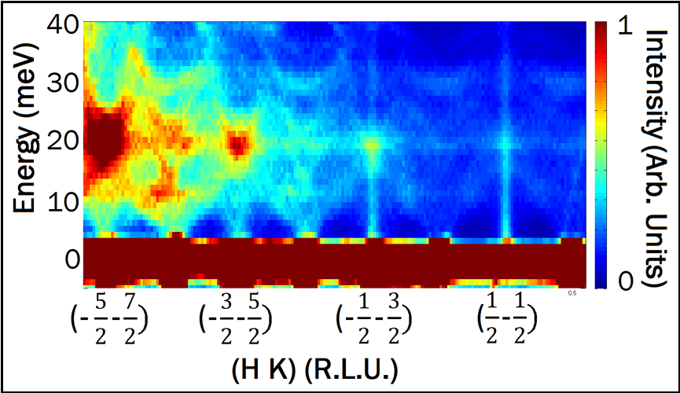
Introduction to Inelastic Neutron Scattering
Bruce D Gaulin
McMaster University
Neutrons: Properties and
Cross Sections
Excitations in solids
Triple Axis and
Chopper Techniques
Practical concerns

Slide 2
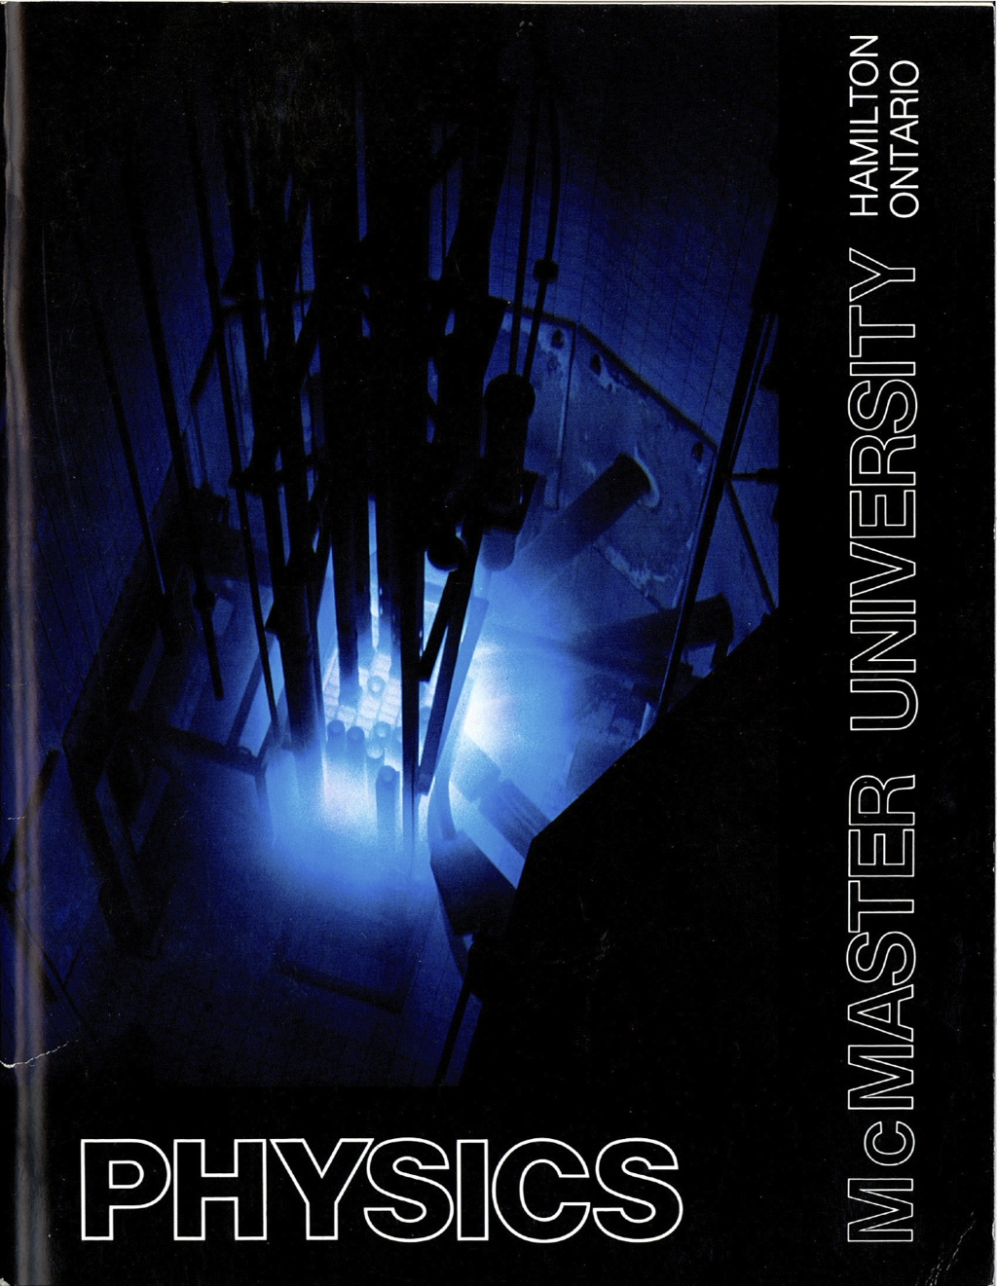
²³⁵U + n
g
daughter nuclei +
2-3 n + gammas
neutrons:
no charge
s=1/2
massive: mc²~1 GeV

Slide 3
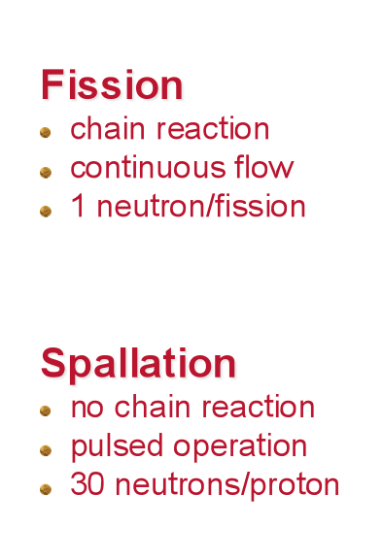

Slide 4
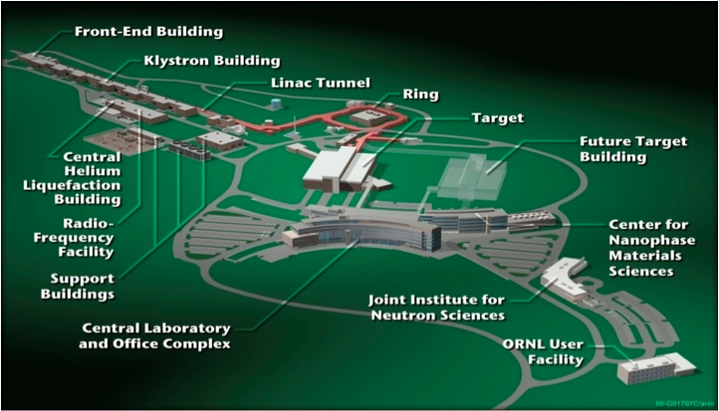

Slide 5
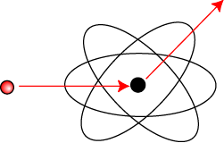
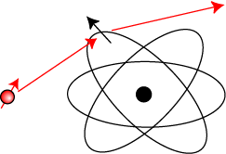
Neutron interactions with matter
Properties of the neutron
Mass m_{n} =1.675 x 10⁻²⁷ kg
Charge 0
Spin-1/2, magnetic moment μ_{n} = -1.913 μ_{N}
Neutrons interact with…
Nucleus
Crystal structure/excitations (eg. Phonons)
Unpaired electrons via dipole scattering
Magnetic structure and excitations
Nuclear scattering
Magnetic dipole scattering

Slide 6
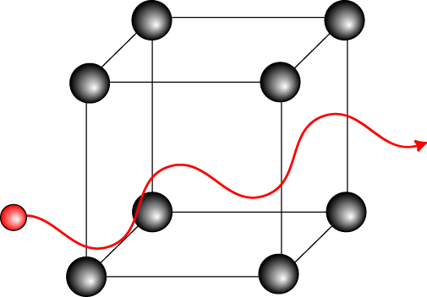
Wavelength-energy relations
Neutron as a wave …
Energy (E), velocity (v), wavenumber (k), wavelength (λ)
λ ~ interatomic spacing → E ~ excitations in condensed matter
 | Energy (meV) | Temperature (K) | Wavelength (Å)
Cold | 0.1 – 10 | 1 – 120 | 4 – 30
Thermal | 5 – 100 | 60 – 1000 | 1 – 4
Hot | 100 – 500 | 1000 – 6000 | 0.4 – 1
Notes:
As with any other quantum particle, the neutron scan be thought of as a wave.
deBroglie wavelength is inversely proportional to the neutron velocity (or wavenumber).
The energy of the neutron is proportional to the inverse-square of the wavelength.
Of course, the energy of the neutron has a temperature scale given by kT.
Neutrons that are most useful for scattering from condensed matter have a wavelength of order the interatomic spacing (roughly an Angstrom). Neutrons of this wavelength have an energy is the range of 10’s of meV. This is a thermal energy scale and consequently is the range of many important excitations in condensed matter systems.

Slide 7
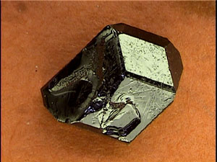
The Basic Experiment:
(θ, φ)
Incident Beam:
monochromatic
“white”
“pink”
Scattered Beam:
Resolve its energy
Don’t resolve its energy
Filter its energy

Slide 8
Fermi’s Golden Rule within the 1st Born Approximation
W = 2π /h |< f | V | i>|² ρ (E_{f})
δσ = W / Φ = (m/2πh²)² k_{f} / k_{i} |< f | V | i>|² δΩ
²σ /δΩ δE_{f} = k_{f}/k_{i} σ_{coh}/4π N S_{coh}(Q, ω)
+ k_{f}/k_{i} σ_{incoh}/4π N S_{incoh}(Q, ω)

Slide 9
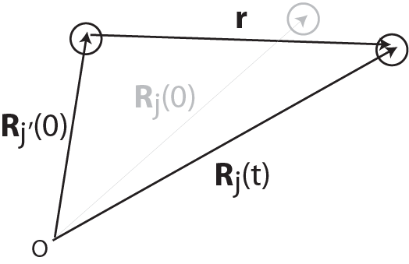
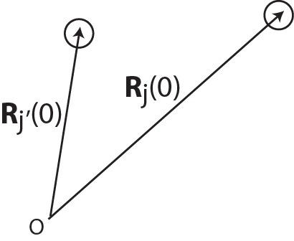
Nuclear correlation functions
Force
Pair correlation function
Intermediate function
Differential scattering
cross-section
Scattering function
Notes:
First consider the nuclear scattering.
The scattering cross-section is proportional to the pair correlation function, G(r,t).
Given two atoms at Rj and Rj’ at time zero, Classically, the function determines the probability that the atom is found at the position Rj’(t) a time later. This probability depends on the forces between atoms.
The scattering function, S(Q,w), is given by the time/space fourier transform of the pair correlation function.
Note that for static lattice, intermediate function is just S(Q) for diffraction
The power of neutron scattering is that the measured cross-section is directly proportional to the scattering function. In many cases, this function can be calculated and compared directly to theory. Experiment tells us about the forces between atoms.

Slide 10
Nuclear (lattice) excitations
Neutron scattering measures simultaneously the wavevector and energy of collective excitations → dispersion relation, ω(q)
In addition, local excitations can of course be observed
Commonly studied excitations
Phonons
Librations and vibrations in molecules
Diffusion
Collective modes in glasses and liquids
Excitations can tell us about
Interatomic potentials & bonding
Phase transitions & critical phenomena (soft modes)
Fluid dynamics
Momentum distributions & superfluids (eg. He)
Interactions (eg. electron-phonon coupling)

Slide 11
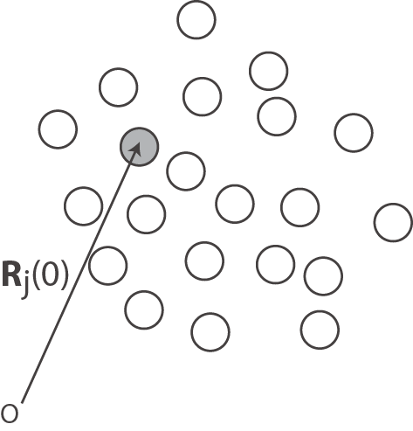
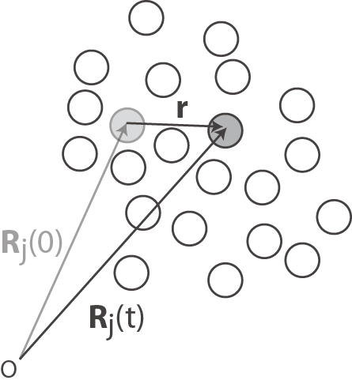
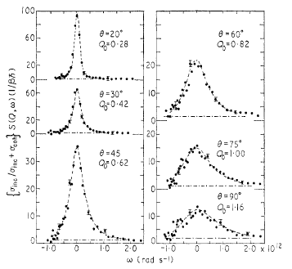
Atomic diffusion
For long times compared to the collision time, atom diffuses
Liquid Na
Auto-correlation function
Cocking, J. Phys. C 2, 2047 (1969)..
Notes:
In a liquid, at long times an atom is in diffusive motion.
We can look at the self-correlation function of the single atom as it moves through the liquid.
The probability that the atom moves a distance r in time t is gaussian.
The scattering function is just the Fourier transform, assuming the mean-squared displacement is linear in time (diffusive). Simple model predicts lorentzian spectrum where the width depends on Q.

Slide 12
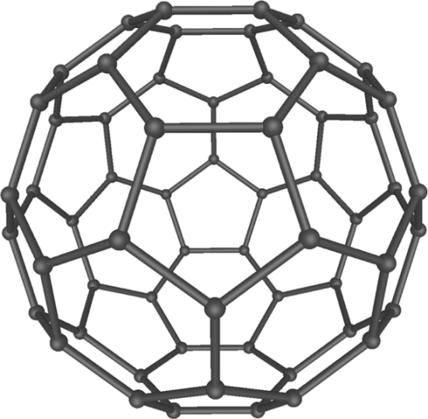
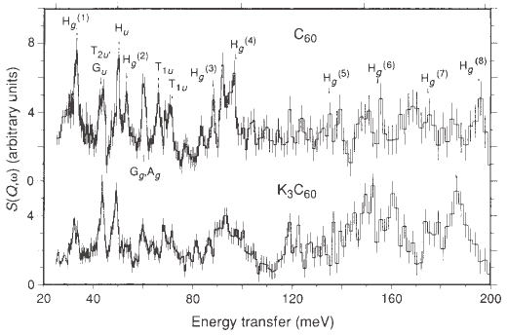
Molecular vibrations
Large molecule, many normal modes
Harmonic vibrations can determine interatomic potentials
C60 molecule
Prassides et al., Nature 354, 462 (1991).
Notes:
A molecule has many atoms connected by many different bonds. For n atoms, there are 3n normal modes, each with potentially different frequencies. Knowledge of these frequencies allows one to determine the strength of the bonding.

Slide 13
Mapping Momentum – Energy (Q-E) space
Origin of reciprocal space;
Remains fixed for any sample rotation
2 π / a
2 π / a

Slide 14
Bragg diffraction:
Constructive Interference
Q = Reciprocal Lattice Vector
Elastic scattering : | k_{i} | = | k_{f} |
k_{f}
k_{i}
-k_{f}
Q

Slide 15
Bragg diffraction:
Constructive Interference
Q = Reciprocal Lattice Vector
a
k_{f}
k_{i}
-k_{f}
Q
2 π / a
Elastic scattering : | k_{i} | = | k_{f} |

Slide 16
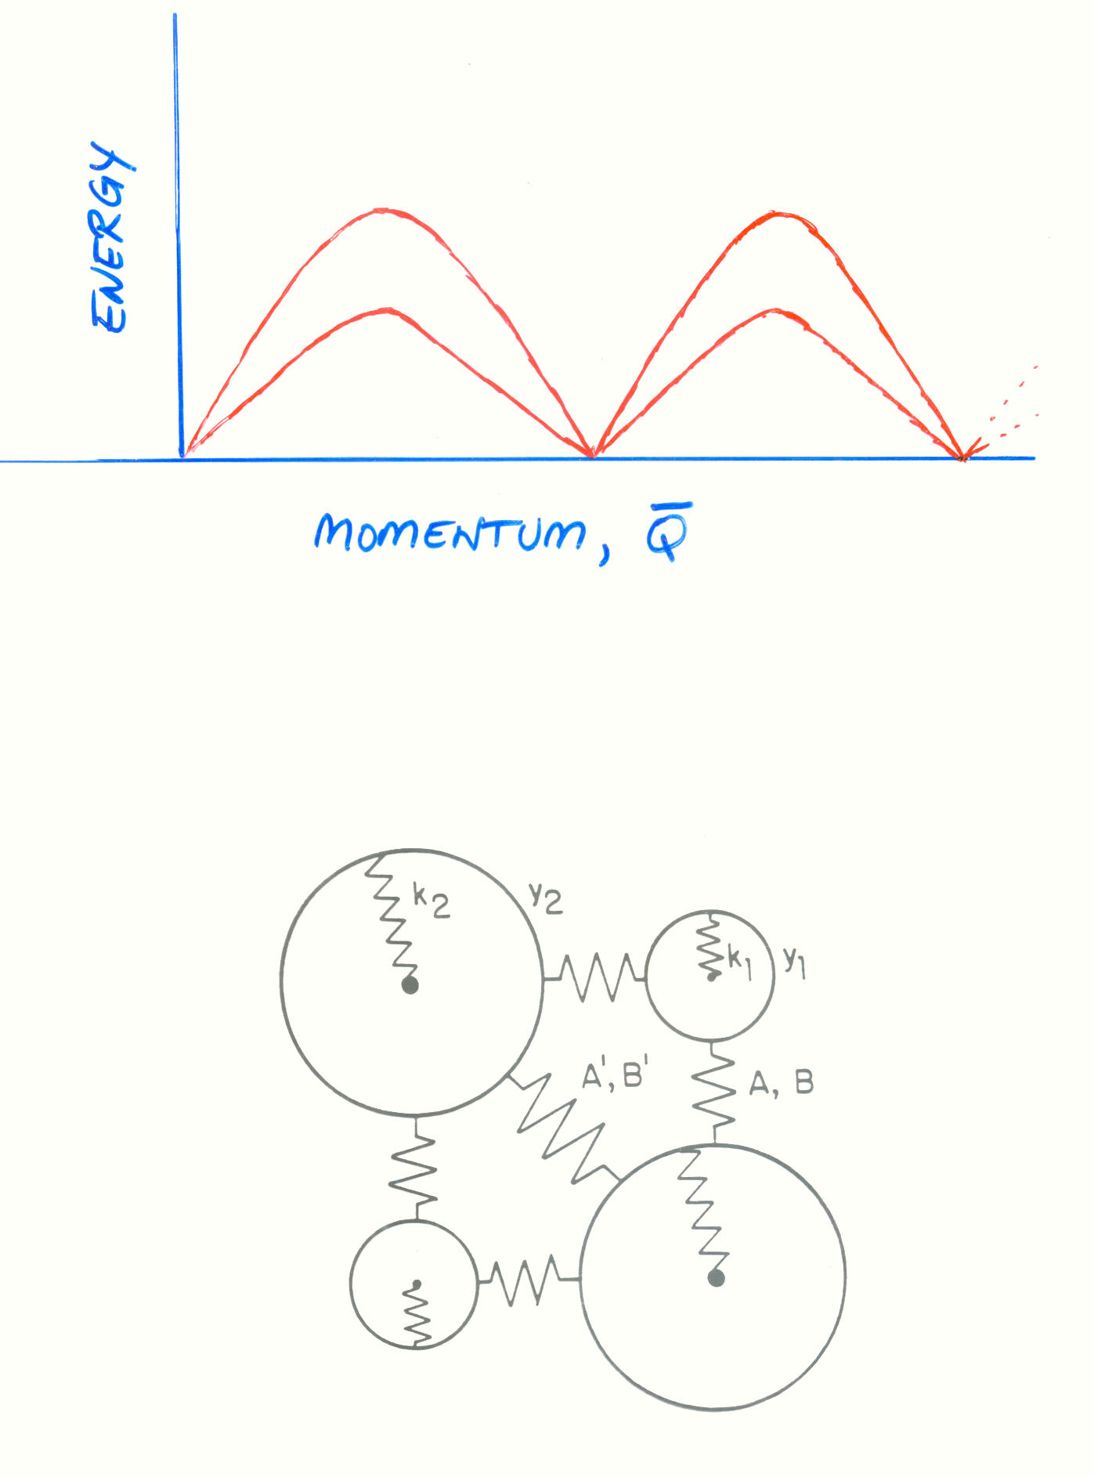
Elementary Excitations in Solids
Lattice Vibrations (Phonons)
Spin Fluctuations (Magnons)
Energy vs Momentum
Forces which bind atoms
together in solids

Slide 17
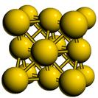
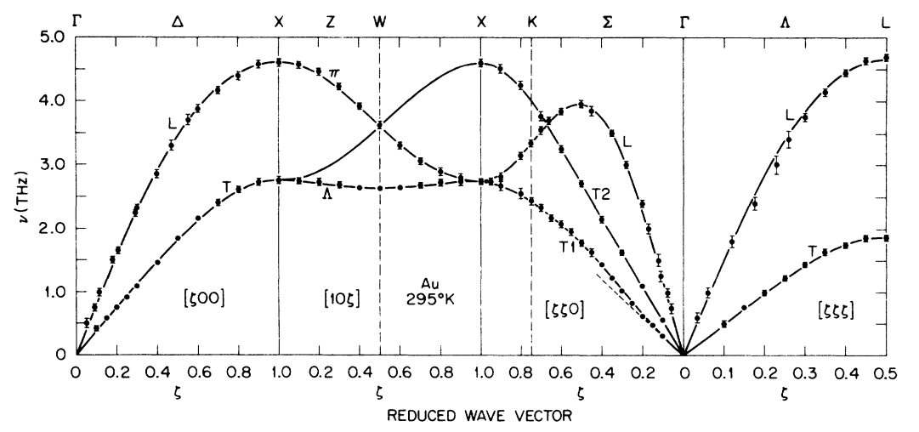
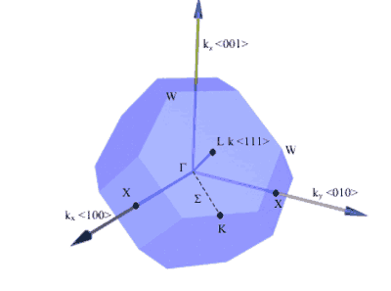
Phonons
Normal modes in periodic crystal → wavevector
Energy of phonon depends on q and polarization
FCC structure
Transverse mode
Longitudinal mode
FCC Brillouin zone
Lynn, et al., Phys. Rev. B 8, 3493 (1973).
Notes:
In a periodic crystal, one can define a wavevector for a normal mode, since the fundamental collective excitations are plane waves. The energy of the phonon depends on the q and the polarization (or displacement pattern) of the atoms in the mode.
In a simple Bravais lattice, such as fcc Au, the polarizations can be classified as either transverse or longitudinal. The phonon dispersion for select directions in the crystal is shown, the labels correspond to special directions in the Brillouin zone.

Slide 18
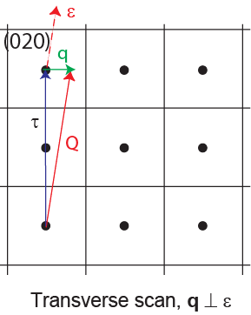
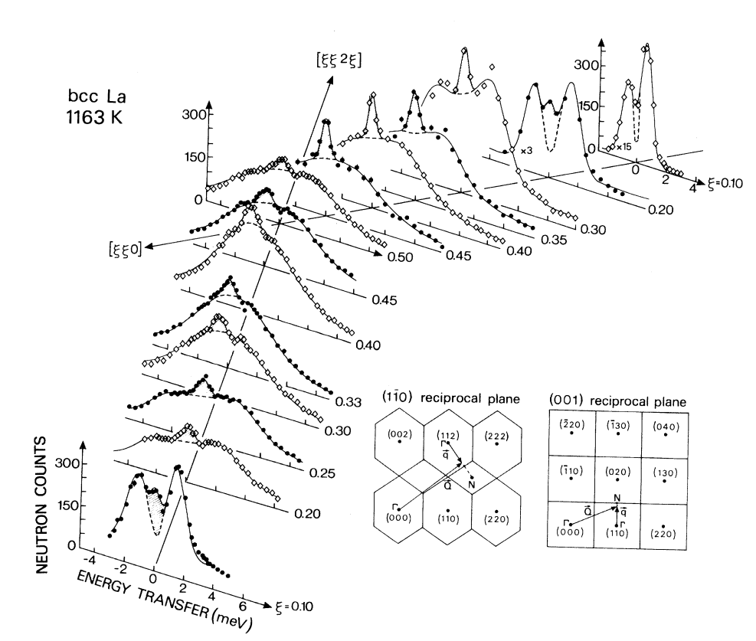
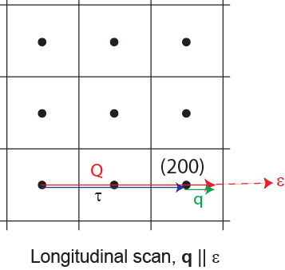
Phonon intensities
Structure (polarization) factor
Guthoff et al., Phys. Rev. B 47, 2563 (1993).
Notes:
The one-phonon structure factor emphasizes that both the dispersion and eigenvector depend on the reduced wavevector, q, within the first Brillouin zone.
However, the intensity measured in a neutron experiment depends on the projection of the phonon eigenvector along the momentum transfer, Q. Thus, the intensity depends on which Q (or zone) the measurement is performed.
For example, suppose I do two measurements at the same q, but different Q.
At Q1=(2.25,0,0), I measure longitudinal phonons since q||e
At Q2=(0.25,2,0), I measure mainly transverse phonons since q perp e.

Slide 19
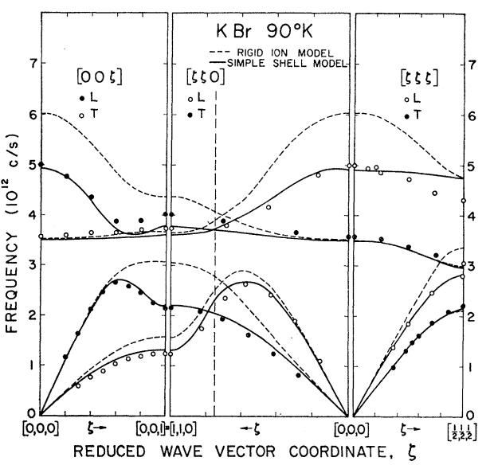
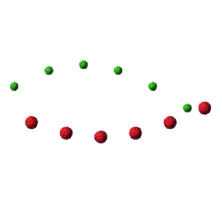
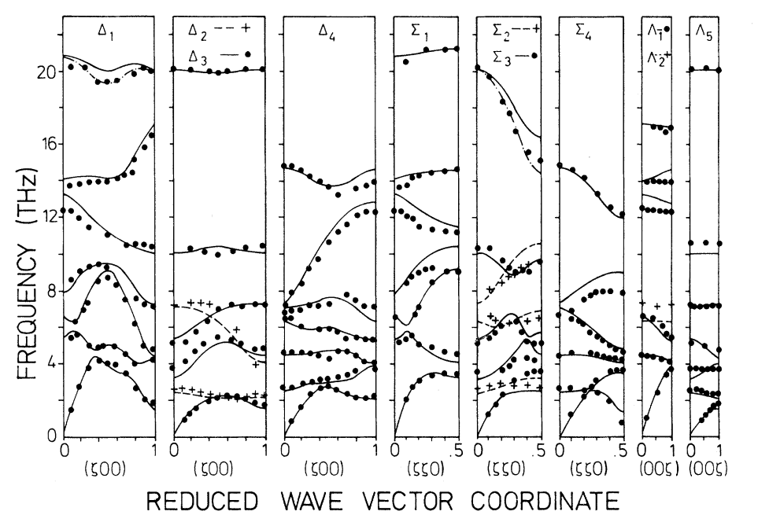
More complicated structures
Acoustic phonon
Woods, et al., Phys. Rev. 131, 1025 (1963).
Optical phonon
La₂CuO₄
Chaplot, et al., Phys. Rev. B 52, 7230(1995).

Slide 20
Spin excitations
Spin excitations
Spin waves in ordered magnets
Paramagnetic & quantum spin fluctuations
Crystal-field & spin-orbit excitations
Magnetic inelastic scattering can tell us about
Exchange interactions
Single-ion and exchange anisotropy (determine Hamiltonian)
Phase transitions & critical phenomena
Quantum critical scaling of magnetic fluctuations
Other electronic energy scales (eg. CF & SO)
Interactions (eg. spin-phonon coupling)
Notes:
Interactions are especially important in the study of correlated electron systems, where energy scales of spin, lattice, and electron are comparable.

Slide 21
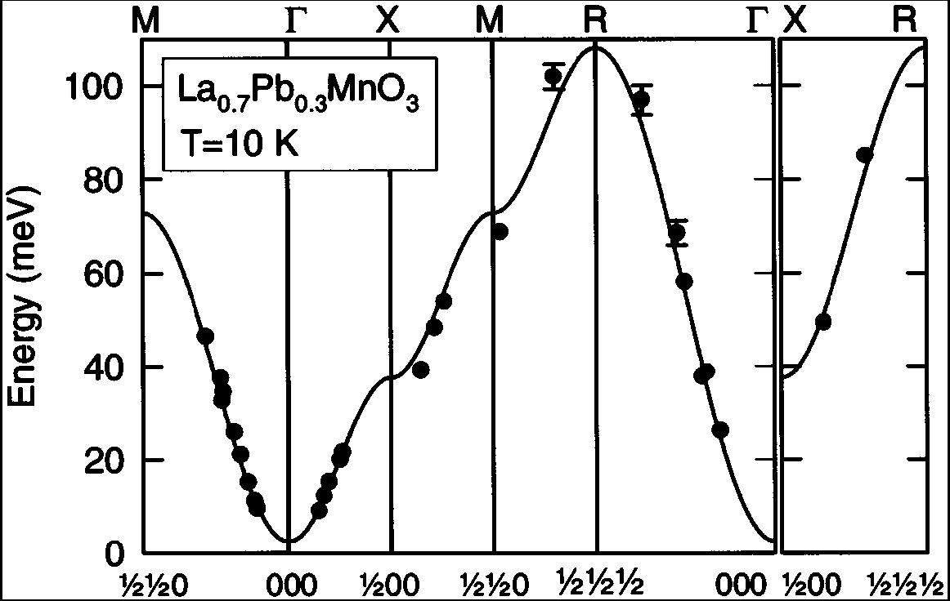
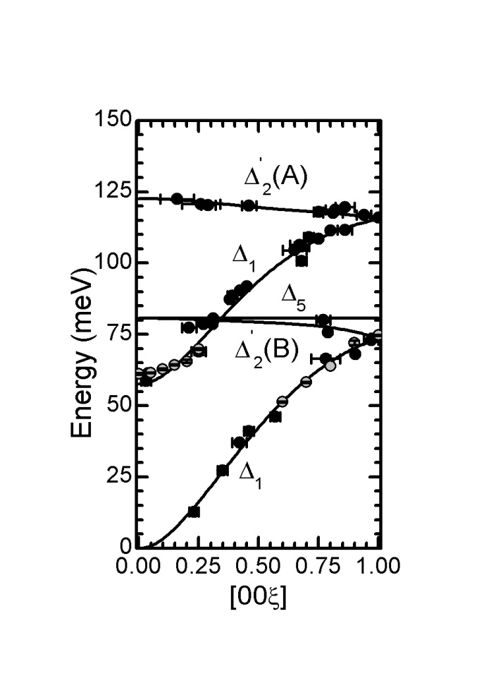
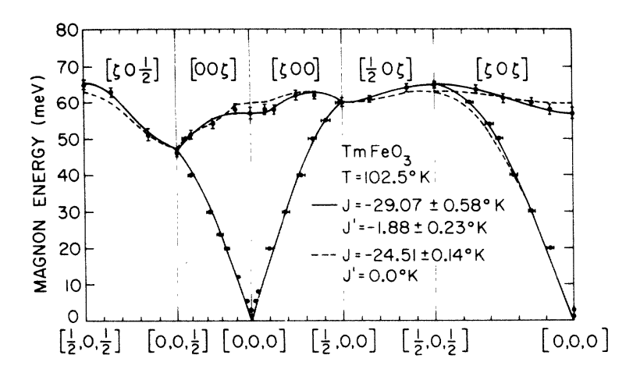
Spin waves
Ferromagnetic
Ferrimagnetic
Perring et al., Phys. Rev. Lett. 77, 711 (1996).
Antiferromagnetic
Fe₃O₄
McQueeney et al., Phys. Rev. Lett. 99, 246401 (2007).
Shapiro et al., Phys. Rev. B 10, 2014 (1974).
Notes:
Spin waves are then identical in spirit to phonons. One can measure the dispersion relation with neutrons. Some examples of spin wave dispersions

Slide 22
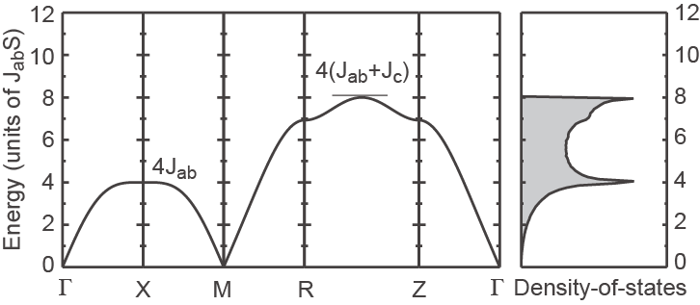
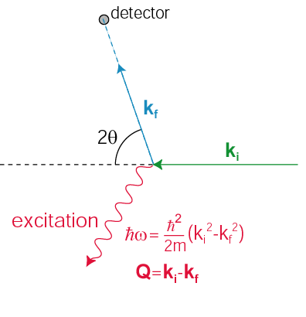
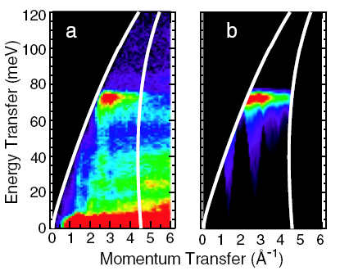
Scattering experiments
Single-crystal
Powder S(|Q|,ω)
Instrument and sample (powder or single-crystal) determine how (Q,ω) space is sampled
Notes:
We use both single-crystal and powder samples for study
If the sample is a single-crystal the spin wave dispersion can be determined directly.
When using powder samples, directional information is lost, but the number of spin wave modes/unit energy (SW DOS) can be determined using INS from powders. Often the information contained in the SWDOS is sufficient to determine the exchange energies.

Slide 23
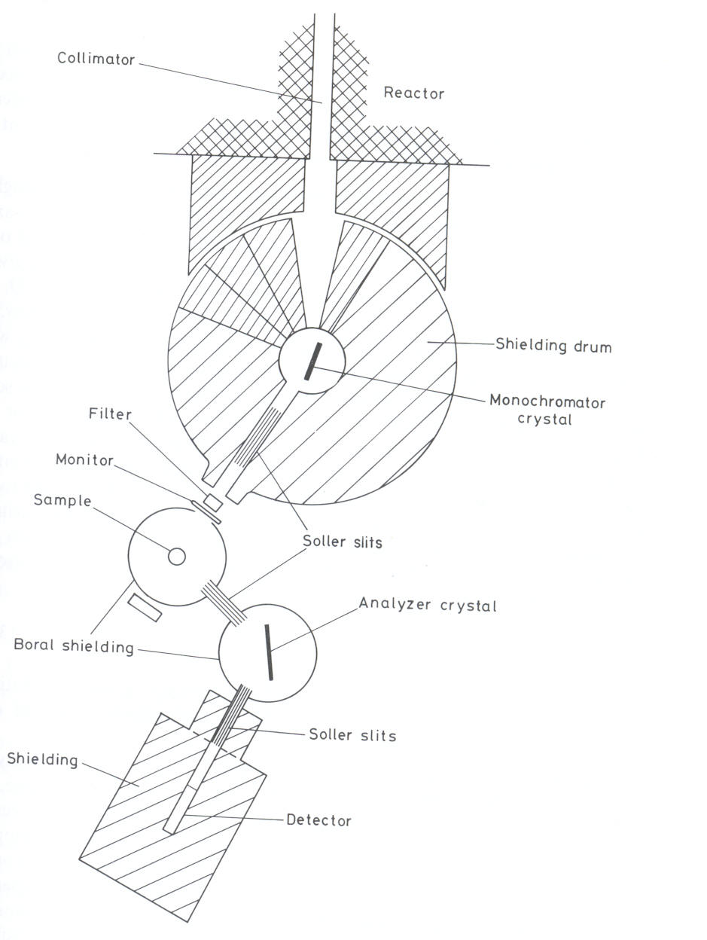
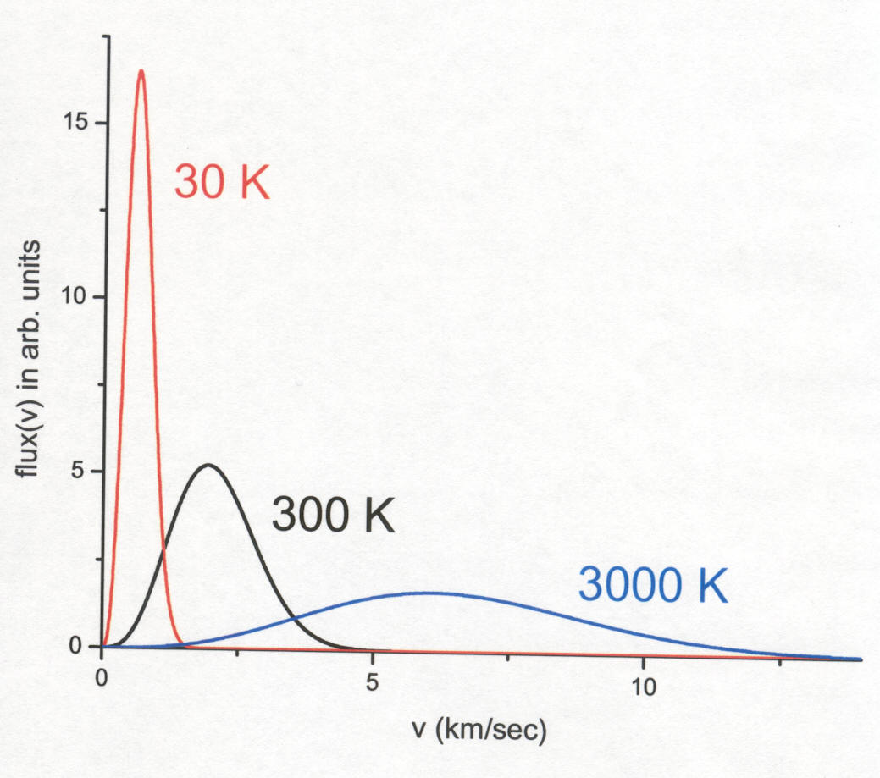
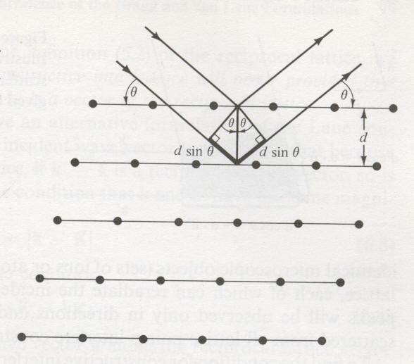
Bragg’s Law: nλ = 2d sin(θ)

Slide 24
Bragg’s Law: nλ = 2d sin(θ)

Slide 25
Brockhouse’s Triple Axis Spectrometer
| k_{i} | = 2 π / λ_{i}
| k_{f} | = 2 π / λ_{f}

Slide 26
Momentum Transfer:
Q = k_{i} – k_{f}
Q
k_{i}
- k_{f}
Energy Transfer:
δ E = h²/2m (k_{i}² – k_{f}²)
k_{f}

Slide 27
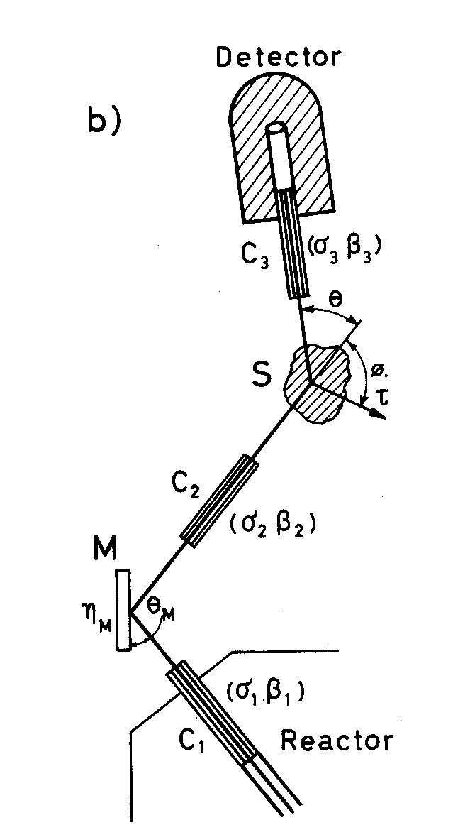
Two Axis Spectrometer:
3-axis with analyser removed
Powder diffractometer
Small angle diffractometer
Reflectometers
Diffractometers often employ working
assumption that all scattering
is elastic.

Slide 28
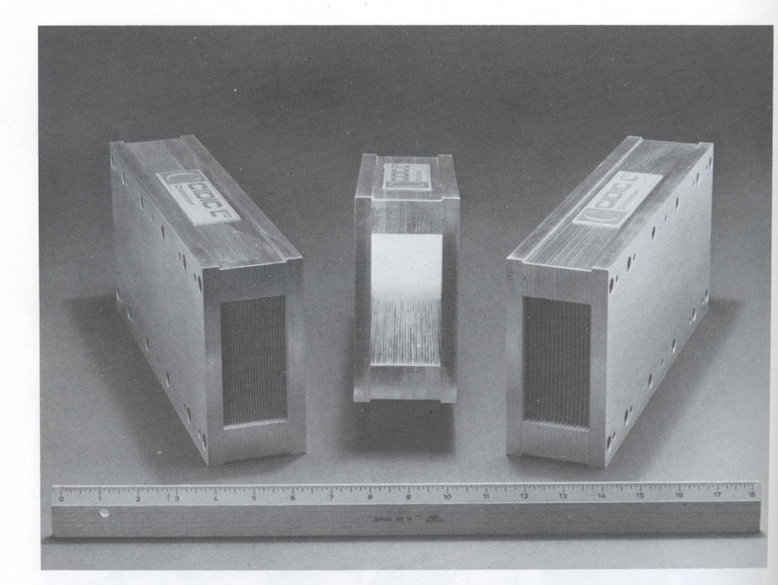
Soller Slits: Collimators
Define beam direction to
+/- 0.5, 0.75 etc. degrees

Slide 29
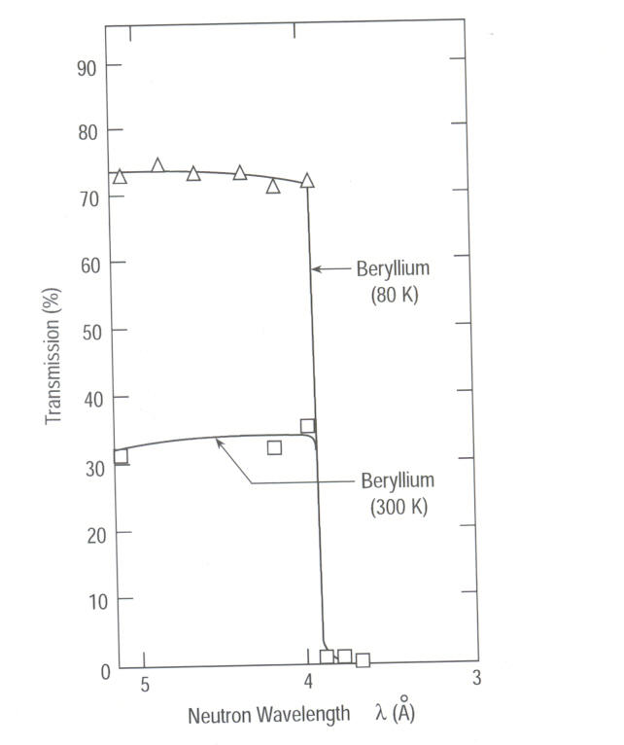
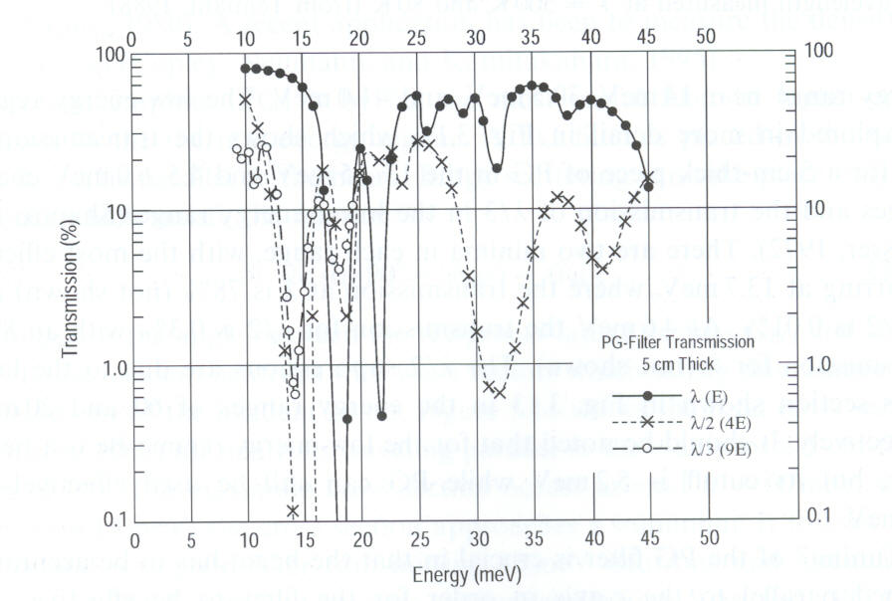
Filters:
Remove λ /n from incident or
scattered beam, or both

Slide 30
Single crystal monochromators:
Bragg reflection and harmonic contamination
nλ = 2d sin(θ)
Get: λ , λ/2 , λ/3 , etc.

Slide 31
Pyrolitic graphite filter:
E = 14.7 meV
λ = 2.37 A
v = 1.6 km/s
2 x v = 3.2 km/s
3 x v = 4.8 km/s

Slide 32
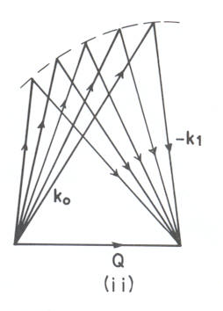
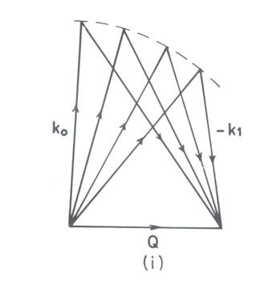
Constant k_{f}
Constant k_{i}
Two different ways of performing constant-Q scans

Slide 33
Mapping Momentum – Energy (Q-E) space
Origin of reciprocal space;
Remains fixed for any sample rotation
2 π / a
2 π / a

Slide 36
Elementary Excitations in Solids
Lattice Vibrations (Phonons)
Spin Fluctuations (Magnons)
Energy vs Momentum
Forces which bind atoms
together in solids

Slide 37
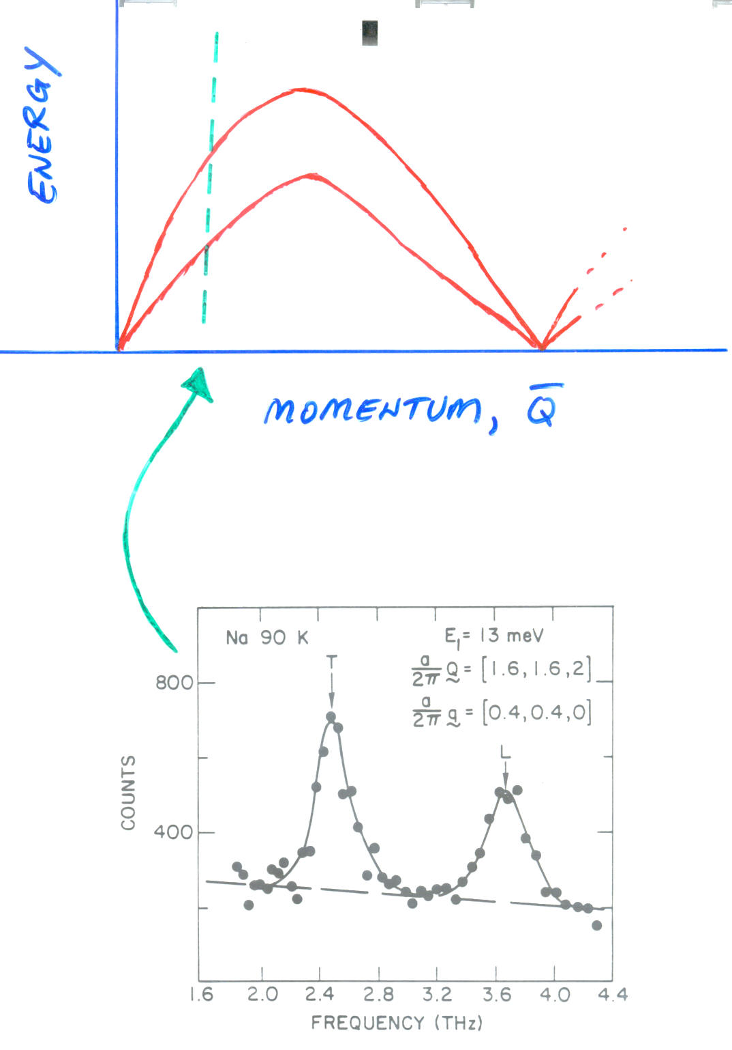
Constant Q, Constant E
3-axis technique allow us to
Put Q-Energy space on a grid,
And scan through as we wish
Map out elementary excitations
In Q-energy space (dispersion
Surface)

Slide 38
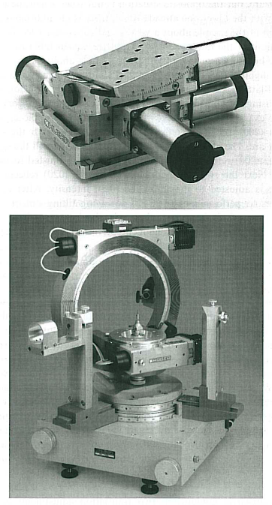
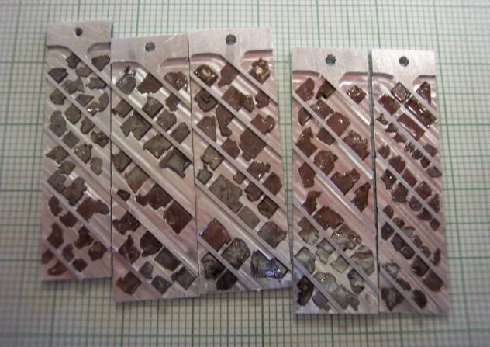
Samples
Samples need to be BIG
~ gram or cc
Counting times are long (mins/pt)
Sample rotation
Sample tilt
HB3-HFIR
IN14-ILL
Co-aligned CaFe₂As₂ crystals

Slide 39
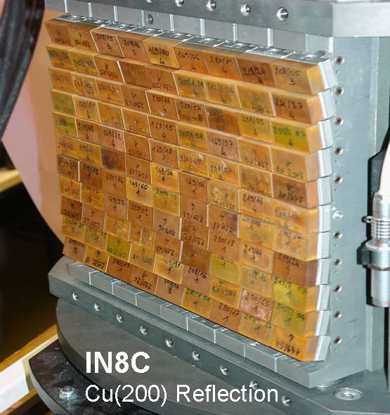
Monochromators
Selects the incident wavevector
Reflectivity
focusing
high-order contamination eg. λ/2 PG(004)
θ
Q(hkl)
Mono | d(hkl) | uses
PG(002) | 3.353 | General
Be(002) | 1.790 | High k_{i}
Si(111) | 3.135 | No λ/2

Slide 40
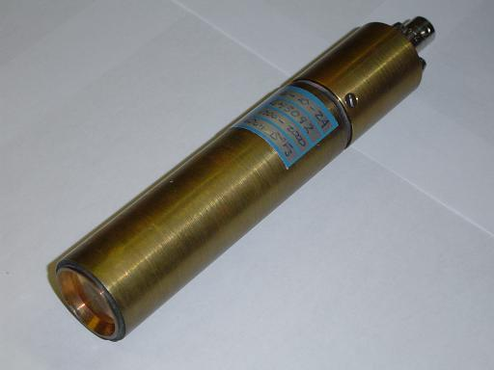
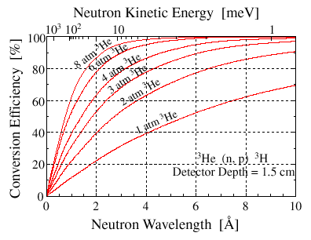
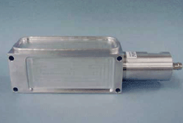
Detectors
Gas Detectors
n + ³He → ³H + p + 0.764 MeV
Ionization of gas
e⁻ drift to high voltage anode
High efficiency
Beam monitors
Low efficiency detectors for measuring beam flux

Slide 41
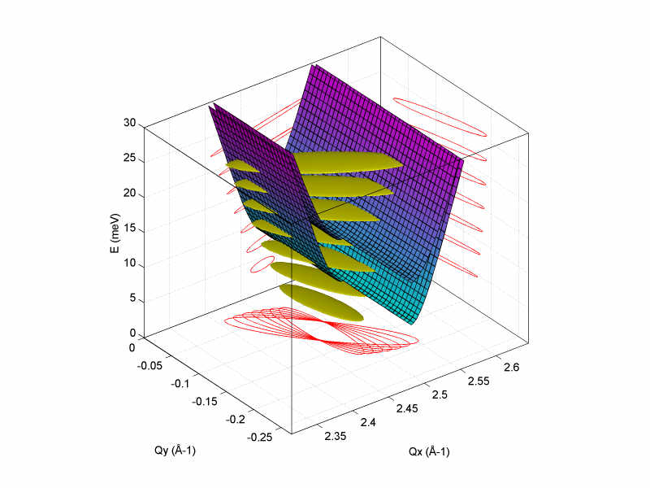
Resolution
Resolution ellipsoid
Beam divergences
Collimations/distances
Crystal mosaics/sizes/angles
Resolution convolutions

Slide 42
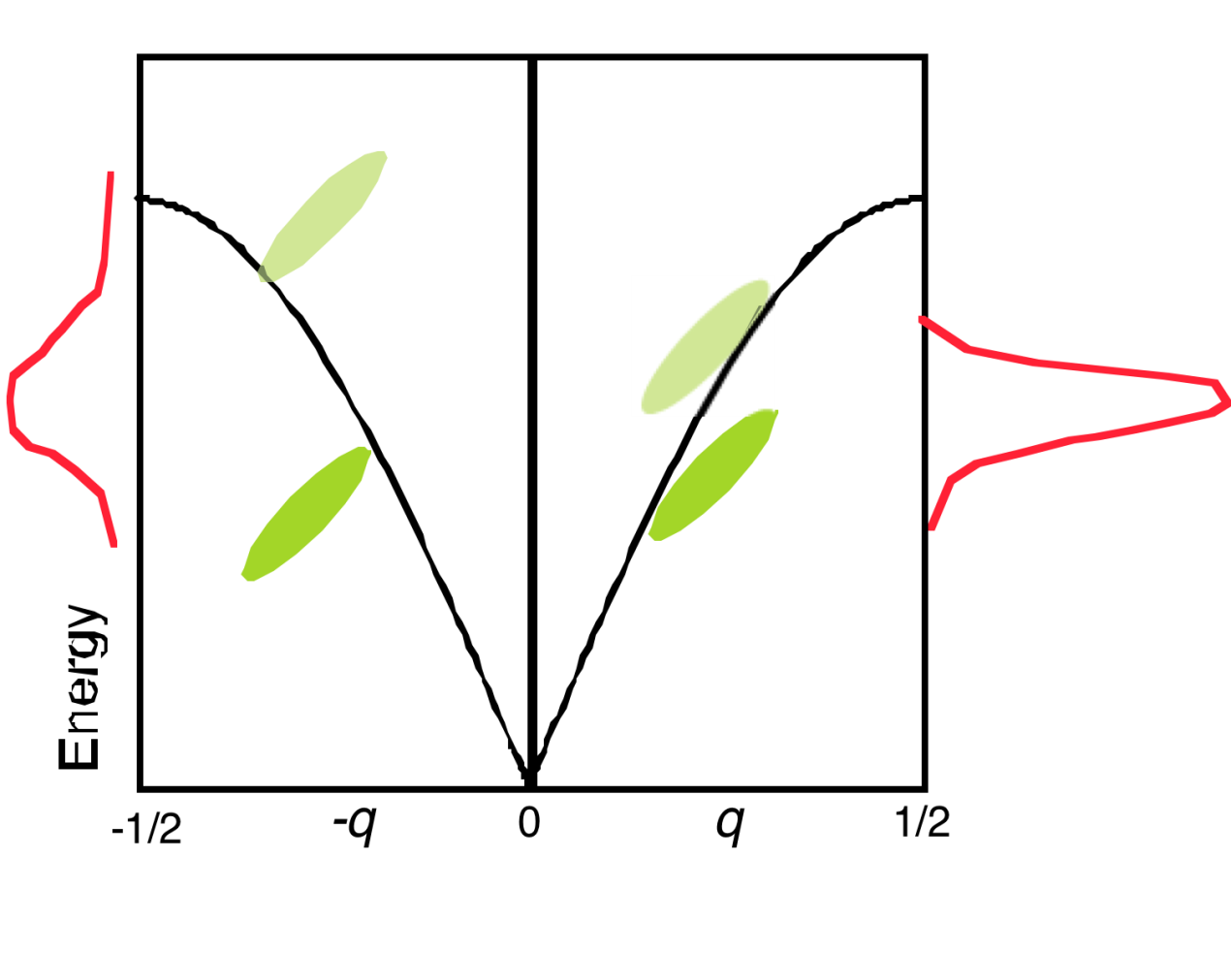
Resolution focusing
Optimizing peak intensity
Match slope of resolution to dispersion

Slide 43
Neutrons have mass
so higher energy means faster – lower energy means slower
v (km/sec) = 3.96 / λ (A)
4 A neutrons move at ~ 1 km/sec
DCS: 4 m from sample to detector
It takes 4 msec for elastically
scattered 4 A neutrons to travel 4 m
msec timing of neutrons is easy
δ E / E ~ 1-3 % - very good !
We can measure a neutron’s energy, wavelength by measuring its speed

Slide 44
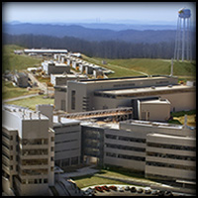
Time-of-flight methods
Effectively utilizes time structure of pulsed neutron groups
Spallation neutron source
Pharos – Lujan Center
detector banks
velocity selector
Scattered
neutrons
sample
Notes:
Time-of-flight methods make use of the pulsed character of a neutron beam that is produced at a spallation source.
The spallation source creates a pulse of neutrons with all wavelengths. This pulse spreads as it travels down the instrument.
A fermi chopper opens for a brief period to let through a single energy.
Inelastic scattering from the sample slows down and speeds up some neutrons, causing neutrons to arrive at the detector over a range of time. The energy transfer can be calculated from the time-of-flight.
Unlike TAS, there is no analyzer required, so a huge detector bank can be used to detect neutrons scattered over a large solid angle. This is very effective for powder samples.
Single-crystal measurements contain a plethora of information, but are sometimes difficult to analyze/interpret.

Slide 48
Fermi Choppers
Body radius ~ 5 cm
Curved absorbing slats
B or Gd coated
~mm slit size
f = 600 Hz (max)
Acts like shutter, Δt ~ μs

Slide 49
T-zero chopper
Background suppression
Blocks fast neutron flash

Slide 50
Position sensitive detectors
³He tubes (usu. 1 meter)
Charge division
Position resolution ~ cm
Time resolution ~ 10 ns
MAPS detector bank

Slide 51
Sample environment
Temperature, field, pressure
Heavy duty for large sample environment
CCR
He cryostats
SC magnets
…
Can be machined from Al
~ neutron transparent
relatively easy to work with
HB3-HFIR
IN14-ILL

Slide 52
Guides
Transport beam over long distances
Background reduction
Total external reflection
Ni coated glass
Ni/Ti multilayers (supermirror)

Slide 53
Size matters
Length = resolution
Instruments ~ 20 – 40 m long
E-resolution ~ 2-4% E_{i}
More detectors
SEQUOIA – 1600 tubes, 144000 pixels
Solid angle coverage 1.6 steradians
Huge data sets
0.1 – 1 GB
SEQUOIA detector
vacuum vessel

Slide 54
Kinematic limitations
Many combinations of k_{i},k_{f} for same Q,ω
Only certain configurations are used (eg. E_{f}-fixed)
Cannot “close triangle” for certain Q,ω due to kinematics
Q
k_{f}
k_{i}
k_{i}
k_{f}
Q
Minimum accessible Q
Kinematic limits, E_{i}=160 meV

Slide 55
Data visualization
Large, complex data from spallation sources
Measure S(Q,ω) – 4D function
La_{1-x}Ca_{x}MnO₃
Ye et al., Phys. Rev. B, 75 144408 (2007).
Notes:
As an example of the difficulties of analyzing TOF single-crystal data, consider the spin waves in ferromagnetic LCMO. Neutron scattering will occur where the dispersion surface and measurement surface intersect. The projection of this intersection on the Qx-Qy plane is shown. Energy is increasing towards the right. Line cuts can be used to determine the energies of parts of the surface and construct the dispersion. Constant-Q cuts of the TAS are easier, but the amount of data from TOF is staggering!

Slide 56
Development of Long Range Order
The appearance of spin waves indicates that the field-induced state is long range ordered
Notes:
If you look higher up in energy, what you find are beautiful, SHARP, dispersive excitations (spin waves!)
These can only come from an ordered state

Slide 57
Field-induced order in the Pyrochlore Yb2Ti2O7:
Weak magnetic field // [110] induces LRO
appearance of long-lived spin waves
at low T and moderate H

Slide 58
References
General neutron scattering
G. Squires, “Intro to theory of thermal neutron scattering”, Dover, 1978.
S. Lovesey, “Theory of neutron scattering from condensed matter”, Oxford, 1984.
R. Pynn, http://www.mrl.ucsb.edu/~pynn/.
Polarized neutron scattering
Moon, Koehler, Riste, Phys. Rev 181, 920 (1969).
Triple-axis techniques
Shirane, Shapiro, Tranquada, “Neutron scattering with a triple-axis spectrometer”, Cambridge, 2002.
Time-of-flight techniques
B. Fultz, http://www.cacr.caltech.edu/projects/danse/ARCS_Book_16x.pdf

