Slide 1
Proposal Writing: Hints for maximizing your chances for getting beam time General background on how DOE user facilities function and evolve –
Neutron X-ray Scattering School, June 26, 2014
(Making sausage isn’t always pretty but we like it anyway)
John Budai
Materials Science and Technology Division
Oak Ridge National Laboratory
No equations! No singing!
Scientists spend alot of time writing proposals, reviewing proposals and giving presentations.

Slide 2
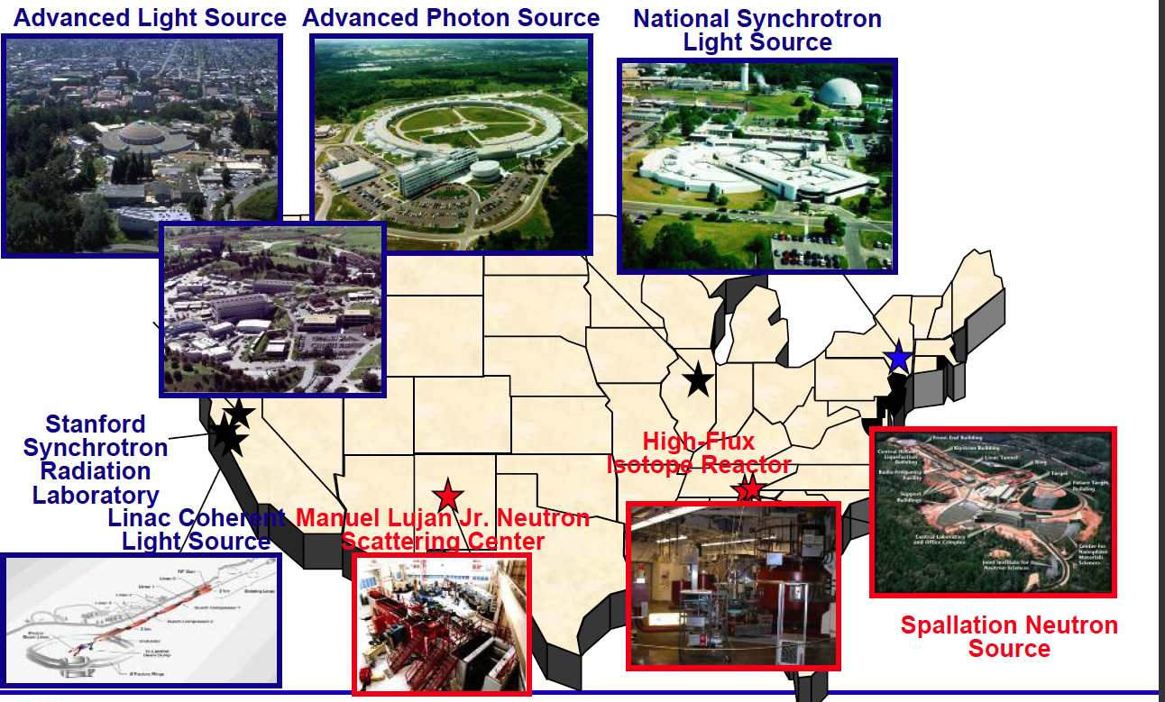
X-ray and Neutron Sources (mostly DOE)
➔NSLS-II
CHESS
NIST
NCNR
Also
5 DOE Nanoscience Centers (BNL, SNL/LANL, ORNL, ANL, LBNL)
3 DOE Electron Microscopy Centers (ANL, LBNL, ORNL)

Slide 3
X-ray and Neutron Sources Available Worldwide
Science Continues to Go Global
◆ Light Sources summarized at www.lightsources.org
~59 facilities
•European Synchrotron Radiation Facility (ESRF), Grenoble, France
•SPRING-8, Japan
•CLS, SLS, SOLEIL, DIAMOND, BESSYII, Taiwan, Shanghai, Pohang, …
◆ Neutron Sources summarized at www.neutronsources.org
~43 centers:
•Institut Laue-Langevin (ILL), Grenoble, France
•JSNS at J-PARC, Japan
•China Spallation Neutron Source (~2018)
•European Spallation Source (ESS), Lund, Sweden (~2019)

Slide 4
BES Scientific User Facilities
Electron Microscopy Center for Materials Research
Advanced Photon Source
Materials Preparation Center
Advanced Light Source
Center for Nanoscale Materials
Intense Pulsed Neutron Source
Center for Functional Nanomaterials
National Center for Electron Microscopy
National Synchrotron Light Source
Molecular
Foundry
National Synchrotron Light Source-II
Stanford Synchrotron Radiation Lab
Spallation Neutron Source
Linac Coherent Light Source
Center for Nanophase Materials Sciences
Combustion Research Facility
Los Alamos Neutron Science Center
BES
Defense
Shared Research Equipment Program
Center for Integrated Nanotechnologies
High-Flux Isotope Reactor
Pulse Radiolysis Facility
(from Pat Dehmer presentation)
4 Synchrotron Radiation Light Sources
Linac Coherent Light Source
4 Neutron Sources
3 Electron Beam Microcharacterization Centers
5 Nanoscale Science Research Centers
3 Special Purpose Centers
Also 4 Advanced Scientific Computing Centers

Slide 5
BES Facilities Construction ~30 Years
$300M
Near Future?
BESAC – Basic Energy Sciences Advisory Committee
LCLS-II (ultrafast, high rep)
APS Upgrade (ultrabright MBA)
SNS 2nd Target (cold neutrons)
Free Electron Laser
Ongoing evaluations - Subject to change?
$200M
$K
N
$100M
S
N
S
S
L
A
P
S
S
$1.4B
2
L
C
NSLS
L
A
L
S
S
From P. Dehmer, Office of Science Update, Feb 28, 2013

Slide 6
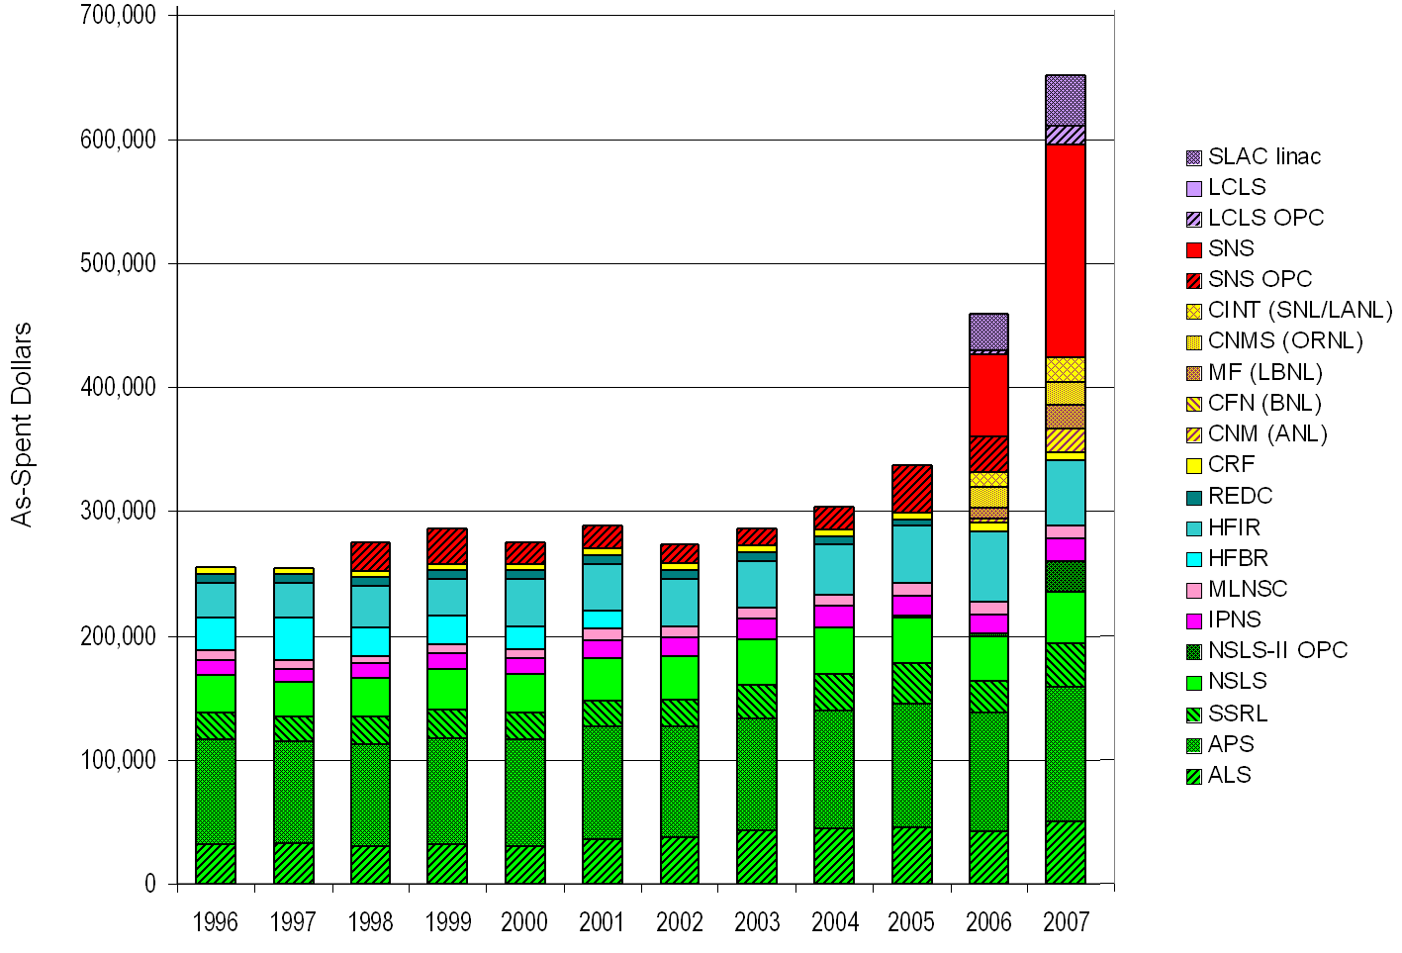
Operating Budgets for the BES Scientific User Facilities
BES FY2013
Materials Sciences & Eng $347M (22%)
Chem, Geo & Energy Bio Sciences $308M (20%)
Scientific User Facilities $849M (55%)
Construction $ 47M ( 3%)
Total $1551M
(K$)
6

Slide 7
FY 2013 BES Budget Appropriation
Research programs
Energy Innovation Hubs (+$4.8M)
Energy Frontier Research Centers
Core Research (- $5.5M)
Scientific user facilities
Synchrotron light sources (-$6.8M)
Neutron scattering facilities (-$3M)
Nanoscale Science Research Centers (-$2.3M)
NSLS-II early ops (+$22M)
FY 2013 Approp:
$ 1,596M
(- $92M from FY 2012)
SBIR/STTR & GPP
50
SUF Research
27
Const, OPC, MIE
Nano NSRCs 100
EFRCs + Hubs
148
126
Neutron Sources
246
CSGB
Research
236
Facilities
Ops 743
Light Sources
396
MSE
Research
266
Construction and instrumentation
National Synchrotron Light Source-II (-$87.5M) and NEXT instrumentation
Spallation Neutron Source instruments (-$11.5M)
Advanced Photon Source upgrade
Linac Coherent Light Source-II (+$15M*)
*Includes $22.5M of prior year carryover

Slide 8
BES User Facilities Hosted Over 15,000 Users in FY 2012
More than 300 companies from various sectors of the manufacturing, chemical, and pharmaceutical industries conducted research at BES scientific user facilities. Over 30 companies were Fortune 500 companies.

Slide 9
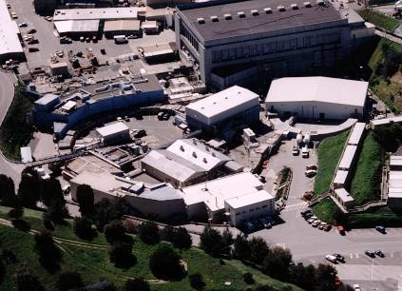
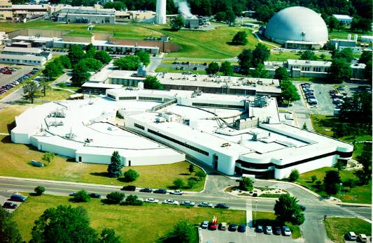
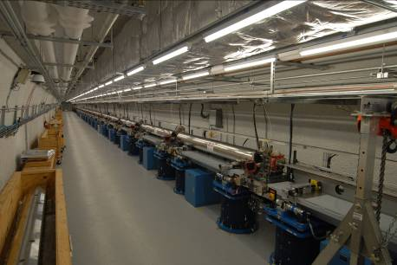
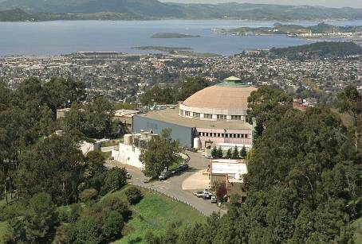
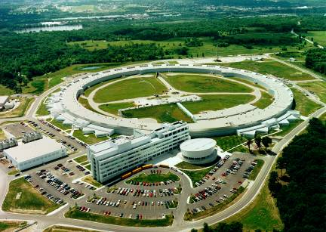
Users by Facility at the Light Sources
SSRL 1974 & 2004
NSLS 1982
LCLS 2009
ALS 1993
APS 1996
Synchrotron Light Sources Serve >11,000 Users/Year

Slide 10
Users by Discipline at the Light Sources
Number of Users
10

Slide 11
Neutron User Community and Research Growing
You

Slide 12
ORNL Home to many User Facilities (acronym required)
BTRIC - Building Technologies Research and Integration Center
CNMS - Center for Nanophase Materials Sciences
CSMB - Center for Structural Molecular Biology (Bio-SANS)
CFTF - Carbon Fiber Technology Facility
HFIR - High Flux Isotope Reactor
MDF – Manufacturing Demonstration Facility
NTRC - National Transportation Research Center
OLCF - Oak Ridge Leadership Computing Facility
Safeguards Laboratory (SL)
SHaRE - Shared Research Equipment (TEM, merging in CNMS)
SNS - Spallation Neutron Source
Also, 2 EFRC’s (Energy Frontier Research Centers), 1 Energy Hub (Nuclear Modeling and Simulation )

Slide 13
Basics of the facility proposal systems
All the DOE (NIST & NSF) neutron and x-ray sources offer access to beam time through an experimental proposal system. “General Users (GU)”.
Proposal submission is done through a web-based application. When and how often proposals are submitted varies by facility.
APS and NSLS three times (“cycles”) per year.
SNS/HFIR and ALS two times per year
All proposals are peer-reviewed and rated, and beam time is allocated using the scores of these reviews. Once time has been allocated, the beamline staff schedule the proposals.

Slide 14
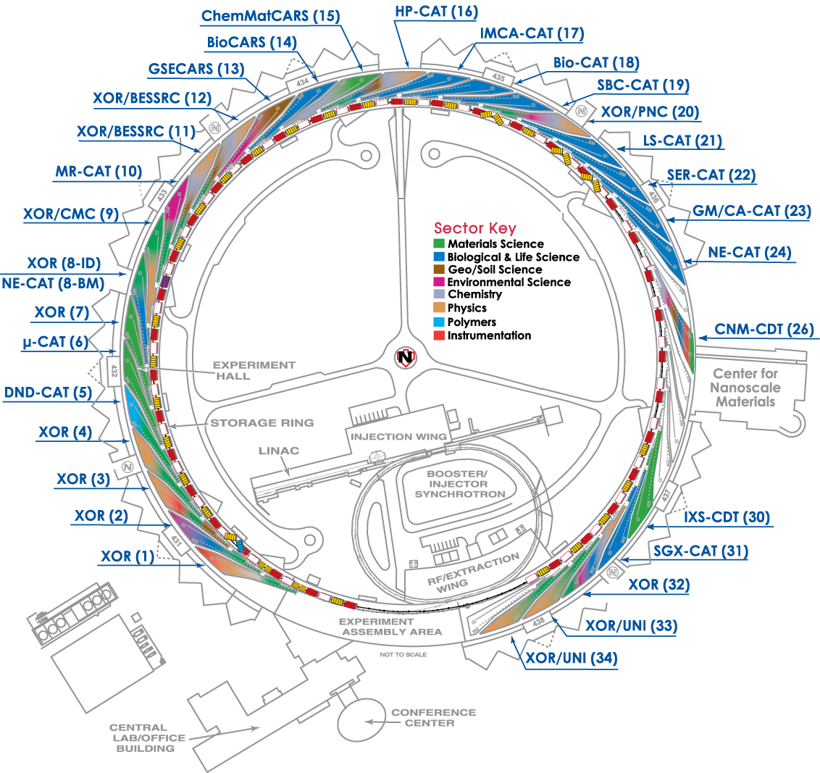
Amount of general user time available
APS/NSLS/SSRL/ALS
All beamlines offer GU beam time.
Most DOE/NSF funded beamlines provide 80-100% of their time to general users.
SNS/HFIR
Amount varies by instrument.
~75% of time will be for general users.
For most, you can search facility websites by technique or by beamline. Quality of proposal websites varies.

Slide 15
Upcoming Proposal Deadlines: www.lightsources.org/deadlines
X-ray sources Deadlines
APS July 11, 2014
ALS First Wednesday in Sept 2014
NSLS(9/2014)➔NSLSII Sept 30, 2014; ➔NSLSII (2015)
LCLS February 11, 2014
Neutron sources HFIR/SNS ~Sept 2014
LANSCE/Lujan? contact user office?
NIST-NCNR contact user office?
At most facilities, these are hard deadlines:
APS always at Friday midnight (12:05 → next cycle)
Inside Tip: Starting APS application process early (without submitting) gives you a lower ID #.

Slide 16
Users Get Started with Assistance of the Instrument Scientists
Study instrument web pages
Contact an Instrument Scientist to discuss your research
What is the research problem?
Which instrument(s) are appropriate? (scores?)
How mature is the research project (risk, size)?
What is the material – sample composition, form, size, availability?
What are the experimental conditions (temperature, pressure, magnetic field, etc)?
What will be measured?
Probability of success? Impact? Significance?
How will results be presented and to whom?
What is the timeline?

Slide 17
Instrument Scientists Assist First-time and Returning Users
Provide technical advice, guidance, and assistance
Instrument options
Sample and experiment preparation
Number of experiment days
Logistics (scheduling, transporting and storing samples)
Proposal preparation tips and assistance
Experiment team members
Data analysis
Publication considerations

Slide 18
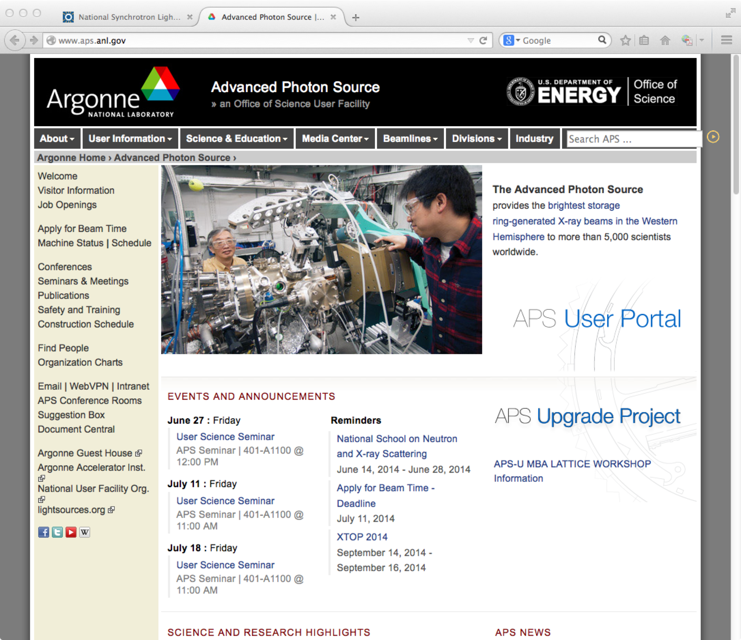
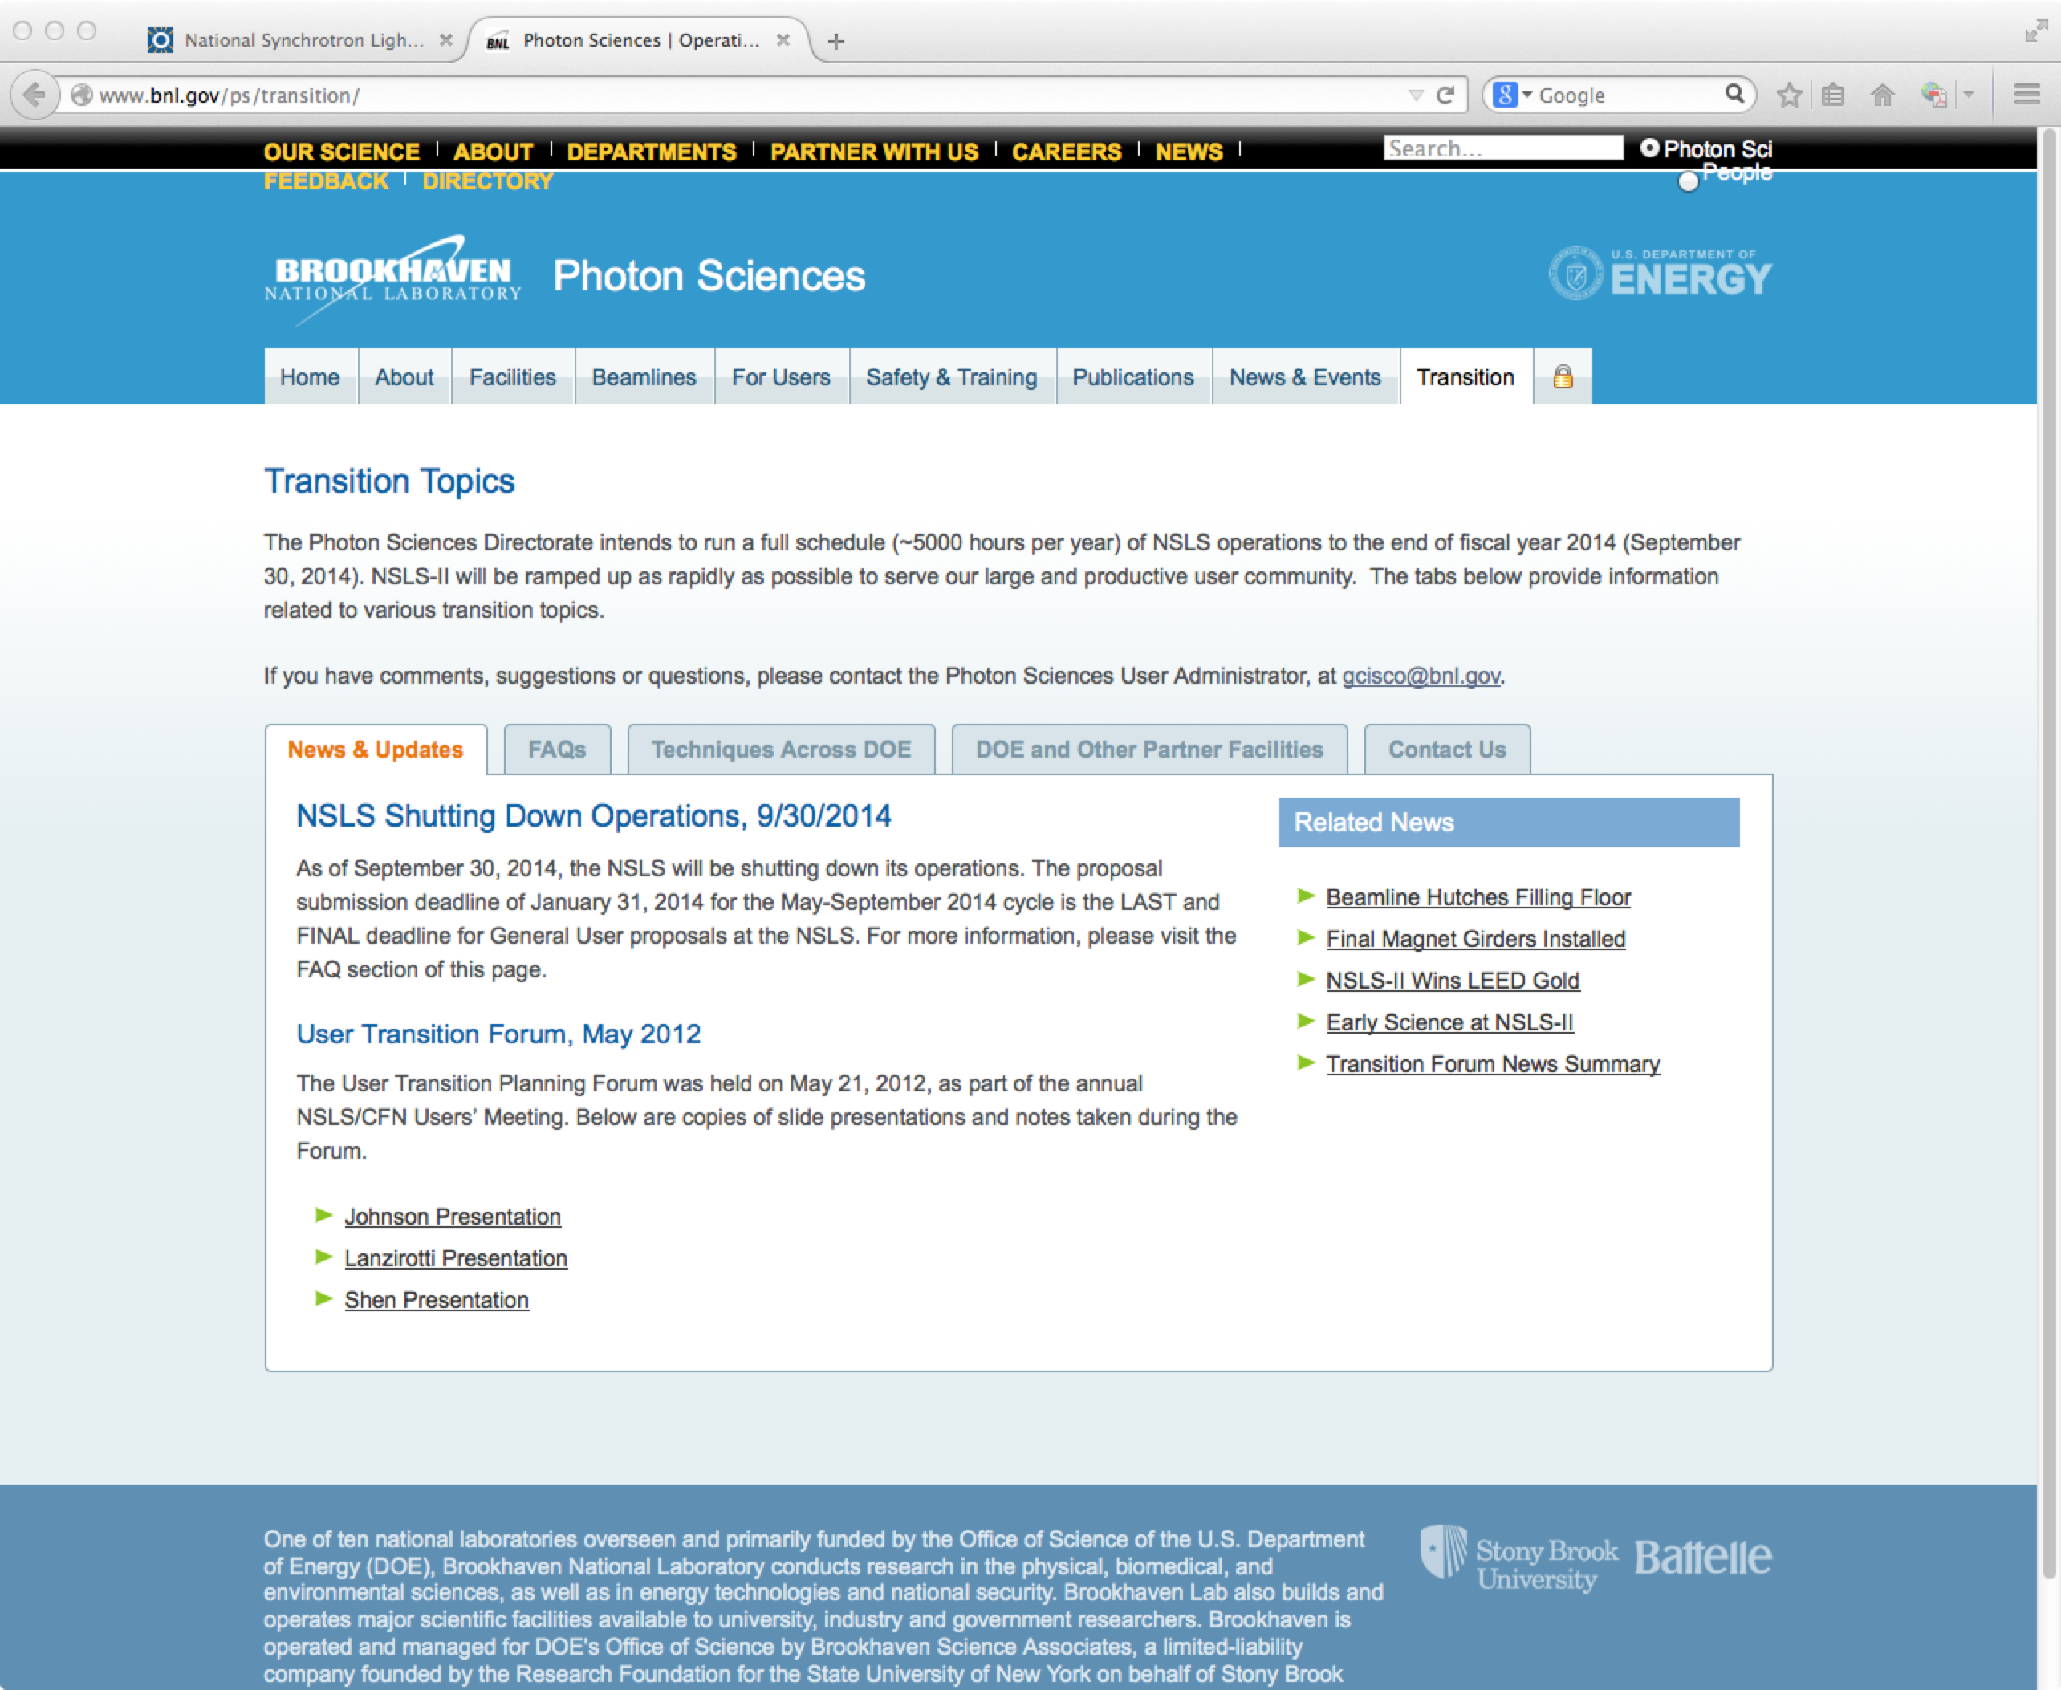
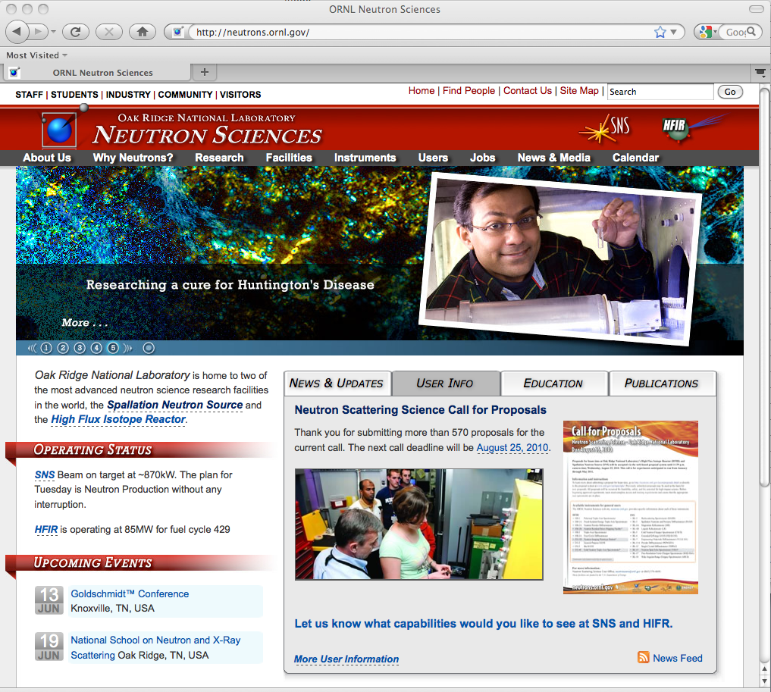
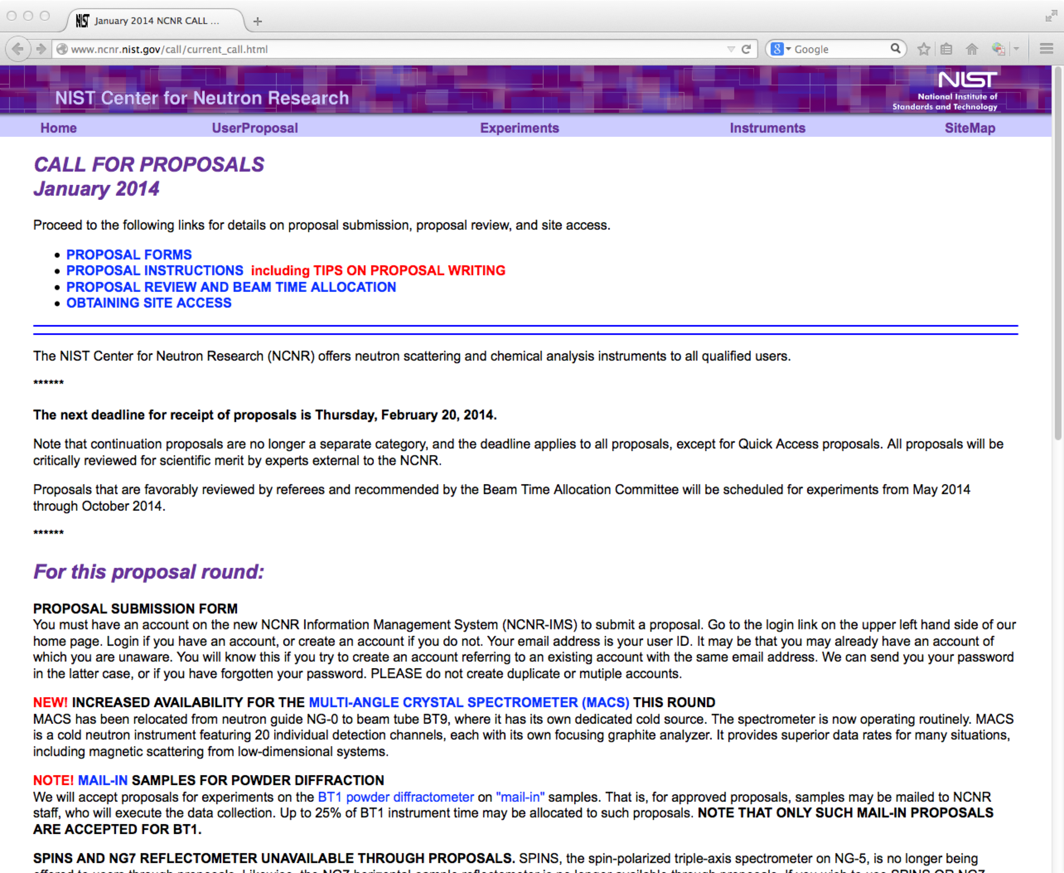
Submitting a proposal
Facilities have link on home page
NSLS-II
NSLS shuts down 9/30/14
APS
NIST
SNS
HFIR

Slide 19
Different types of proposals allow facility flexibility
Each facility has particular systems or proposal modes:
APS
GUP - General User Proposal. A "rapid-access beamtime request" against a submitted proposal can be considered for any unallocated general user time during the current run.
PUP – Partner User Proposal - Groups whose work involves a greater degree of collaboration with the APS. (e.g. major new instrumentation).
11-BM User Program – Accepts user proposals for both on-site experiments and for the rapid-access mail-in service (~60% of user beamtime reserved for mail-in samples). Very easy – they send you capillary tubes. This capability is not obvious on the GUP website.
CHESS – Cornell (just received new NSF funding)
Express-Mode proposals are for a single visit of limited duration to CHESS to perform a straight-forward experiment. Express-Mode proposals undergo a rapid on-line review process to enable users to quickly gain access to beam time.
Feasibility Study proposals are to test an idea or procedure at one of the CHESS stations.
NSLS ➔ NSLS-II
MAIL-IN EXAFS Service at Beamline X18B Prepare your samples according to their thickness guide and mount on standard holder. Transmission mode. Charges are ~$100/hr.

Slide 20
Different types of proposals allow facility flexibility – cont.
NIST NCNR
MAIL-IN SAMPLES FOR POWDER DIFFRACTION We will accept proposals for experiments on the BT1 powder diffractometer on ”mail-in” samples. That is, samples may be mailed to NCNR staff, who will execute the data collection.
QUICK ACCESS PROPOSALS If a user feels that beam time is required very soon to carry out important measurements that cannot be delayed, a proposal may be submitted requesting expedited access. The proposal will be reviewed by the BTAC, and held to a substantially higher standard than regular proposals.
Crystallography is somewhat a separate, self-contained community
A separate proposal system at APS.
Highly automated for mail-in measurements.
Beamtime relatively available.

Slide 21
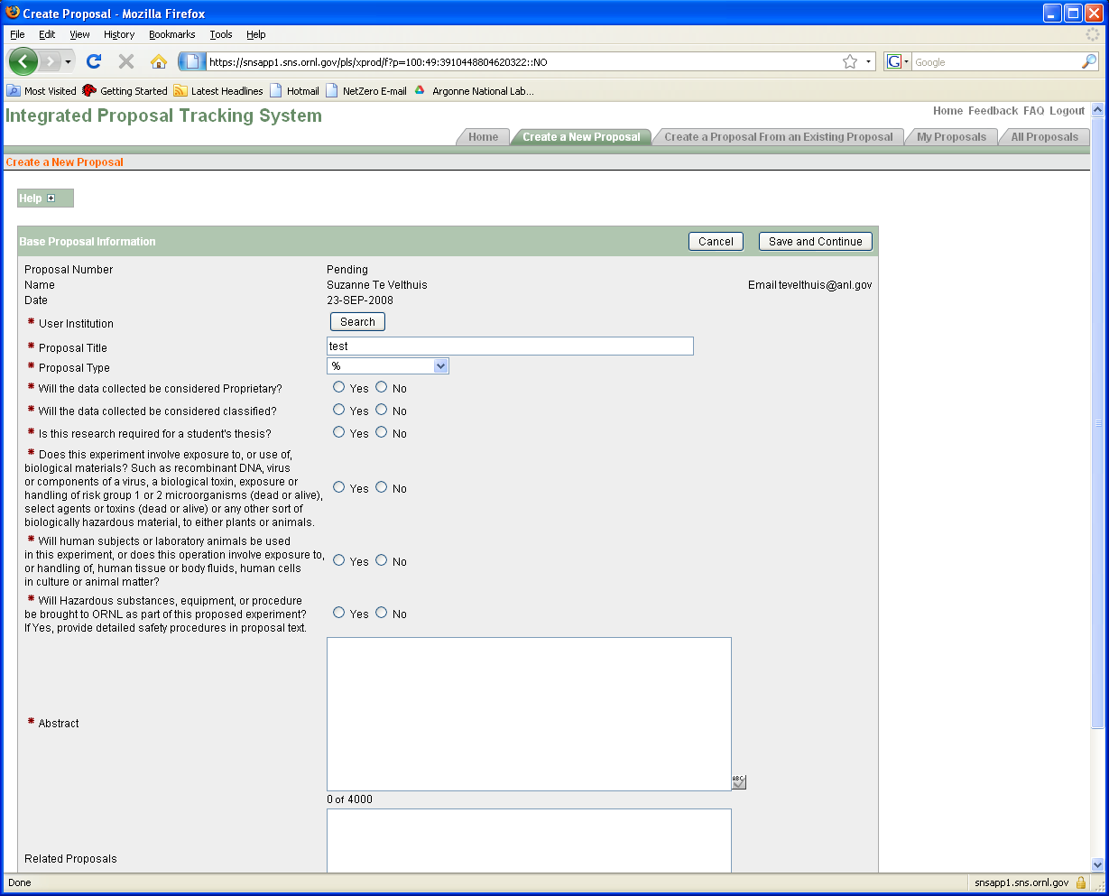
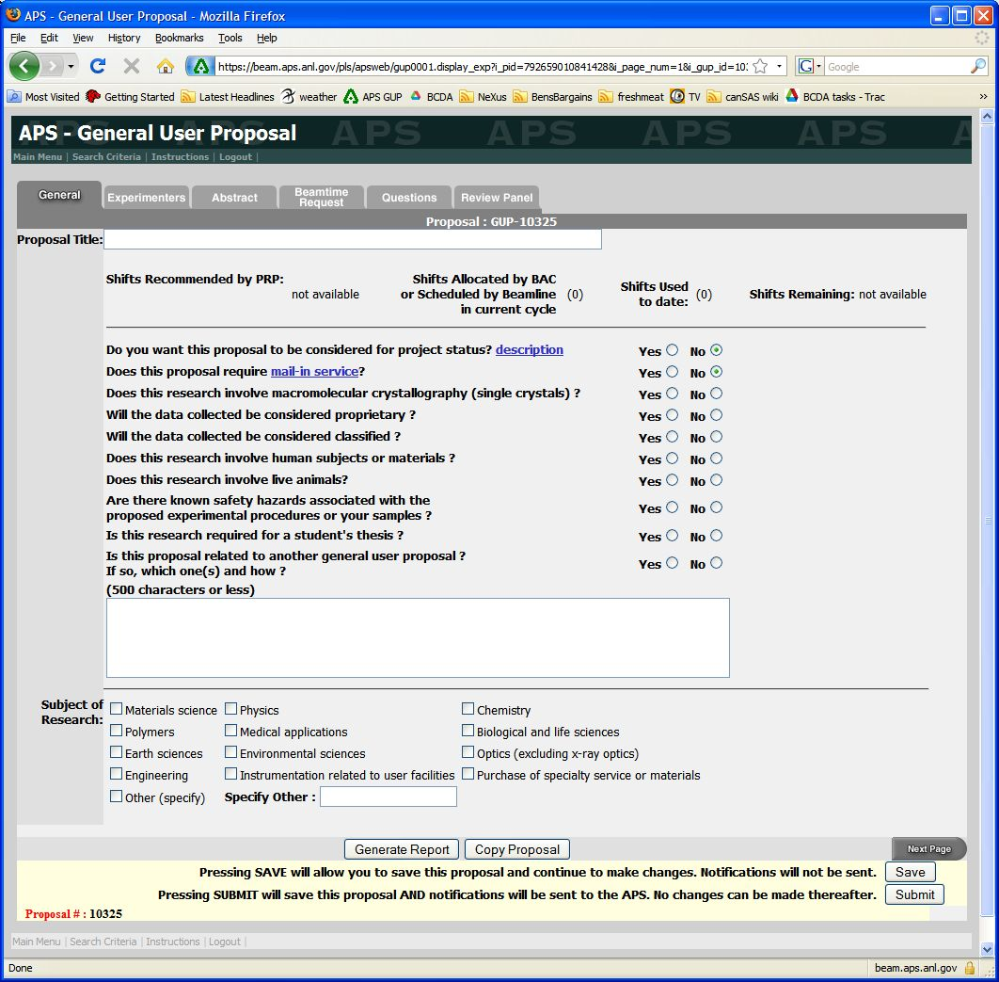
Proposal forms at SNS and APS
SNS/HFIR
APS
Each proposal system will ask very similar questions

Slide 22
Questions asked
Proposal Title
General Info (Title, Experimenters, Funding source, etc.)
Abstract - What is the scientific importance of the proposed research?
Why do you need the facility to do this research?
Neutron vs. X-rays
Why do you need an insertion device beamline instead of a bending magnet?
Spallation source vs. reactor source
Hard X-rays vs. Soft X-rays
Why do you need the beam line (and/or instrument)?
Particular technique or sample environment
What previous experience / results do you have (pubs important)?
Describe the proposed experiment(s), including samples and procedures. Show that you’re prepared.
Justification of the amount of time requested. Don’t be greedy or unrealistic about time needed. Ask beamline staff.

Slide 23
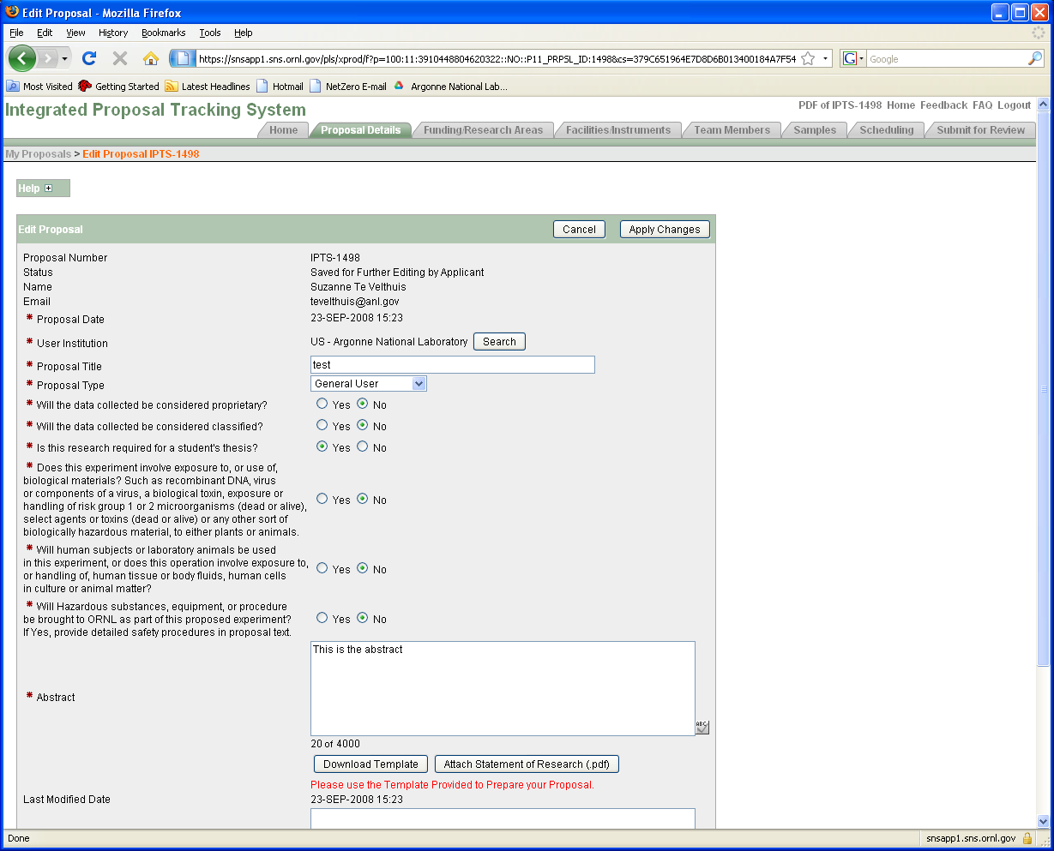
General Information

Slide 24
Proposal: General information
Pick a good title. Specific and to the point is better than spectacular and vague.
Good: “XAS study of Fe valence in CaFe2As2 under pressure ”
Bad: “Understanding superconductivity in superconductors”
Is it thesis related? Is there a deadline?
Will push your proposal up if scores are close
Fill in the abstract. Do not just upload a PDF document!
More work for reviewer.
Do upload a publication from previous work (include previous proposals).
Shows you made good use of beam time. Becoming more important.
Do not upload a 20 pages of supplemental information (figures often help, couple of plots with text OK)

Slide 25
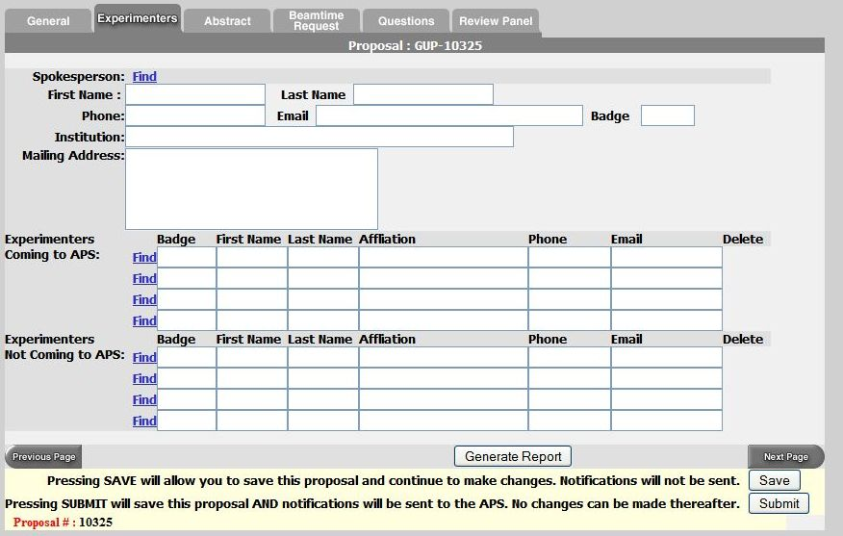
Proposal: Experimenters page
Use the “find” feature
List everyone involved in experiment
Even theorists are useful

Slide 26
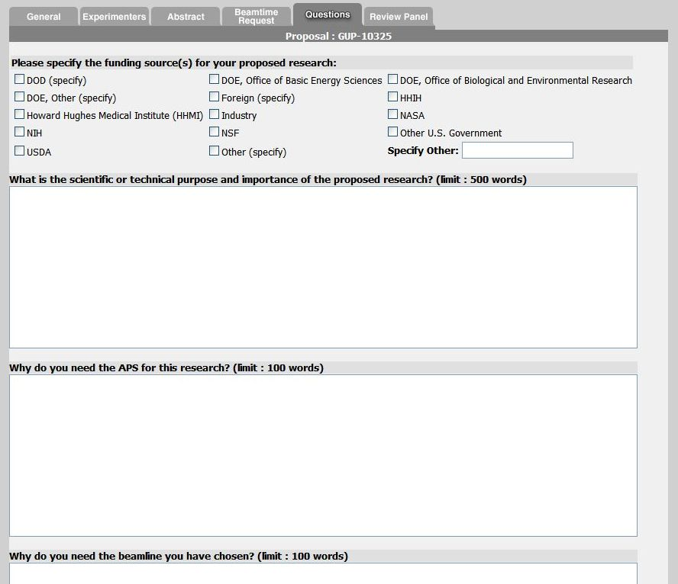
Experiment Description
Note guidance! Don’t write one sentence or 1000 words.

Slide 27
Experimental Details
Give background information why it is important.
Science at facilities is very diverse. Reviewer is not necessarily an expert on your subject. Try to capture imagination of reviewer with basic idea.
@ APS each committee gets ~60 proposals each cycle (~700 total/cycle)
Clearly state what you want to measure and how
Give details. Temperature range, X-ray Energy, Sample geometry
What sample characterization has been done already? (XRD, SEM, etc.)
Reviewer needs to judge if experiment is feasible
Does x-ray energy match laser penetration depth
% of dilute atoms OK for fluorescence measurements
Why use x-rays or neutrons?
Neutron vs. X-rays
TEM, Mössbauer, Laser Raman, etc.
Justify the amount of beam time requested (ask instrument scientist!)

Slide 28
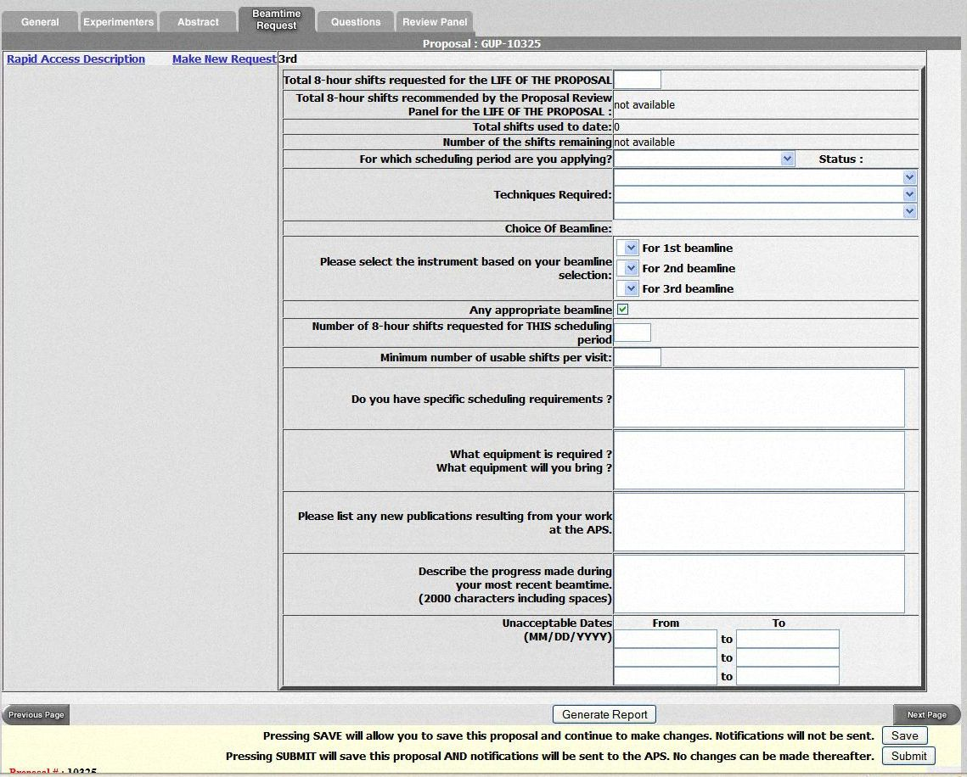
Beamtime Request
Proposals are valid for two years, but need to put in beam time request each cycle.
Chose multiple beamlines.
SAXS (12-ID, 5-ID, 15-ID)
XAFS (20-BM, 10-ID,12-BM)
General Diffraction
Don’t list only one week that you can come. Holidays?
Special sample environment / detectors will place more constraints on schedule.
GE amorphous Si detector
Magnet
….

Slide 29
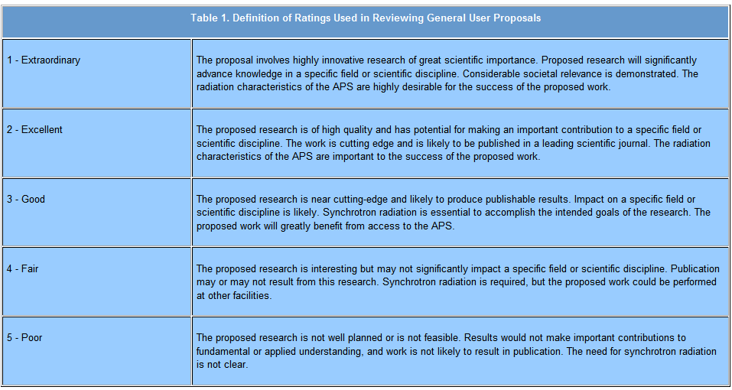
Ratings for APS Proposals
APS proposals are rated on a scale from 1 to 5
Average score is ~2.2
Cut off score for receiving beam time varies by beamline (1.5 - 2.2)
Proposal “ageing” (score improves by 0.2 each cycle it does not receive time). This is needed for getting time at some oversubscribed beamlines, so long-term planning is needed. But you have to remember to request beamtime again for every cycle.

Slide 30
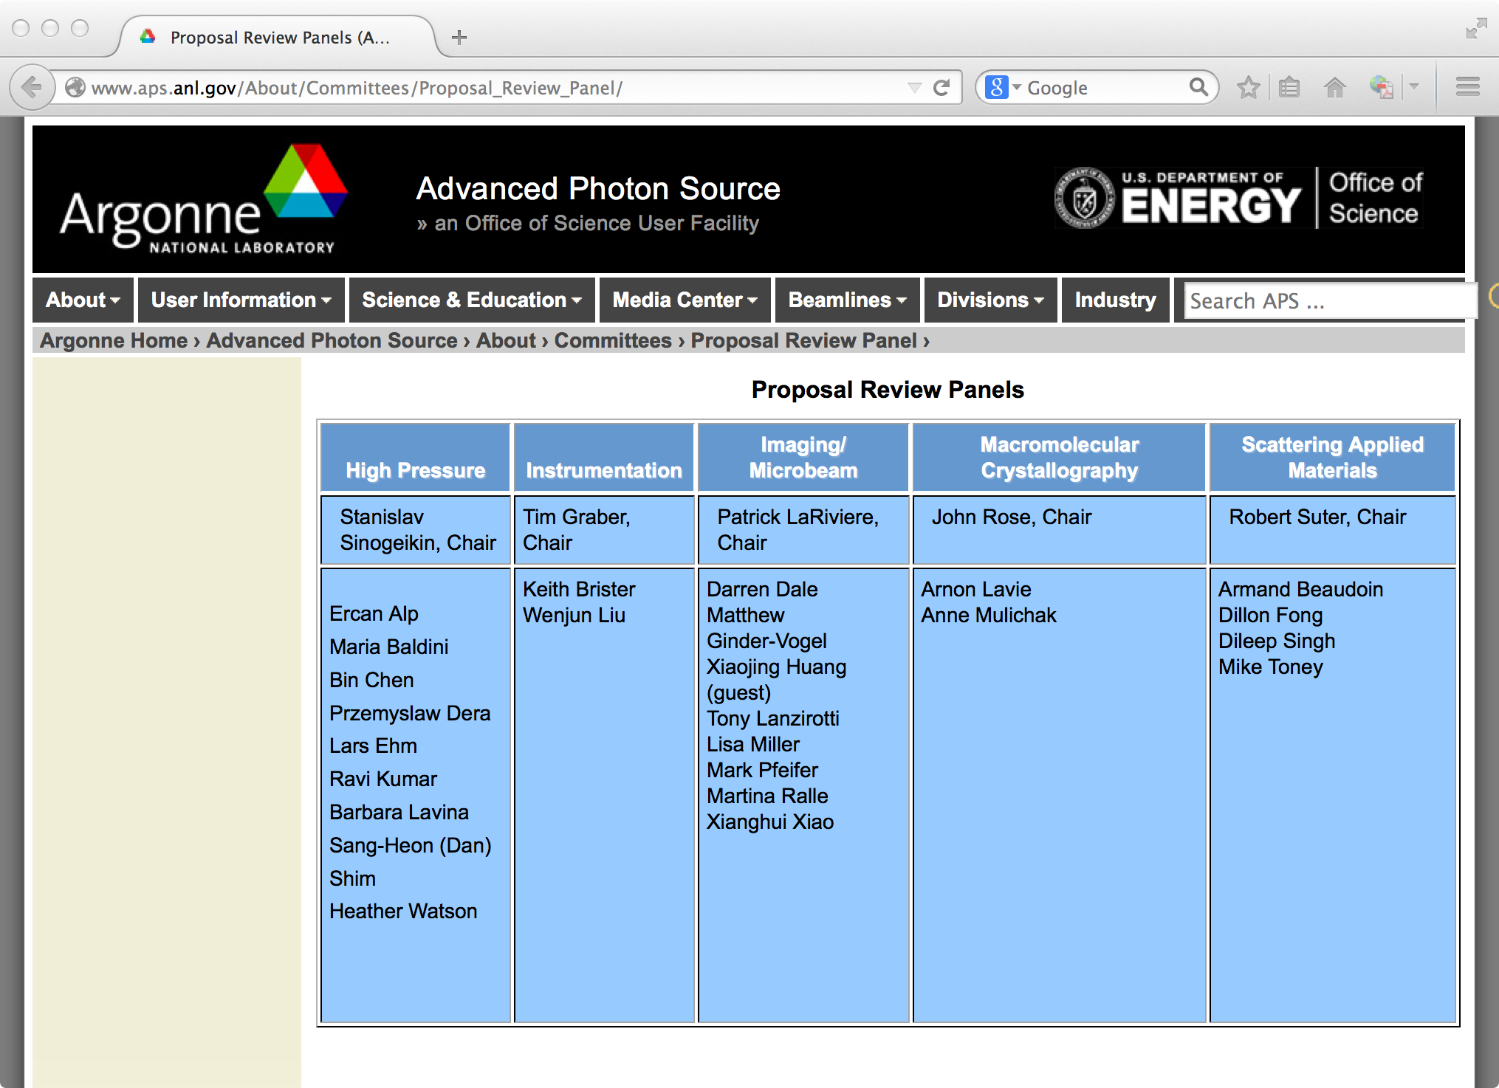
Pick appropriate panel
If multiple possibilities - Look at members & Ask staff

Slide 31
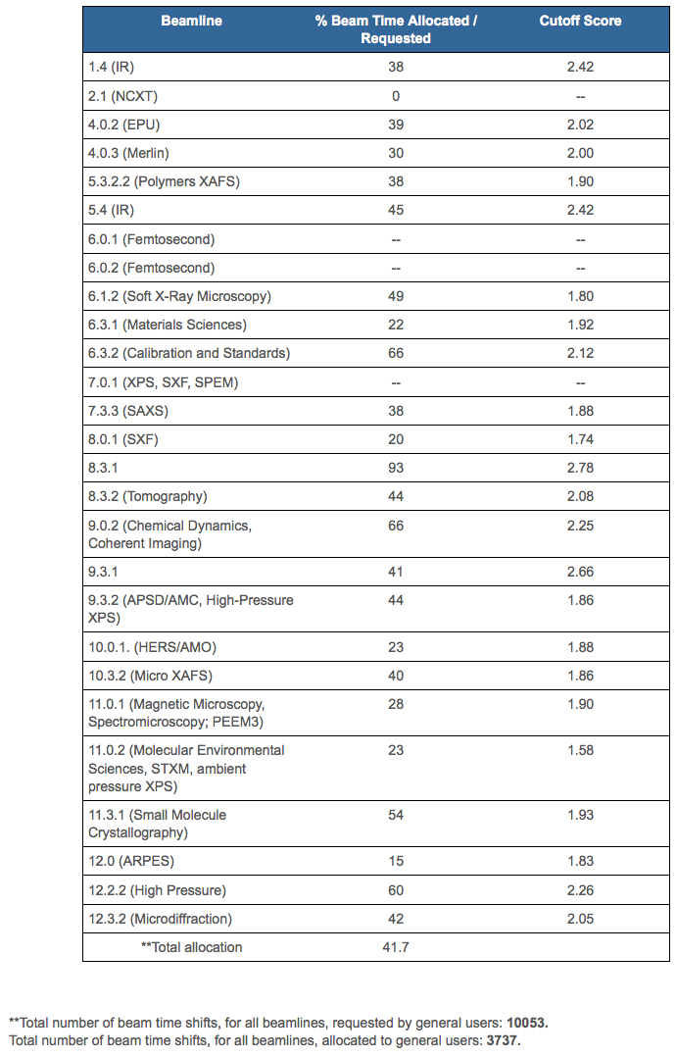
ALS provides cutoff scores – Helps you know what to expect
Beamline cutoff scores
➔
easier
➔
harder
➔
easier
➔
easier
➔
harder
➔
harder

Slide 32
Tips
Give a concise explanation of this specific proposal
Provide background on importance (i.e., “bigger picture”)
State clearly and exactly what you are going to measure and why.
Reviewer want so assess likelihood of success.
Include relevant details to experiment but do not get too verbose
Reviewer needs to judge not only scientific importance, but also if the experiment is feasible and if you are asking for the right instrument.
If you are a first time user, talk to the local contact/instrument scientist.
Find out about details of the instrument, typical measuring times…
Over-subscription rate? Can a less popular instrument do the same measurements?
Send them the proposal ahead of time and ask for advice. Collaborate?
If you have previous results from other experiments include them!
Home, other institution, previous experiment.
Sample characterization.
Take advantage of proposal ageing. Plan ahead!

Slide 33
Several common pitfalls
Proposer assumes committee is familiar with their specialty.
Proposer writes large general vague proposal asking for multiple weeks of time. Better to write a shorter proposal with a well defined objective. Be realistic with beam time request.
Proposer submits 2 (or more) similar proposals for related materials thinking that multiple proposals increases chances.
Proposal deadline (for next cycle) is before scheduled beam time this cycle.
Common Reviewer comments:
“Proposers could improve their score by including more experimental details, attaching previous results and expanding on the purpose and importance of the research.”
“Hasn't the proposed research been published previously?”
“We do not feel that granting 20 shifts/cycle for 2 years is consistent with the history of publication of this work.”
“Proposer should perform initial characterization with lab sources or TEM.”

Slide 34
After submission
Allow time for review and revisions
Expect feedback several weeks from the call close
Be ready to schedule experiment if approved
Identify participating team members
Respond to facility access approval information
Facilitate execution of user agreements
Complete required training
Confirm sample availability and description and laboratory needs
Consider reviewer comments if not approved and plan to resubmit this proposal or a new proposal in the next call. Opportunities (# of facilities and beamlines/facility) continue to grow.

Slide 35
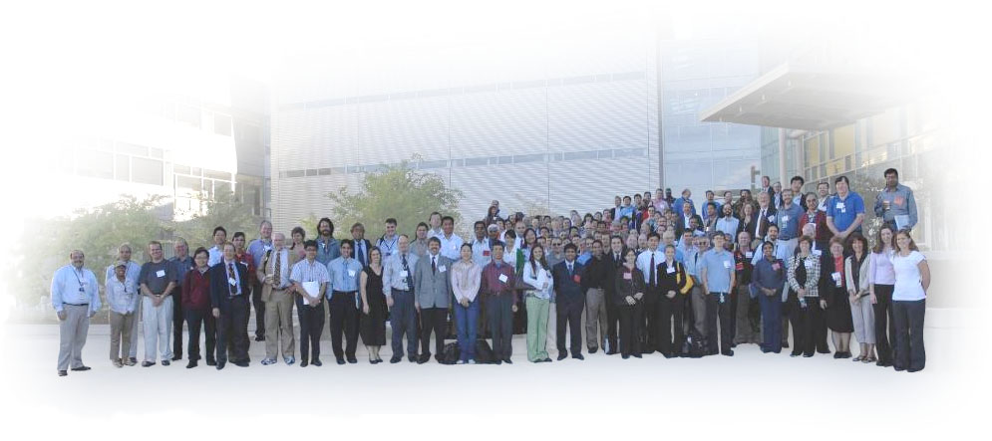
Join SNS HFIR User Group (SHUG)
Chartered 1998
Open to individuals interested in using SNS and HFIR
Provides input to management on user concerns
Serves as a forum for keeping the user community informed
Acts as an advocacy group for neutron scattering science

Slide 36
ORNL’s Neutron Scattering Facilities HFIR and SNS
Numerous opportunities for collaboration
Become a user
Join SNS/HFIR User Group (SHUG)
Have your friends and colleagues apply to the National School on Neutron and X-ray Scattering
Attend workshops and conferences
Seek EPSCoR grants http://www.nsf.gov/div/index.jsp?org=EPSC and http://www.sc.doe.gov/BES/EPSCoR/about.html
Promote ORISE internships, fellowships, and research participation programs http://orise.orau.gov/sep/index.htm
Bring student groups to ORNL
Invite ORNL scientists to your campus

Slide 37
Seek EPSCoR Grants
EPSCoR State Institutions are eligible for grants to support research
http://www.nsf.gov/div/index.jsp?org=EPSC
http://www.sc.doe.gov/BES/EPSCoR/about.html
Travel support for users from UT-ORNL Joint Institute for Neutron Sciences (JINS). Contact Takeshi Egami at egami@utk.edu

Slide 38
Office of Science Early Career Research Program (for your future consideration – very good for tenure)
Purpose: To support individual research programs of outstanding scientists early in their careers and to stimulate research careers in the disciplines supported by the Office of Science
Eligibility: Within 10 years of receiving a Ph.D., either untenured academic assistant professors on the tenure track or full-time DOE national lab employees (no postdocs)
Award Size:
University grants $150,000 per year for 5 years to cover summer salary and expenses
National lab awards $500,000 per year for five years to cover full salary and expenses
FY 2010 (Inaugural Year) Results:
69 awards funded via the American Recovery and Reinvestment Act
1,750 proposals peer reviewed to select the awardees
47 university grants and 22 DOE national laboratory awards
Awardees are from 44 separate institutions in 20 states
FY 2014:
35 scientists funded (750 applications), 17 National Labs + 18 Universities
Usually pre-application in Sept, Full applications from those encouraged in November.
http://science.energy.gov/early-career/

Slide 39
Scientific User Facilities – (mostly from Pat Dehmer presentation)
Under construction at the time of the evaluation
Spallation Neutron Source
5 Nanoscale Science Research Centers
SSRL (SPEAR3) upgrade
Facilities underway since the evaluation
Transmission Electron Aberration Corrected Microscope
Linac Coherent Light Source
National Synchrotron Light Source - II
Facilities rated longer-term priority at the time of the evaluation
Spallation Neutron Source power upgrade (CD-0 signed)
---------------------------------------------------------------------------------
Spallation Neutron Source 2nd target station
Advanced Light Source upgrade
Advanced Photon Source upgrade
What’s next in our planning?
Ongoing BESAC Future Science Needs and Opportunities Evaluations
operating
operating
operating
operating
operating
commissioning
Restarted three times!
BESAC evaluation February 2003
Report released late 2003
Available at
www.science.energy.gov/bes/archives/plans/FFS_10NOV03.pdf

Slide 40
Next Generation Light Source is being Debated BESAC = Basic Energy Sciences Advisory Committee
http://science.energy.gov/bes/besac/reports/
Next Big Machine – Soft XFEL?
Free Electron Laser (FEL)?
“Ultimate” storage ring?
Energy Recovery Linac (ERL)?
APS/ESRF Upgrades
MAX IV Low-emittance lattice
Continue research development?
Impact of large Scientific User Facilities has grown significantly in the past ~25 yrs. They now represent ~55% of BES budget and growth will likely continue.
They enable powerful new techniques, but researchers (you) have to do the science.
Need good science, progress also involves enthusiasm, politics, luck & perseverance.
Impact of large Scientific User Facilities has grown significantly in the past ~25 yrs. They now represent ~55% of BES budget and growth will likely continue.
They enable powerful new techniques, but researchers (you) have to do the science.

