Slide 1
Proposal Writing: Hints for maximizing your chances for getting beam time
John Budai
Materials Science and Technology Division
Oak Ridge National Laboratory
Bryan Chakoumakos
Neutron Scattering Sciences Division
Oak Ridge National Laboratory
Neutron X-ray Scattering School
June 25, 2010

Slide 2
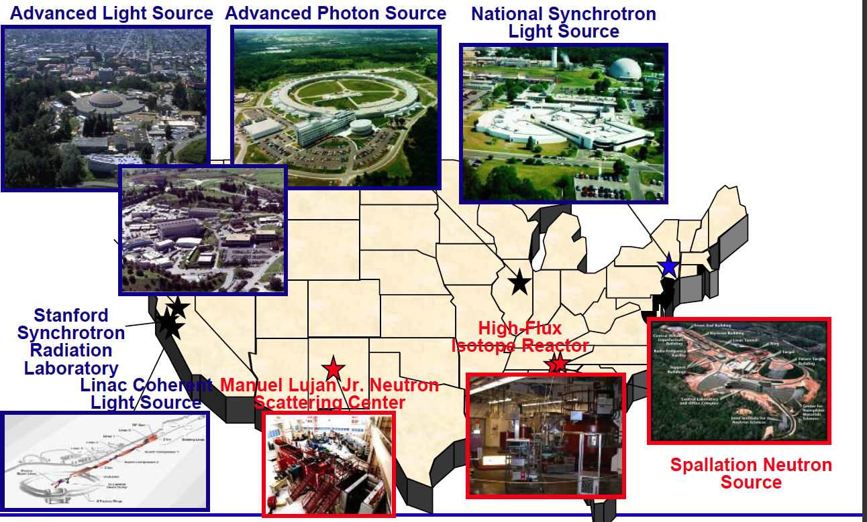
DOE X-ray and Neutron Sources
➔NSLS-II
CHESS
NIST
Also
5 DOE Nanoscience Centers (BNL, SNL/LANL, ORNL, ANL, LBNL)
3 DOE Electron Microscopy Centers (ANL, LBNL, ORNL)

Slide 3
BES Scientific User Facilities - (from Pat Dehmer presentation 2007)
Electron Microscopy Center for Materials Research
Advanced Photon Source
Materials Preparation Center
Advanced Light Source
Center for Nanoscale Materials
Intense Pulsed Neutron Source
Center for Functional Nanomaterials
National Center for Electron Microscopy
National Synchrotron Light Source
Molecular
Foundry
National Synchrotron Light Source-II
Stanford Synchrotron Radiation Lab
Spallation Neutron Source
Linac Coherent Light Source
Center for Nanophase Materials Sciences
Combustion Research Facility
Los Alamos Neutron Science Center
Shared Research Equipment Program
Center for Integrated Nanotechnologies
High-Flux Isotope Reactor
Pulse Radiolysis Facility
4 Synchrotron Radiation Light Sources
Linac Coherent Light Source
4 Neutron Sources
3 Electron Beam Microcharacterization Centers
5 Nanoscale Science Research Centers
3 Special Purpose Centers

Slide 4
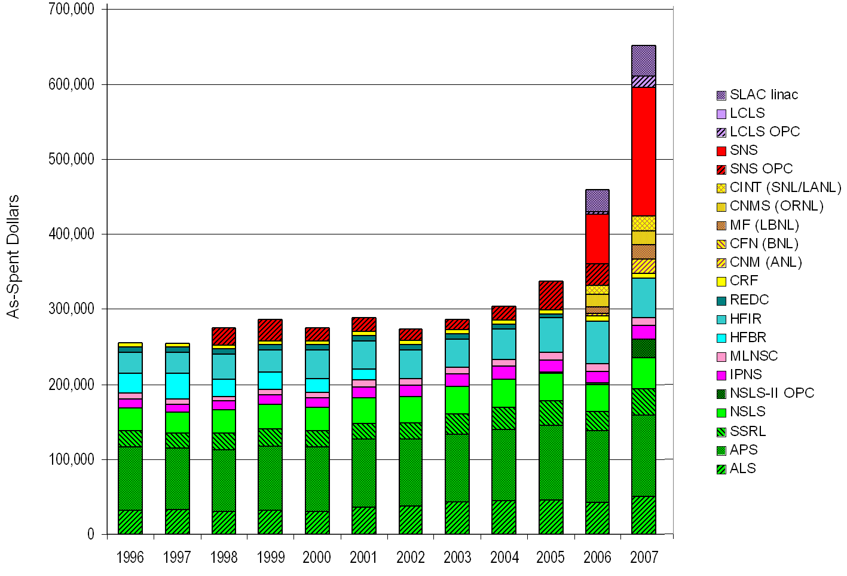
Operating Budgets for the BES Scientific User Facilities
(K$)
4

Slide 5
ORNL Home to 12 User Facilities
Building Technologies Research and Integration Center
Center for Nanophase Materials Sciences (CNMS)
Center for Structural Molecular Biology (Bio-SANS)
High Flux Isotope Reactor (HFIR) User Facilities
High Temperature Materials Laboratory (HTML)
Holifield Radioactive Ion Beam User Facility (HRIBF)
National Center for Computational Sciences
National Transportation Research Center (NTRC)
Oak Ridge Electron Linear Accelerator (ORELA)
Safeguards Laboratory (SL)
Shared Research Equipment (SHaRE) User Facility
Spallation Neutron Source Experimental Facility (SNS)

Slide 6
Basics of the facility proposal systems
All the DOE (NIST & NSF) neutron and x-ray sources offer access to beam time through an experimental proposal system. “General Users (GU)”.
Proposal submission is done through a web-based application. When and how often proposals are submitted varies by facility.
APS and NSLS three times (“cycles”) per year.
SNS/HFIR and ALS two times per year
All proposals are peer-reviewed and rated, and beam time is allocated using the scores of these reviews. Once time has been allocated, the beamline staff schedule the proposals.

Slide 7
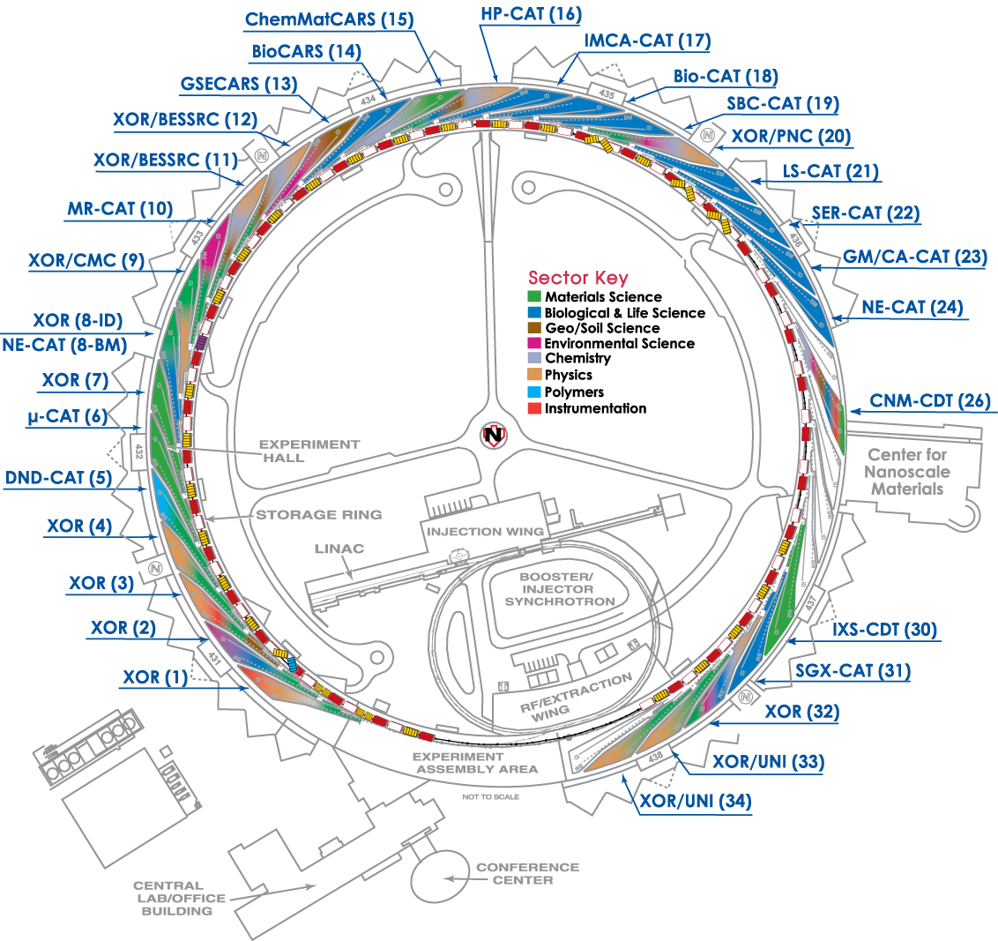
Amount of general user time available
25%
APS/NSLS/SSRL/ALS
All beamlines offer GU beam time.
Most DOE/NSF funded beamlines provide 80-100% of their time to general users.
SNS/HFIR
Amount varies by instrument.
~75% of time will be for general users.
25%
40%
25%

Slide 8
Upcoming Proposal Deadlines:
X-ray sources Deadlines
(http://www.lightsources.org/cms/?pid=1000336) APS July 9, 2010
ALS July 15, 2010
NSLS Sept 30, 2010
Neutron sources HFIR/SNS Aug 25, 2010
LANSCE July 26, 2010
NIST-NCNR Aug 17, 2010
(10.5 month shutdown commences in April)
Note at most facilities these are hard deadlines:
APS always at Friday midnight (12:05 → next cycle)

Slide 9
Users Get Started with Assistance of the Instrument Scientists
Study instrument web pages
Contact an Instrument Scientist to discuss your research
What is the research problem?
Which instrument(s) are appropriate?
How mature is the research project (risk, size)?
What is the material – sample composition, form, size, availability?
What are the experimental conditions (temperature, pressure, magnetic field, etc)?
What will be measured?
Probability of success? Impact? Significance?
How will results be presented and to whom?
What is the timeline?

Slide 10
Instrument Scientists Assist First-time and Returning Users
Provide technical advice, guidance, and assistance
Instrument options
Sample and experiment preparation
Number of experiment days
Logistics (scheduling, transporting and storing samples)
Proposal preparation tips and assistance
Experiment team members
Data analysis
Publication considerations

Slide 11
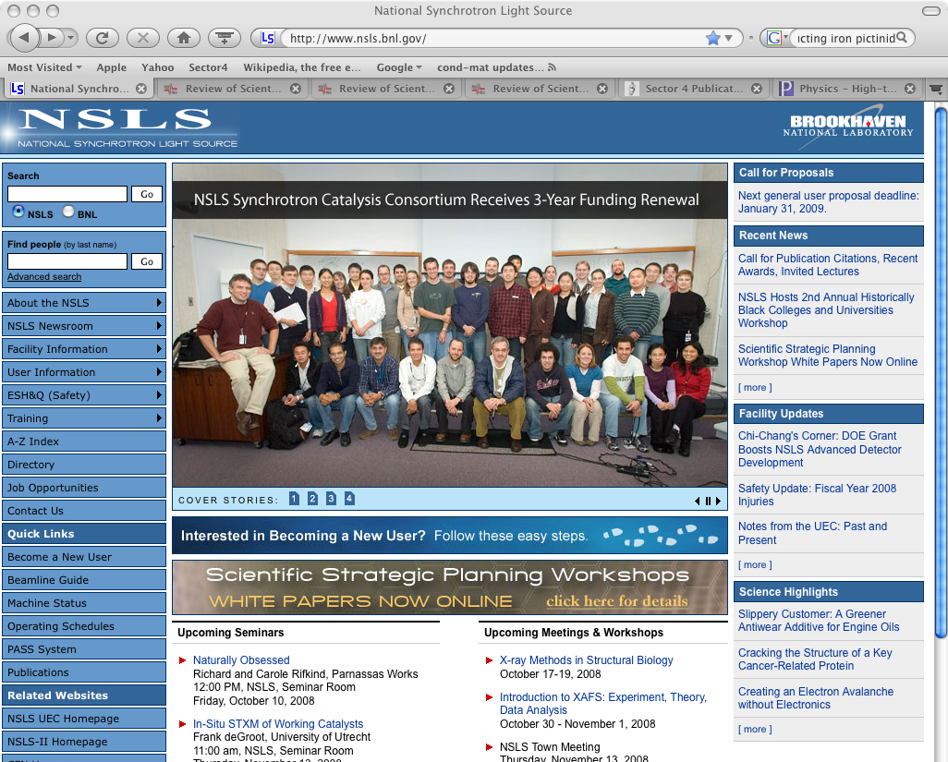
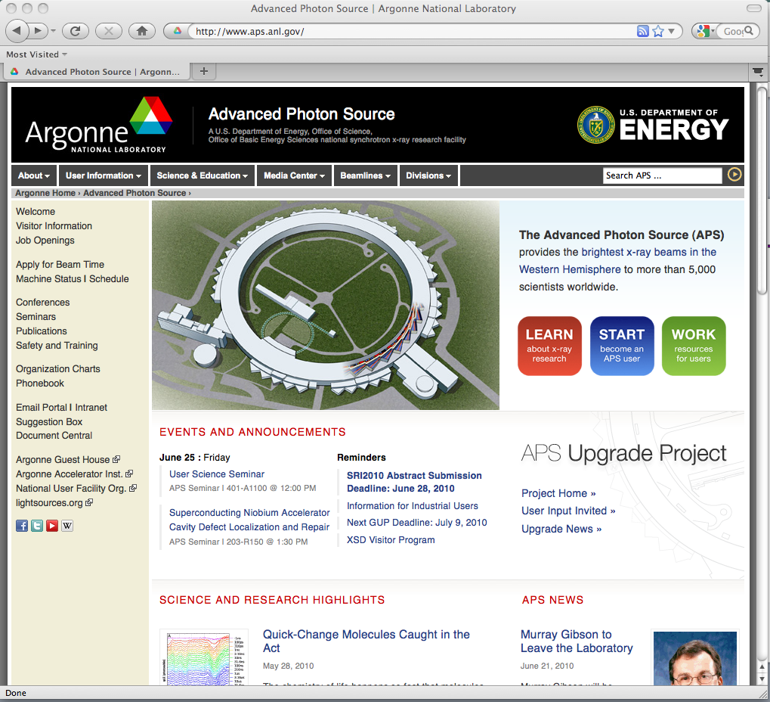
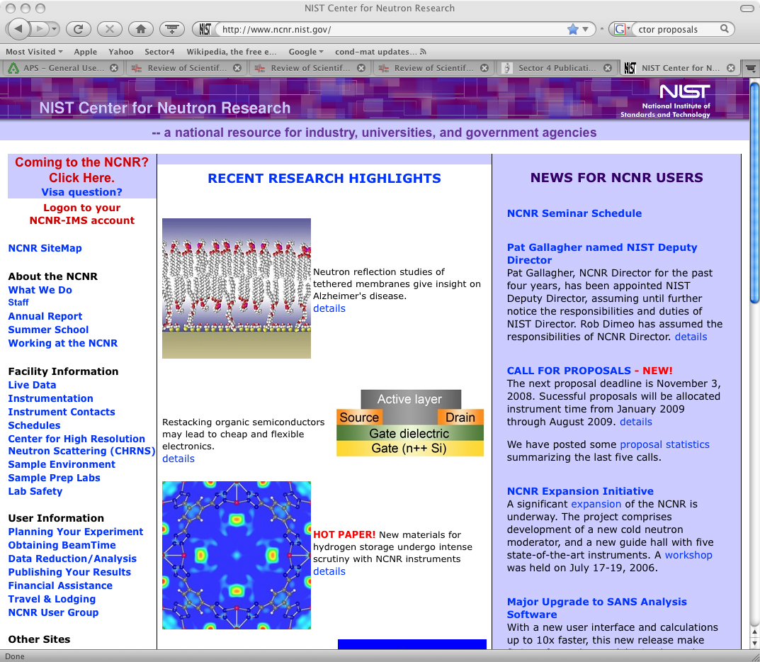
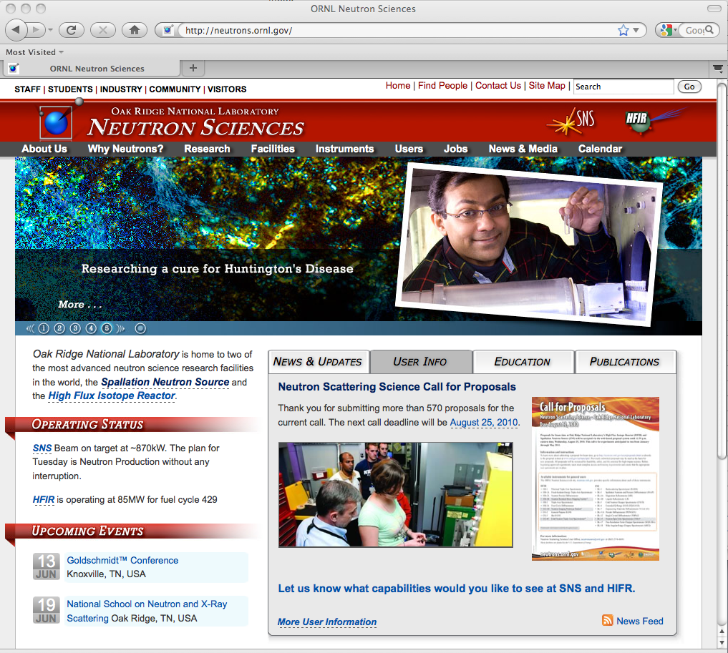
Submitting a proposal
Facilities have link on home page
NSLS
APS
NIST
SNS
HFIR

Slide 12
Different types of proposals allow facility flexibility
Each facility has particular systems or proposal modes:
APS
GUP - General User Proposal. A "rapid-access beamtime request" against a submitted proposal can be considered for any unallocated general user time during the current run.
PUP – Partner User Proposal - Groups whose work involves a greater degree of collaboration with the APS. (e.g. major new instrumentation).
11-BM User Program – Accepts user proposals for both on-site experiments and for the rapid-access mail-in service (~60% of user beamtime reserved for mail-in samples). Very easy – they send you capillary tubes. This capability is not obvious on the GUP website.
CHESS - Cornell
Express-Mode proposals are for a single visit of limited duration to CHESS to perform a straight-forward experiment. Express-Mode proposals undergo a rapid on-line review process to enable users to quickly gain access to beam time.
Feasibility Study proposals are to test an idea or procedure at one of the CHESS stations.
NSLS
MAIL-IN EXAFS Service at Beamline X18B Prepare your samples according to their thickness guide and mount on standard holder. Transmission mode. Charges are ~$100/hr.

Slide 13
Different types of proposals allow facility flexibility – cont.
NIST NCNR
MAIL-IN SAMPLES FOR POWDER DIFFRACTION We will accept proposals for experiments on the BT1 powder diffractometer on ”mail-in” samples. That is, samples may be mailed to NCNR staff, who will execute the data collection.
QUICK ACCESS PROPOSALS If a user feels that beam time is required very soon to carry out important measurements that cannot be delayed, a proposal may be submitted requesting expedited access. The proposal will be reviewed by the BTAC, and held to a substantially higher standard than regular proposals.
Crystallography is somewhat a separate, self-contained community
A separate proposal system at APS.
Highly automated for mail-in measurements.
Beamtime relatively available.

Slide 14
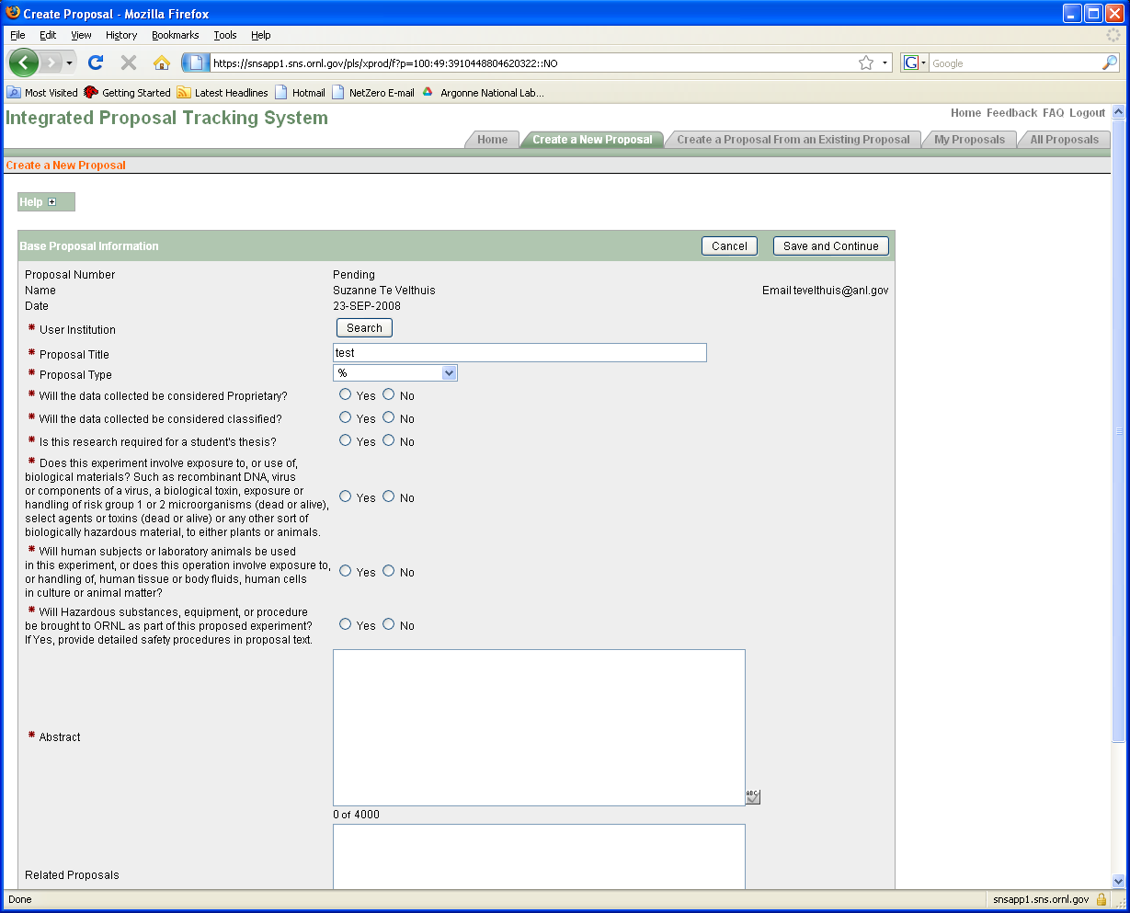
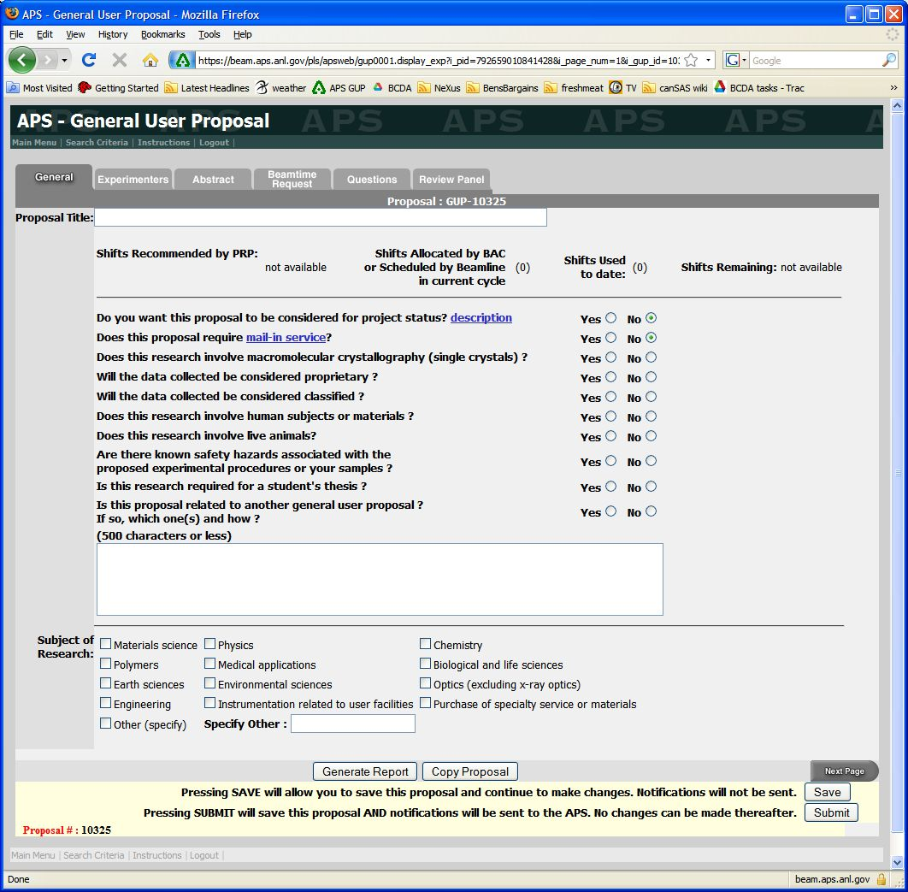
Proposal forms at SNS and APS
SNS/HFIR
APS
Each proposal system will ask very similar questions

Slide 15
Questions asked
Proposal Title
General Info (Title, Experimenters, Funding source, etc.)
Abstract - What is the scientific importance of the proposed research?
Why do you need the facility to do this research?
Neutron vs. X-rays
Why do you need an insertion device beamline instead of a bending magnet?
Spallation source vs. reactor source
Hard X-rays vs. Soft X-rays
Why do you need the beam line ( and/or instrument)?
Particular technique or sample environment
What previous experience / results do you have?
Describe the proposed experiment(s), including samples and procedures.
Justification of the amount of time requested.

Slide 16
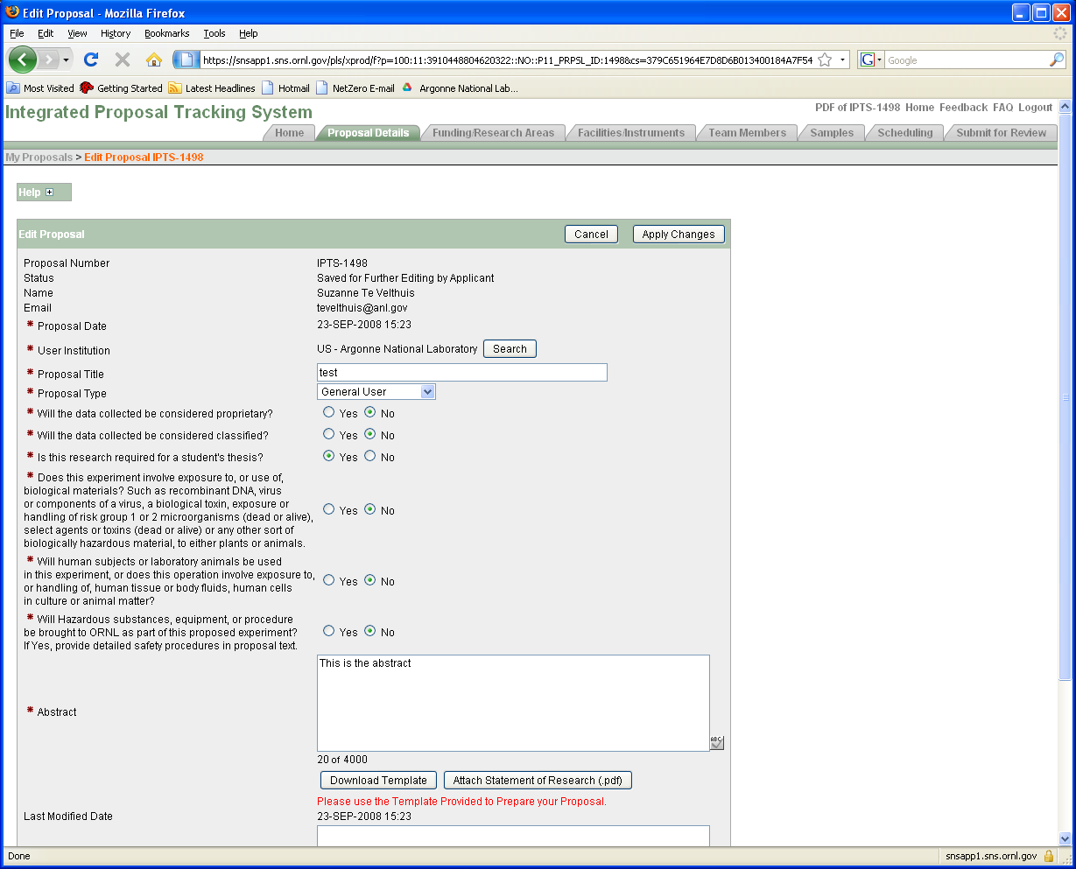
General Information

Slide 17
Proposal: General information
Pick a good title. Specific and to the point is better than spectacular and vague.
Good: “XAS study of Fe valence in CaFe2As2 under pressure ”
Bad: “Understanding superconductivity in iron pnictides”
Is it thesis related? Is there a deadline?
Will push your proposal up if scores are close
Fill in the abstract. Do not just upload a PDF document!
More work for reviewer.
Do upload a publication from previous work (mention previous proposal).
Shows you made good use of beam time.
Do not upload a 20 pages of supplemental information (figures often help, couple of plots with text OK)

Slide 18
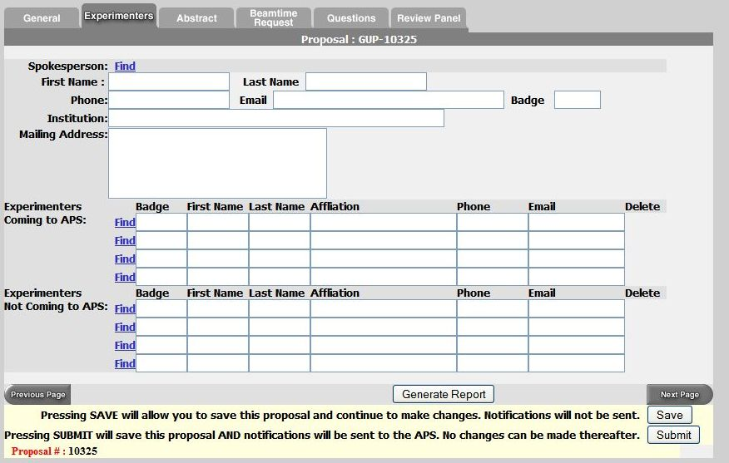
Proposal: Experimenters page
Use the “find” feature
List everyone involved in experiment

Slide 19
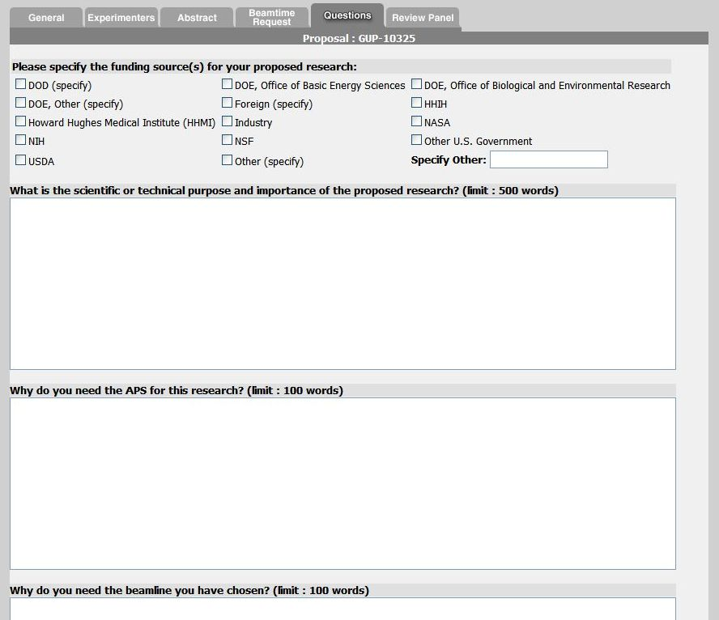
Experiment Description
Note guidance. Don’t write one sentence or 1000 words.

Slide 20
Experimental Details
Give background information why it is important.
Science at facilities is very diverse. Reviewer is not necessarily an expert on your subject.
@ APS each committee gets ~60 proposals each cycle (~700 total/cycle)
Clearly state what you want to measure and how
Give details. Temperature range, X-ray Energy, Sample geometry
What sample characterization has been done already? (XRD, SEM, etc.)
Reviewer needs to judge if experiment is feasible
Does x-ray energy match laser penetration depth
% of dilute atoms OK for fluorescence measurements
Why use x-rays or neutrons?
Neutron vs. X-rays
TEM, Mössbauer, Laser Raman, etc.
Justify the amount of beam time requested (ask instrument scientist!)

Slide 21
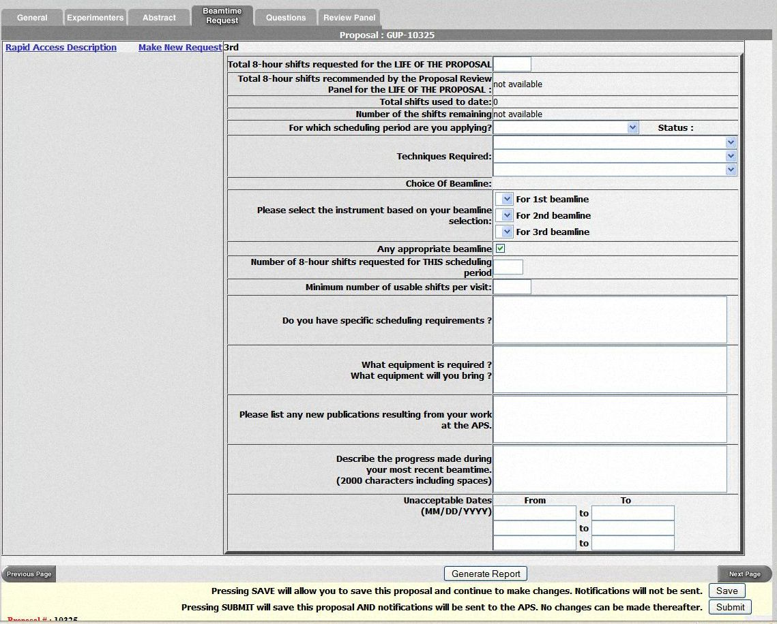
Beamtime Request
Proposals are valid for two years, but need to put in beam time request each cycle.
Chose multiple beamlines.
SAXS (12-ID, 5-ID, 15-ID)
XAFS (20-BM, 10-ID,12-BM)
General Diffraction
Don’t list only one week that you can come. Holidays?
Special sample environment / detectors will place more constraints on schedule.
GE amorphous Si detector
Magnet
….

Slide 22
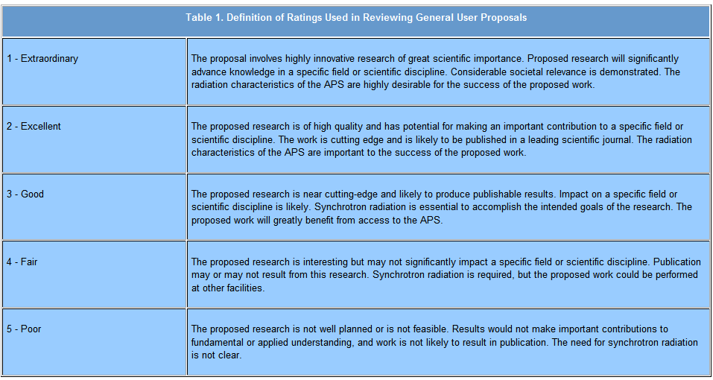
Ratings for APS Proposals
APS proposals are rated on a scale from 1 to 5
Average score is ~2.2
Cut off score for receiving beam time varies by beamline (1.5 - 2.2)
Proposal “ageing” (score improves by 0.2 each cycle it does not receive time). This is needed for getting time at some oversubscribed beamlines, so long-term planning is needed.

Slide 23
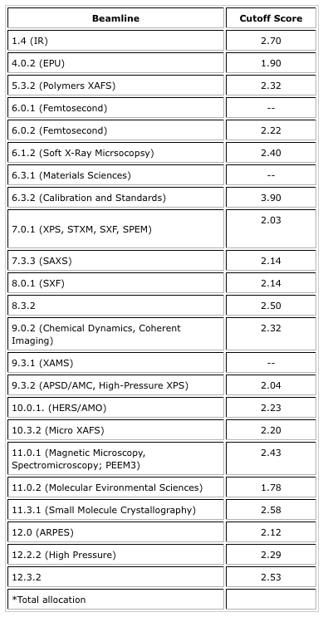
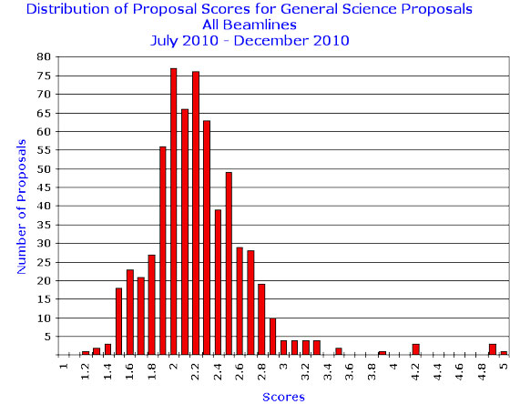
ALS provides cutoff scores – Helps you know what to expect
➔
easier
➔
easier
➔
harder

Slide 24
Tips
Give a concise explanation of this specific proposal
Provide background on importance (i.e., “bigger picture”)
State clearly and exactly what you are going to measure and why.
Reviewer want so assess likelihood of success.
Include relevant details to experiment but do not get too verbose
Reviewer needs to judge not only scientific importance, but also if the experiment is feasible and if you are asking for the right instrument.
If you are a first time user, talk to the local contact/instrument scientist.
Find out about details of the instrument, typical measuring times…
Over-subscription rate? Can a less popular instrument do the same measurements?
Send them the proposal ahead of time and ask for advice. Collaborate?
If you have previous results from other experiments include them!
Home, other institution, previous experiment.
Sample characterization.
Take advantage of proposal ageing. Plan ahead!

Slide 25
Several common pitfalls
Proposer assumes committee is familiar with their specialty.
Proposer writes large general proposal asking for multiple weeks of time. Better to write a shorter proposal with a well defined objective. Be realistic with beam time request.
Proposal deadline (for next cycle) is before scheduled beam time this cycle.
Common Reviewer comments:
“Proposers could improve their score by including more experimental details, attaching previous results and expanding on the purpose and importance of the research.”
“Hasn't the proposed research been published previously?”
“We do not feel that granting 20 shifts/cycle for 2 years is consistent with the history of publication of this work.”
“Proposer should perform initial characterization with lab sources or TEM.”

Slide 26
After submission
Allow time for review and revisions
Expect feedback several weeks from the call close
Be ready to schedule experiment if approved
Identify participating team members
Respond to facility access approval information
Facilitate execution of user agreements
Complete required training
Confirm sample availability and description and laboratory needs
Consider reviewer comments if not approved and plan to resubmit this proposal or a new proposal in the next call. Opportunities (# of facilities and beamlines/facility) continue to grow.

Slide 27
The 6 Federally Funded U.S. Light Sources Hosted 9,159 Users in FY 2005
9,000
SRC
8,000
SRC
CHESS
3%
4%
7,000
6,000
APS
NSLS
5,000
25%
Number of Users
APS
4,000
CHESS
ALS
35%
SSRL
3,000
SSRL
ALS
11%
2,000
22%
1,000
NSLS
-
'82
'83
'84
'85
'86
'87
'88
'89
'90
'91
'92
'93
'94
'95
'96
'97
'98
'99
'00
'01
'02
'03
'04
'05
FISCAL YEAR
LCLS operating
NSLS-II under construction.
The size and demographics of the user community have changed dramatically since the 1980s when only a few hundred intrepid users visited the synchrotron light sources each year. Here, “user” is a researcher who proposes and conducts peer-reviewed experiments at a scientific facility or conducts experiments at the facility remotely. A user does not include individuals who only send samples to be analyzed, pay to have services performed, or visit the facility for tours or educational purposes. Users also do not include researchers who collaborate on the proposal or subsequent research paper but do not conduct experiments at the facility. For annual totals, an individual is counted as 1 user at a particular facility no matter how often or how long the researcher conducts experiments at the facility during the year.

Slide 28
Neutron User Community and Research Opportunities Growing

Slide 29
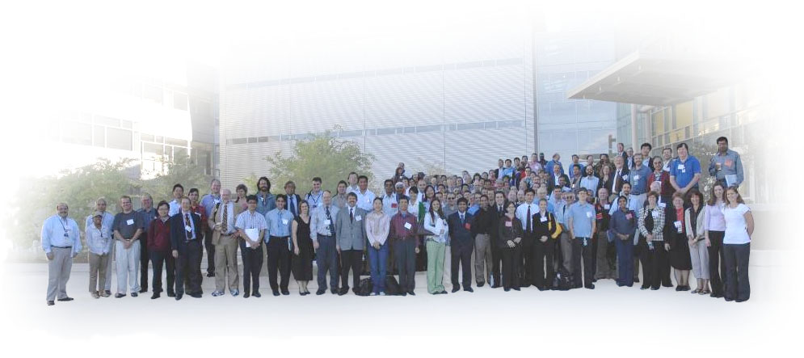
Join SNS HFIR User Group (SHUG)
Chartered 1998
Open to individuals interested in using SNS and HFIR
Provides input to management on user concerns
Serves as a forum for keeping the user community informed
Acts as an advocacy group for neutron scattering science

Slide 30
ORNL’s Neutron Scattering Facilities HFIR and SNS
Numerous opportunities for collaboration
Become a user
Join SNS/HFIR User Group (SHUG)
Have your friends and colleagues apply to the National School on Neutron and X-ray Scattering
Attend workshops and conferences
Seek EPSCoR grants http://www.nsf.gov/div/index.jsp?org=EPSC and http://www.sc.doe.gov/BES/EPSCoR/about.html
Promote ORISE internships, fellowships, and research participation programs http://orise.orau.gov/sep/index.htm
Bring student groups to ORNL
Invite ORNL scientists to your campus

Slide 31
Seek EPSCoR Grants
EPSCoR State Institutions are eligible for grants to support research
http://www.nsf.gov/div/index.jsp?org=EPSC
http://www.sc.doe.gov/BES/EPSCoR/about.html
Travel support for users from UT-ORNL Joint Institute for Neutron Sciences (JINS). Contact Takeshi Egami at egami@utk.edu

Slide 32
Scientific User Facilities – (mostly from Pat Dehmer presentation 2007)
Under construction at the time of the evaluation
Spallation Neutron Source
5 Nanoscale Science Research Centers
SSRL (SPEAR3) upgrade
Facilities underway since the evaluation
Transmission Electron Aberration Corrected Microscope
Linac Coherent Light Source
National Synchrotron Light Source - II
Facilities rated longer-term priority at the time of the evaluation
Spallation Neutron Source power upgrade (CD-0 signed)
---------------------------------------------------------------------------------
Spallation Neutron Source 2nd target station
Advanced Light Source upgrade
Advanced Photon Source upgrade
What’s next in our planning?
Future Science Needs and Opportunities for Electron Scattering: Next-Generation Instrumentation and Beyond , March 1-2, 2007
BESAC Future Science Needs and Opportunities for Light Sources, 2007
operating
operating
operating
operating
~ operating
construction
CD-0 signed
BESAC evaluation February 2003
Report released late 2003
Available at
www.science.energy.gov/bes/archives/plans/FFS_10NOV03.pdf
Impact of large Scientific User Facilities has grown significantly in the past ~25 yrs. They now represent more than 50% of BES budget and growth will likely continue.
They enable powerful new techniques, but researchers (you) have to do the science.

