Slide 1

ESS
Keeping them up!
… The roll of availability issues in the Engineering of Neutron Scattering instruments.
4-10-2013
Notes:
The impact of instrument reliability on the scientific output and reputation of a research facility will be explored using examples from recent studies carried out at the ESS. The argument is made that the design of long pulse spallation sources coupled with the changing expectations of the user community will raise the importance of instrument reliability, availability and serviceability issues to the same level as that of pure neutronic performance as drivers for the design of the next generation of neutron instruments.

Slide 2
Game plan
Intro
Why
What (we did)
What (we found out)
Some Conclusions

Slide 3
WHY

Slide 4
ESS Instrument suite
Notes:
Why
Because at least on the instrument side this is just the beginning
at the moment this is pretty much all that there is
Concepts and wishes
Why
Because as engineers we know that there are benefits to looking at the big issues early
Beacause this institue will run for 40 years
Because it matters

Slide 5
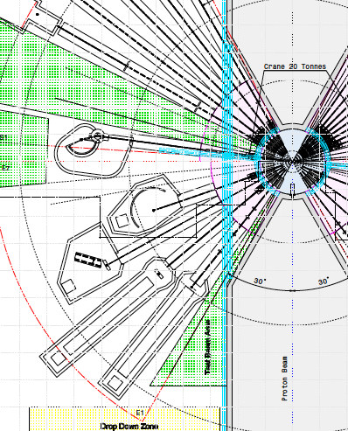
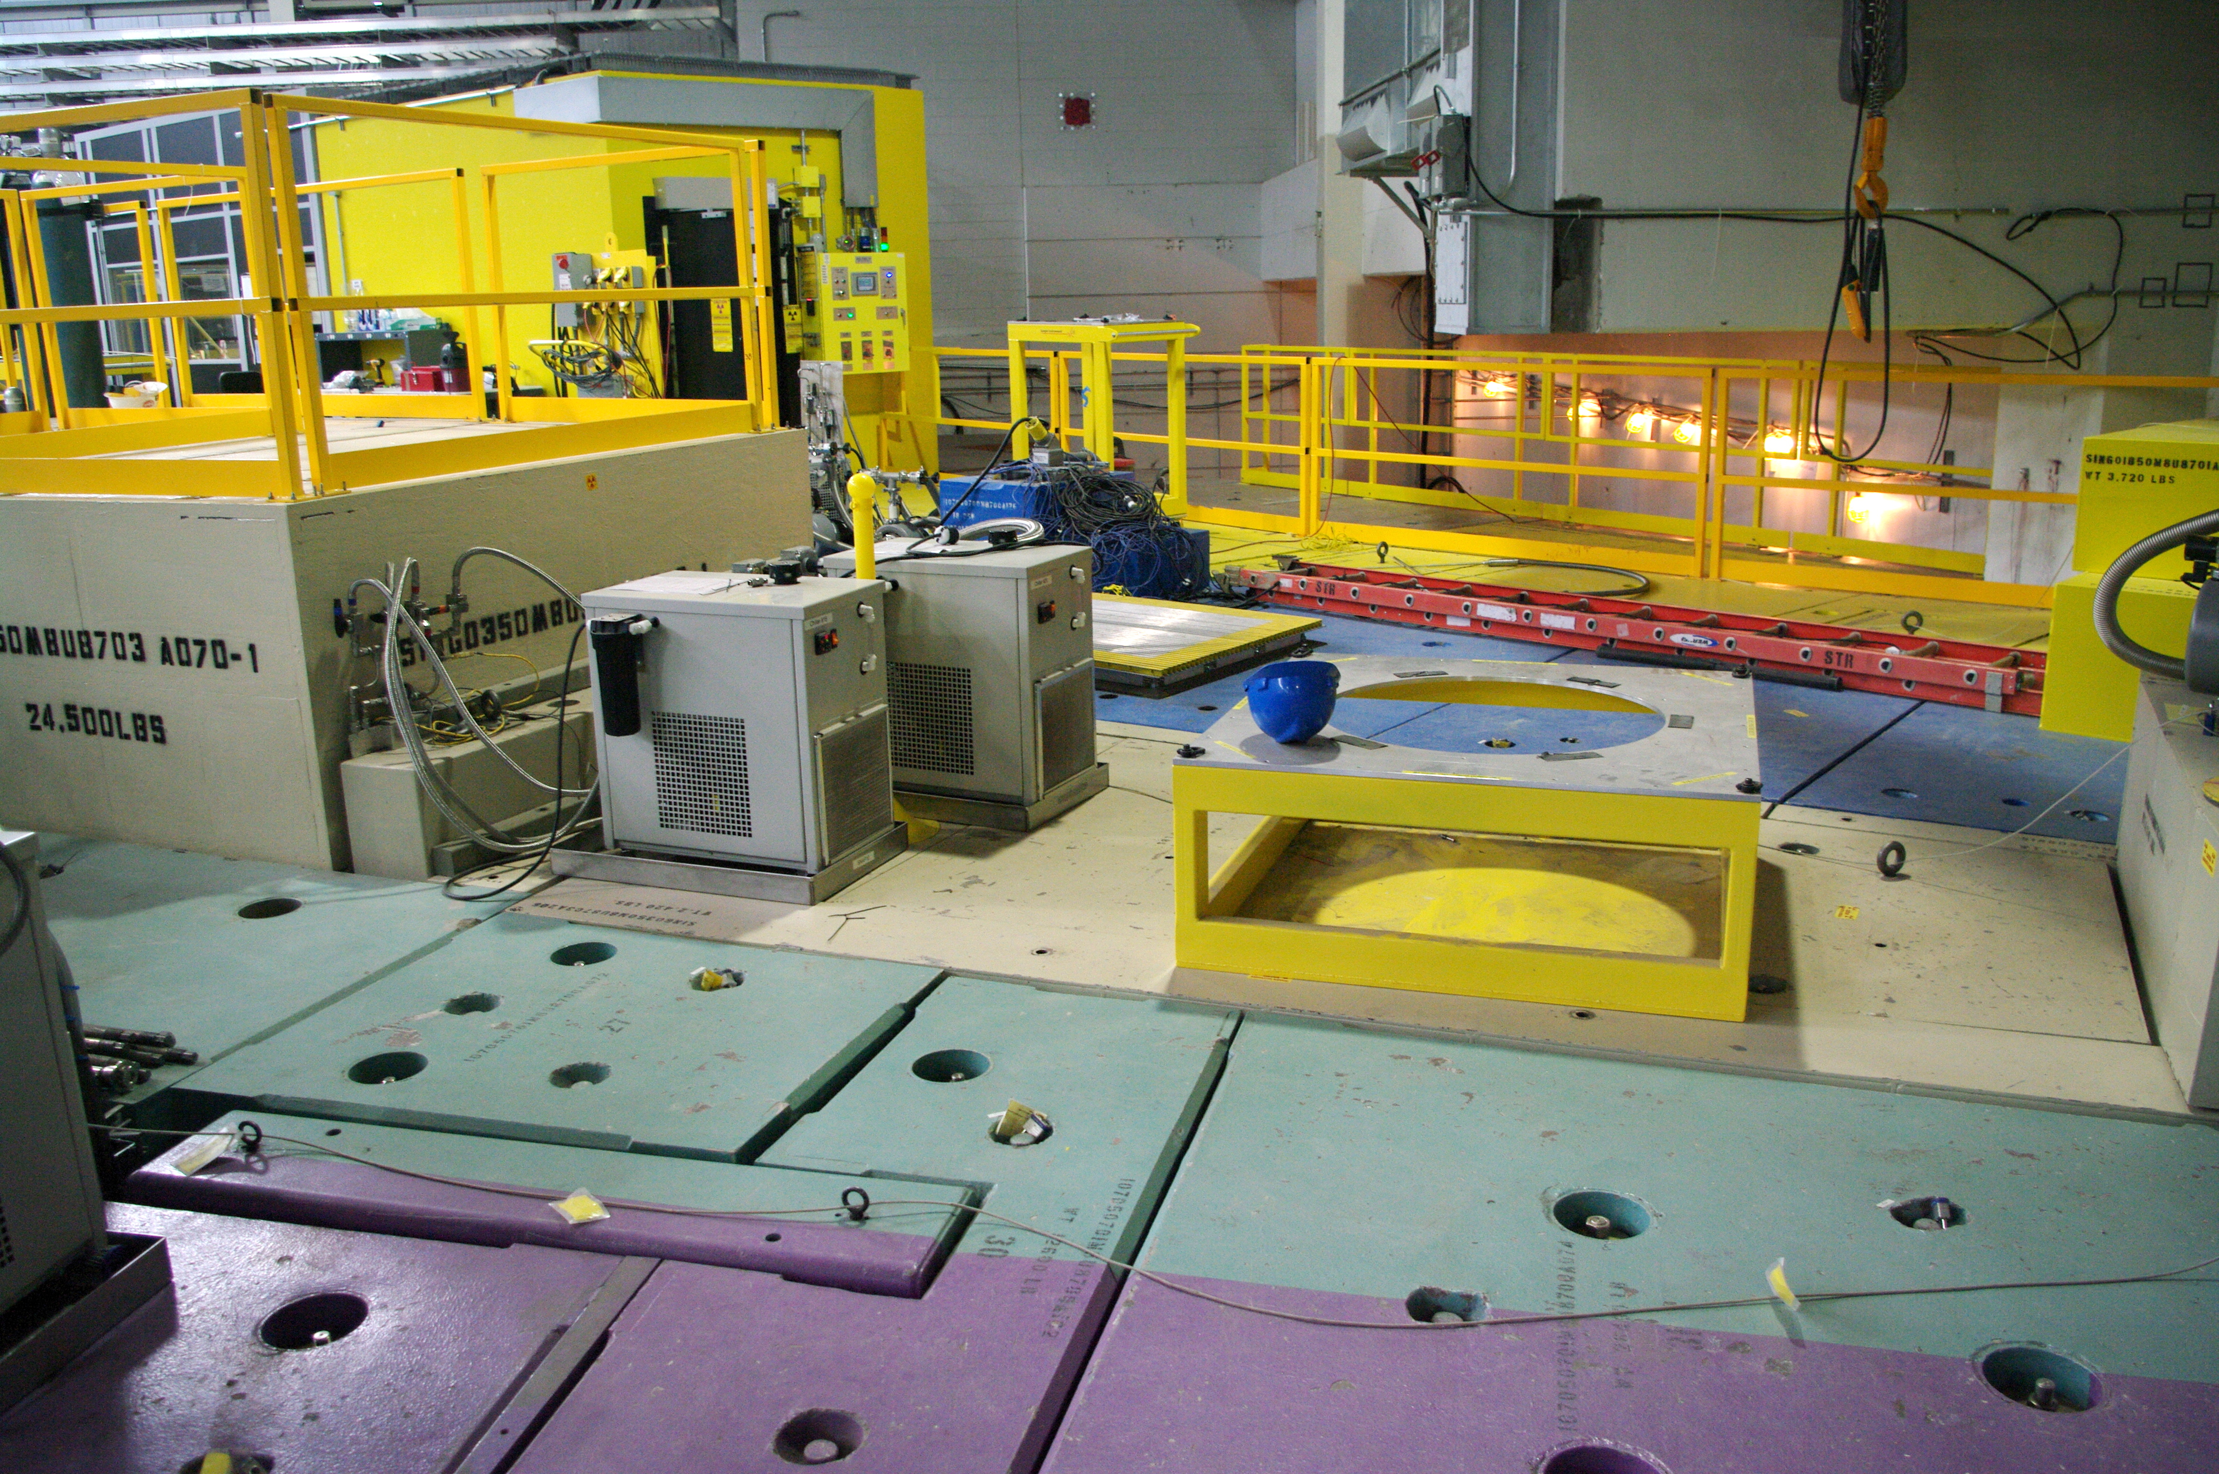
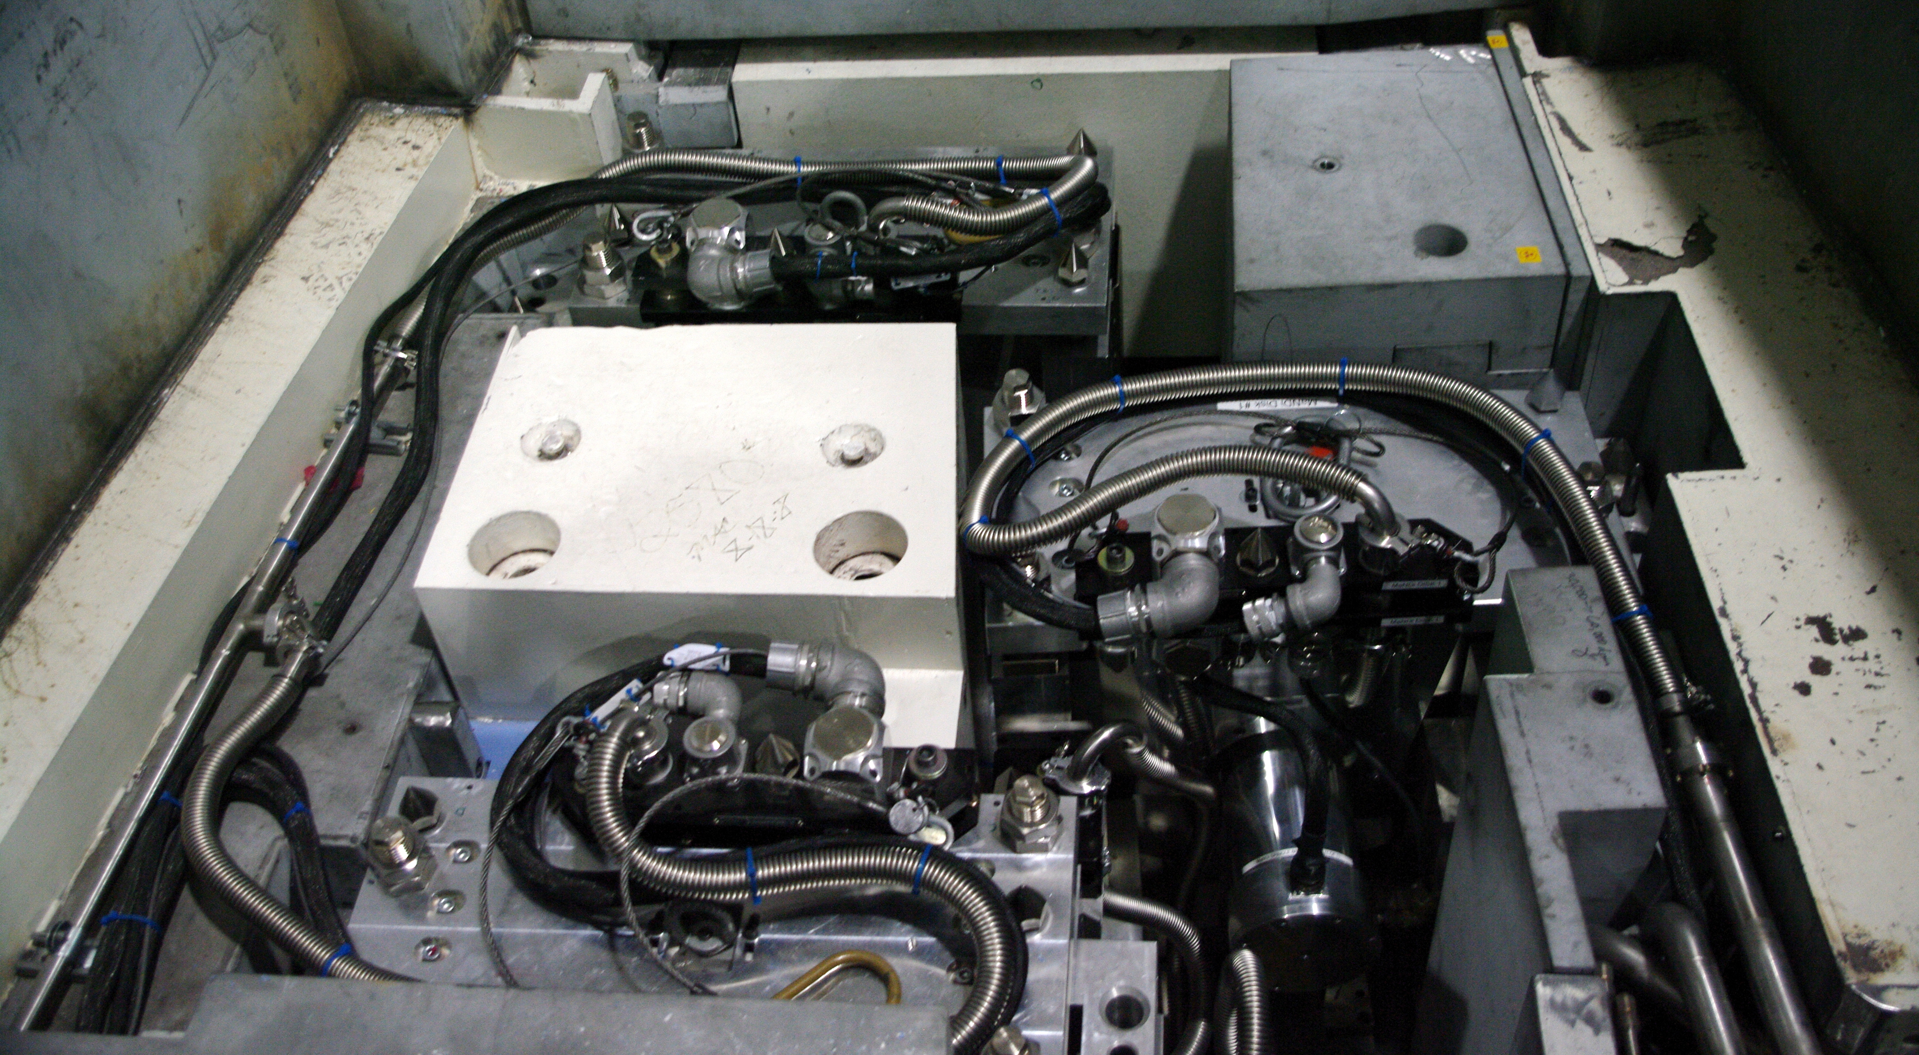
The instrument access conundrum
 | Beam Separation | Beam lines shutdown for access
ISIS | 15 degrees | 3
ESS | 10 degrees | 5 +
 | 7.5 or 5 | 8 (whole sector)
Notes:
Because ESS is going to be a little difference from everything that has gone before
I little more powerful
A few more instruments (in the same space)
And a whole new pulse
And taken together that means a lot more complexity

Slide 6
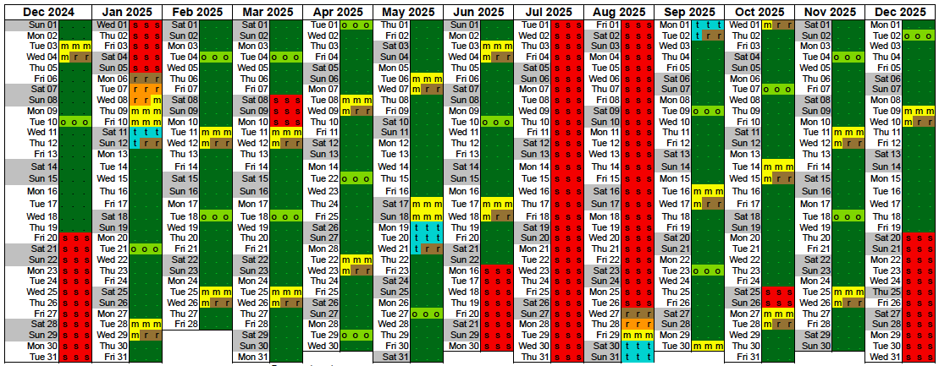
Balancing act
  Aggressive operating schedule
  (225 beam days)
  Complex instruments
  (130+ choppers)
  Availability > 95% (?)
Notes:
We also have new targets
More beam time to users
Instruments with higher performance and yet are easier to use
And require less technical support
In short
Complex problem with conflicting requirements
Need of the facility were not always aligned with those of individual instruments
What we needed is an objective approach to consider the options

Slide 7
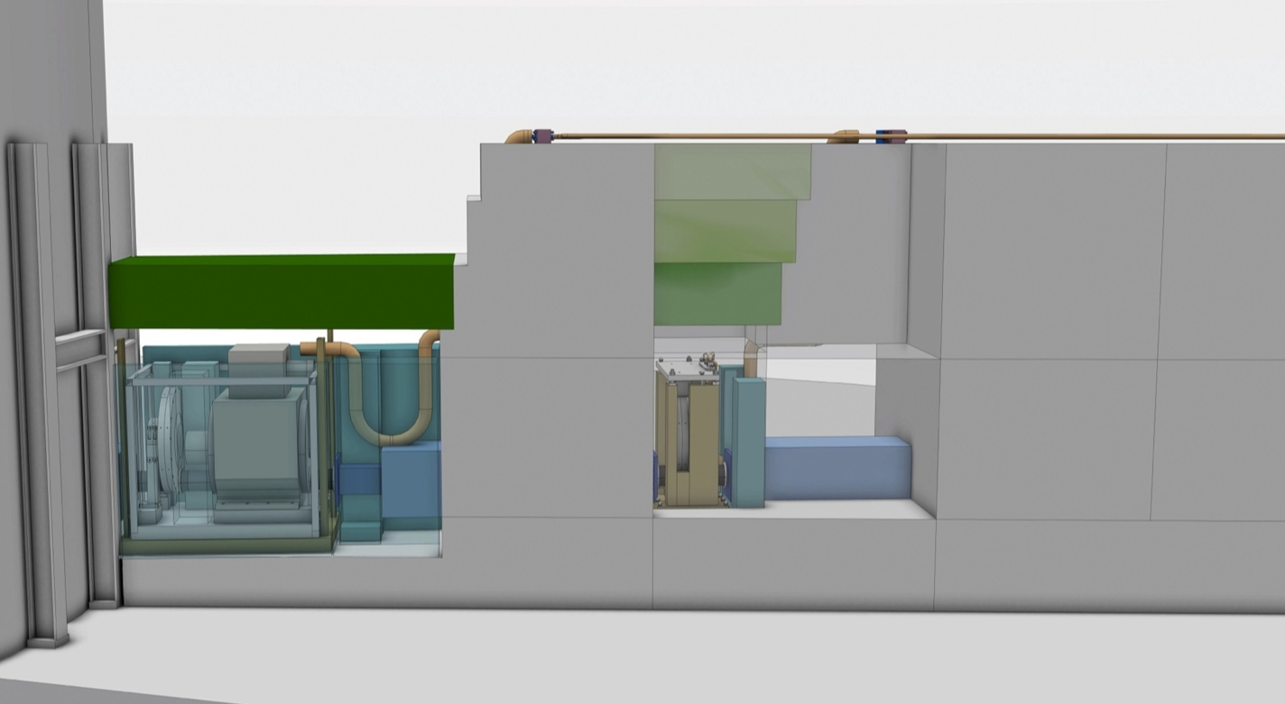
OBJECTIVES
Construct a simple model of the suite of the ESS instrument suite in order to provide information on the influence of both facility and instrument design parameters on operation and maintenance.
Schedule
Shutter placement
Beam separation
Instrument availability
BUNKER CRANE 20t
HALL CRANE 30t
ACCESS PATH
Notes:
So faced with a new challenge as engineers – we seek new tools
New to me at least though well know in space, aeronautic or nuclear industries
tools from the chest of systems engineering
Methods designed to see a bigger picture

Slide 8
Building a MODEL

Slide 9
ESS Instrument suite
Notes:
Baseline dimensions for target monolith, R6m
Baseline design of instrument halls
Reference suite of instrument from TDR
Operation considered during normal operation
225 Scheduled days at nominal power (5MW)
Beam lines were operationally independent when separated by 1.4m of lateral shielding
The reference suite represents a vision of a suite of instruments designed to meet the communities needs.
It is a working assumption of the types and balance of instruments which the community will themselves choose and is used for engineering studies preparing for construction.

Slide 10
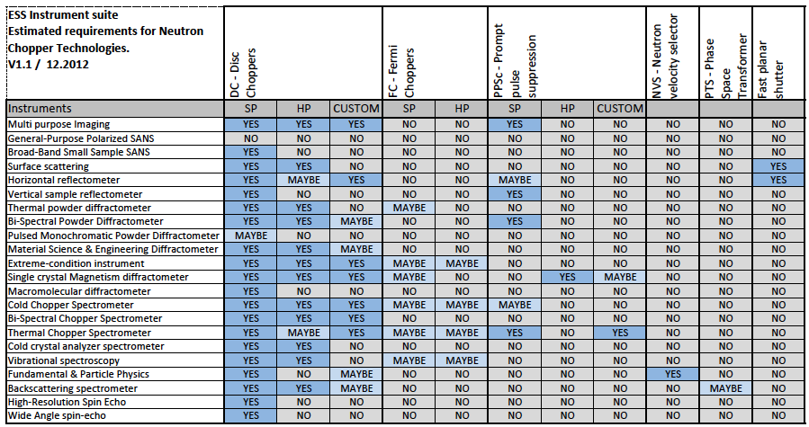
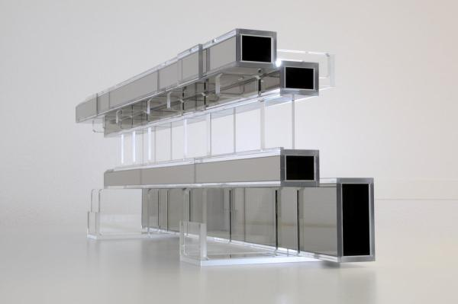
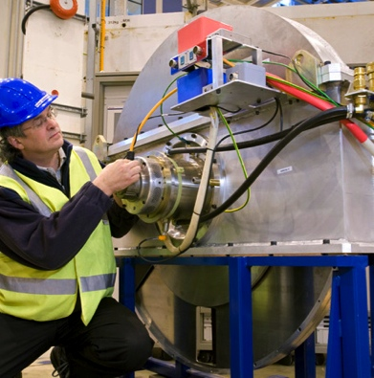
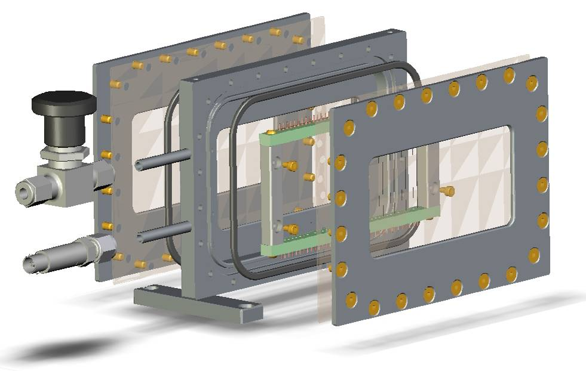
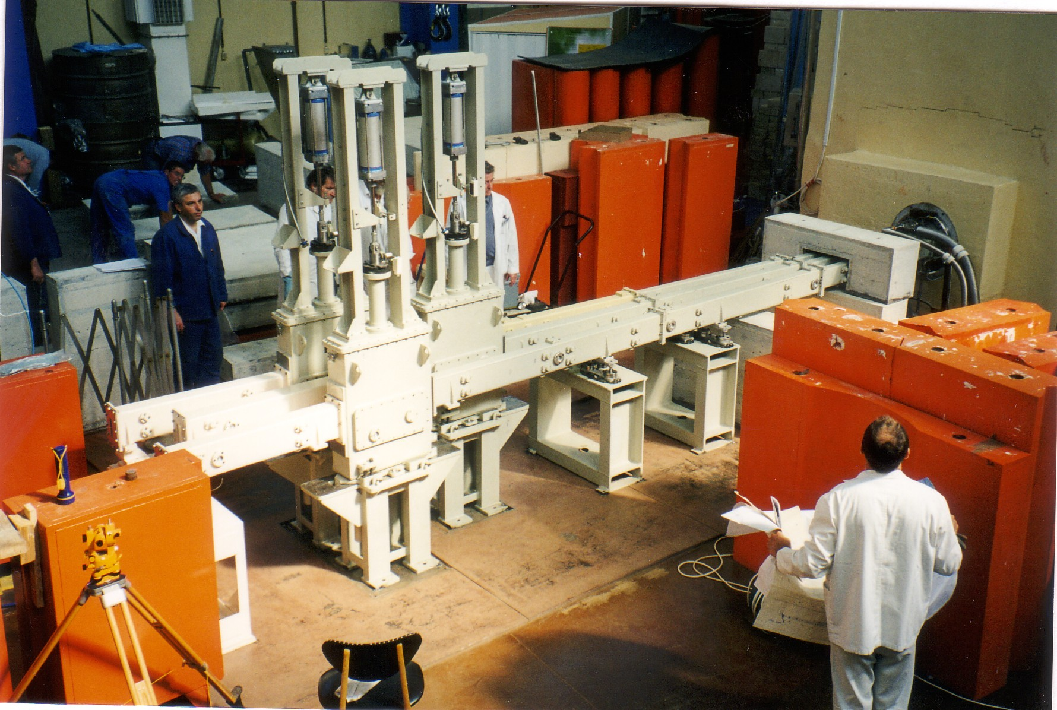
Instrument Technologies
Notes:
Working form the reference suite in order to establish some preliminary requirements
Looked into which technologies were likely to be employed on individual beamlines …
This is important for the ESS to identify which requirements it must build up the organisation to fulfill and indicate where it need to look for help from outside
As you can see a vast majority of instruments expressed interest in Disc choppers
A number put options on Fermi’s
A small number requests of PPSc were identified
Plus to the right a very small number of more exotic devices …

Slide 11
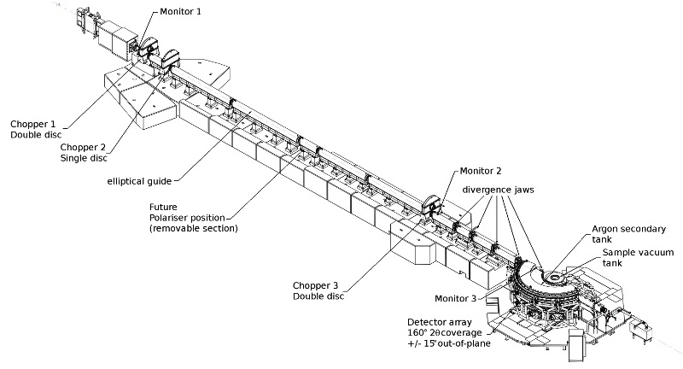
Spallation source instruments
BEAM SHUTTER
-HEAVY
DETECTOR
-BEAM MONITOR
NEUTRON OPTICS
- IN MONOLITH GUIDE
BEAM LINE SHIELDING
PHOTO ISIS Instrument
- overlay schematic components
CHOPPER 1
CHOPPER 2
DETECTOR
-BEAM MONITOR
BEAM SHUTTER
-LIGHT
NEUTRON OPTICS
- GUIDE
NEUTRON OPTICS
- COLLIMATION
NEUTRON OPTICS
- POLARIZER
FLIGHT TANK
SAMPLE
ENVIRONMENT
Instrument
Shielding
Choppers
Sample area
Detectors
Control systems
Optics
CHOPPER 3
DETECTOR
-BEAM MONITOR
DETECTOR
-ARRAY
Notes:
Beam lines were divided up into 2m long ‘modules’ from R = 2 to R = 24.
Conditions required for access considered with Proton beam on target.
Consider mechanical components only
Optical and steady state components are assumed to be reliable ie MTBF >100 x Mechanical components

Slide 12
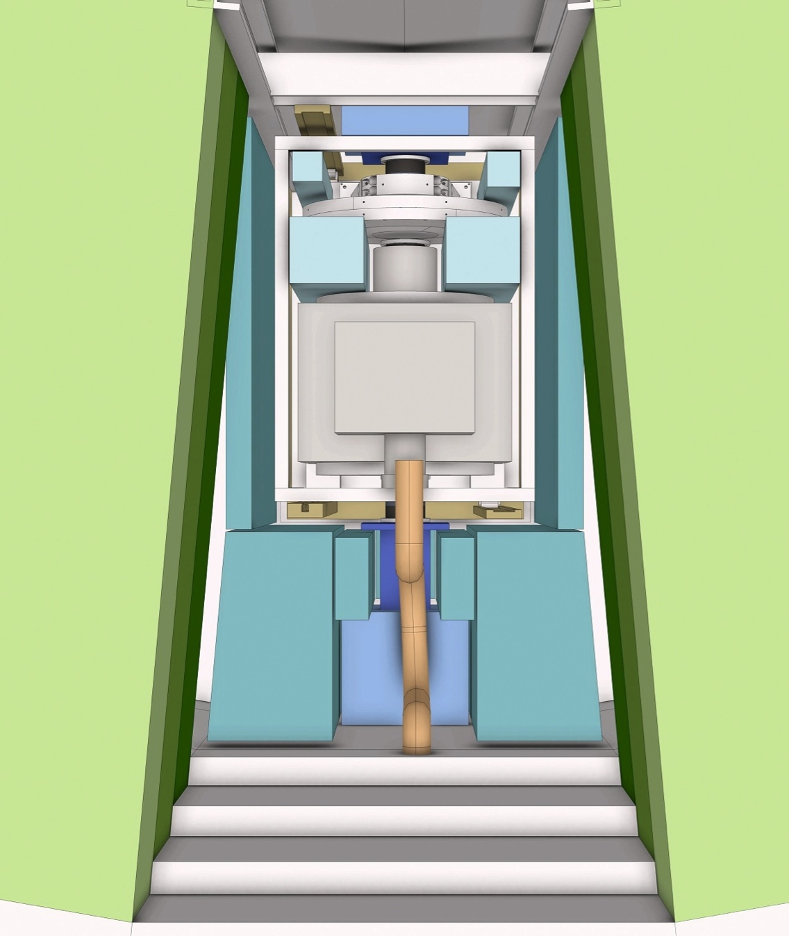
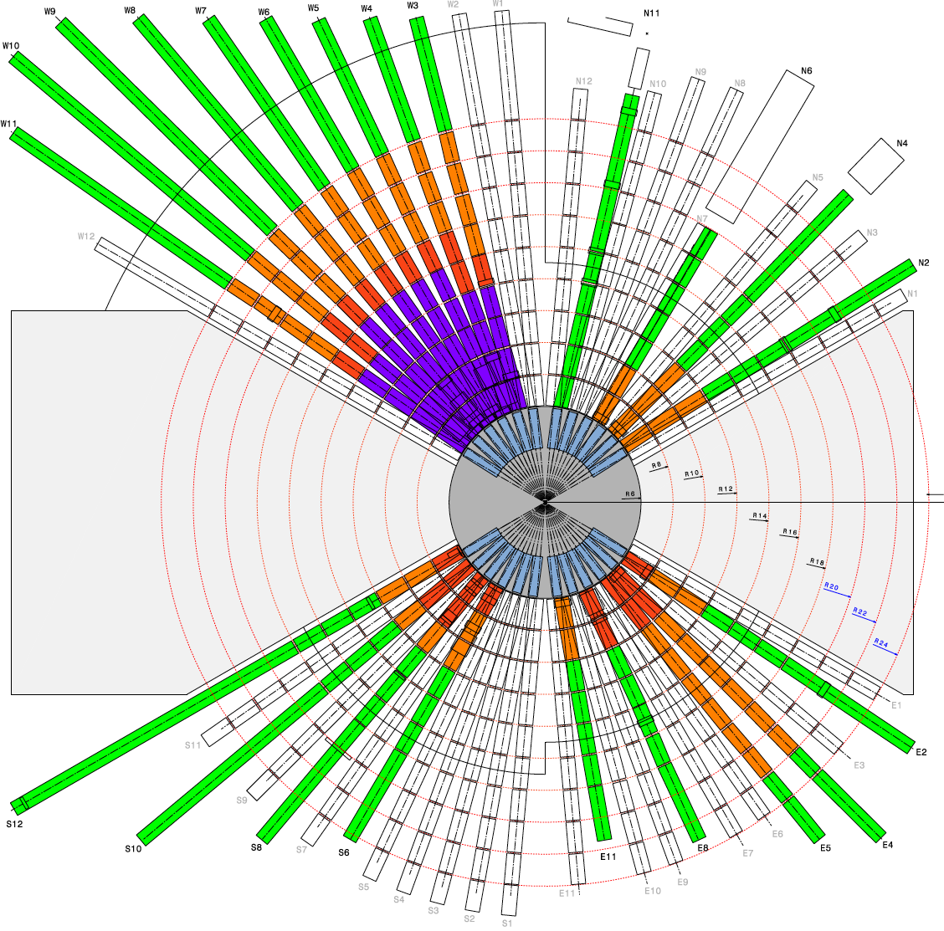
Instrument suite model
TARGET MONOLITH
INSTRUMENT 01
INSTRUMENT 03
INSTRUMENT 02
< 5 degree >
<-------------- 15 degree ------------- >
Notes:
Beam lines were divided up into 2m long ‘modules’ from R = 2 to R = 24.
Conditions required for access considered with Proton beam on target.
Consider mechanical components only
Optical and steady state components are assumed to be reliable ie MTBF >100 x Mechanical components

Slide 13
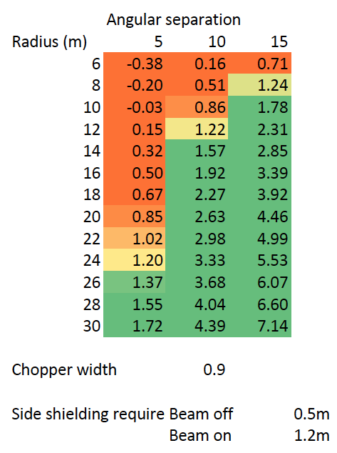
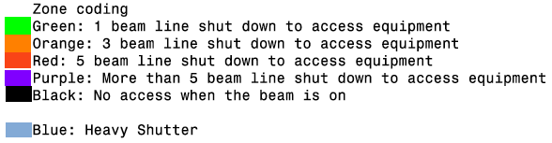
Serviceability
Lateral shielding
Access levels
Mean Time To Repair (MTTR)
Time to access (zone dependent)
Time to repair (equipment dependent)
Notes:
Evaluate for each 2m section of each beam-line
Quantity & Type of equipment installed
Level of accessibility (p-beam ON)
Access time

Slide 14
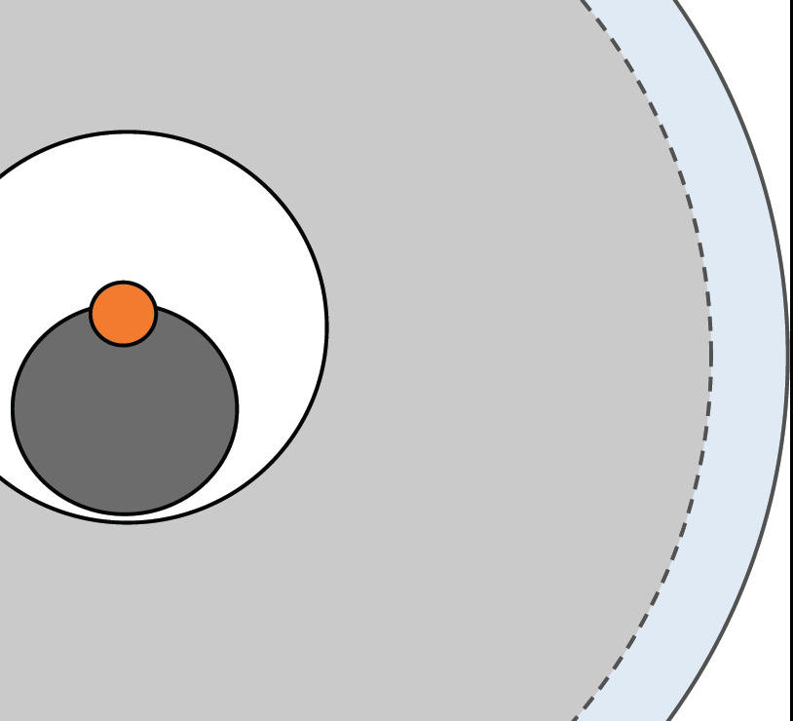
Instrument/ Target configurations
(A)
(B)
Light
Shutter
Heavy shutter
(C)
Light
Shutter
Heavy shutter
Heavy shutter
Curved guide
(D)
(E)
(F)
Notes:
What is studied?
Impact on ‘operational’ issues
Construction
Commissioning
Support during operation
Maintenance
Repair
Upgrade / Modification
Decommissioning
Why ?
Effect on availability of the instrument suit
Effect on level of commitment required to support instrument operation

Slide 15
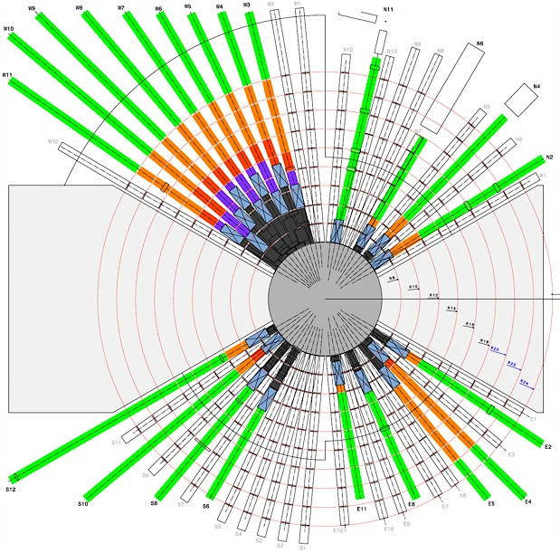
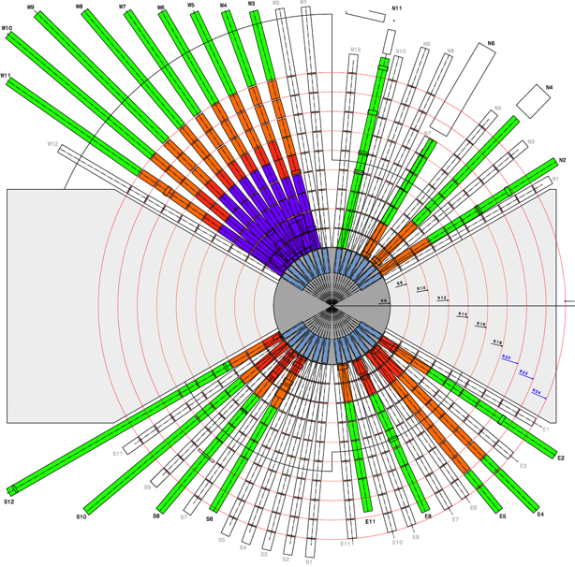
A-B : Light Shutters
6 options to consider …
E : Ext Heavy Shutters
F : Curved guide & Light shutter
D : Ext Heavy Shutters
C : Internal Heavy Shutters
Notes:
Operational performance ‘very similar’
No access to components within LOS with the proton beam on.
B support of shutters must now conducted from within instruments hall
Instrument performance is measurable degraded in B due to moving 1st choppers backwards 0.5m

Slide 16
Feeding the model - DATA

Slide 17
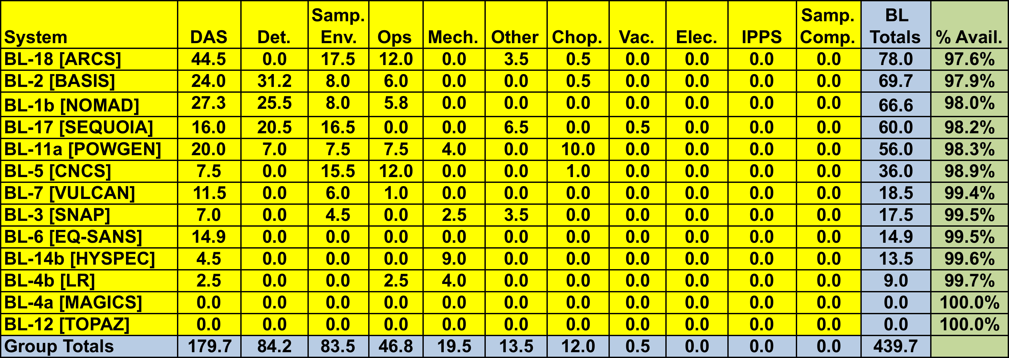
SNS Beam line/Group totals & availability – FY13 thru June 2, 2013
Instrument suite downtime
“SNS neutron beamline/instrument availability is about 89%”
Instrument suite downtime
Data from ISIS, TS1 & 2 (2007-2011)
CAUSE OF STOPPAGE
BLUE Chopper system
RED Other component
GREEN At request of I.S.
Cycles (Normalized to 35 day)
~ 3 ‘significant’ interruption per 100 beam days
+3.5 uses of shutters to effect ‘running repairs’
Beam interruptions
Notes:
As I have said we were interested in modeling reliability
So went out search for data
From the other facilities reactor or spallation sources
ISIS
SNS
J-PARC
ILL
Frequency of shutdowns
Duration
Cause

Slide 18
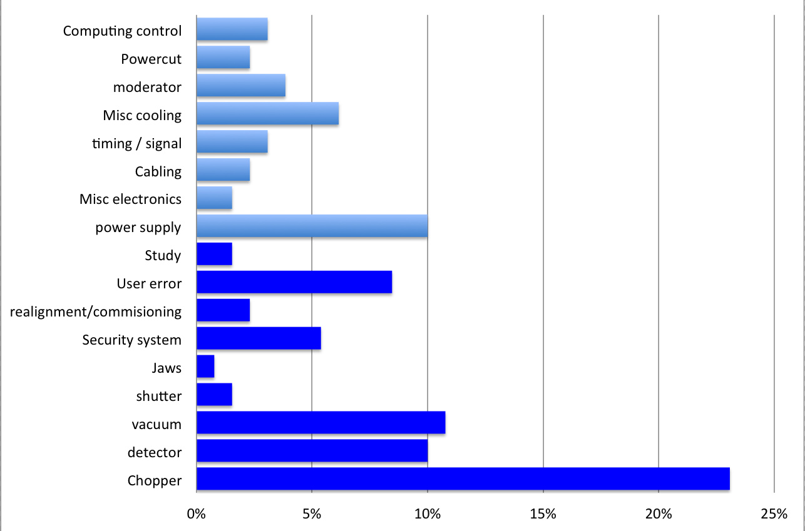
Instrument related causes of beam loss
Causes not requiring access within heavy shielding for repair
Causes often requiring access within heavy shielding for repair
Instrument MTBF ~598 days
Instrument suite MTBF ~35 days
Note: excluding - Sample environments, Computing & Motion control
Source: ISIS
Notes:
Calculated failure rates for existing instruments and equipment
And from that
Factoring in the increase comlexity of ESS instruments tried to come up with some estimates for our own instruments
Failure of a specific instruments every 3 or 4 years
Failure of ‘An’ instrument each 35day cycle

Slide 19
ESS Equipment reliability targets
 |  | Working hours |  |  | shutter option
Reliability Classification |  | MTBF |  | MTBR | Name |  | Distribution |  | Typical components
Class A |  | 72000 (10-15yrs) |  | 36 | Very reliable - quick fix |  | 70% |  | Std choppers, Vacuum systems, Fixed Collimation, Std optics
Class B |  | 72000 |  | 168 | Very reliable – slow fix |  | 10% |  | Special Choppers Special optics
Class C |  | 3600 (8-12mnths) |  | 36 | Reliable – quick fix |  | 15% |  | diaphragms
Class D |  | 3600 |  | 136 | Reliable – slow fix |  | 5%
Note
These figures concern only
Equipment installed within the common shielding area (radius 24m)
Equipment presenting a significant risk of breakdown - ie no supports, shielding
Equipment critical to instrument performance - options and non essentials have been excluded
Notes:
Estimates of MTBR for shutter option A – F will always be shutdown within 3days in order to effect repairs. This requires that the 'cost of the shutdown' be multiplied by the number of beams shutdown

Slide 20
ANALYSIS

Slide 21
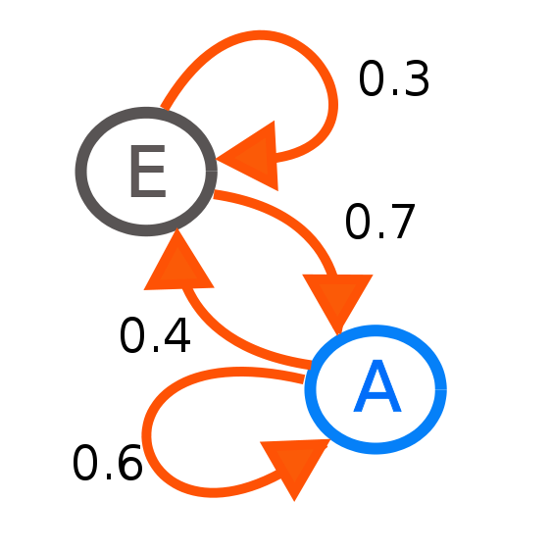
Instrument States model
Markov chains
dP_{E}/dt = -0.7P_{E}+0.4P_{A}
dP_{A}/dt = 0.7P_{E}-0.4P_{A}
1 = P_{E}+P_{A}
22λ
21λ
λ
22
21
20
…
1
0
μ_{d}
2μ_{d}
22μ_{d}
Work conducted with R.Duperrier
Notes:
Modeling of states and transitions through
Markov chains

Slide 22
SOME RESULTS

Slide 23
Instrument availability
(averaged across suite)
WHAT WE HAVE BUDGET FOR
WHAT WE ENDED UP WITH
WHAT WE WANTED
Notes:
No prizes for those guessed that this is the one we ended up recommending
This is the one that management told us we could afford !
And this is what we will probably end up doing
So now it time to live with it and return to the model and try to do the best we can

Slide 24
Instrument availability
(averaged across suite)
Notes:
This is what we came up with – the red bars
By tweaking the schedule to improve the distribution of maintainaince periods were able to reduce the time that instruments risk to remain idle following a serious brakdown.
And for the cost of a few days of beamtime we currently have this E
It’s not yet there – there is a shortfall
but what is important is that we are aware of it and can now feed this into the design of instruments …

Slide 25
Discussion

Slide 26
Preliminary conclusions
Availability > 90% is challenging !
Instrument availability is numerically dominated by medium length interventions 6-48hrs.
Heavy Shutters are essential to getting availability
The situation of long and short instruments is considerable different.
Notes:
Stragegy for these incidents is critical
Access
Spares
Manpower
tooling

Slide 27
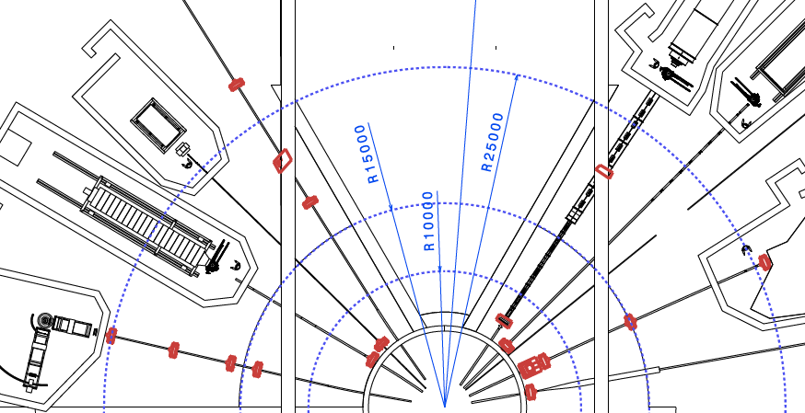
SHORT INSTRUMENTS
Notes:
Having shutter is not enough
They need to give access for personnel to the area where repair is required - idealy by being upstream of all instrument components
Consideration of context of neighboring beam lines

Slide 28
Conclusions for ‘short & wide’ instruments
Penalty for access :Low
‘Breakdown in Black’ risk :Moderate
Optimum schedule (for beam-days)
Run long cycles short breaks
Breakdown strategy
Shutdown during cycle for rapid repair
Use shutters and lateral shielding to permit access.
Design priorities
Long service intervals
Rapid intervention ready MTTR <48hrs
Hot swap capable (remote handling compatible)
Notes:
Thus if component reliability is high,
Information from several

Slide 29
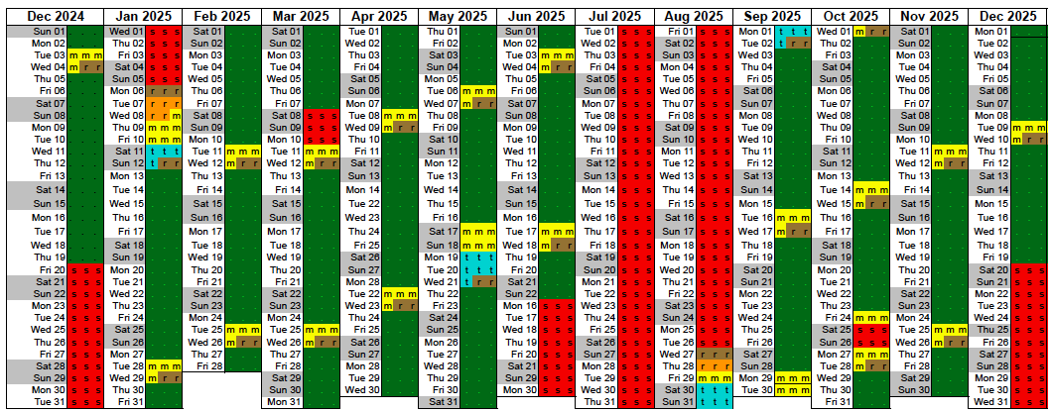
A better schedule for short & wide instruments (?)
Number of operating days ~223 beam days
Optional weekly breaks removed
Weekly 2 day ‘short intervention’ breaks
Bi-monthly 5 day ‘long intervention’ breaks
Notes:
Less frequent but longer breaks
Maximize uninterrupted beam days

Slide 30
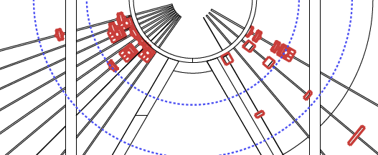
LONG INSTRUMENTS
A DISCUSSION OF SCHEDULEs & SHUTTERs

Slide 31
Conclusions for ‘narrow & long instruments
Penalty for access :Extremely high
‘Breakdown in Black’ Risk :High
Optimum schedule (for beam-days)
Run short cycles with frequent short-ish planned breaks (3-4days)
Breakdown strategy
Wait till planned breaks
Ensure MTTR <4days
Design priorities
Reduce equipment in Black
High component reliability
Limp Home Strategies
Notes:
Space constraints in poor accessibility, complex removal and increased duration of interventions.
MTTA is improved is shutters are used to provide cool off period prior to intervention.

Slide 32
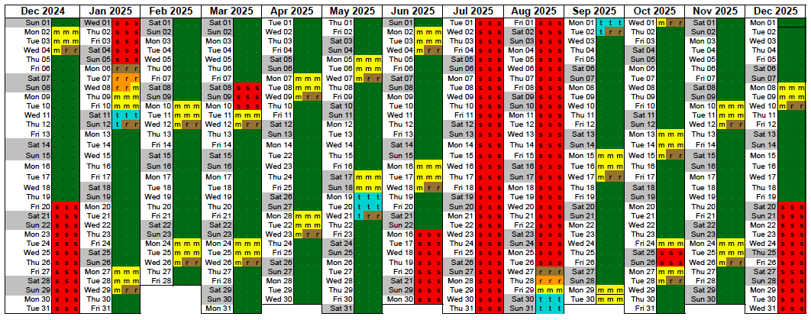
A better schedule for long & narrow instruments (?)
Number of operating days ~209 beam days
Optional weekly breaks removed
10 day ON - 3 day ‘OFF’ cycles (+1 day)
40 day ON - 5 day ‘OFF’ ‘long intervention’ breaks
Notes:
As a general rule unscheduled shut downs for repair are restricted to GREEN zones
Access to components in other zones must await scheduled ‘short shutdown’ – to cope with more complex interventions.
Longer interventions will be dealt with in two steps, with removal of equipment during one S-SD, repair off line and replacement at the next S-SD.
In the case of interventions requiring extended SD then shutters can be held close after start up of the facility.

Slide 33
SHUTTER POSITIONING

Slide 34
Distribution of ‘high risk’ components
SHUTTER – UP STREAM
THE RISK GAP !
SHUTTER – DOWN STREAM
Access zone Black Purple Red Orange Green
ACCESS DELAY 50days 20days 10days 5day 1day
Notes:
THE EFFECT OF PLACING THE SHUTTER UPSTREAM IS TO SIGNIFICANTLY IMPROVE
ACCESS TO EQUIPMENT AND REDUCE RISK TO INSTRUMENT AVAILABILITY

Slide 35
ESS Instrument suite
If the ESS instrument suite is to perform operationally ‘only’ as well as existing facilities critical component will have to be several times more reliable than currently operating.
ESS Instrument MTTF = >1000 days ?
(MTTF) - Mean Time To Failure
(MTTR) – Mean Time To Repair
Notes:
Average 9.5 Instrument shutdowns per year. Or 4.75 per 5 month cycle.
For example, 50% of breakdown are choppers 3.75 per instrument @ ISIS.
Increase reliability (>MTBF)
Possible but ….
Due to new ‘long pulse’ techniques WFM, RRM, and new technology ESS instruments will be more complex than at any other facility – approximately twice as many choppers as at existing short pulse sources…
ESS instruments components will have to be more than twice as reliable as existing items just in order to stand still. Instruments will have to be x5 more reliable in order to meet availability targets.

Slide 36
CONCLUSIONS
Notes:
So was it worth it ?
Are simple configerational studies and operational modelisation worth the effort ?

Slide 37
Was it useful ?
YES!
Permitting the objective evaluation of the influence on operational performance (RAS) of configerational changes to :
Target systems (shutters)
Instrument architecture & component placement
Access
Operating Schedule
Angular separation of beam-lines
Risk (to schedule)
Notes:
Well my personal view – as an initial skeptic is YES
As an design tool

Slide 38
Applications
Design of instruments
Design of facilities
Evaluation of operational strategies
Identification of critical issues
But most of all …
As a means of improving communication across engineering and organization boundaries.
By giving a glimpse of the ‘bigger picture’ during decision making and alternative to personal opinion

Slide 39
A bigger picture
(stake holder – sci.community)
(meta parameters
- excellence, publications, satisfaction)
(meta parameters
- reputation, community fidelity )
(meta parameters
- community size, facility lifespan )
(Driver – Sci.Dir)
(Driver – Dir. A & T & S )
(Driver – Sci.Dir)
(baseline + upgrade potential)
(Flux , Signal/Noise, Options )
(Beam days, reliability, experiments lost)
Scientific
output
(x)
(y)
(z)
= performance x number of inst x availability
total facility costs
(e)
(Driver – CEO)
(investment cost + operating costs)
(meta parameters
Value for money, political acceptance,
community satisfaction)
(stake holder – funding bodies & sci. community)
(stake holder – funding bodies)
Notes:
Optimising the technology to get the best performance instrument is a facinating field
Getting the right type and number of instruments are issues of community and design at the facility
That all of this must be achieved within cost constrains is an unfortunate fact of life
But what I would like to talk about today is the little term on the end ‘availability’
… and how … at least at spallation sources it has become increasingly important driver to the design of instruments

Slide 40
Thank-you to ..
ESS
Design team
Erik Nilsson
System Engineering
R.Duperrier
Neutron scattering systems
Phil.Bently
Rob Connatser
ISIS
Leigh Perrot
Peter Galsworthy
Matt Fletcher
Steve Wakefield
SNS
Bill McHargue
And to you for your attention …

Slide 41
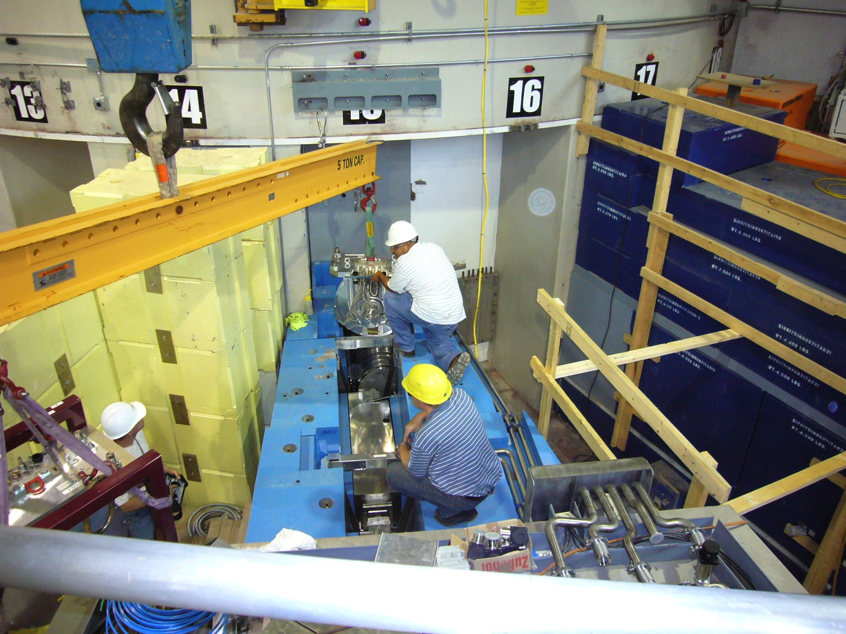
THE END

Slide 42
Closing words
From TS2 lessons learned
Summing up
‘Projects need to have and keep a very clear idea of their end goal – the project benefits. The end goal of the TS2 project was to produce science, not just to produce brighter neutron beams … ‘
On moderator design
‘… optimisation was over-done. Predicted flux increases of a few % were achieved at the expense of significantly more complex and less robust engineering designs. … engineering staff did not feel empowered to challenge the requirements of the scientists, and the review process was not sufficiently critical. ‘

Slide 43
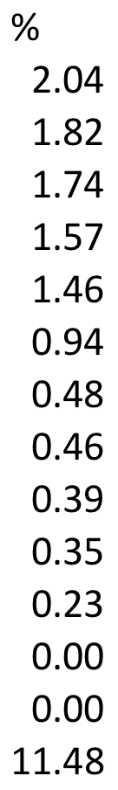
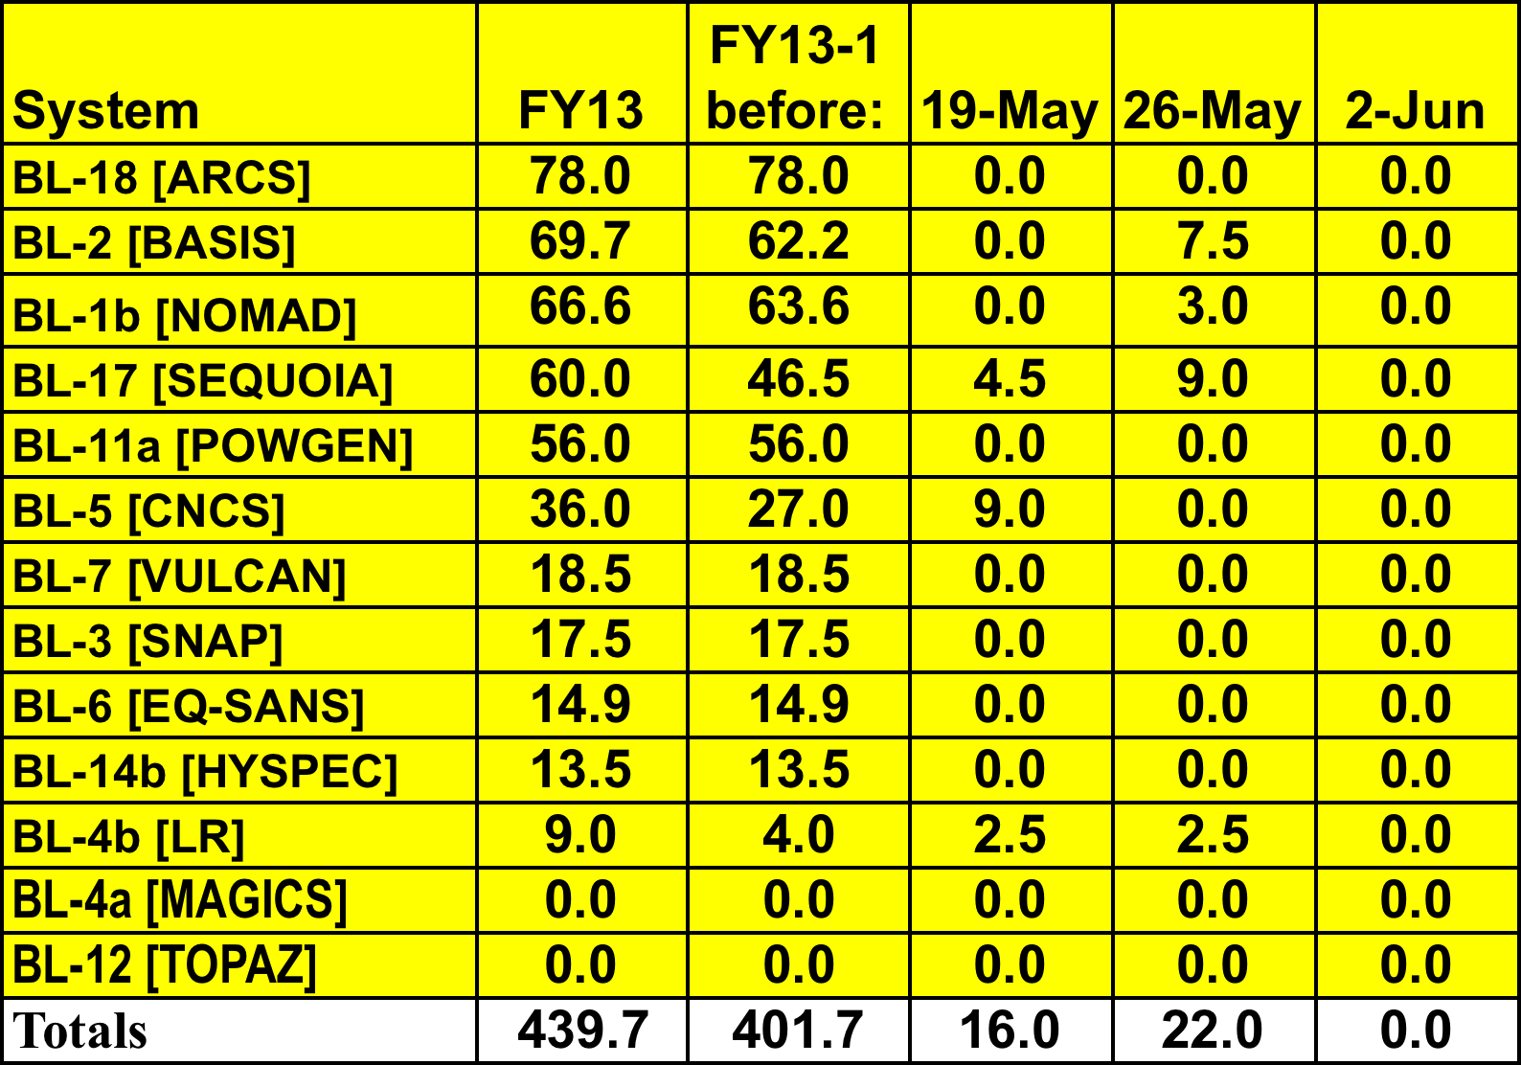
Beamline downtime – FY13 thru June 2, 2013
Total beam time delivered 3831.1h

Slide 44
Distribution of ‘high risk’ components

