Slide 1
Evolution of the Detector Module Design for CORELLI at SNS

Slide 2
Outline of Talk
Introduction to Corelli and Corelli Detectors
Why the Need for a Different Detector Design
Design Challenges
Working Solutions
Final Comments

Slide 3
What is CORELLI? aka Elastic Diffuse Scattering Spectrometer (managed as part of the SING II project)
Corelli is a statistical chopper spectrometer designed and optimized to probe local disorder through diffuse scattering from single crystals
It combines the high efficiency of white beam Laue diffraction with energy discrimination by modulating the beam with a statistical ‘correlation’ chopper
Corelli will be the first instrument in the world dedicated to the study of diffuse scattering with energy discrimination

Slide 4
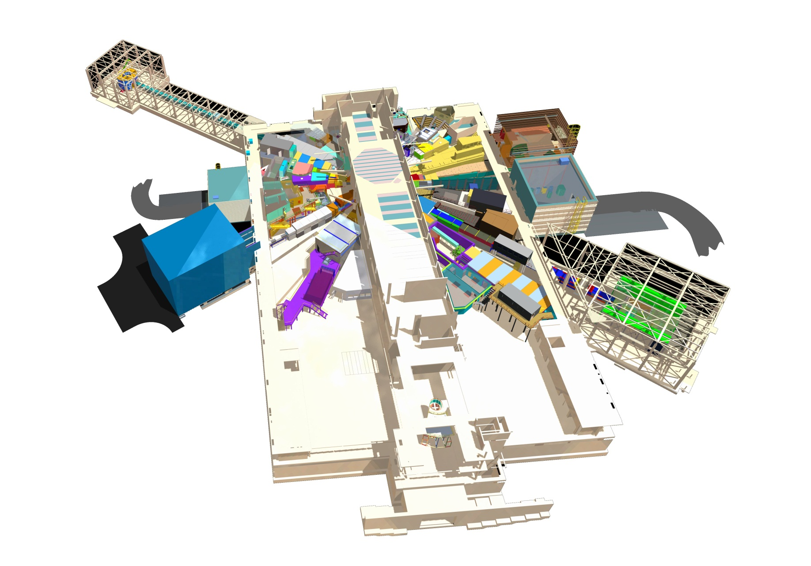
CORELLI is located on BL9 at SNS
Proton Beam Direction
Bridge to CLO
Corelli BL9

Slide 5
Instrument Layout
Moderator C/L
Sample C/L
Detector C/L
20 m
2.5 m
Choppers
Sample Scattering Vessel

Slide 6
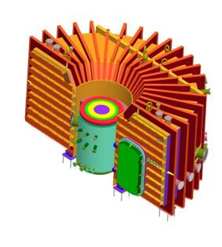
Detector Array
Sample Scattering Vessel
Detector Array Frame
3 rows of He-3 Filled Linear Position Sensitive Detectors (GE Reuter-Stokes)
1.27 cm diameter x 83.9 cm active length, Spatial Resolution ≈ 1 cm x 1 cm
16 tubes per module, 30 modules per row for a total of 1440 tubes
Vertical Range - 28.5º to + 28.5º
Horizontal Range - 23º to + 152º
Initial phase to consist of 38 modules, mostly located along middle row

Slide 7
No Isolation Valve for Corelli …
No room to fit valve to isolate sample vacuum space from detector vacuum space
Thus, we need to vent and pump entire vacuum vessel with each sample change

Slide 8
... Resulting in a Few Design Challenges Compared with the ‘ARCS’ detector
1. To reduce pump down time, detector electronics need to be placed inside compartment which is separate from the vacuum space
ARCS design open to vacuum
2. 15 Watts per module
twice that of ARCS 8-pack design
3. Electronic circuit board designs (preamplifiers in particular) require temperatures to be stable to within 1-2 ºC for reliable performance
same as for ARCS but harder
to achieve for Corelli due to
periodic vent/vacuum cycles
ARCS 8-pack detector module 2.54 cm dia. x 100 cm long tubes

Slide 9
Design Challenge #1 Met
Detector Electronics Tray Assembly
Electronics Tray Fits in Compartment Behind Detector Tubes

Slide 10
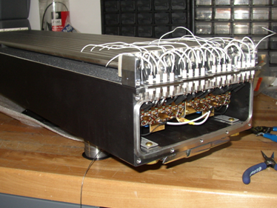
Design Challenge #2 (15 Watts of Power) Two Options Considered:
Active Cooling
(forced air flow through electronics compartment)
Passive Cooling via heat sinks and black surfaces
Cooling Lines
Painted Black Inside and Out

Slide 11
Thermal Imaging Identified ‘Hot Spots’ for Placement of Heat Sinks

Slide 12
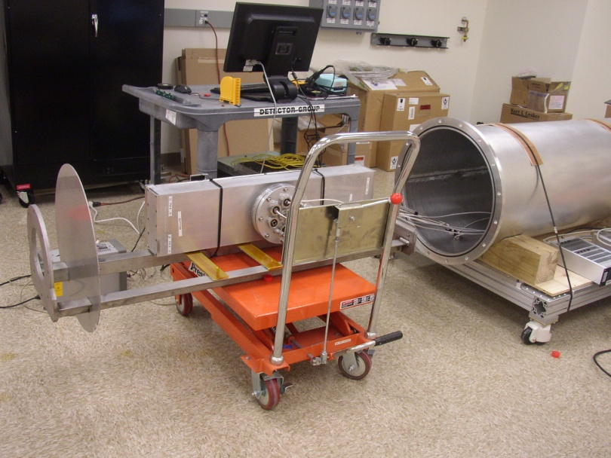
Custom Vacuum Chamber Built to Simulate Vent/Vacuum Cycles in Lab
Atm to <1E-4 Torr in 30 min
Cooling lines connected to house air (and flow controllers)
Circuit boards have built in thermal sensors
Also used TC gauges to measure surface temperatures
Power and signal cables to quantify stability of detector electronics

Slide 13
Design Challenge #2 Met
We targeted < 60 ºC to be consistent with ARCS design
Able to adequately cool with reasonable air flow (0.5 CFM)
Also able to passively cool with black surfaces, modest repositioning of boards, and application of heat sinks

Slide 14
Design Challenge #3 (temperature instability of preamps)
Temperature stability during 2 hour vent cycle was not achieved
Instrument team needs to be able to take data once acceptable vacuum is reached (est. 2-3 hours)
Time constant to return to equilibrium temperatures > 24 hours
Vent Begins
Repump Begins

Slide 15
Effect of Temperature Drift on Calculated Neutron Position
Temperature drift of preamps is known to have detrimental effect on calculated event position
Effect much more pronounced near tube ends than center

Slide 16
Design Challenge #3 Met with Electronic Solution
Preamplifier modification provides solution to peak shift problem
capacitive decoupling of
1st stage op amp leads to
exceptional peak stability
with temperature change

Slide 17
Performance Stable Over Temperature Range Expected During Sample Change-Out
Change in FWHM (mm)
Vent Begins
units
RED (mm)
GREEN (mm)
BLUE (ºC)
Repump Begins

Slide 18
Redesign of Preamplifier Boards
Incorporated decoupling capacitor modification
Improved protection circuitry to buffer against HV breakdown (Corona)
Plug-in connectors to facilitate tray removal for maintenance

Slide 19
Upon further testing, vacuum group recommended removing all cabling from vacuum space
Rear view of detector module showing NW25 bellows

Slide 20
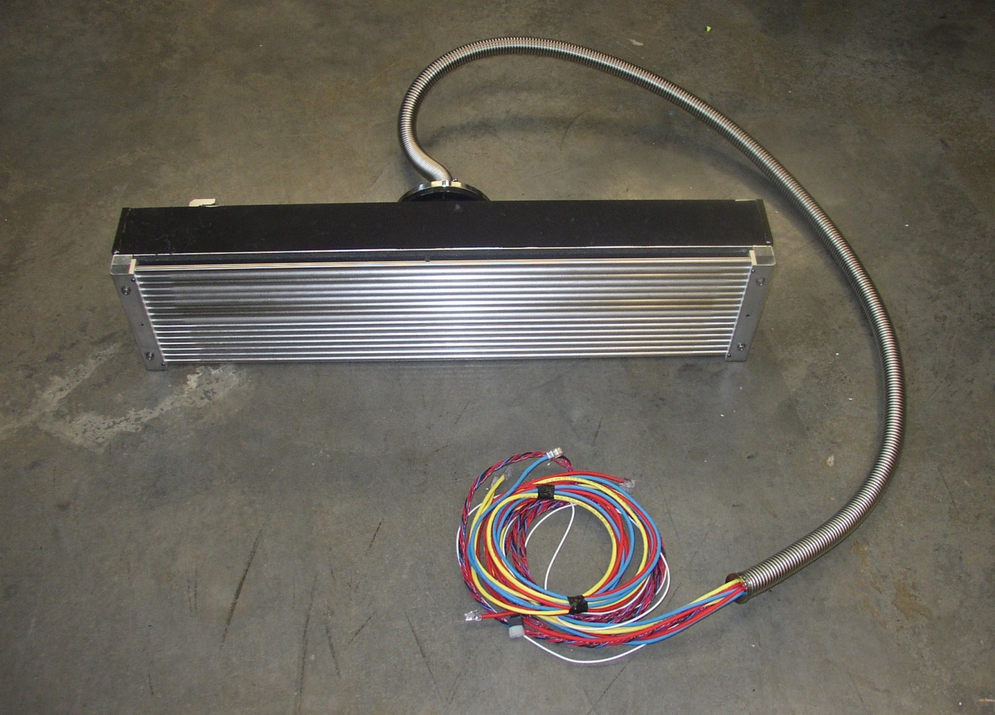
Preparing for Installation
The first phase of 38 Corelli detector modules are currently undergoing assembly and testing, on track for an early CD-4 finish date in Feb 2014

Slide 21
Detector Development Team – Key Players
Feng Ye
Instrument Scientist
George Rennich
Lead Engineer
Bill Turner
Designer
Mark Wendel
Thermal Analysis
Kevin Berry, Justin Beal
Detector Development
Vlad Sedov
Electronics Development

