Slide 1

An Introduction to Small-Angle Scattering
William T. Heller
EQ-SANS Lead instrument Scientist
Biology and Soft Matter Division (BSMD)
National School on Neutron and X-ray Scattering

Slide 2
Outline
What is SAS and what can it do for you?
Basic concepts of the technique
SANS instrumentation
Planning a SAS experiment and data reduction
SAS data analysis and interpretation

Slide 3
SAS
SAS is a tool for structural characterization of materials
  X-rays, neutrons and laser light can be used for SAS
One of the most widely applicable structural characterization techniques
  Solids, liquids, gasses
  Amorphous, crystalline or anything in between
  Pretty much any kind of material

Slide 4
SAS applications A to Z
…anything?
Pretty close!
Alzheimer’s disease, aerogel, alloys
Bio-macromolecular assemblies, bone
Colloids, complex fluids, catalysts
Detergents, dairy (casein micelles)
Earth science, emulsions
Fluid adsorption in nanopores, fuel cells, food science (chocolate)
Gelation, green solvents
High pressure, high temperature…, hydrogen storage, helium bubble growth in fusion reactors
Implants (UHDPE)
Jelly
Kinetics (e.g. of polymerization or protein folding), keratin
Liquid Crystals
Magnetic flux lines, materials science
Nano-anything
Orientational order
Polymers, phase behavior, porosity
Quantum dots (GISAXS)
Rubber, ribosome
Soft matter, surfactants, switchgrass
Time-resolved, thermodynamics
Uranium separation
Vesicles, virus
Wine science
Xylose isomerase
Yttrium-stabilized zirconia (YSZ)
Zeolites

Slide 5
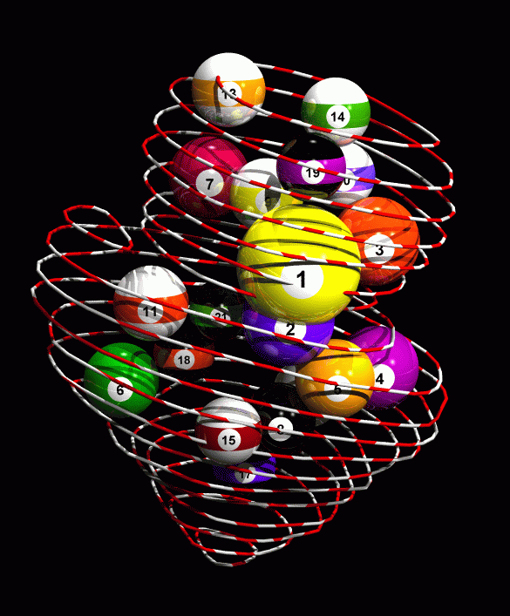
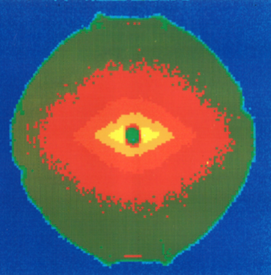
Difference between SAS and Microscopy
Microscopy uses lenses to resolve a real-space image of the sample
incident
beam
Image
Sample
focusing optics
SAS measures the interference of waves
Fourier space!
Averaged over volume!
scattering angle
incident
ϑ
beam
wavelength λ
Sample
Detector

Slide 6
SAS is related to diffraction
Bragg: waves with wavelength λ reflected by sets of lattice planes
Wave vector k: |k| = k = 2π/λ
k
θ
θ
2θ = ϑ
k_{o}
d
θ θ
k
q
ϑ
Δ = 2d sin(θ)
k_{o}
if Δ = n λ then reflection, else extinction
q in nm⁻¹ or Å⁻¹

Slide 7
SAS probes density differences
Incoming waves scatter off the electron cloud (x-rays) or nuclei (neutrons)
Interference of scattered wavelets from the material adds up to a “net scattering” amplitude
  Fourier transform of the structure.
Measured intensity is the magnitude square of the amplitude.

Slide 8
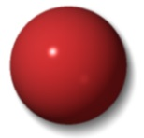


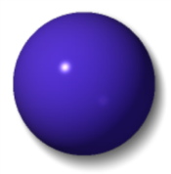





SAS – SAXS and SANS
The fundamental physics of x-ray and neutron scattering don’t really differ, but their properties differ a great deal
X-rays
No charge
No mass
Interacts with electrons
Interaction varies with atomic number
Neutrons
No charge
Has mass
Interacts with atomic nucleus
Has spin
Interaction is a property of the nucleus
H
D
C
O
S
Mn
Zr
Cs

Slide 9
SAS – SAXS and SANS
SAXS and SANS are very closely related and provide directly complementary information
The choice between x-rays and neutrons is dictated by the problem
X-rays
Readily available
  Lab-based sources
  Synchrotrons
Massive fluxes possible
  Time-resolved studies
  Extremely precious material
Neutrons
Large user facilities only
  Spallation sources
  Reactors
No radiation damage
Contrast variation
There are many experiments that really don’t require the use of neutrons.

Slide 10
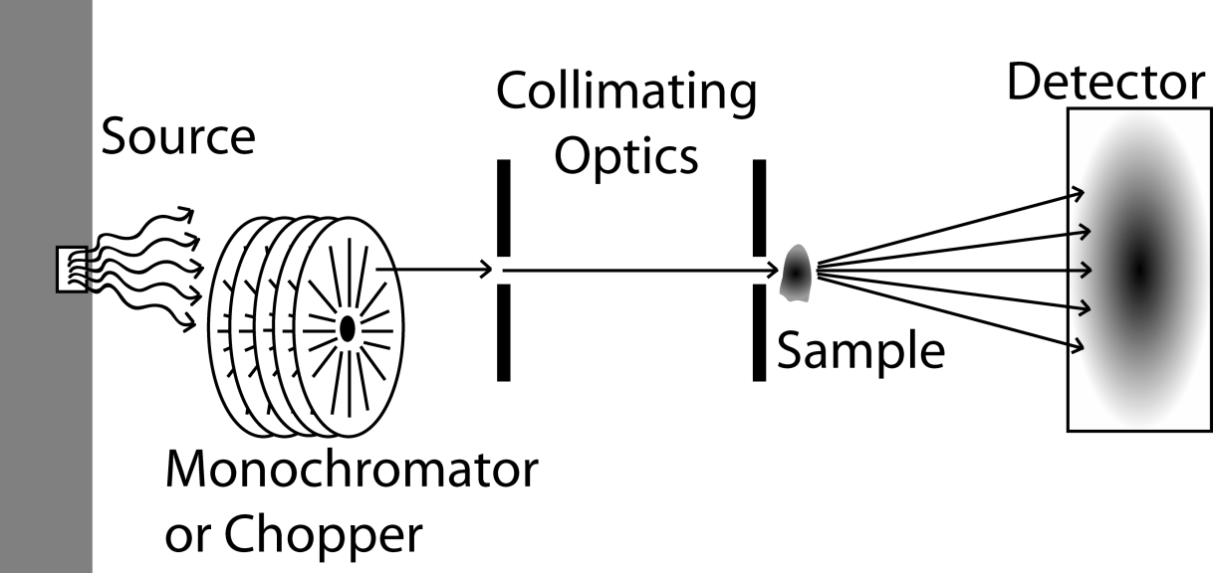
SAS Instrumentation
SAS instruments are conceptually simple
Source: x-ray generator, synchrotron, spallation source or reactor
Monochromator/Chopper: Defines wavelength(s)
Collimating Optics: Defines the angular divergence of the beam
Determines the maximum size probed
Detector: Collects the radiation scattered by the sample
Large detectors provide better angular coverage

Slide 11
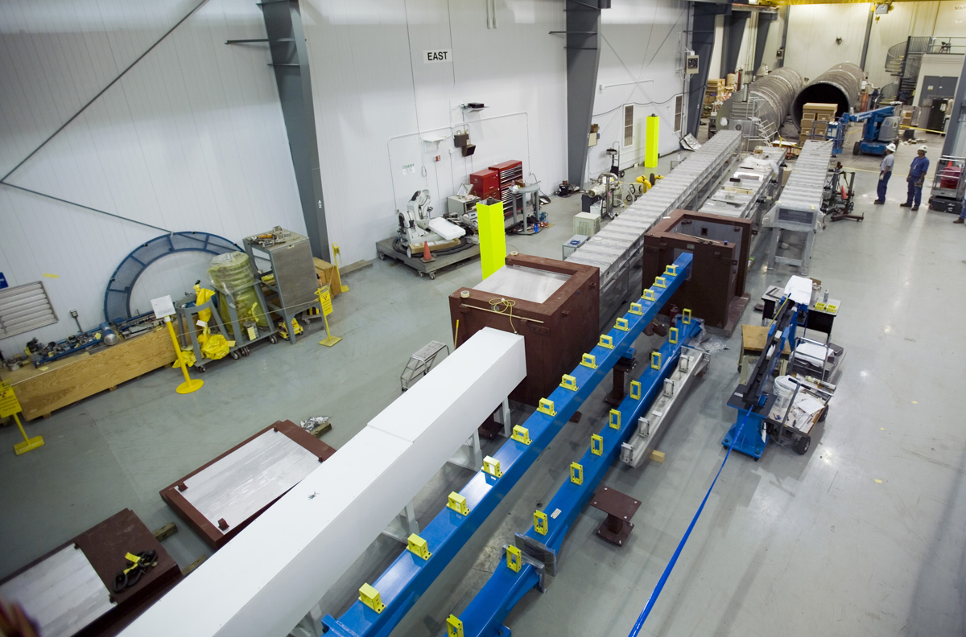
SAS Instrumentation
HFIR guide hall
a few years ago

Slide 12
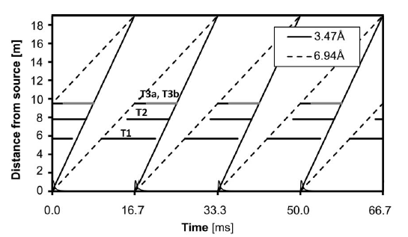
SAS Instrumentation
The neutron wavelength is related to its momentum
De Broglie:
The wavelength-velocity relationship enables time-of-flight neutron scattering techniques

Slide 13
SAS measurements
A SAS measurement, once properly reduced, provides the scattering cross section per unit volume
dI
D
dΩ
I_{o}
[cm⁻¹sterad⁻¹]
dI/dΩ = Scattered intensity per solid angle
Io = Primary beam intensity
T = Transmission (x-ray absorption, incoherent neutron scattering)
D = Thickness
dΣ/dΩ = Scattering cross section per unit volume [cm⁻¹sterad⁻¹]
SANS instruments more commonly provide reduced data in absolute units (1/cm) than SAXS instruments

Slide 14
SAS measurements
Plan your experiment well!
  What Q-range would I like, and what must I have?
  How large is each sample?
  How much material do I need?
  For how long should I measure my samples?
  How can I optimize my sample quality?
  What control measurements do I need to perform?
  How will I reduce my data?
  Less is often more: Do fewer things but those do right! (especially with neutrons)
  Ask your local contact / instrument scientist for advice well ahead of time!

Slide 15
SAS Measurements
Normalization to monitor or time
Background data sets
Sample transmission
Azimuthal averaging
Absolute intensity scale (cm⁻¹)
Measure and subtract background very carefully!
Do the absolute intensity calibration – it’s worth the extra effort!

Slide 16
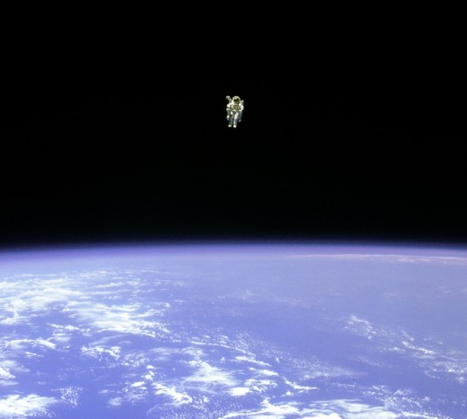
SAS Analysis
Analyzing SAS data is far harder than taking SAS data
Model fitting is complicated by the sheer number of models available for fitting the data
Be patient and be prepared to explore
If you feel like you are floating off in the middle of nowhere, you are neither the first, nor will you be the last, SAS practitioner to feel that way
Bruce McCandless II took the first untethered space walk in February 1984. Here we see him from Challenger, floating above Earth.

Slide 17
Scattering from Particles
Discreet particles are often the easiest to understand
is the number density of particles
is the form factor (particle shape)
is the structure factor (particle interactions)

Slide 18
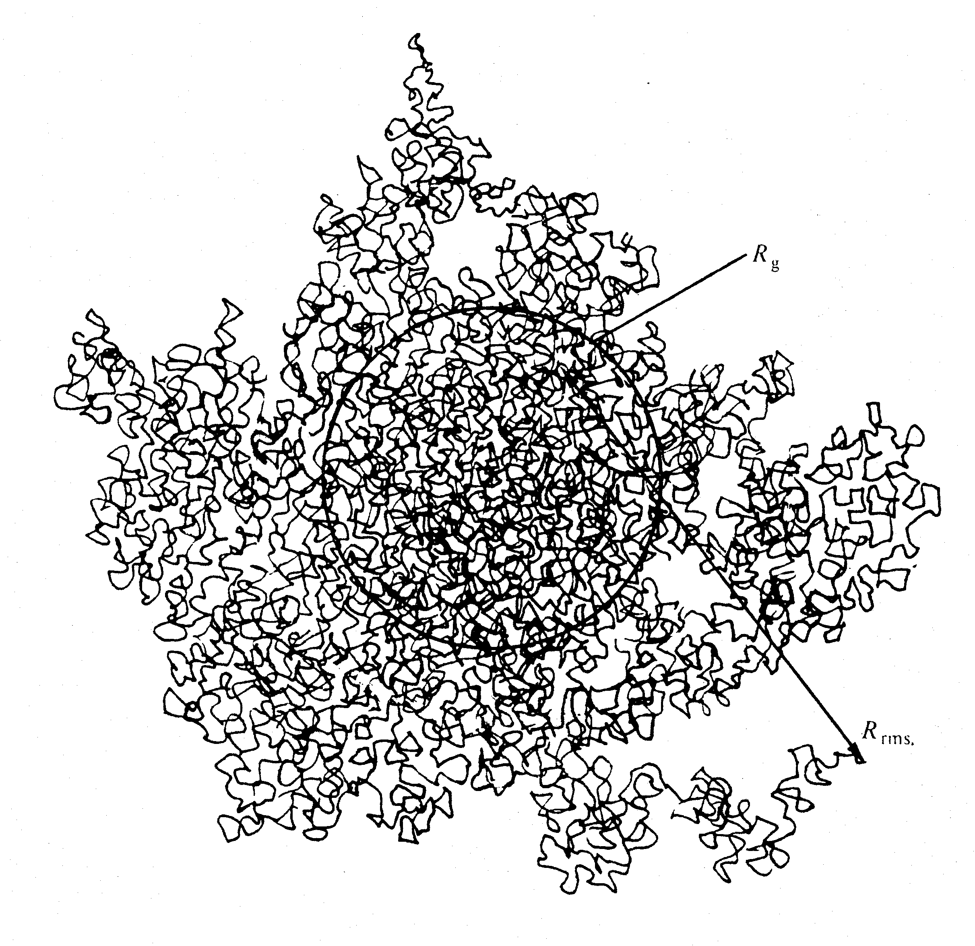
Form Factors
Long & Thin cylinder
Sphere
Polymer coil
Ellipsoid of Revolution

Slide 19
Structure Factor
S(q) examples: hard sphere potential, sticky sphere, screened coulomb etc.
S(q)·P(q) is not always valid and useful!

Slide 20
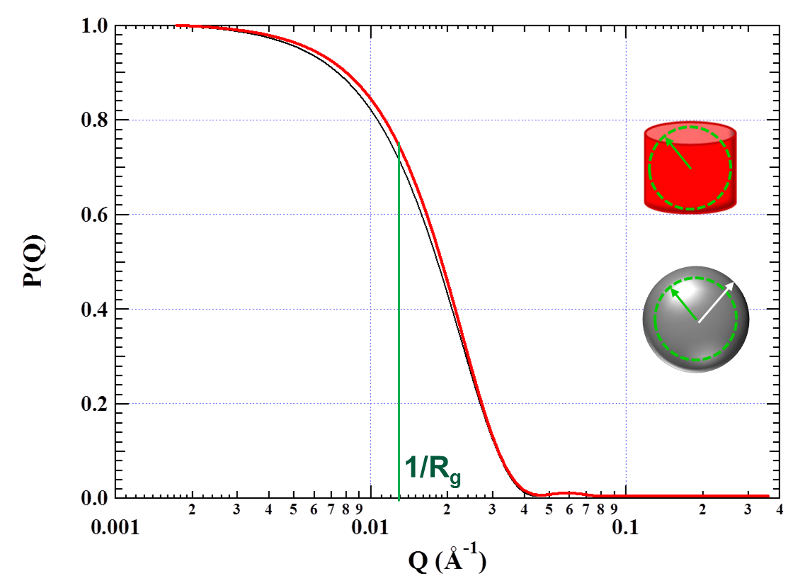
Guinier Analysis
At small q, anything that could reasonably be considered a discrete object follows Guinier’s approximation.
~77.46 Å R_{g}
Modified Guinier approximations exist to determine cross sectional radius of rods or thicknesses of sheets
100 Å radius

Slide 21
Guinier Analysis
Guinier fitting can be applied to scattering data from discreet particles regardless of the shape of the particle
Precise R_{g} is 77.46 Å

Slide 22
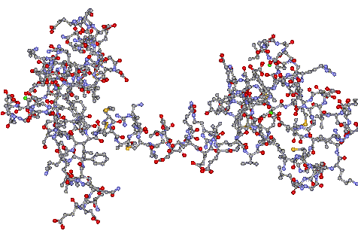
Pair Correlation Function Analysis
  P(r) : inverse Fourier transform of scattering function : Probability of finding a vector of length r between scattering centers within the scattering particle.
D_{max}
r
D_{max}
P(r) provides some indication of particle shape

Slide 23
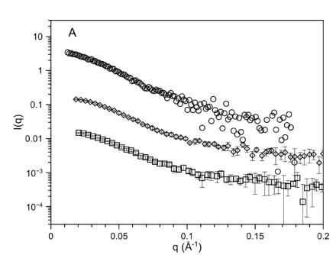
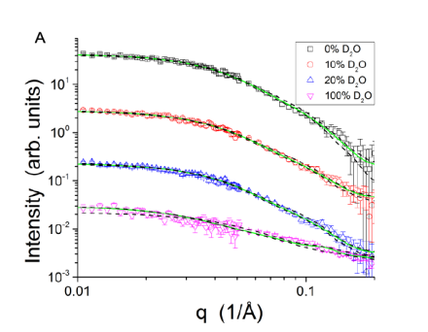
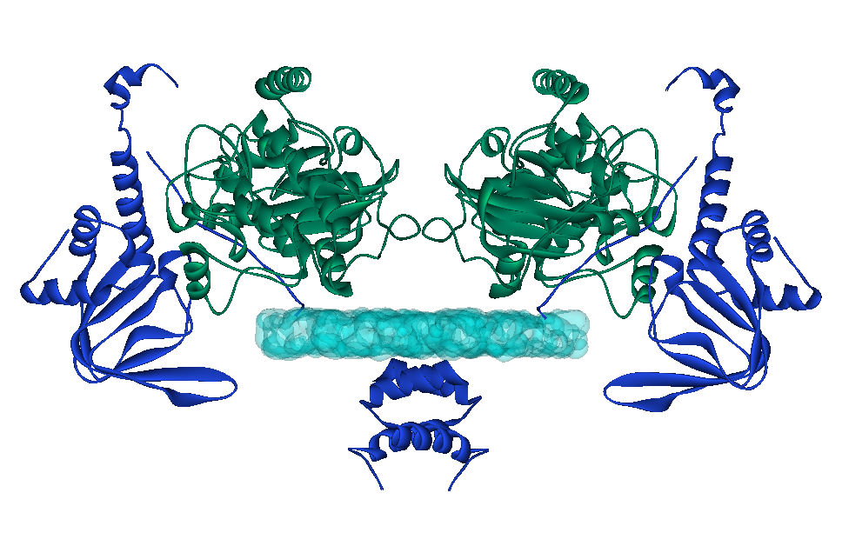
Example: A Protein Complex
Protein Kinase A is an important regulatory protein complex that phosphorylates proteins in response to a cellular signal
SAXS and SANS with contrast variation, when combined with structural modeling, made it possible to construct a model that shows how the subunits in the complex assemble into the holoenzyme
Blumenthal, et al., J. Biol. Chem 289: 28505-28512 (2014).

Slide 24
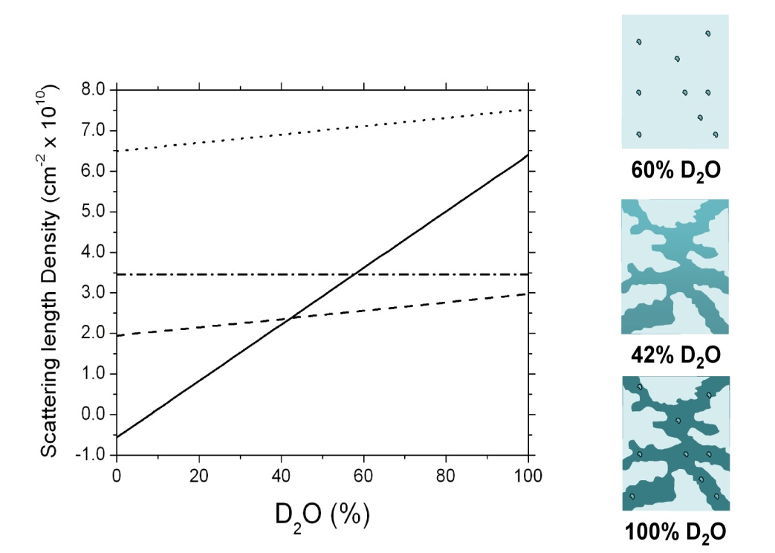
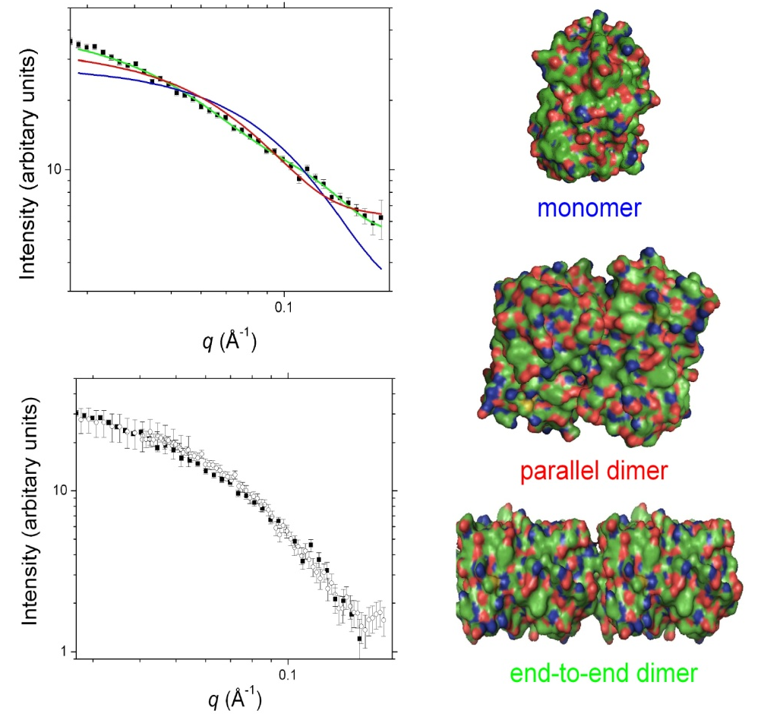
Example: Proteins in a Porous Material
Entrapment of bio-macromolecular assemblies: bio-composite, biomimetic, bio-inspired for catalysts, sensors, functional materials – for example light harvesting antenna complexes for solar energy
SANS with contrast variation shows structure of proteins in a complex gel matrix
Luo, et al., ACS Appl. Mater. Interfaces 1: 2262-2268 (2009).

Slide 25
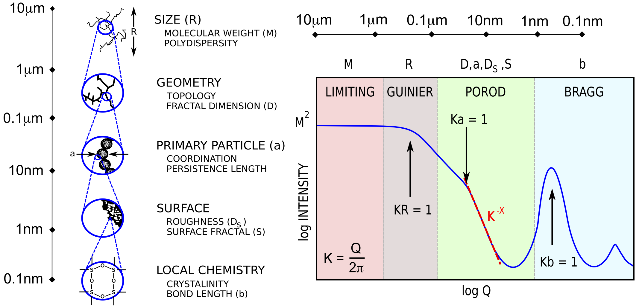
Hierarchical Structures
Adapted from DW Schaefer MRS Symposium Proceeding 1987
Structural information viewed on five length scales. Structural features at larger length scales are observed at smaller Q.
Scattering analysis that describes hierarchical structures: Mass Fractal (Teixeira), Unified Fit (Beaucage) combine power law scattering ranges with R_{g} transitions

Slide 26
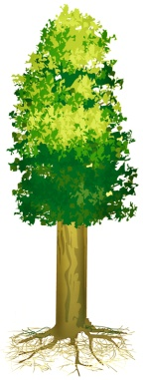
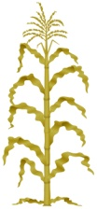

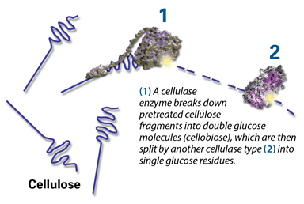
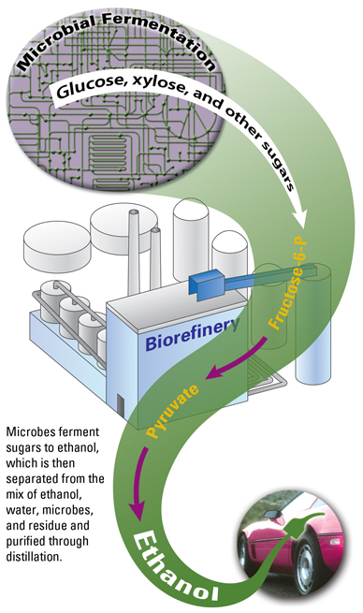
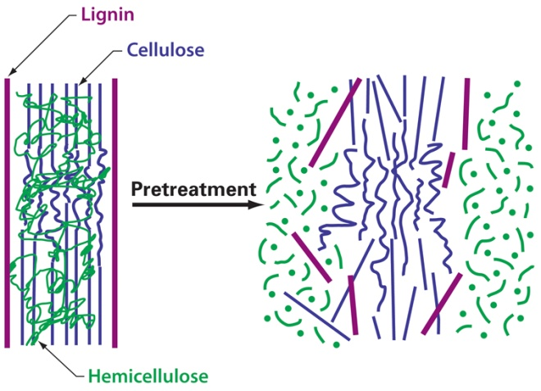
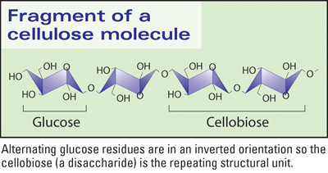
Example: Biomass to Cellulosic Ethanol
“grass to gas”
Feedstock
Corn Stover
Hydrolysis
Fermentation
Poplar
Switchgrass
Pretreatment
Cellulase enzyme
4 X 14 nm
The challenge: structural complexity!
Cell wall
100 nm
Adapted from DOE GTL image gallery (genomics.energy.gov)

Slide 27
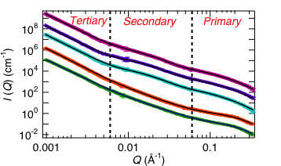
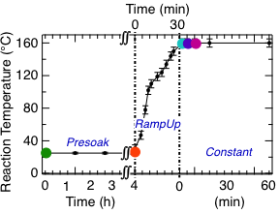
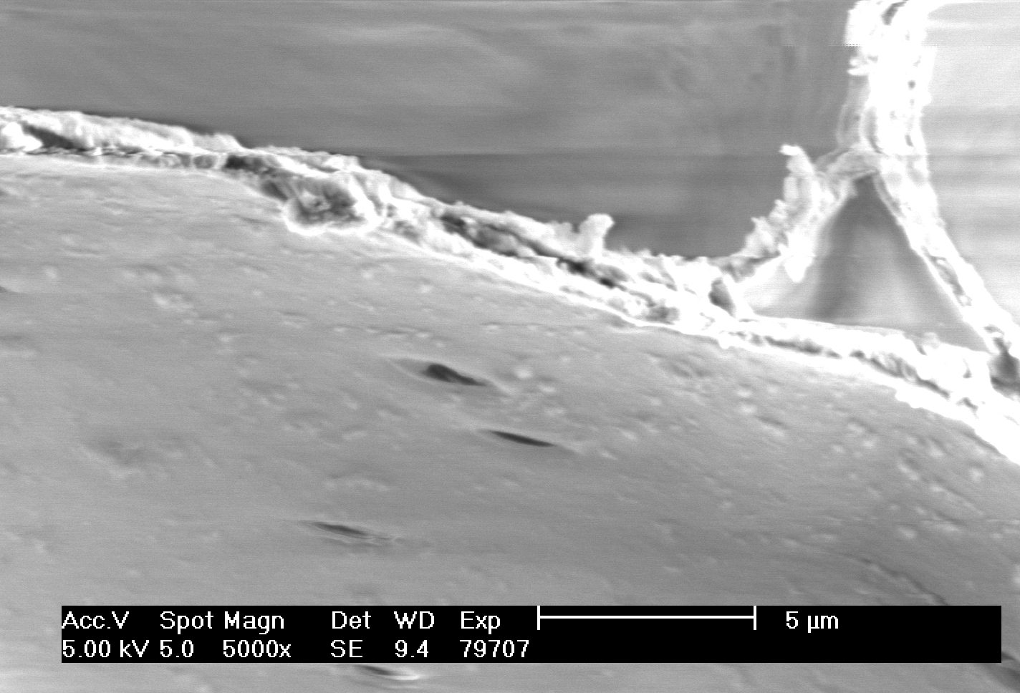
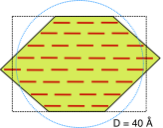
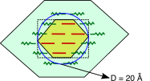
Dilute Acid Pretreatment of Switchgrass
SANS of Switchgrass in D₂O
Structural
Change Onset
Q⁻⁴
Treated
D
SEM
Elementary Cellulose Fibril
Cross-sectional View
Pingali, et al., Biomacromolecules 11: 2329-2335 (2010).

Slide 28
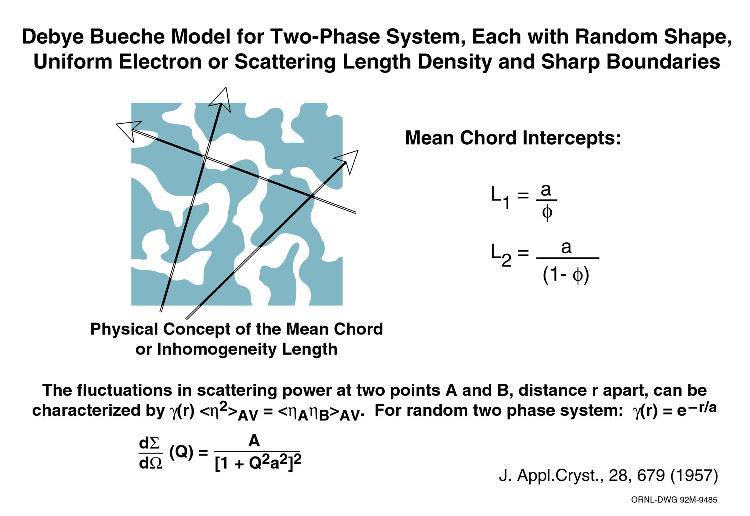
Non-particulate Scattering

Slide 29
SAS Summary
SAS probes length scales from 1nm to 100nm
SAS does not see atoms, but larger, interesting features over many length scales
SAS is similar to diffraction but does not require crystals
SAS applications are only limited by imagination
SAS can be used alone, but often complementary to other methods, such as microscopy, NMR
SAS data analysis is application dependent, using a diverse set of approximations, models and software

Slide 30
Further Reading
Guinier, A., Fournet, G. 1955. Small-Angle Scattering of X-rays. John Wiley & Sons, New York.
The classical work on SAS. The book focuses on x-rays, but the theory and data interpretation also applies to SANS.
Roe, R. J. 2000. Methods of X-Ray and Neutron Scattering in Polymer Science. Oxford University Press, New York and Oxford.
This book covers the basic scientific principles of SAS thoroughly and is suitable for the non-expert.
Higgins, J. S., and Benoît, H. C. 1994. Neutron Scattering from Polymers. Clarendon Press, Oxford.
A comprehensive description of neutron scattering, particularly SANS, that is focused on polymers. It is very useful for anyone interested in SANS.
Pedersen, J. S., 1997. Analysis of small-angle scattering data from colloids and polymer solutions: modeling and least-squares fitting. Adv. Colloid Interface Sci. 70:171-210.
Contains a comprehensive list of form factors and structure factors that are used for interpreting SAS data.
Urban, V. S., 2012. Small-Angle Neutron Scattering. In: Characterization of Materials, edited by Elton N. Kaufmann. Copyright 2012 John Wiley & Sons, Inc.
A concise introduction to theory and practical considerations of SANS.

