Slide 1
X-ray Detection
Antonino Miceli (amiceli@aps.anl.gov)
June 14, 2015
NX School

Slide 2
Outline
Counting vs. integrating
Indirect versus direct detection
  Scintillation Counters
  Area detectors using scintillators
    Large area for diffraction (low spatial resolution, ~ 100 μm)
    Small area for imaging (high spatial resolution, ~ 1 μm)
  Ion Chambers
  Pixel array detectors (e.g., Pilatus)
  Energy resolving detectors (i.e., spectroscopic detectors)
    Measuring the energy of photons
    Silicon diodes
    Superconducting detectors

Slide 3
How do you detect x-rays?
Need to convert to something that you can measure
  Electrons… Q = CV
    Indirectly (x-rays → optical photons → electrons)
      Scintillators + Optics + photomultiplier/CCDs
    Directly (x-rays → electrons)
      Ion Chambers, Pixel Array detectors (e.g., Pilatus)
  Temperature
    ΔT = E_{γ} / (Heat Capacity)
      Superconducting calorimeters

Slide 4
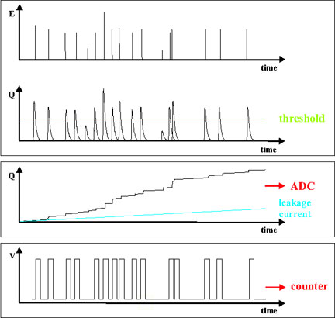
Counting versus Integrating
?
?
Analog Output
Pulse Height ~ Energy
threshold
Counting
Digitizer
Integrating
Dark Current

Slide 5
Counting versus Integrating
Counting
  Single photon counting
    Scintillator counting detectors (e.g., Cyberstar)
    Pilatus (counting pixel array detectors)
    Energy-resolving Detectors (Silicon or Germanium diode detectors)
  Deadtime limitations!!!
  Dark current rejected with a sufficiently high threshold.
Integrating
  Signal accumulates
  CCDs, Ion chamber
  No deadtime limitations
  Read noise and dark current are issues to consider

Slide 6
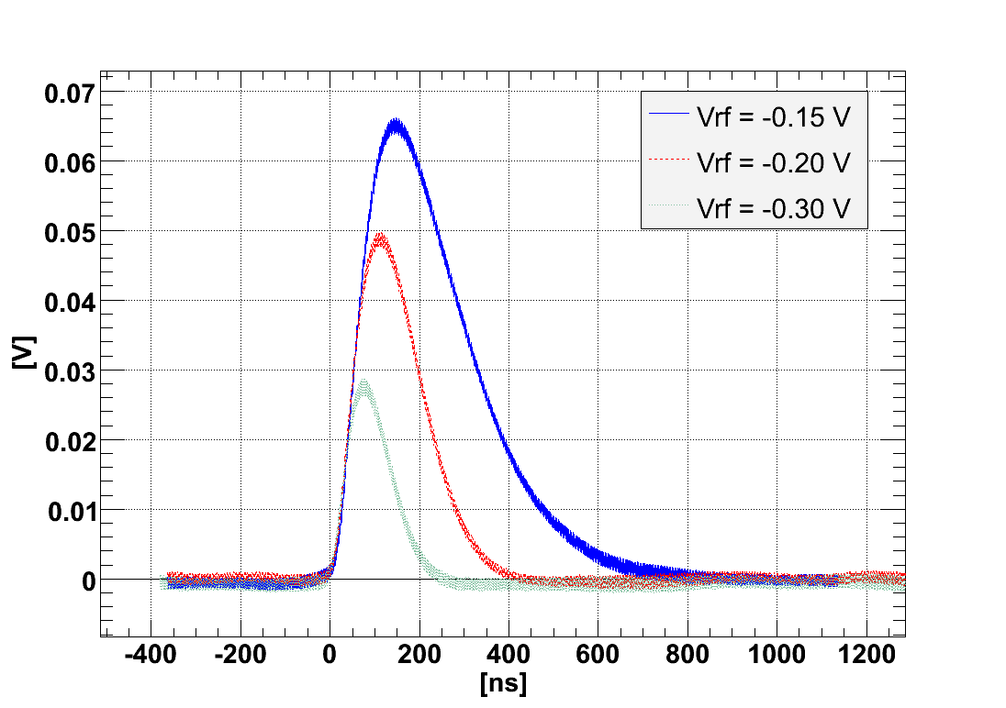
Shaping time – counting detectors
Response time of detector
  In most detectors, the user can change this via software.
Gain is usually associated with longer shaping time.
Longer shaping time improved the energy resolution
  But reduced the total count rate throughput.
  Energy resolution is important for certain techniques (e.g., XANES, XAFS)
Analog response of a counting detector to the same x-ray photon energy

Slide 7
Deadtime limitations for counting detectors
Analog pulses
Discriminator output (Digital)

Slide 8
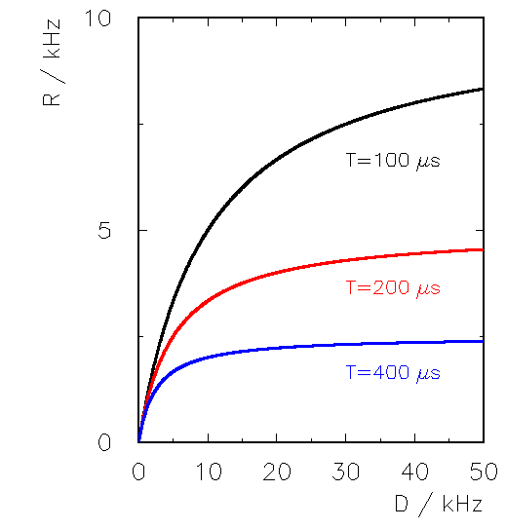
Deadtime
As you increase the input count rate (ICR), does the output count rate (OCR) follow linearly?
  The longer the shaping time, the lower the ICR before deviating from linearity.
When to worry?
  Rate > 1 / (2 x τ)
Output count rate (OCR)
Input count rate (ICR)

Slide 9
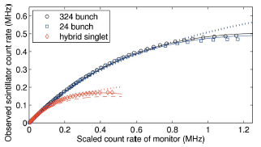
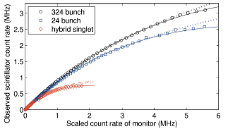
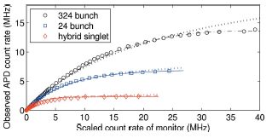
Deadtime for synchrotron (pulsed source)
Depends on the fill pattern and speed of the detector
Counting detectors can detect at most one photon per bunch
Fast detector (shorter shaping time)
NaI
YAP
APD
D.A. Walko, D.A. Arms, E.C. Landahl, J. Synchro. Rad. 15 (2008) 612; http://dx.doi.org/10.1107/S0909049508022358

Slide 10
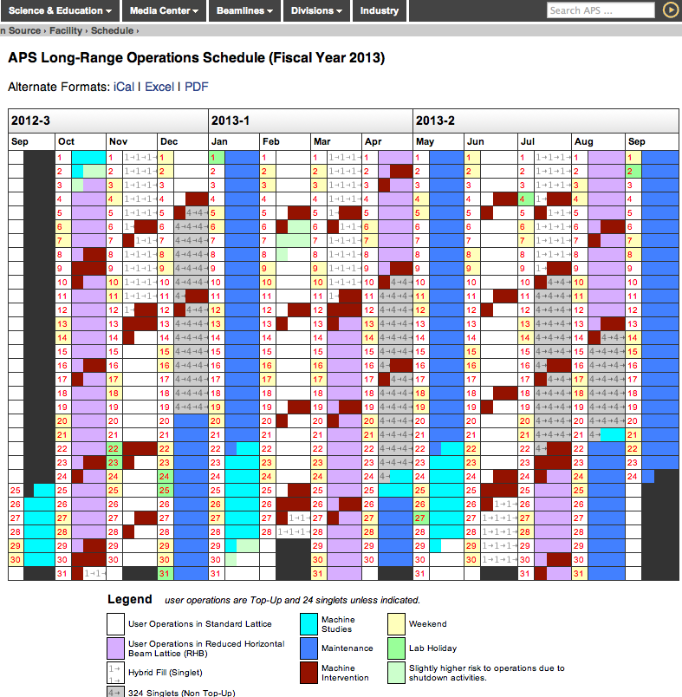
What fill pattern pattern will you be using?
Hybrid singlet and 324 bunch mode each 2 weeks a run.
Hybrid singlet useful for certain timing experiments.
  Not great for high count rate experiments (e.g., XANES, XAFS, spectro-microscopy)

Slide 11
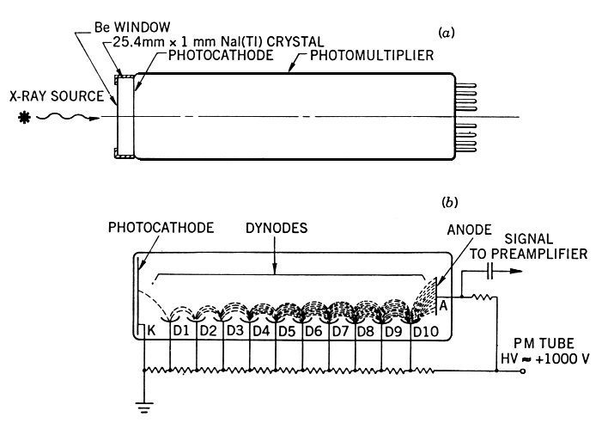
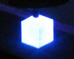
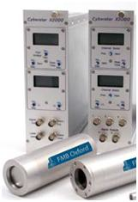
    Indirectly (x-rays → optical photons → electrons)
    Scintillation Counters
One pixel
  “Point detector”
Still workhorse for high resolution diffraction experiments (plus a pair of slits)
NaI(Tl) is the most common scintillator and gives a energy resolution (ΔE/E) of about 35% - 40%. Organic (plastic) scintillators are used for higher speed applications but energy resolution is sacrificed.

Slide 12
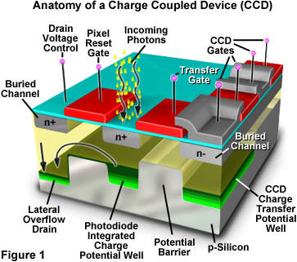
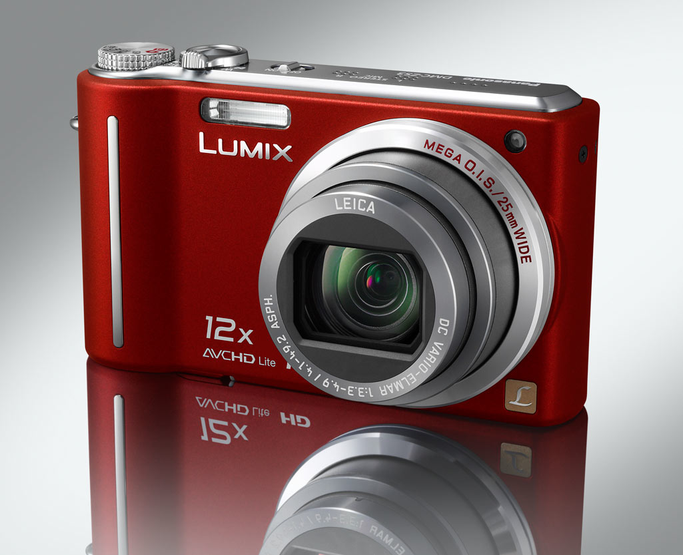
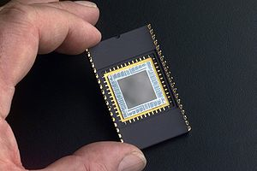
Indirectly (x-rays → optical photons → electrons)
Charge Coupled Devices (CCDs)
Optical detectors are everywhere in our lives… camera phones, etc.
CCDs are integrating detectors. No dead-time issues, but read noise and dark current

Slide 13
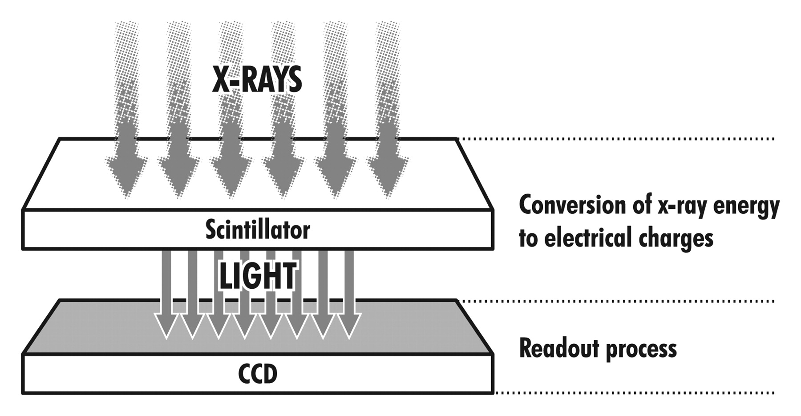
Indirectly (x-rays → optical photons → electrons)
Charge Coupled Devices (CCDs) + x-ray scintillators
Thickness of scintillator dictates the usable energy range

Slide 14
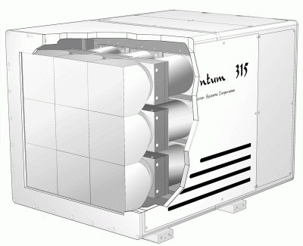
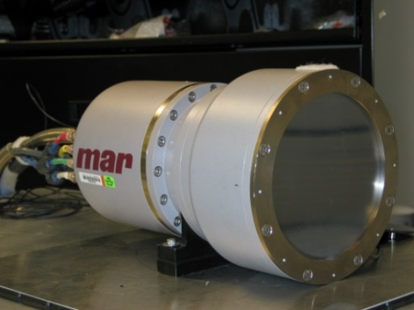
Indirectly (x-rays → optical photons → electrons)
Charge Coupled Devices (CCDs) + x-ray scintillators
With demagnification for large area detectors
  Diffraction ( < 30 keV)
CCD
sample
x-rays
Fiber Optic Taper (Optical photons)
(1 – 3 De-Magnification)
Scintillator (e.g., Gd₂O₂S)
Spatial resolution ~ 100 μm
No deadtime correction
Calibrations
  Dark Subtraction
  Spatial Distortion
  Spatial gain variations

Slide 15
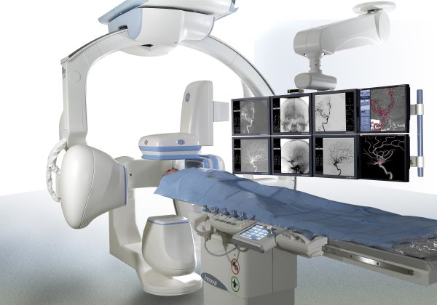
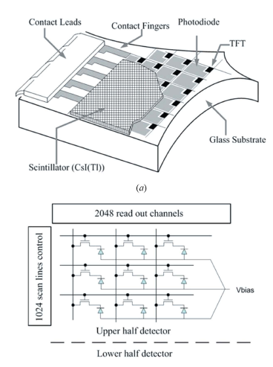
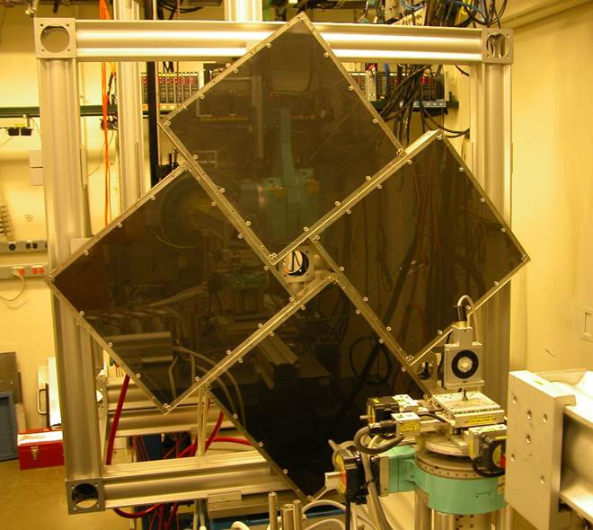
Indirectly (x-rays → optical photons → electrons)
Amorphous Silicon Flat Panel + x-ray scintillators
Used at higher energies ( > 50 keV)
Thin film transistor (TFT) technology (a-Si photo-sensors) allows large area detectors
  Cheaper than CCDs, but higher noise and less dynamic range!
  Typically faster than CCDs.
Sector 1
~ 120 cm

Slide 16
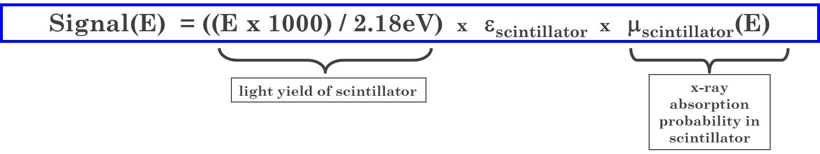
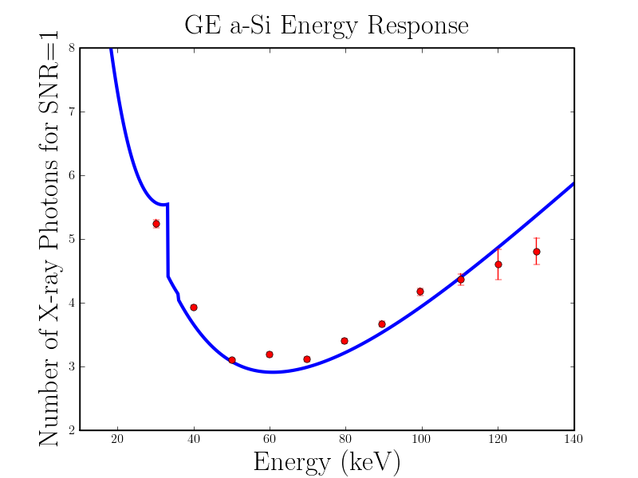
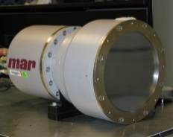
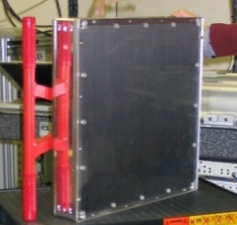
Scintillator Thickness and Optimal Energy Range
Simple Energy-Dependence Model for Indirect Detection Area Detectors
Signal Size
GE a-Si Flat Panel
8
marCCD/165
500 μm CsI
7
10
40 μm Gd₂O₂S
6
5
Number of X-ray Photons for S/N ratio = 1
4
3
2
2
10 30 50 70 90
Energy (keV)
40 60 80 100 120 140
Energy (keV)

Slide 17
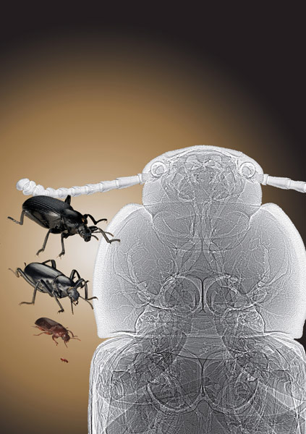
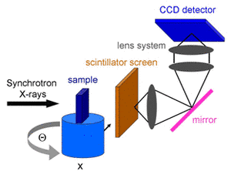
Indirectly (x-rays → optical photons → electrons)
Charge Coupled Devices (CCDs) + x-ray scintillators
Magnification → Microscopy
  μm-scale spatial resolution with x-rays

Slide 18
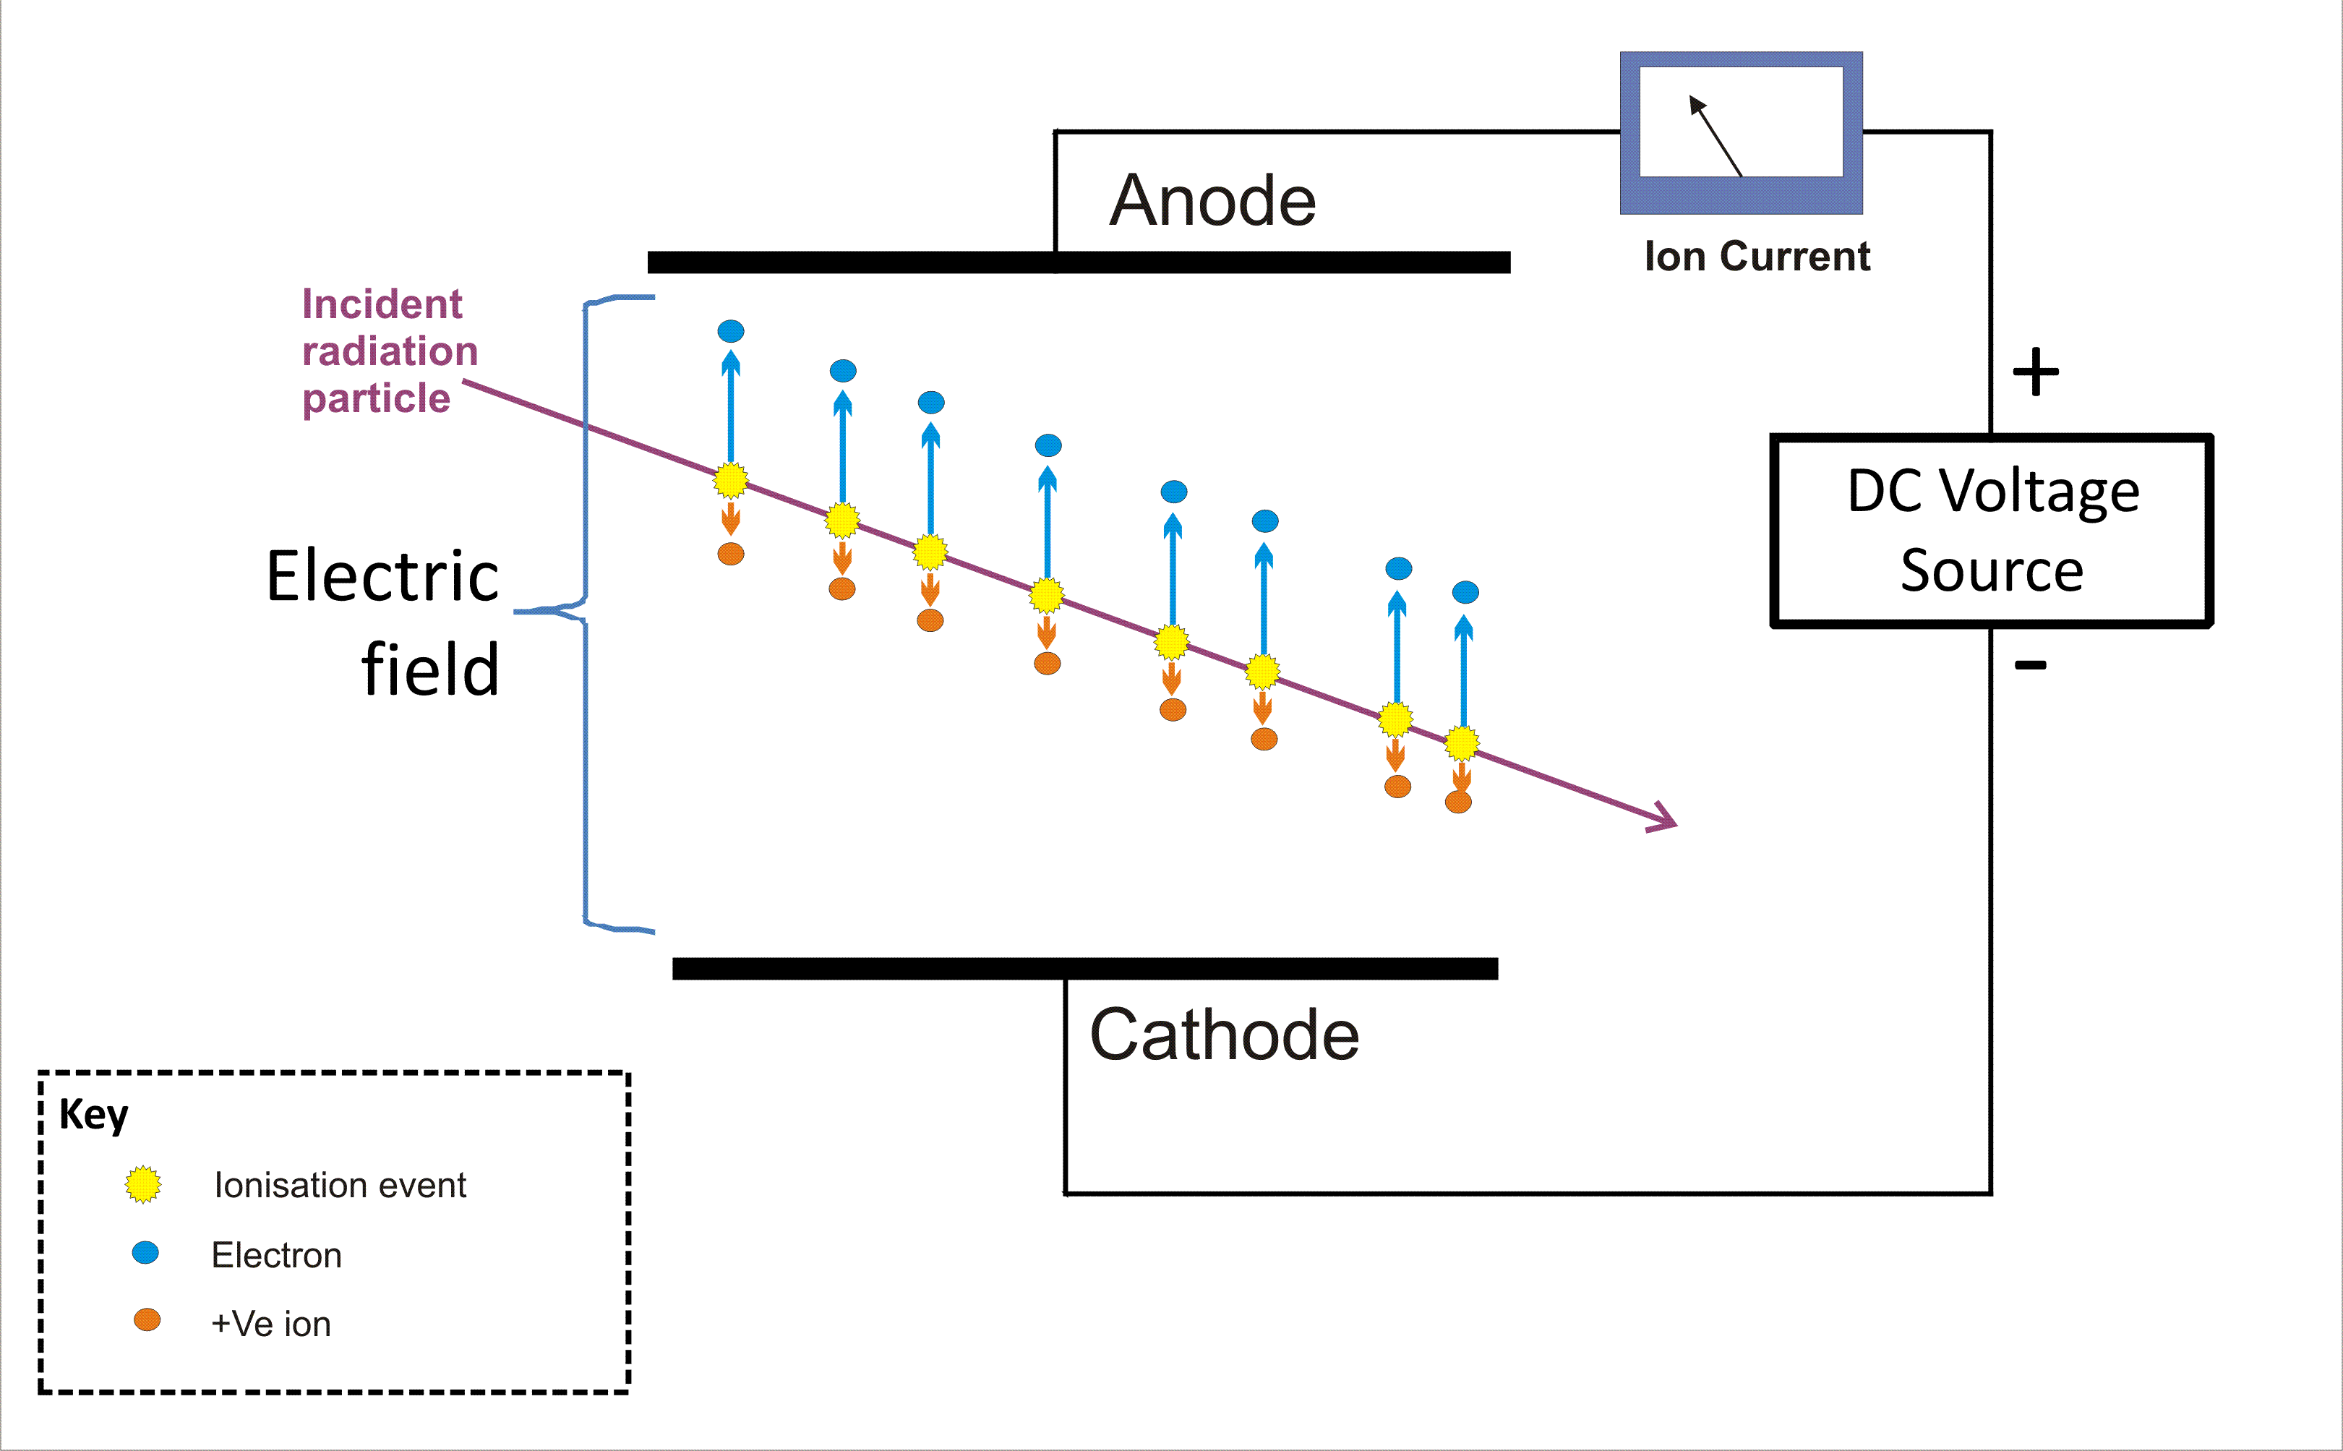
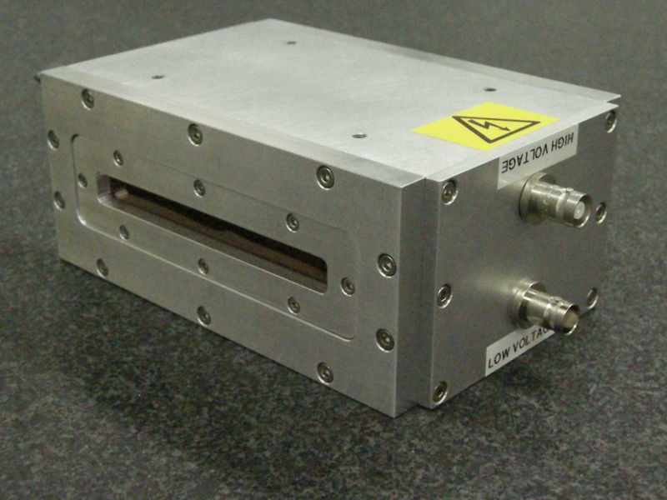
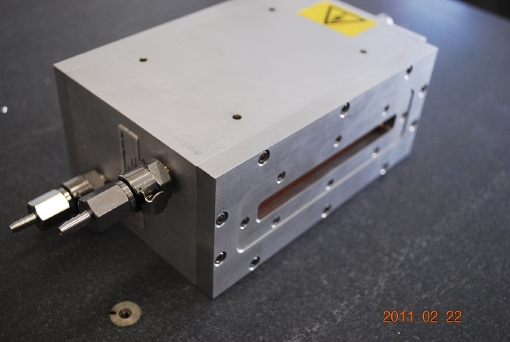
    Directly (x-rays → electrons)
    Ion Chambers
Integrating detectors… ion current ~ x-ray flux
Used to monitor beam intensity
Used to normalize data to the beam intensity (“I0”)
Also used for transmission XAS measurements.

Slide 19
Directly (x-rays → electrons)
Pixel Array Detectors (e.g., Pilatus)
Dectris Ltd

Slide 20
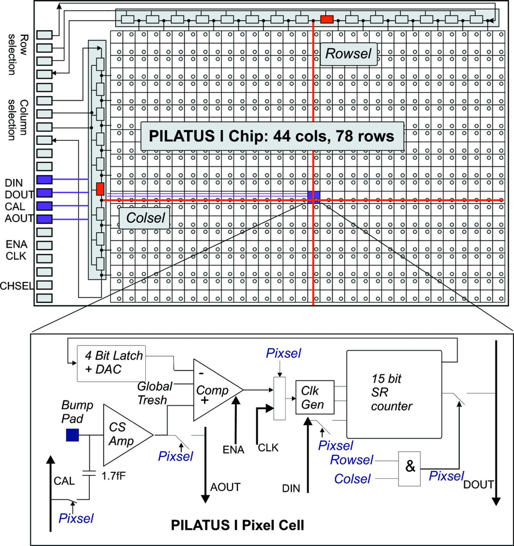
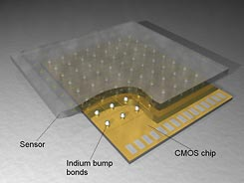
Directly (x-rays → electrons)
Pixel Array Detectors (e.g., Pilatus)
CMOS readout chip (i.e., Application Specific Integrated circuit, ASIC)
Pilatus is a digital PAD (photon counting)
AGIPD pixel
PSI/SLS Detector Group

Slide 21
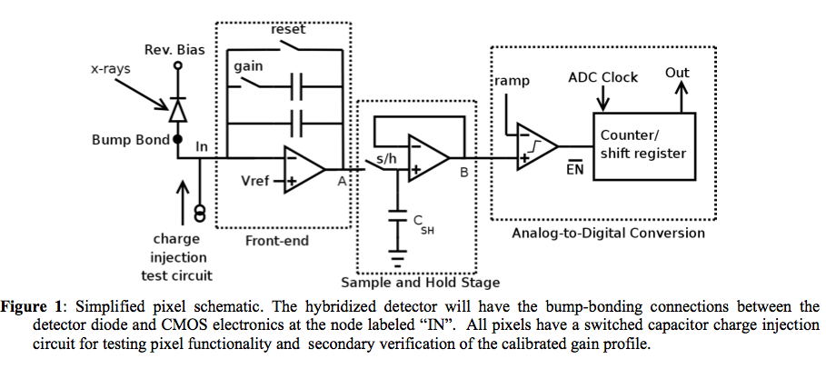
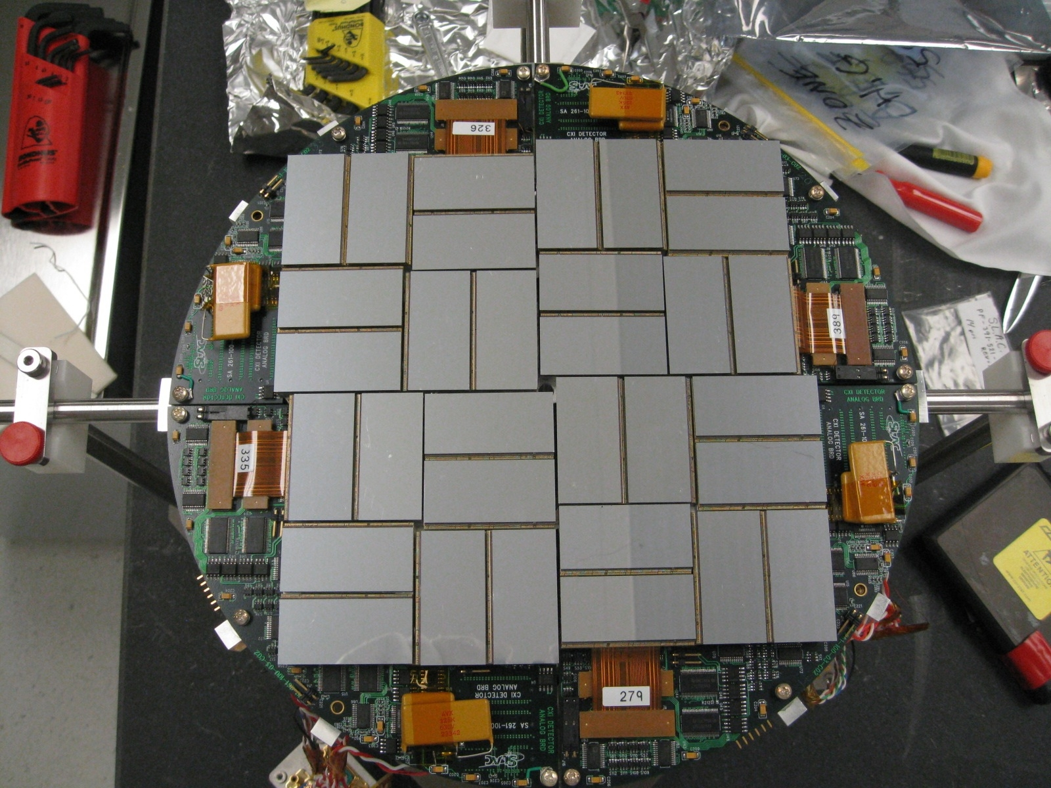
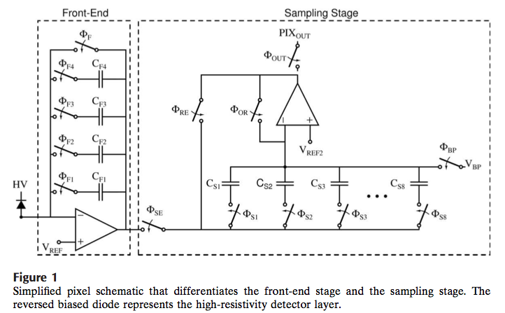
Directly (x-rays → electrons)
Integrating Pixel Array Detectors
You can design the CMOS readout in anyway you like.
  e.g., with an integrating front end.
CSPAD at LCLS
Gruner et al.,

Slide 22
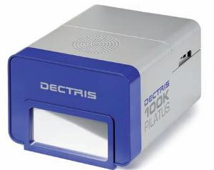
    Directly (x-rays → electrons)
    Pixel Array Detectors (e.g., Pilatus)
Each pixel is a single photon counting detectors!
Thus has count rate limitations
487 x 195 pixels (172 μm)
8.3 cm x 3.3 cm Area
Count Rate ~ 1 MHz/pixel
20-bit counter/pixel
5ms readout (Frame Rate = 200 Hz)
320 micron thick Silicon sensor
Gateable & electronic shutter
Lower Level Discriminator only
Brönnimann et al. @ PSI in Switzerland (Dectris)

Slide 23
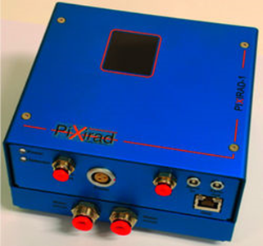
A variety of Pixel Array detectors
Quantum efficiency of pixel detectors is x-ray absorption efficiency (i.e., photoelectric)
  Desire thick and high-Z sensor materials
Silicon (Z = 14) sensors → Pilatus
  Currently maximum thickness ~ 1 mm
CdTe (Z_{eff} = 50)sensors → Pixirad
  CdTe thickness 0.5 to 1 mm
Pixirad CdTe Pixel Detector

Slide 24
Directly (x-rays → electrons)
Pixel Array Detectors – Pilatus Threshold
Threshold
Where to set the threshold?
Is there an “optimal” threshold?

Slide 25
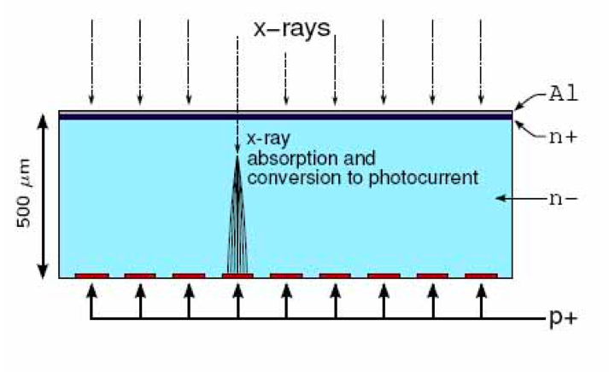
Pilatus Threshold – pixel charge sharing
Pixels

Slide 26
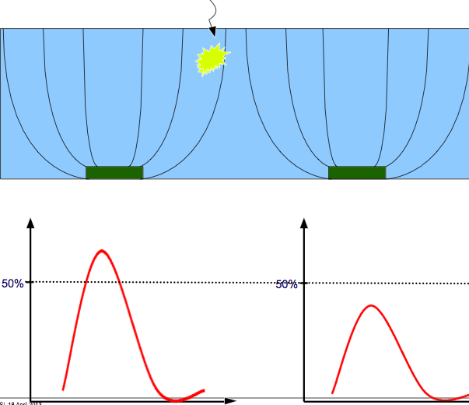
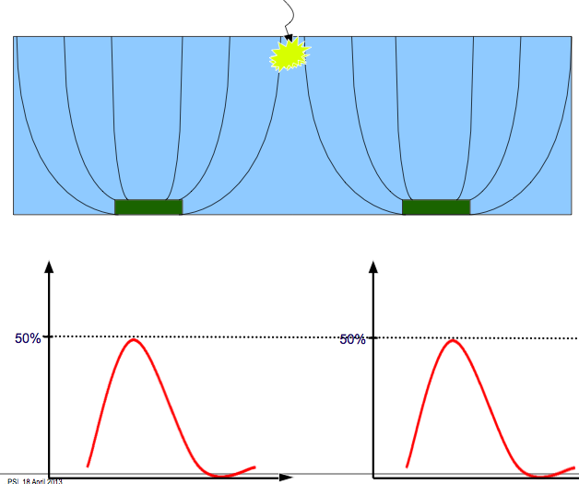
Pilatus Threshold – pixel charge sharing
B. Schmitt et al
If threshold is too high, then you under count events (effectively a small pixel)
If threshold is too low, then you double count events
“Optimal” threshold is 50% of beam energy
  Unless you need to reject fluorescent background.

Slide 27
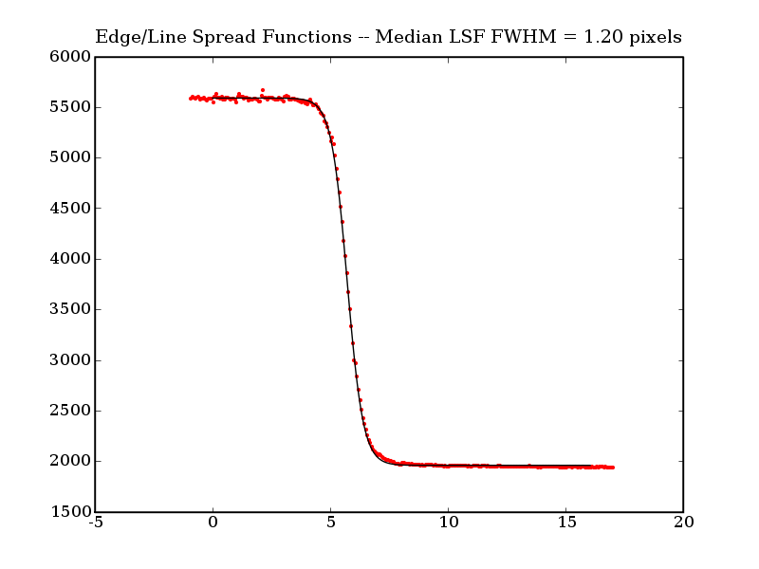
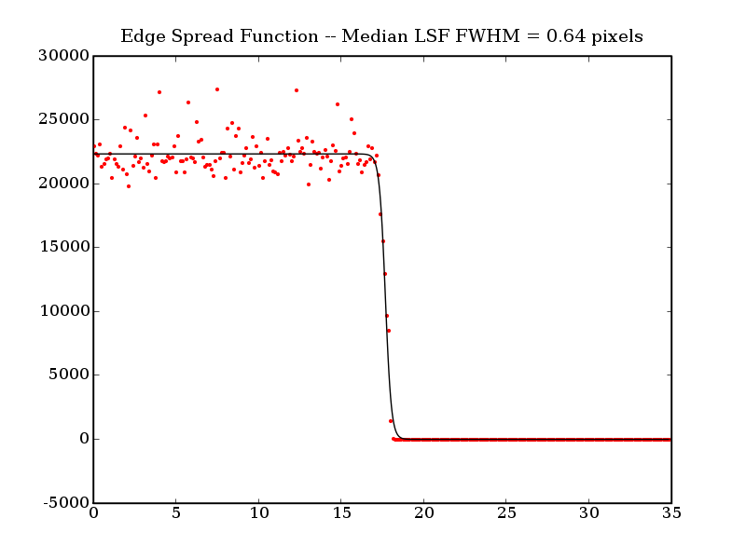
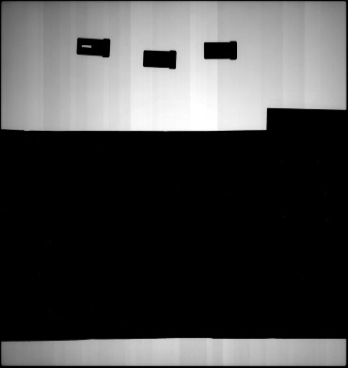

Spatial Resolution: Indirect vs. Direct
Indirect detection area detectors resolution is limited by the thickness of the scintillator because of optical blurring
Direct detection detectors have single-pixel resolution
GE a-Si Flat Panel (CsI)
Pilatus Silicon
Tungsten Knife Edge

Slide 28
Energy Resolving Detectors
(aka Energy Dispersive Detectors)
(aka Spectroscopic Detectors)
(aka XRF detector)
Copper
x-ray beam
Spectrum
XRF detector
Cu Kβ
Cu Kα

Slide 29
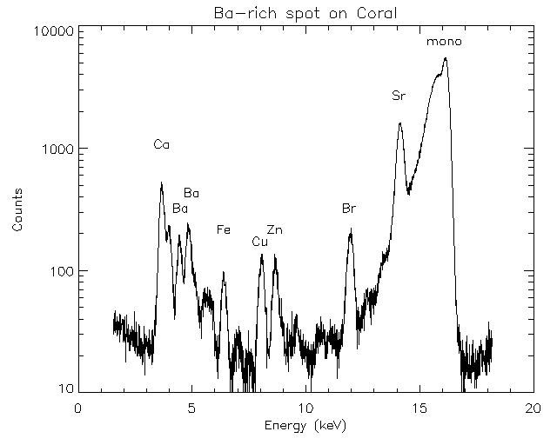
Fluorescence (XRF) Measures…
Abundance (ppm level) and spatial correlations of heavy elements
XRF Image of a cell
Sea Coral
Matt Newville, 13-id
Barry Lai, 2-id
Elemental Compositions of Comet 81P/Wild 2 Samples Collected by
Stardust (Flynn et al 2006)
Solid-phases and desorption processes of arsenic within Bangladesh
sediments (Polizzotto et al 2006)
A link between copper and dental caries in human teeth identified by
X-ray fluorescence elemental mapping (Harris et al 2008)
Levels of Zinc, Selenium, Calcium, and Iron in Benign Breast Tissue
and Risk of Subsequent Breast Cancer (Cui et al 2007)

Slide 30
Spectroscopic Detectors
( Silicon or Germanium )
x-ray
X-Ray Energy ~ # of e-h pair
( 3.67 eV are need to produce 1 e-h pair for Silicon!!)

Slide 31
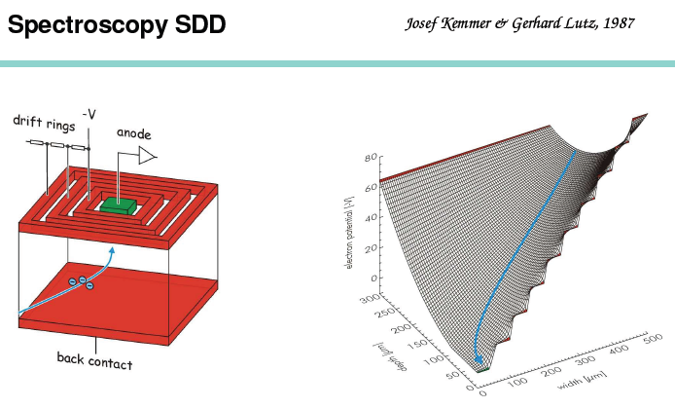
In reality, we use Silicon Drift Diodes …
Noise scale like the area of the anode!
  Thus make the anode small

Slide 32
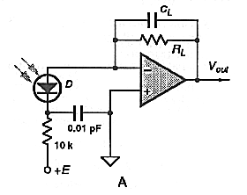
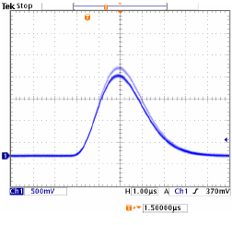
Spectroscopic Detectors – Signal Chain
Preamp
x-ray
Digitizer
diode
Shaping Amp
Pulse Height Analyzer
Multi-Channel Analyzer
Histogram
Pulse Height
1 V
3 μs
Energy ~ P.H. ~ channel #

Slide 33
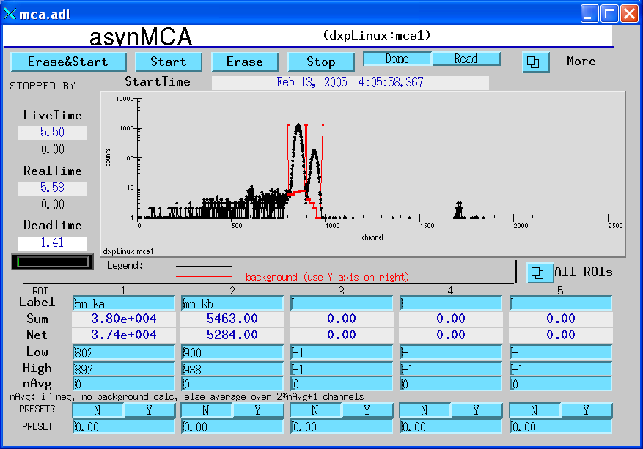
Spectroscopic Detectors – Pulses to Histograms
Fe-55 Source on a scope.
Mn Kα
Mn Kβ
Pulse Height
1 V
3 μs
MCA = histogram (e.g., 2048 channels)
SCA = Single Channels (i.e., ROIs)

Slide 34
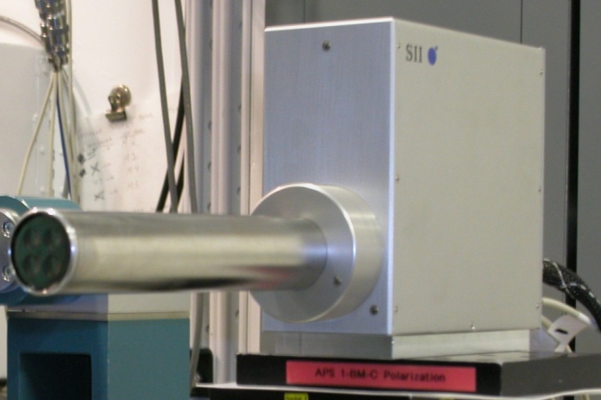
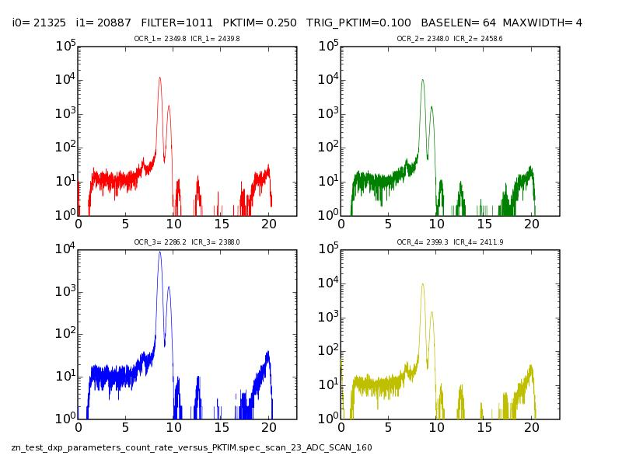
4-element Silicon Drift Diode
4-element SDD (SII Nano Inc)
Peak-to-Background Important!!!
  Usually signal is buried here!
  Recombination, incomplete charge capture, etc.
Best Energy Resolution ~ 150eV

Slide 35
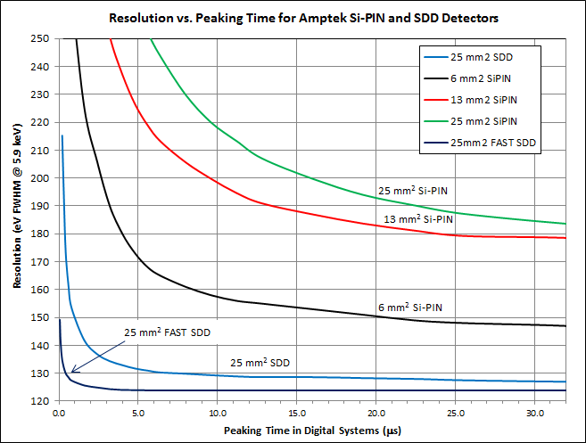
Trade-off between count rate and energy resolution!!!
Shorter shaping time (length of pulse) means more count rate, but less energy resolution.
  Depends on your experiment.

Slide 36
Dynamic Range
We typically have weak signals next to strong signals in the same image.
For counting detectors, dynamic range is set by how big your counter is (e.g., Pilatus has a 20-bit counter in each pixel)
For integrating detectors (e.g., CCD, a-Si flat panels), the dynamic range is set by how much charge each pixel can storage and the noise level.
Gruner et al.,
Detector Signal
Level
S
DR = S
1
Input Flux
Detector Signal
Level
S
DR = S/σ
σ
Input Flux

Slide 37
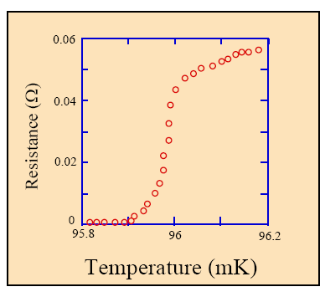
Beyond Silicon … Superconducting sensors
1/e response time = 100 μs - 1 ms
Kent Irvin et al, NIST-Boulder

Slide 38

Transition Edge Sensors
High resolution, low count rates → Need to make arrays

Slide 39



Microwave Kinetic Inductance Detectors
‘Microwave’ refers to the readout frequency!

Slide 40


Why use Low Temperature Superconductors?
Energy Gap
Silicon – 1.10000 eV
Aluminum – 0.00018 eV
Energy resolution:
Cooper Pair

Slide 41
Microwave Kinetic Inductance Detectors
Excess quasiparticles or ΔT generated by x-ray causes an inductance increase (i.e., “kinetic inductance”)
  Measure inductance change in a LC resonating circuit
Observables….
ΔL_{s}
Multiplexing: Lithographically vary geometric inductance/resonant frequency…
ΔR_{s}

Slide 42

Cryogenic Detector R&D at APS
The goal is energy resolution < 5eV with good count rate capabilities (> 100kcps)
Three Main Aspects:
  Device Fabrication
    Completely in-house with dedicated deposition chamber
  Cryogenics and Device Characterization
    Turnkey 100 mK cryostat (cryogen-free)
  Readout electronics
    Multi-pixel implementation in progress

Slide 43



Anatomy of a thermal MKID (i.e., calorimeter)
Feedline
Microcalorimeter
Superconducting
Resonator
Capacitor
0.5 μm thick SiN
Inductor
+
300 μm
Absorber
Empty
Space
0.5 x 300 x 300 μm Tantalum Absorber
100 nm WSi₂ resonator

Slide 44






Microfabration Fabrication Process
Six Layer Mask Layout (2” wafer)
0.5 μm SiN + 300 μm Silicon wafer
Resonator deposition (@ APS)
Resonator Lithography (MA-6, CNM)
Resonator Etch (Oxford RIE, CNM)
Resist strip (1165 remover, CNM)
Absorber Lithography (MA-6, CNM)
Absorber deposition (@ APS, CNM)
Absorber liftoff (1165 remover, CNM)
SiN bridge lithography(MA-6, CNM)
Backside SiN membrane lithography (MA-6, CNM)
Backside SiN etch (March etcher, CNM)
Bulk Si etch (KOH, CNM)
Backside protective Al depositions (@ APS)
SiN bridge etch (March etcher, CNM)
Al wet etch (CNM)
Resist strip (1165 remover, CNM)

Slide 45
Conclusions
Take a moment to analyze what kind of detector you are using!
  Counting or Integrating?
    Counting: Deadtime limitations (what’s the fill pattern during my experiment?)
    Integrating: Dark Subtraction?
  Pilatus detector (counting pixel array detectors)
    What threshold should use?
  Energy resolving detectors?
    What shaping time to use?
      Speed versus resolution
  Interested in detector physics? Come talk to me!
    Looking for some young minds to develop new detectors!

