Slide 1
Inelastic neutron scattering
Rob McQueeney
Deputy ALD for Neutron Sciences
Oak Ridge National Laboratory
NXS Summer School
June 22, 2015

Slide 2
Outline
Interaction of the neutron
  Nuclear
  Magnetic
General inelastic scattering
Nuclear inelastic scattering
  Correlation functions
  Examples
Magnetic inelastic scattering
  Correlation functions
  Examples
Techniques and instrumentation

Slide 3
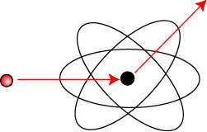
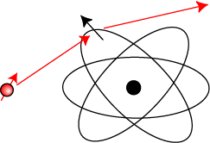
Neutron interaction with matter
Properties of the neutron
  Mass m_{n} =1.675 x 10⁻²⁷ kg
  Charge = 0
  Spin-1/2, magnetic moment m_{n} = -1.913 m_{N}
Neutrons interact with…
  Nucleus
    Crystal structure/excitations (eg. phonons)
  Unpaired e⁻ via dipole scattering
    Magnetic structure/excitations (eg. spin waves)
Nuclear scattering
Magnetic dipole scattering

Slide 4
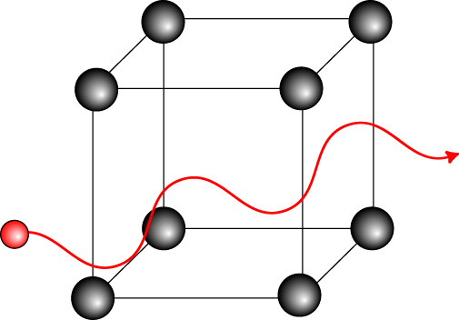
Wavelength-energy relations
Neutron as a wave …
  Energy (E), velocity (v), wavenumber (k), wavelength (λ)
λ ~ interatomic spacing → E ~ excitations in condensed matter
 | Energy (meV) | Temperature (K) | Wavelength (Å)
Cold | 0.1 – 10 | 1 – 120 | 4 – 30
Thermal | 5 – 100 | 60 – 1000 | 1 – 4
Hot | 100 – 500 | 1000 – 6000 | 0.4 – 1
Notes:
As with any other quantum particle, the neutron scan be thought of as a wave.
deBroglie wavelength is inversely proportional to the neutron velocity (or wavenumber).
The energy of the neutron is proportional to the inverse-square of the wavelength.
Of course, the energy of the neutron has a temperature scale given by kT.
Neutrons that are most useful for scattering from condensed matter have a wavelength of order the interatomic spacing (roughly an Angstrom). Neutrons of this wavelength have an energy is the range of 10’s of meV. This is a thermal energy scale and consequently is the range of many important excitations in condensed matter systems.

Slide 5
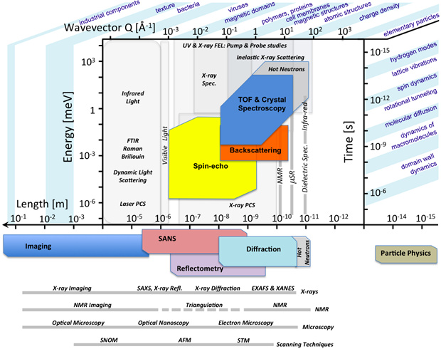
Time and length scales
Shorter length scales
Faster processes

Slide 6
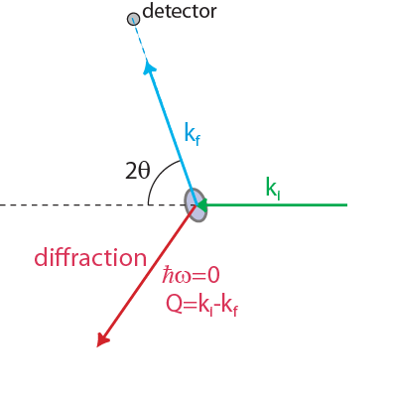
Elastic scattering
Scattering process where energy of neutron does not change
Conservation of energy and momentum
Scattering triangle
Elastic scattering
Notes:
Inelastic scattering is a process where two systems exchange energy during a collision. Both momentum and energy must be conserved during the collision.
As phyisicsts, we keep track of inelastic processes by measuring the incoming and outgoing neutron wavevectors and use conservation of energy and momentum determine the excitation created in the system
In elastic scattering,

Slide 7
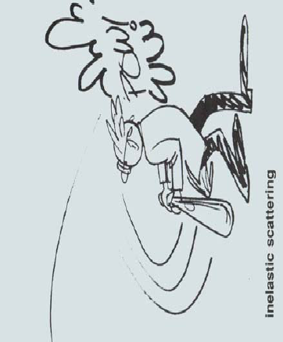
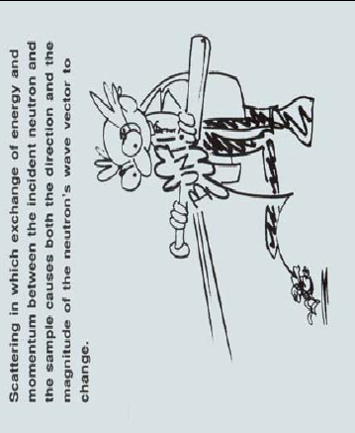
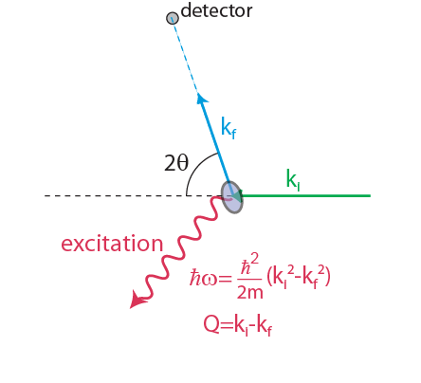
Inelastic scattering
Scattering process that changes energy of neutron
Conservation of energy and momentum
Scattering triangle
Inelastic scattering
Notes:
As phyisicsts, we keep track of inelastic processes by measuring the incoming and outgoing neutron wavevectors and use conservation of energy and momentum to determine the properties of the excitation

Slide 8
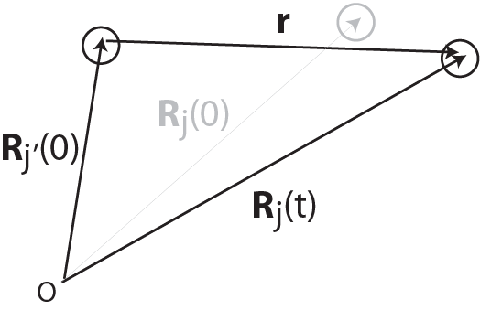
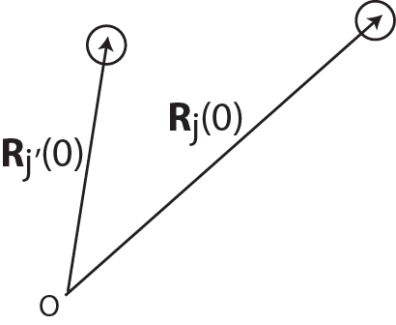
Nuclear correlation functions
Force
Pair correlation function
Intermediate function
Differential scattering
cross-section
Scattering function
Notes:
First consider the nuclear scattering.
The scattering cross-section is proportional to the pair correlation function, G(r,t).
Given two atoms at Rj and Rj’ at time zero, Classically, the function determines the probability that the atom is found at the position Rj’(t) a time later. This probability depends on the forces between atoms.
The scattering function, S(Q,w), is given by the time/space fourier transform of the pair correlation function.
Note that for static lattice, intermediate function is just S(Q) for diffraction. Time averaged static correlation function.
The power of neutron scattering is that the measured cross-section is directly proportional to the scattering function. In many cases, this function can be calculated and compared directly to theory. Experiment tells us about the forces between atoms.

Slide 9
Nuclear (lattice) excitations
Neutron scattering measures simultaneously the wavevector and energy of collective excitations → dispersion relation, ω(q)
In addition, local excitations can of course be observed
Commonly studied excitations
  Phonons
  Librations and vibrations in molecules
  Diffusion
  Collective modes in glasses and liquids
Excitations can tell us about
  Interatomic potentials & bonding
  Phase transitions & critical phenomena (soft modes)
  Fluid dynamics
  Momentum distributions & superfluids (eg. He)
  Interactions (eg. electron-phonon coupling)

Slide 10
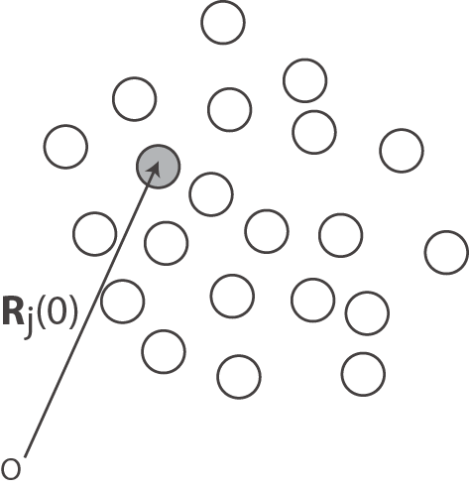
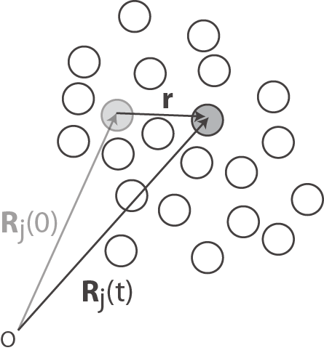
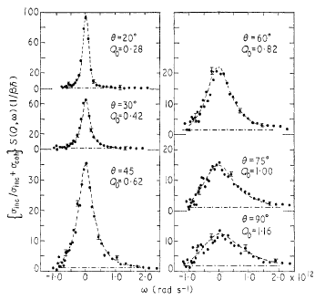
Atomic diffusion
For long times compared to the collision time, atom diffuses
Liquid Na
Auto-correlation function
Cocking, J. Phys. C 2, 2047 (1969)..
These kinds of measurements are a specialty of the BASIS spectrometer
Notes:
In a liquid, at long times an atom is in diffusive motion.
We can look at the self-correlation function of the single atom as it moves through the liquid.
The probability that the atom moves a distance r in time t is gaussian.
The scattering function is just the Fourier transform, assuming the mean-squared displacement is linear in time (diffusive). Simple model predicts lorentzian spectrum where the width depends on Q.

Slide 11
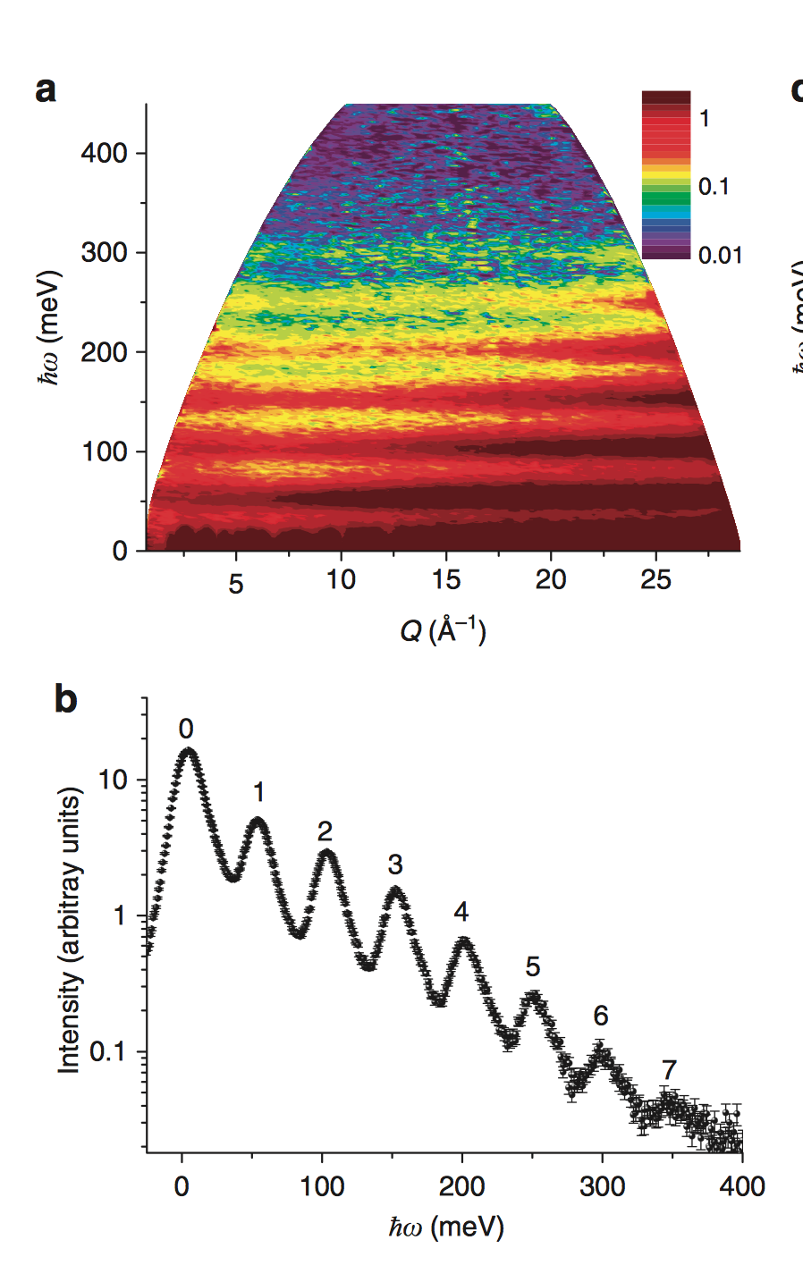
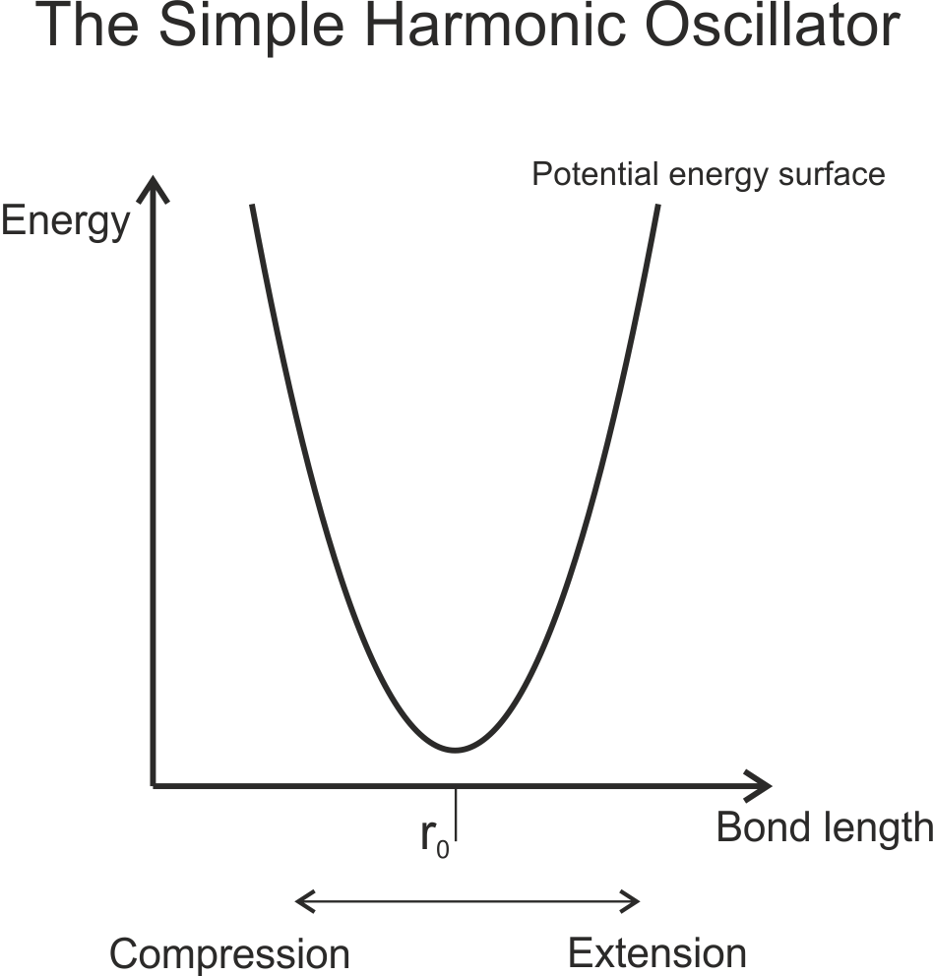
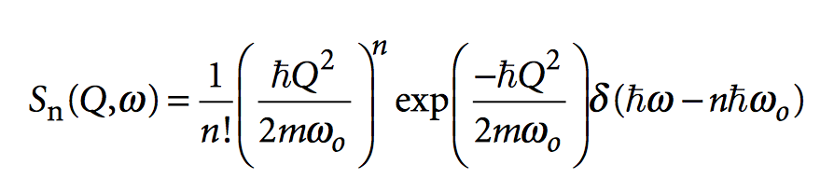
Simple harmonic oscillator
Nitrogen motion in uranium nitride
A.A. Aczel, et al., Nature Commun 3, 1124, (2012).
These kinds of measurements are a specialty of the
ARCS and SEQUOIA spectrometers
Notes:
Single atom oscillating in a harmonic potential
Simple harmonic oscillator has frequency w0.
Quantum mechanical solution is a set of equally spaced energy levels spaced by hbar w0.
The scattering cross-section will then also consist of a set of excitations spaced equally by w0.
Ultimately, the higher energy states correspond to increased vibrational amplitude. In other words, the r-dependence (and by Fourier transform) the Q-dependence depend on the excitation level.
Each energy level has a unique Q-dependence, even though it is only scattering from a single atom.
Data shows nitrogen vibrations in uranium nitride. Light atom trapped in a cage of heavy uranium act like a 3D harmonic oscillator.
Data shows vibrational energy levels beyond n=10.

Slide 12
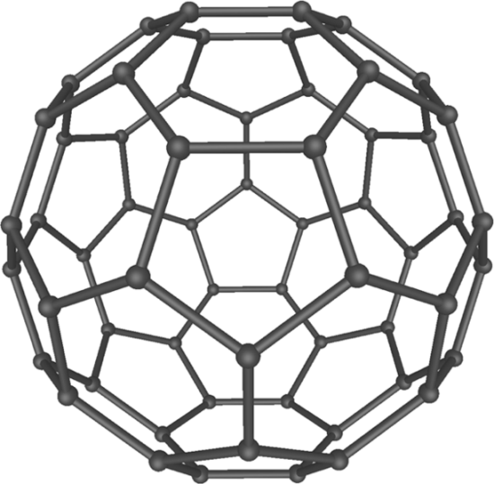
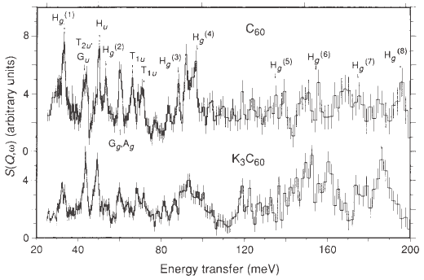
Molecular vibrations
Large molecule, many normal modes
Harmonic vibrations can determine interatomic potentials
C60 molecule
Prassides et al., Nature 354, 462 (1991).
These kinds of measurements are a specialty of the VISION spectrometer
Notes:
A molecule has many atoms connected by many different bonds. For n atoms, there are 3n normal modes, each with potentially different frequencies. Knowledge of these frequencies allows one to determine the strength of the bonding.

Slide 13

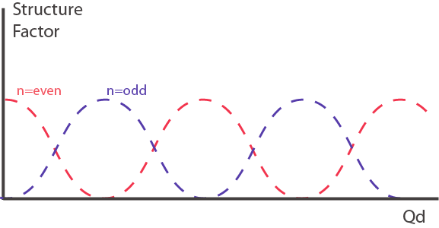
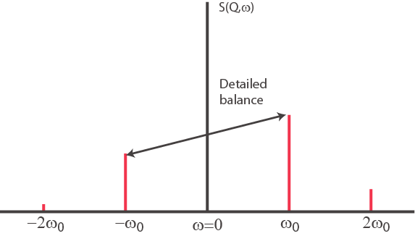
Diatomic molecule
Debye-
Waller
Detailed
balance
Structure factor
Form
factor
Excitation
energy
Small-amplitude approximation, y small
Elastic scattering
One quantum
Multi-quanta
Notes:
Resulting scattering function for the diatomic molecule contains several factors
DW factor: is the same as that in crystallography, reduction of scattering intensity due to mean-squared displacement of atoms
Detailed balance: Relates intensity of equivalent excitations in energy loss and energy gain.
Structure factor: Contains variations in intensity that depend on the structure. Due to interference of scattering from two atoms.
Form factor: Contains information about the shape of the scatterer. In this case, the size of the displacement controls the scattered intensity as a function of Q.
Excitation energy: Excitations will only appear at intervals of w0.
Often the vibrational scattering function is expanded assuming that the product Qu is small. In this case, the form factor can be expanded, leading to elastic, one-quantum, and multi-quanta terms. The form factor for one-quantum scattering is proportional to Q^2.

Slide 14
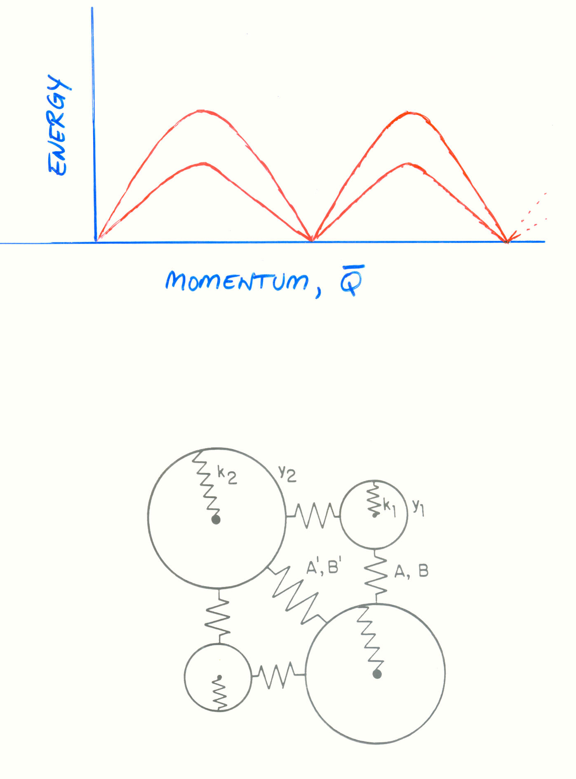
Elementary Excitations in Solids
Lattice Vibrations (Phonons)
Spin Fluctuations (Magnons)
Energy vs Momentum
Forces which bind atoms
together in solids

Slide 15
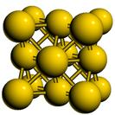


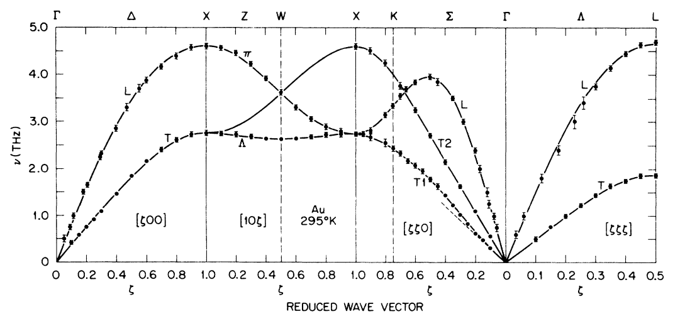
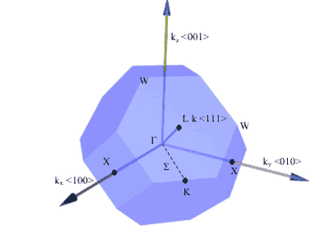
Phonons
Normal modes in periodic crystal → wavevector
Phonon energy depends on q and polarization, ω_{j}(q)
FCC structure
Transverse mode
Longitudinal mode
Phonons in gold
FCC Brillouin zone
Lynn, et al., Phys. Rev. B 8, 3493 (1973).
Notes:
In a periodic crystal, one can define a wavevector for a normal mode, since the fundamental collective excitations are plane waves. The energy of the phonon depends on the q and the polarization (or displacement pattern) of the atoms in the mode.
In a simple Bravais lattice, such as fcc Au, the polarizations can be classified as either transverse or longitudinal. The phonon dispersion for select directions in the crystal is shown, the labels correspond to special directions in the Brillouin zone.

Slide 16
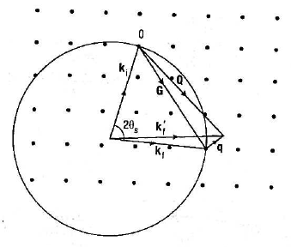
Reciprocal space
Momentum/energy transferred to sample
Wavevector in 1st
Brillouin zone
Scattering triangle
FCC Brillouin zone

Slide 17
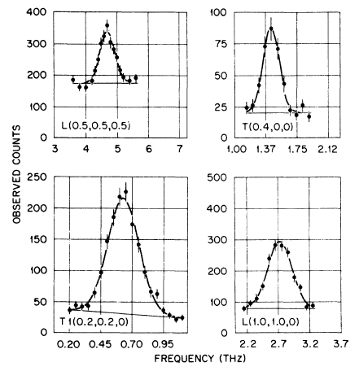
INS data
Intensities as a function of Q and ω
Phonons in gold
Lynn, et al., Phys. Rev. B 8, 3493 (1973).
These measurements are a specialty of the HB3 spectrometer

Slide 18
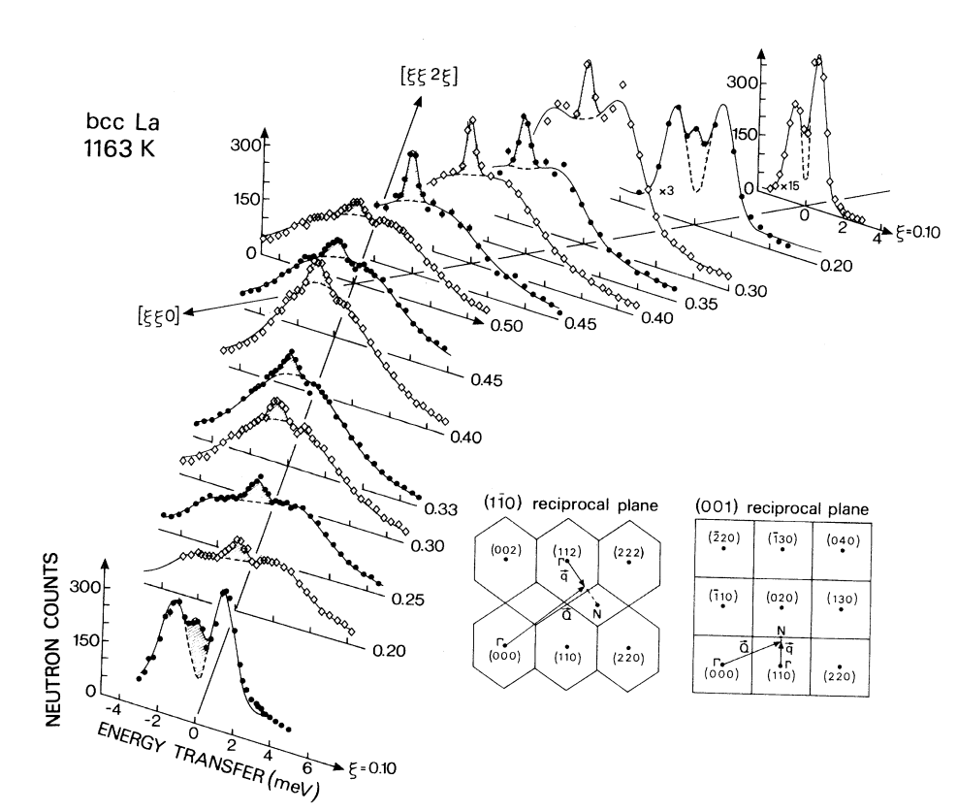
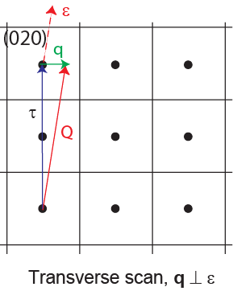
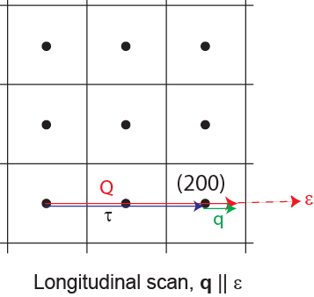
Phonon intensities
Structure (polarization) factor
Can separately measure
longitudinal and transverse modes
Guthoff et al., Phys. Rev. B 47, 2563 (1993).
Notes:
The one-phonon structure factor emphasizes that both the dispersion and eigenvector depend on the reduced wavevector, q, within the first Brillouin zone.
However, the intensity measured in a neutron experiment depends on the projection of the phonon eigenvector along the momentum transfer, Q. Thus, the intensity depends on which Q (or zone) the measurement is performed.
For example, suppose I do two measurements at the same q, but different Q.
At Q1=(2.25,0,0), I measure longitudinal phonons since q||e
At Q2=(0.25,2,0), I measure mainly transverse phonons since q perp e.

Slide 19
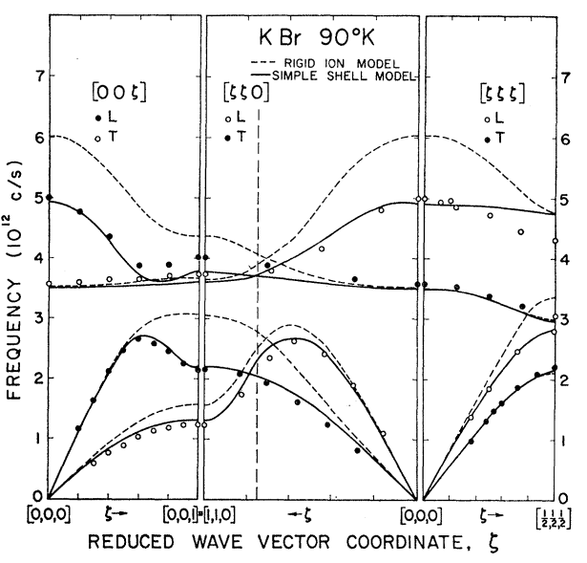

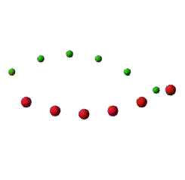
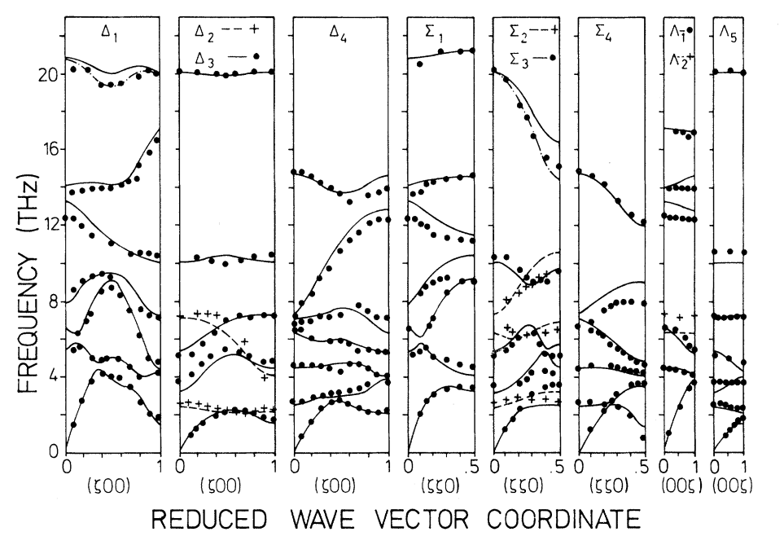
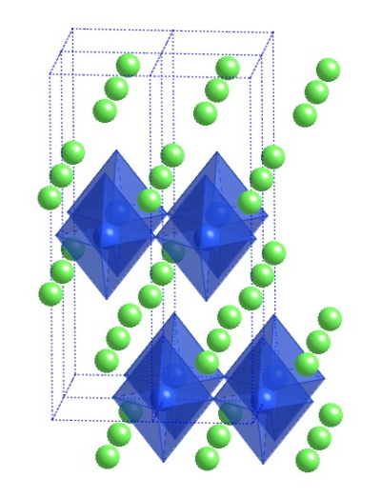
More complicated structures
Acoustic phonon
Woods, et al., Phys. Rev. 131, 1025 (1963).
Optical phonon
La₂CuO₄
Chaplot, et al., Phys. Rev. B 52, 7230(1995).

Slide 20
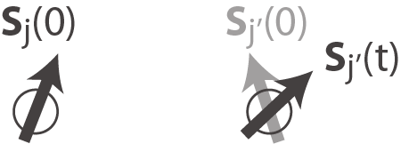
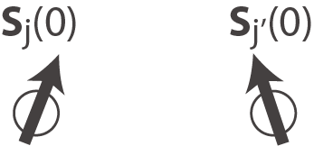
Spin correlation functions
Scattering
cross-section
Dipole
interaction
Spin-spin
correlation function
The cross-section is proportional to the magnetic susceptibility,
i.e. it is the response of the system to spatially & time varying magnetic field
Notes:
For magnetic scattering, the differential cross-section (spin only, static lattice) can be broken down into several terms
Magnetic cross-section: moment size squared x magnetic form factor (FT of magnetization density of a single atom)
Dipole interaction: neutron scattering is only sensitive to the projection of the moment perpendicular to the momentum transfer direction
Spin-spin correlation function: contains all of the physics of the system.
One can also write the differential cross-section in terms of the imaginary part of the magnetic susceptibility

Slide 21
Spin excitations
Spin excitations
  Spin waves in ordered magnets
  Paramagnetic & quantum spin fluctuations
  Crystal-field & spin-orbit excitations
Magnetic inelastic scattering can tell us about
  Exchange interactions
  Single-ion and exchange anisotropy (determine Hamiltonian)
  Phase transitions & critical phenomena
  Quantum critical scaling of magnetic fluctuations
  Other electronic energy scales (eg. CF & SO)
  Interactions (eg. spin-phonon coupling)
Notes:
Interactions are especially important in the study of correlated electron systems, where energy scales of spin, lattice, and electron are comparable.

Slide 22
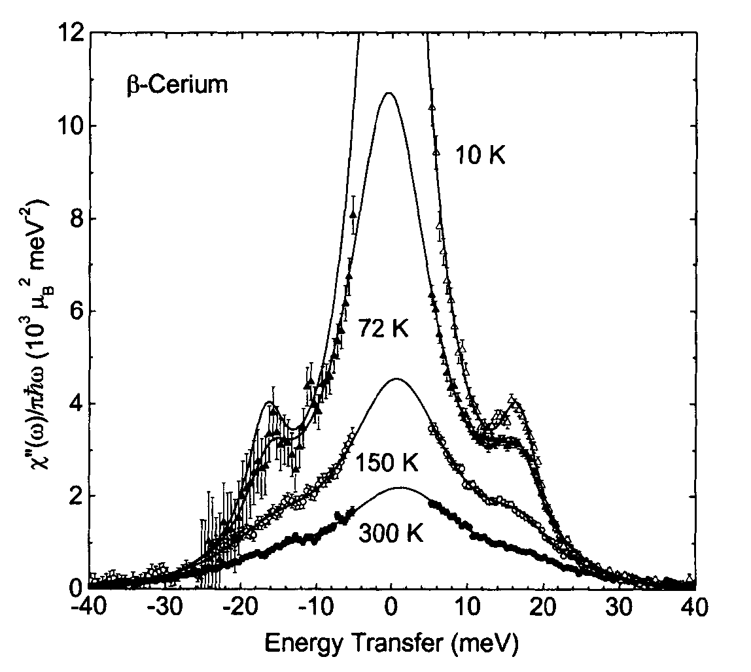
Paramagnetic scattering
Single ion scattering
Inverse width, 1/Γ, gives relaxation time
Note crystal field excitation
McQueeney et al., Phil. Mag. B 81, 675 (2001).
Notes:
A simple example is paramagnetic scattering, where a spin engages in orientational fluctuations that are uncorrelated with neighboring spins.
In this case, spin correlations between different atoms are zero. For self-correlation, a spin pointing along z will lose memory of this orientation exponentially with time.
The dynamic susceptibility is then lorentzian in form (and Q-independent).
Sum rules are also valuable for inelastic scattering and can determine both the moment size and bulk magnetic susceptibility (although this is an expensive wave to measure bulk susceptibility!!)

Slide 23

Spin waves
Linear spin wave theory
Heisenberg Hamiltonian
For a simple ferromagnet
Linear spin waves
Notes:
Spin interactions can be represented mathematically with the Heisenberg Hamiltonian. Thus, a spin and its neighbor are slightly misaligned by some angle and must pay an energy cost proportional to J. When spin deviations from an ordered state are small, one can solve the HH by assuming that only transverse spin fluctuations occur. Correlation functions of the form S+S- indicate the transfer of one spin quantum to the next site. In a crystal, the solutions take the form of precession waves called spin waves (1-D ferromagnet shown).
The spin correlation function is straightforward to analyze for a ferromagnet (as shown). Other magnetic structures are more complicated.

Slide 24
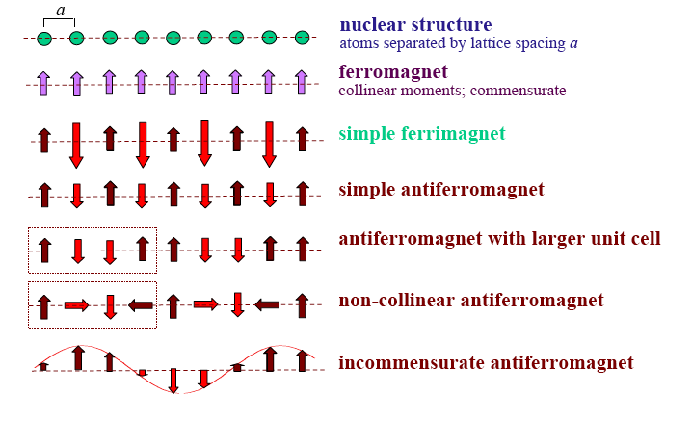
Different types of magnetic order result from complex magnetic interactions

Slide 25
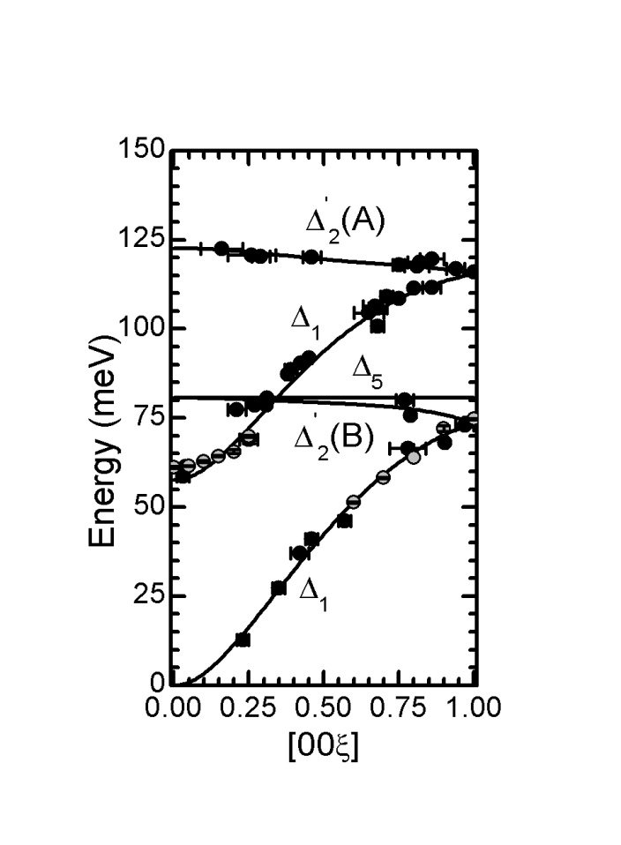
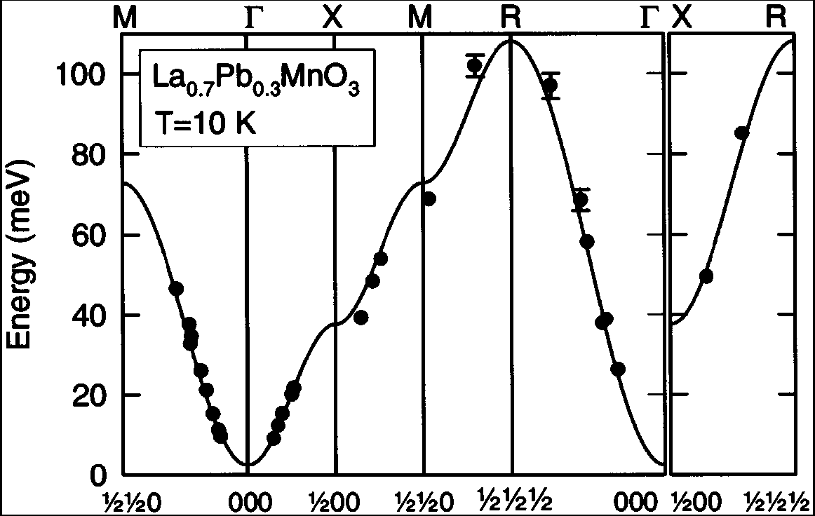
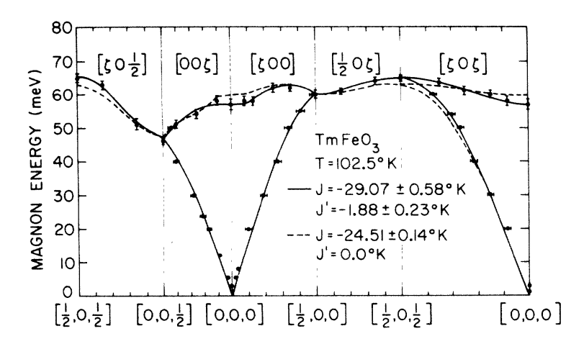
Spin waves from different types of magnetic order
Ferromagnetic
Ferrimagnetic
Perring et al., Phys. Rev. Lett. 77, 711 (1996).
Antiferromagnetic
Fe₃O₄
McQueeney et al., Phys. Rev. Lett. 99, 246401 (2007).
Shapiro et al., Phys. Rev. B 10, 2014 (1974).
Notes:
Spin waves are then identical in spirit to phonons. One can measure the dispersion relation with neutrons. Some examples of spin wave dispersions

Slide 26
Inelastic neutron scattering - Techniques

Slide 27
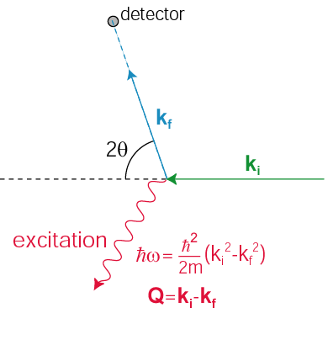
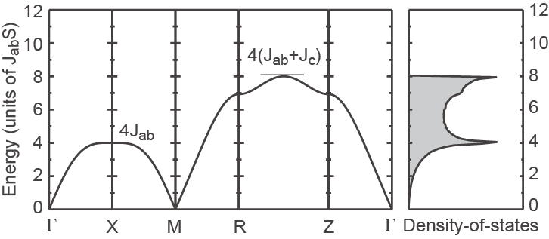
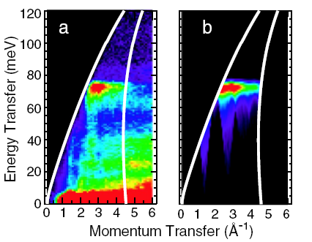
INS experiments
Any inelastic experiment must simultaneously resolve k_{i} and k_{f}
Single-crystal
Powder S(|Q|,ω)
Instrument and sample (powder or single-crystal) determine how (Q,ω) space is sampled by selection of k_{i} and k_{f}
Notes:
We use both single-crystal and powder samples for study
If the sample is a single-crystal the spin wave dispersion can be determined directly.
When using powder samples, directional information is lost, but the number of spin wave modes/unit energy (SW DOS) can be determined using INS from powders. Often the information contained in the SWDOS is sufficient to determine the exchange energies.

Slide 28
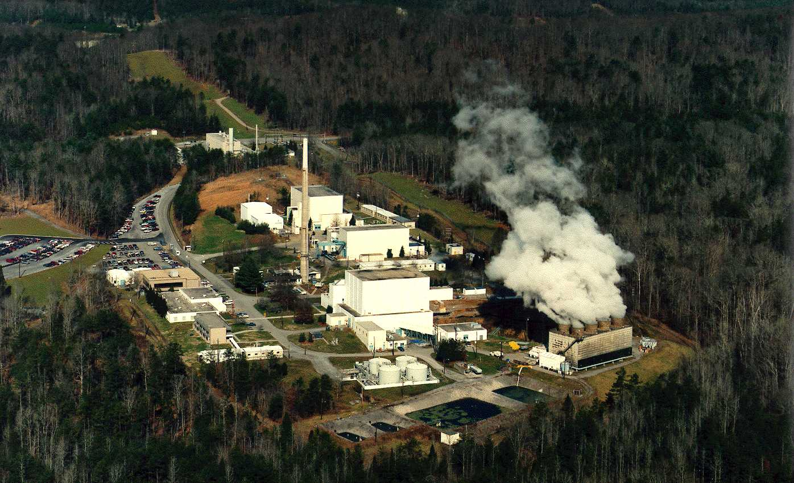
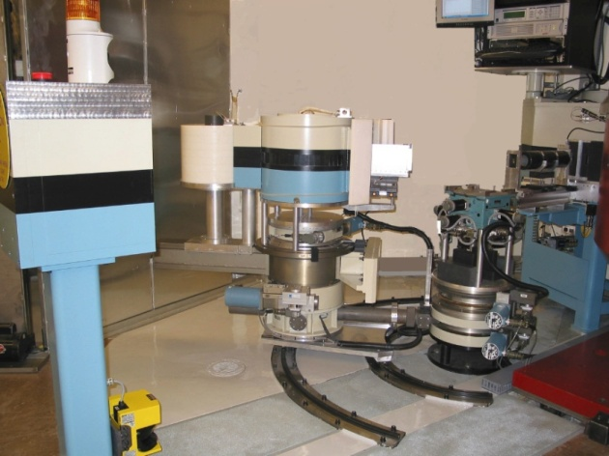
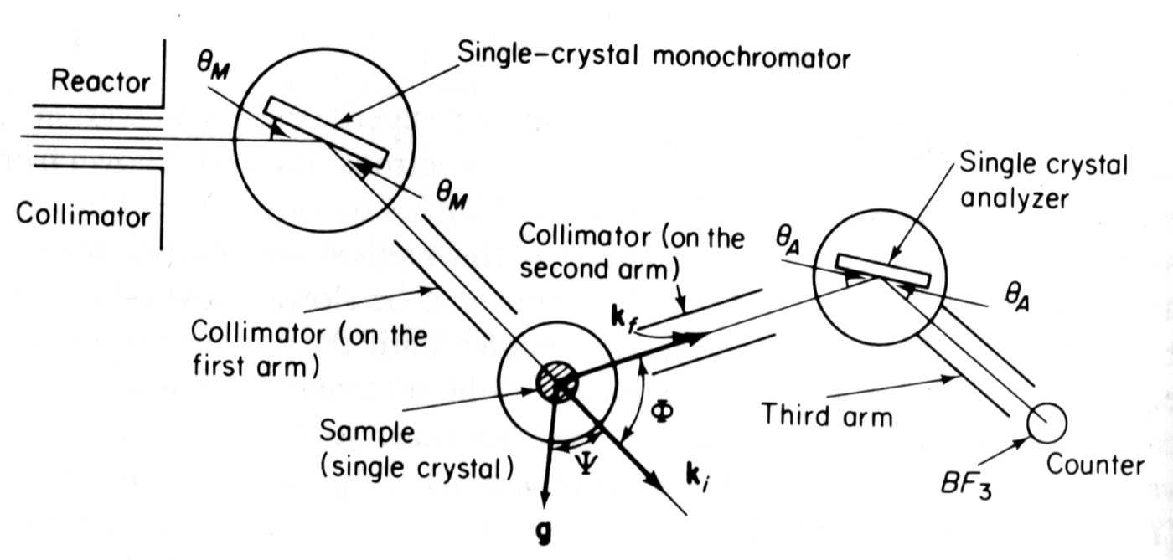
Triple-axis instruments
High flux isotope reactor - ORNL
HB-1A 3-axis spectrometer
k_{i}
Hardware flexibility
Constant-Q (or E) scans
Ideally suited for single-xtals
k_{f}
Notes:
Triple-axis instruments are the workhorses of INS.
- Incident neutron energy is selected by a monochromator crystal reflection using Bragg’s law
Scattering occurs from the sample, creating a spectrum of scattered neutrons
A single energy is selected from this spectrum using an analyzer crystal
Since ki, kf, 2q, and sample orientation can all be varied independently, the triple-axis has great flexibility and is ideal for the study of single-crystals

Slide 29
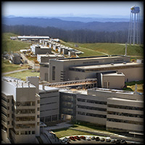
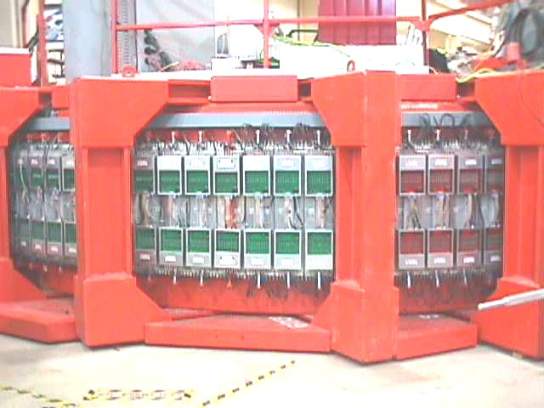
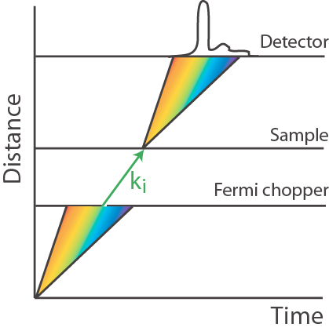
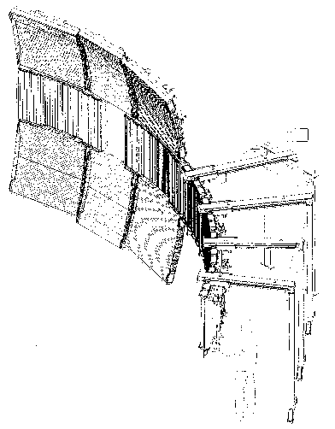
Time-of-flight methods
Hardware inflexible
Effective for powders
Complicated Q,E-scans a challenge for single-xtals
Spallation neutron source
Pharos – Lujan Center
detector banks
velocity selector
Scattered
neutrons
sample
Notes:
Time-of-flight methods make use of the pulsed character of a neutron beam that is produced at a spallation source.
The spallation source creates a pulse of neutrons with all wavelengths. This pulse spreads as it travels down the instrument.
A fermi chopper opens for a brief period to let through a single energy.
Inelastic scattering from the sample slows down and speeds up some neutrons, causing neutrons to arrive at the detector over a range of time. The energy transfer can be calculated from the time-of-flight.
Unlike TAS, there is no analyzer required, so a huge detector bank can be used to detect neutrons scattered over a large solid angle. This is very effective for powder samples.
Single-crystal measurements contain a plethora of information, but are sometimes difficult to analyze/interpret.

Slide 30
Triple-axis instruments
Workhorse INS instrument
  k_{i},k_{f} defined by Bragg scattering
  Sample goniometer
  Detector
  Resolution/collimators
HB-1A 3-axis spectrometer
k_{i}
k_{f}
Notes:
Triple-axis instruments are the workhorses of INS.
- Incident neutron energy is selected by a monochromator crystal reflection using Bragg’s law
Scattering occurs from the sample, creating a spectrum of scattered neutrons
A single energy is selected from this spectrum using an analyzer crystal
Since ki, kf, 2q, and sample orientation can all be varied independently, the triple-axis has great flexibility and is ideal for the study of single-crystals

Slide 31


Monochromators/analyzers
Selects the incident/final wavevector
k_{i} or k_{f}
θ
Q(hkl)=2k_{i} sin θ
Mono | d(hkl) | uses
PG(002) | 3.353 | General
Be(002) | 1.790 | High k_{i}
Si(111) | 3.135 | No λ/2
Notes:
Reflectivity
focusing
high-order contamination
eg. λ/2 PG(004)

Slide 32

Filters
Suppress background contamination
  Xtal Sapphire: fast neutron background
  Poly Be: low-energy (5 meV) band pass
  PG: higher order contamination
PG filter transmission
Notes:
Magic numbers E_{f} = 13.7, 14.7, 30.5, 41 meV

Slide 33



Detectors
Gas Detector
  n + ³He → ³H + p + 0.764 MeV
  Ionization of gas
  e⁻ drift to high voltage anode
  High efficiency counting of scattered neutrons
Beam monitor
  Low efficiency measure of incident flux
Monitor
Detector

Slide 34

Collimators/Masks
Soller Collimators
  Define beam divergence (~degree)
  Q,ω resolution function
Masks
  Beam definition
  Background reduction

Slide 35


Samples
Samples need to be BIG
  ~ gram or cc
  Counting times are long (mins/pt)
Sample rotation
Sample tilt
HB3-HFIR
IN14-ILL
Co-aligned CaFe₂As₂ crystals

Slide 36


Sample environment
Temperature, field, pressure
Heavy duty for large
sample environment
  CCR
  He cryostats
  SC magnets
  …
HB3-HFIR
IN14-ILL

Slide 37

Acquiring data
Constant-Q scans
  Most common
Constant-ω scans
  Used for steep dispersions
Au
Lynn, et al., Phys. Rev. B 8, 3493 (1973).

Slide 38


Constant-ω scans
Steep AF spin waves in CaFe₂As₂
McQueeney et al, PRL 101, 227205 (2008)
Slice of spin wave cone in Fe₃O₄
McQueeney et al, PRB 73, 174409 (2006)

Slide 39


Constant-Q scans
Optical phonons in Nd_{0.85}Ce_{0.15}CuO₄
Braden, et al, PRB, 72 184517 (2005).

Slide 40

Resolution
Resolution ellipsoid
  Beam divergences
  Collimations/distances
  Crystal mosaics/sizes/angles
Resolution convolutions

Slide 41
Resolution focusing
Optimizing peak intensity
Match slope of resolution to dispersion

Slide 42
Time-of-flight methods
We can measure a neutron’s energy, wavelength by measuring its speed
Effectively utilizes time structure of pulsed neutron groups
Spallation neutron source
Pharos – Lujan Center
detector banks
velocity selector
Scattered
neutrons
sample
Notes:
Time-of-flight methods make use of the pulsed character of a neutron beam that is produced at a spallation source.
The spallation source creates a pulse of neutrons with all wavelengths. This pulse spreads as it travels down the instrument.
A fermi chopper opens for a brief period to let through a single energy.
Inelastic scattering from the sample slows down and speeds up some neutrons, causing neutrons to arrive at the detector over a range of time. The energy transfer can be calculated from the time-of-flight.
Unlike TAS, there is no analyzer required, so a huge detector bank can be used to detect neutrons scattered over a large solid angle. This is very effective for powder samples.
Single-crystal measurements contain a plethora of information, but are sometimes difficult to analyze/interpret.

Slide 43


TOF vs. 3-axis
Efficient measurement of large swaths of (Q,ω)
Epithermal (up to 2 eV)
Absolute normalization
Hardware inflexible
Software intensive
Focused studies in Q,ω (soft modes, gaps, etc.)
High flux of thermal neutrons
Polarized beams readily accessible
Hardware intensive
Software inflexible

Slide 44


Fermi Choppers
Body radius ~ 5 cm
Curved absorbing slats
  B or Gd coated
  ~mm slit size
f = 600 Hz (max)
Acts like shutter, Δt ~ μs

Slide 45


T-zero chopper
Background suppression
Blocks fast neutron flash

Slide 46



Position sensitive detectors
³He tubes (1-4 meters)
Charge division
Position resolution ~ cm
Time resolution ~ 10 ns
SEQUOIA detector bank

Slide 47


Guides
Transport beam over long distances
Background reduction
Total external reflection
  Ni coated glass
  Ni/Ti multilayers (supermirror)

Slide 48


Size matters
Length → resolution
  Instruments ~ 20 – 40 m long
  E-resolution ~ 2-4% E_{i}
More detectors
  SEQUOIA – 1600 tubes, 144000 pixels
  Solid angle coverage 1.6 steradians
Huge data sets
~ 1 TB
SEQUOIA detector
vacuum vessel

Slide 49


Data visualization
Large, complex data from spallation sources
Measure S(Q,ω) – 4D function
La_{1-x}Ca_{x}MnO₃
Ye et al., Phys. Rev. B, 75 144408 (2007).
Notes:
As an example of the difficulties of analyzing TOF single-crystal data, consider the spin waves in ferromagnetic LCMO. Neutron scattering will occur where the dispersion surface and measurement surface intersect. The projection of this intersection on the Qx-Qy plane is shown. Energy is increasing towards the right. Line cuts can be used to determine the energies of parts of the surface and construct the dispersion. Constant-Q cuts of the TAS are easier, but the amount of data from TOF is staggering!

Slide 50

Slicing and dicing complex data

Slide 51



Computation
Fe₃O₄ spin waves
McQueeney et al, Phys. Rev. Lett. 99, 246401 (2007).
SnTe and PbTe phonons
C. W. Li, et al,” Phys. Rev. Lett. 112, 175501 (2014).
Titan supercomputer at ORNL
Notes:
A large part of TOF analysis depends on the ability to calculate complicated cross-sections to compare to data. This a major area of development at the SNS.

Slide 52
References
General neutron scattering
G. Squires, “Intro to theory of thermal neutron scattering”, Dover, 1978.
S. Lovesey, “Theory of neutron scattering from condensed matter”, Oxford, 1984.
Polarized neutron scattering
Moon, Koehler, Riste, Phys. Rev 181, 920 (1969).
Triple-axis techniques
Shirane, Shapiro, Tranquada, “Neutron scattering with a triple-axis spectrometer”, Cambridge, 2002.
Time-of-flight techniques
B. Fultz, http://www.cacr.caltech.edu/projects/danse/ARCS_Book_16x.pdf

Slide 53

Diatomic molecule
SHO correlation
functions
Notes:
Another simple example is used to explain the treatment of vibrations.
In a diatomic molecule, atoms vibrate with a frequency sqrt(K/M). Displacements of each atom are in opposition and their position at any time is given by the formula here.
The displacement operator u(t) can be represented in the usual sense for a using raising and lowering operators for the simple harmonic oscillator.
The scattering function can then be written as shown, where care must be taken to treat u(t) as operators. The thermal averages for the SHO are well known.
Equations can be simplified

Slide 54

Kinematic limitations
Many combinations of k_{i},k_{f} for same Q,ω
  Only certain configurations are used (eg. E_{f}-fixed)
Cannot “close triangle” for certain Q,ω
due to kinematics
Q
k_{f}
k_{i}
k_{i}
k_{f}
Q
Minimum accessible Q
Kinematic limits, E_{i}=160 meV

Slide 55


Other triple-axis stuff
Soller Collimators
  Define beam divergence
  Q,ω resolution function
Filters
  Xtal Sapphire: fast neutron background
  Poly Be: low-energy (5 meV) band pass
  PG: higher order contamination
Masks
  Beam definition
  Background reduction

Slide 56
Spurions
Bragg – incoherent – Bragg
  Eg. k_{i} – 2k_{f}
    ħω = 41.1 meV
    E_{f} = 13.7 meV
    E_{i} = 54.8 meV
    4E_{f} = 54.8 meV
    Incoherent elastic scattering
    visible from analyzer λ/2
incoherent – Bragg – Bragg
  Sample 2θ in Bragg condition for k_{f}-k_{f}
  Even for inelastic config, weak incoherent from mono

Slide 57

Configurations
E_{f}-fixed mode
  Mono moves during ω-scan
  Beam monitor accounts for
  variations in incident flux
E_{i}-fixed mode
  Analyzer moves during ω-scan
  Useful for expts requiring
  low background
  Analysis more complicated
Magic numbers
  λ/2 contamination
  E_{i} or E_{f} = 13.7, 14.7, 30.5, 41 meV
θ_{M}/2θ_{M}
k_{f}
θ_{S}
k_{i}’
k_{i}
k_{f}
2θ_{S}
Q’
Q
Fixed-E_{f} mode

Slide 58



Resolution effects

Slide 59

Absolute normalization
Absolute normalization
  Using incoherent scattering
  from vanadium
  σ/4π = 404 mbarns/Sr

