Slide 1
Neutron Generation and Detection
Lee Robertson
Instrument & Source Division
Oak Ridge National Laboratory
17th National School on Neutron and X-ray Scattering
June 21, 2015

Slide 2
Neutron Sources
Low Flux Sources
Fission Radioisotopes in a Low-Z Matrix: AmBe 10⁷ n/s
Photoneutron Emission: Target is bombarded by photons above its nuclear binding energy (10-40 MeV) 10⁷ n/s
Fission Radioisotopes: Cf-252 10⁸ n/s
Neutron Generators: D/T beam on D/T metal hydride target induces fusion 10¹⁰ n/s
High Flux Sources
There are two main types of high flux neutron sources: continuous (10¹⁵ n/s) and pulsed (10¹⁶ n/s).

Slide 3
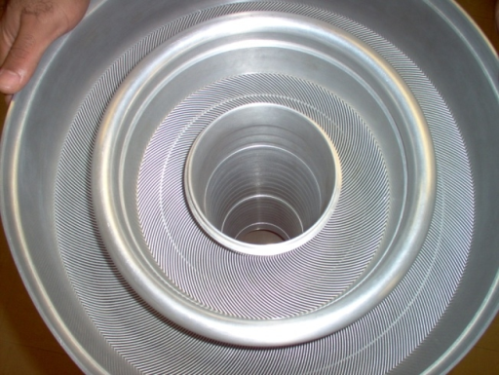
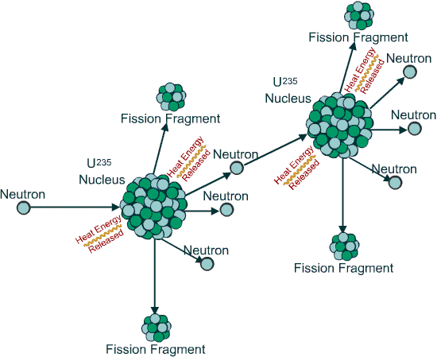
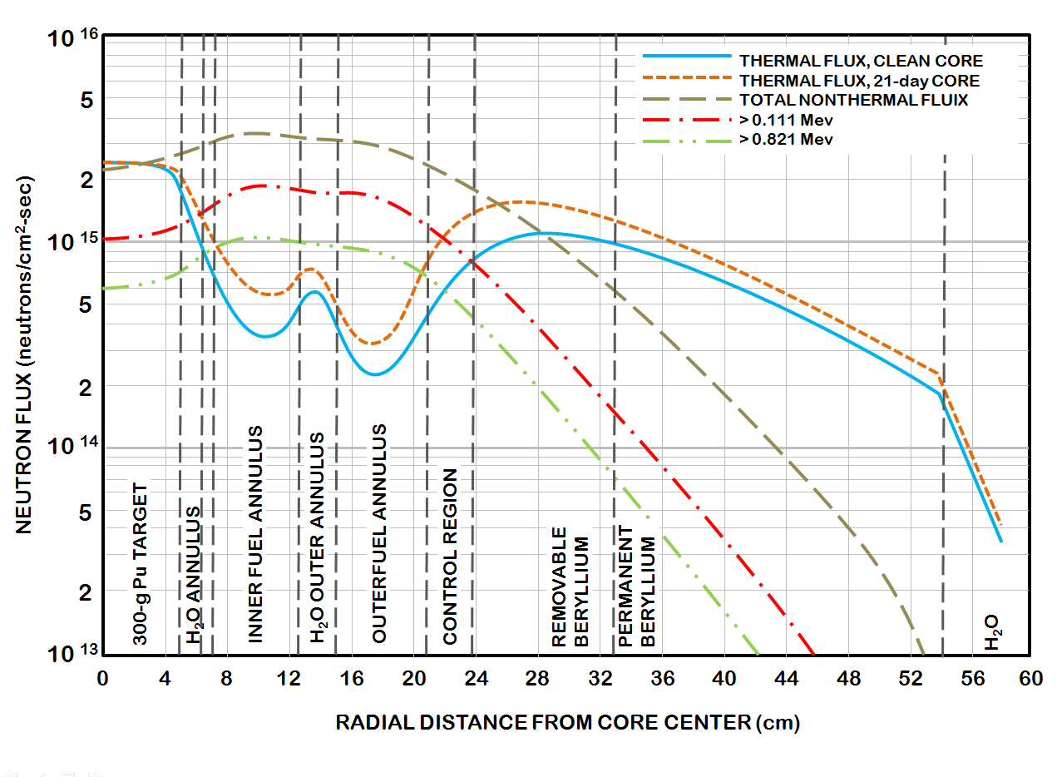
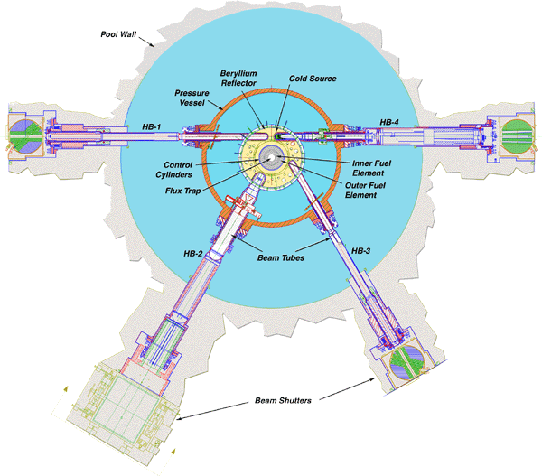
Neutron Sources
Continuous Source (Nuclear Reactors)
Neutrons produces by fission (usually ²³⁵U)
Fission spectrum must be moderated
Neutrons produced at a more or less constant rate
Very high neutron fluxes (10¹⁵ n/cm²/s)
NEUTRON PRODUCTION

Slide 4
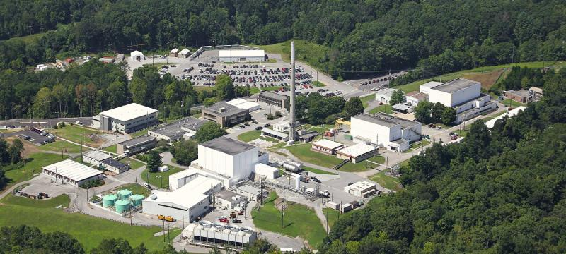
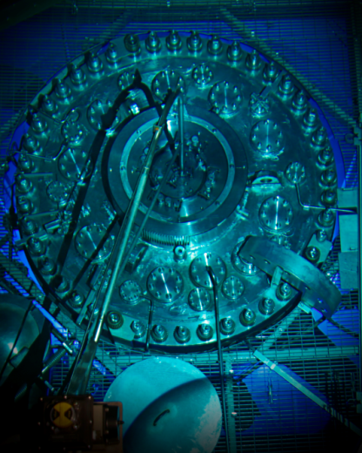
High Flux Isotope Reactor (HFIR)

Slide 5
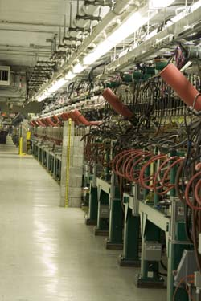
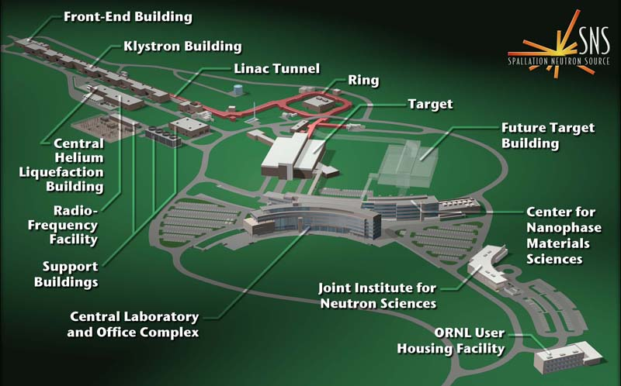
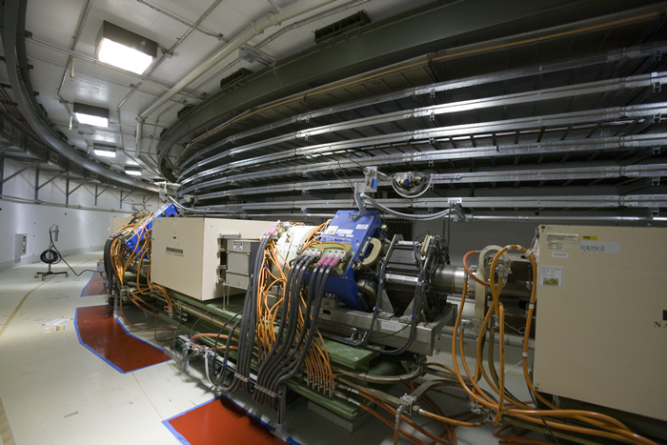
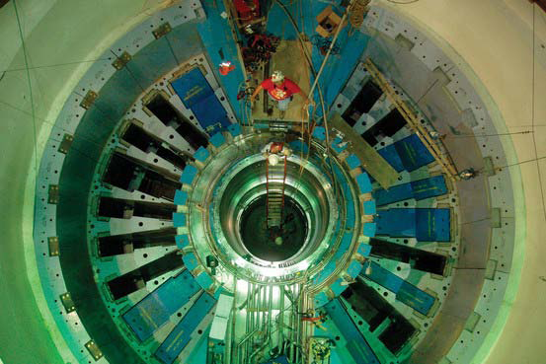
Neutron Sources
Pulsed (Spallation Sources)
Neutrons produced by nuclear spallation
Neutron beams inherently pulsed
Neutron energies must be moderated
Very high peak fluxes (10¹⁶ n/cm²/s)
How It Works
Negatively charged hydrogen ions are produced by an ion source -> H--
The ions are injected into a linear accelerator
The ions are passed through a stripper foil -> proton
The protons pass into a ring where they accumulate in bunches
Each bunch of protons is released from the ring as a pulse
The high-energy proton pulses strike the target -> neutrons
You are Here

Slide 6
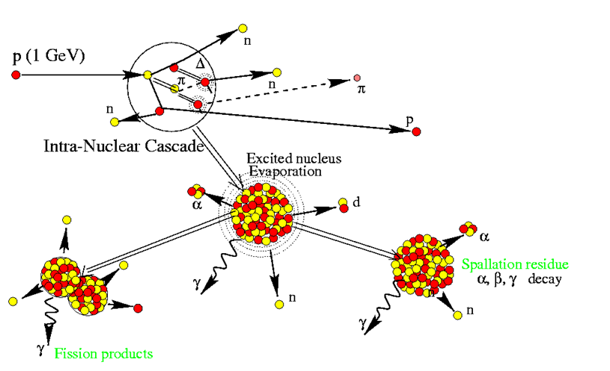
What Exactly is Neutron Spallation?
P (1 GeV)
Intra-Nuclear Cascade
Excited Nucleus
Evaporation
Spallation Residue
α, β, γ decay
Fission Products

Slide 7
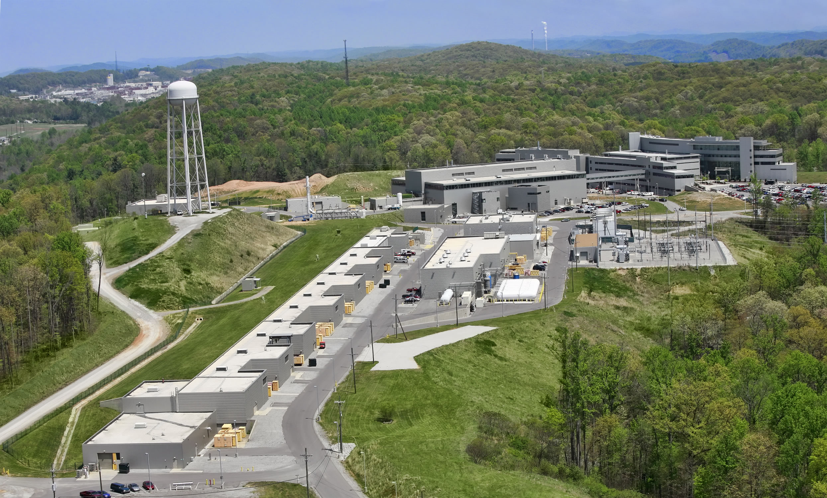
Spallation Neutron Source (SNS)

Slide 8
Pulsed vs Continuous Apples vs Oranges
Spallation Neutron Source (pulsed)
The peak neutron production of the SNS is about 10x that of the HFIR
The HFIR neutron production is about 15x the time averaged production of the SNS
Neutrons Produced (n/s)
High Flux Isotope Reactor (continuous)
Time (μs)

Slide 9
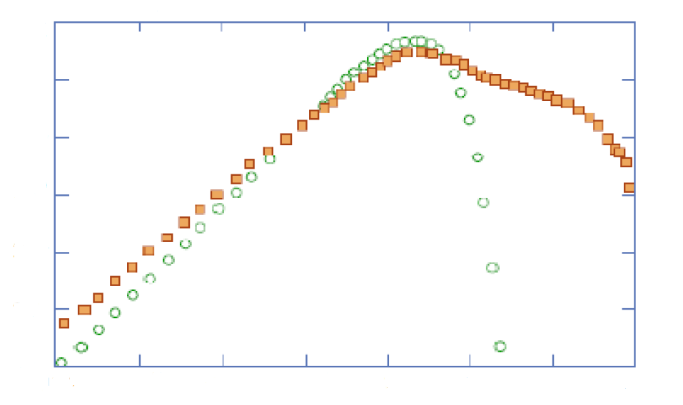
Neutron Sources: Energy Spectrum
http://www.inbk.rwth-aachen.de/publikationen/Shetty_Nabbi_High_Energy_Proton_Beam_2011.pdf
E$\text{=}{\text{k}}_{\text{B}}\text{T}\text{=}\left(\text{86.1}\text{7}×\text{10}\text{-6 }\text{eV}\text{/} \text{K}\right)\text{T}$
1
10⁻¹
10⁻²
10⁻³
10⁻⁴
10⁻⁵
10⁻⁶
²³⁵U fission
For E = 2 MeV, T = 2.3 x 10¹⁰ K !!
Neutron Leakage
(spectra normalized)
$$\text{k}=\frac{{\text{m}}_{n}\text{v}}{\text{h}}=\frac{2\text{π}}{λ}$$
800MeV protons
for W spallation
$$\text{E}=\frac{{\text{h}}^{2}{\text{k}}^{2}}{2{\text{m}}_{n}}=\frac{{\text{h}}^{2}}{2{\text{m}}_{n}}{\left(\frac{2π}{λ}\right)}^{2}$$
10⁻⁴
10⁻³
10⁻²
10⁻¹
1
10¹
10²
10³
$$=\frac{81.81×{10}^{3}\text{eV}{\text{K}}^{−1}}{λ^{2}}$$
Neutron Energy (MeV)
Detector
But for λ=1.8Å :
(typical interatomic distance)
E=25meV (that’s meV NOT MeV!)
Scattered Wavevector
k_{f}
Source
Incident Wavevector
k_{i}
Sample
So for E=25meV, T=290K =17°C
That’s ambient temperature!

Slide 10
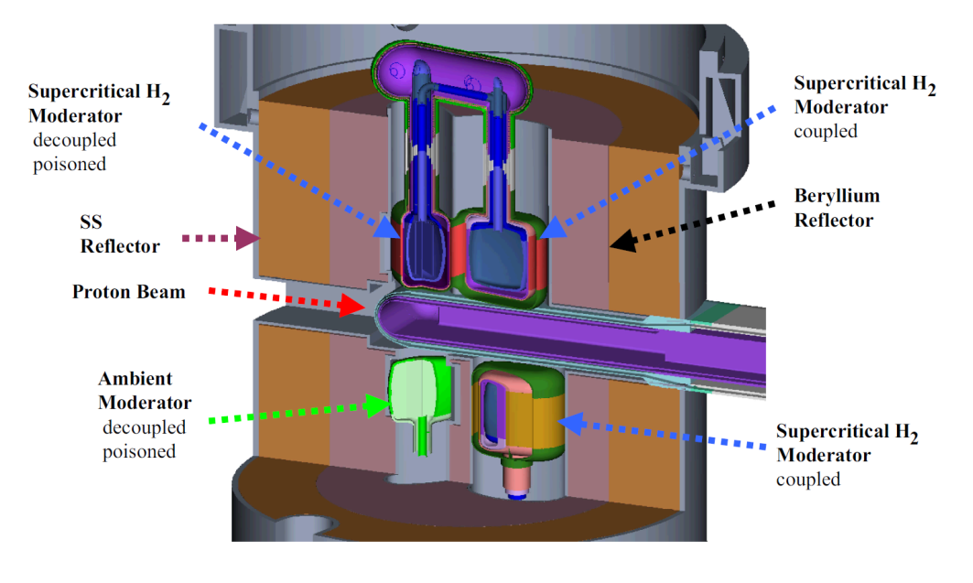
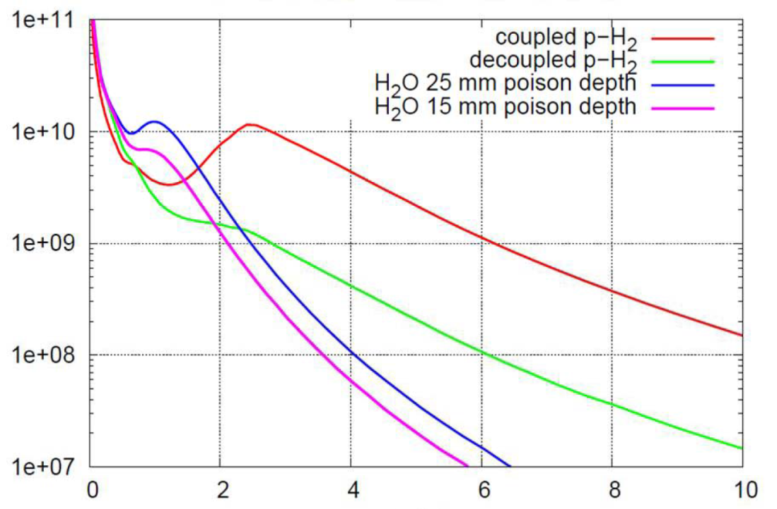
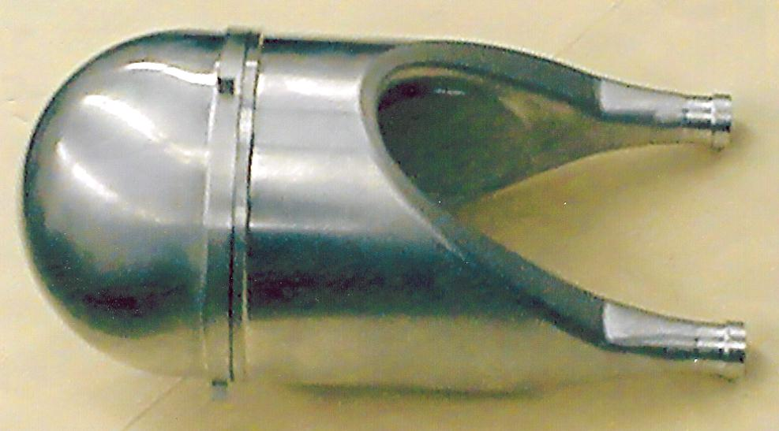
Moderators: GeV→MeV→keV→eV→meV
SNS Moderators
HFIR Be Moderator and Cold Source
Source Brightness
(n/cm²/sterad/Å/MW/pulse)
Neutron Wavelength (Å)

Slide 11
Neutron Detectors
We can’t detect them directly
They are neutral particles so they don’t have any charge.
They don’t have enough energy (10’s of meV).
Fortunately, there are nuclear reactions that can convert these low energy neutrons into high energy charged particles. Then we can use standard techniques for detecting those particles.
Gas proportional counters
Ion chambers
Scintillation detectors
Semiconductor detectors

Slide 12
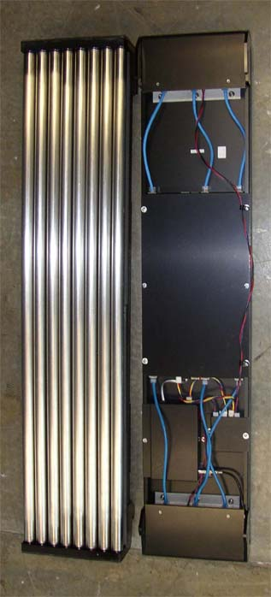
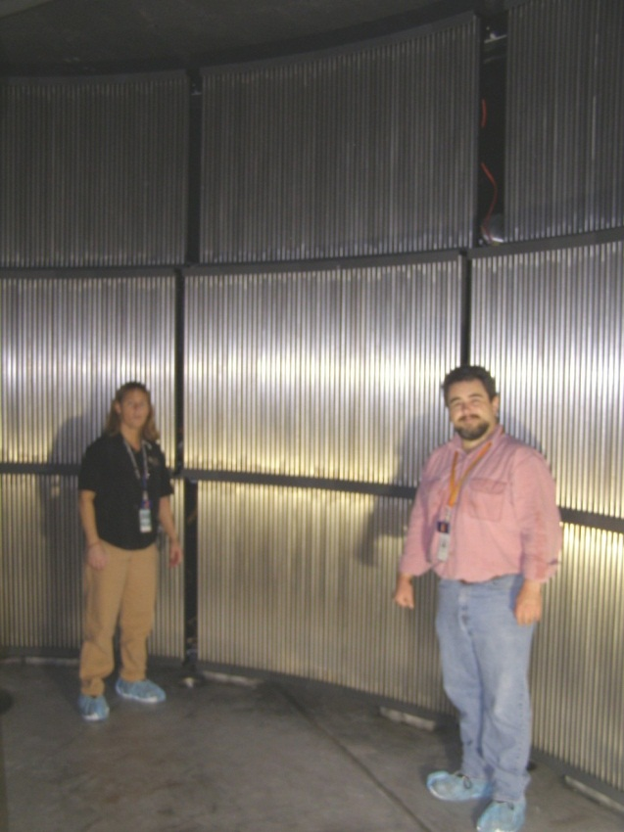
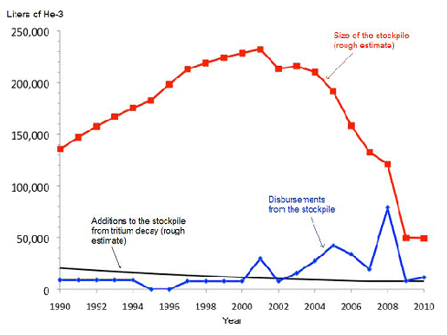
Neutron Detectors: ³He
ARCS Detector Array
930 ³HE LPSD’s
Today, approximately 75% of the detectors for neutron scattering experiments use ³He
n + ³He → ³H + ¹H + 0.764 MeV
These detectors are efficient, stable, low noise, have excellent gamma discrimination, and good timing
Unfortunately, the supply of ³He is rapidly diminishing
Detector 8-Pack

Slide 13
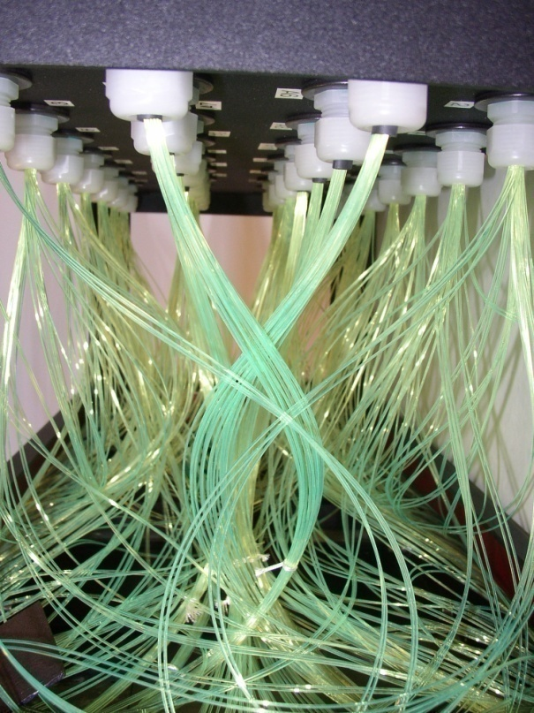
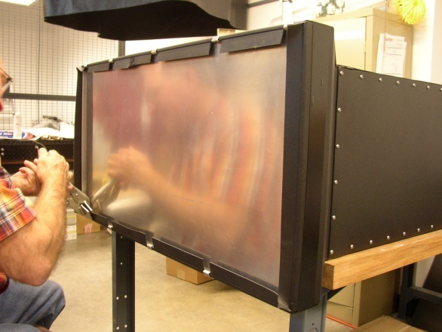
Neutron Detectors: Scintillators
Wavelength-shifting fiber detector developed for powder diffraction applications
Uses a ⁶LiF/ZnS(Ag) scintillator
n + ⁶Li → ³H + ⁴He + 4.78MeV
Collisions with these charged particles cause the ZnS(Ag) to scintillate at a wavelength of approximately 450nm.
Blue scintillation light is shifted to green and captured in the fibers
308 × 152 pixels – 5mm x 54mm resolution
~70% detection efficiency @ 1.8Å

Slide 14
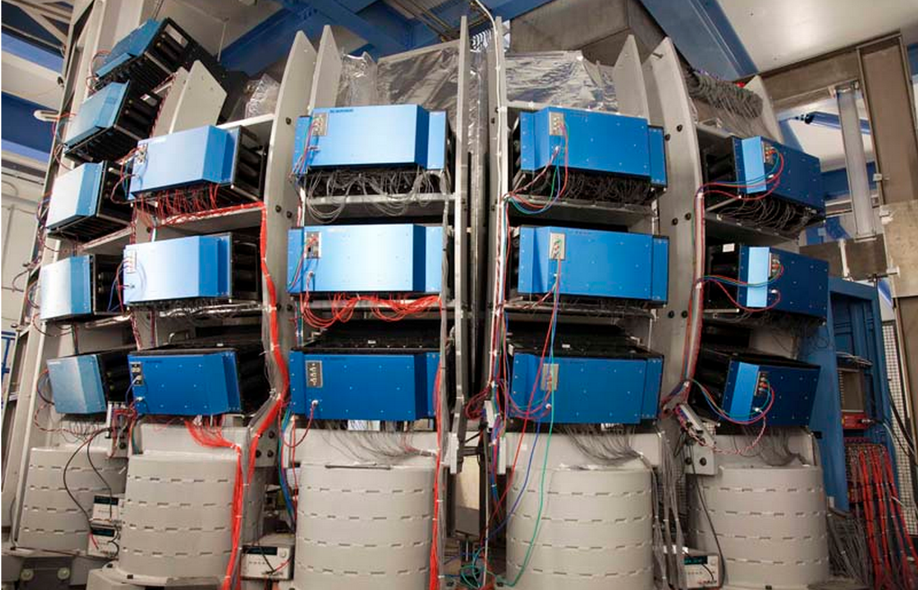
Wave Shifting Fiber Detectors on VULCAN

Slide 15
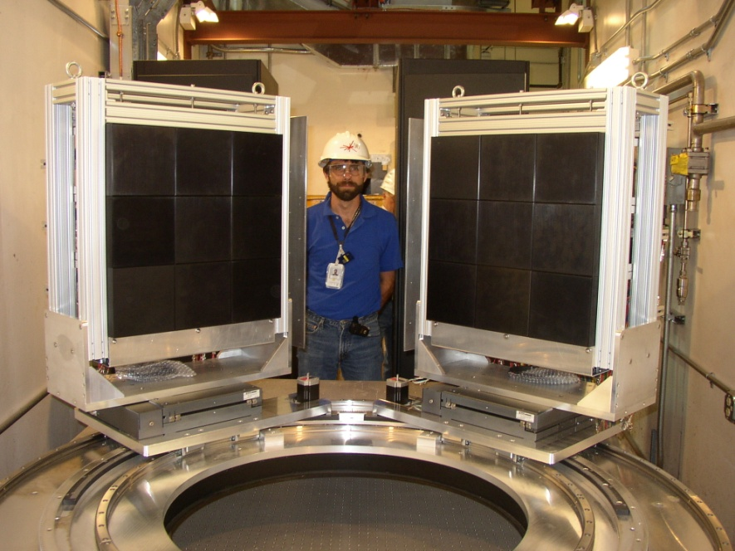
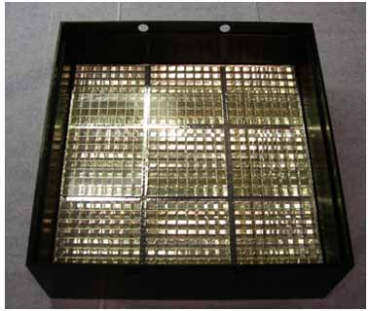
Detectors: Anger Cameras
The Anger camera optics package maps the scintillator (2mm GS20 Li glass) area to the 6mm x 6mm PMT anodes
Fit measured light cone with a 2-gaussian function to determine neutron position (current resolution is 0.8mm)
Developed for single crystal instruments
coupling plate
scintillator
photomultipliers

Slide 16
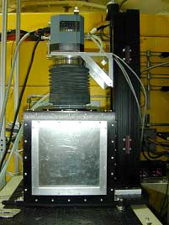
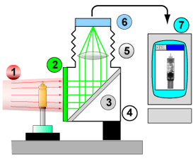
Neutron Camera
Point source of neutrons
Neutron to light converter
First surface mirror (45 degree)
Light tight box
Standard camera lens
Peltier cooled CCD chip
Computer

Slide 17
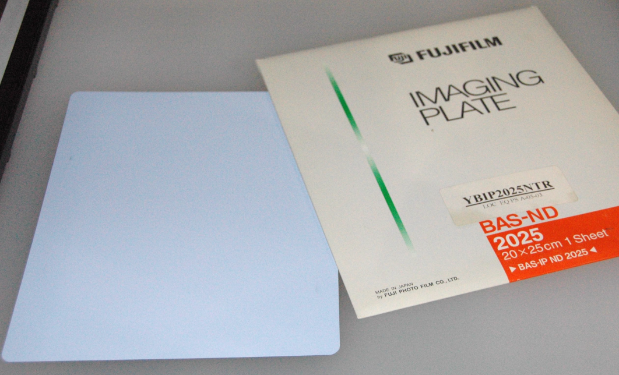
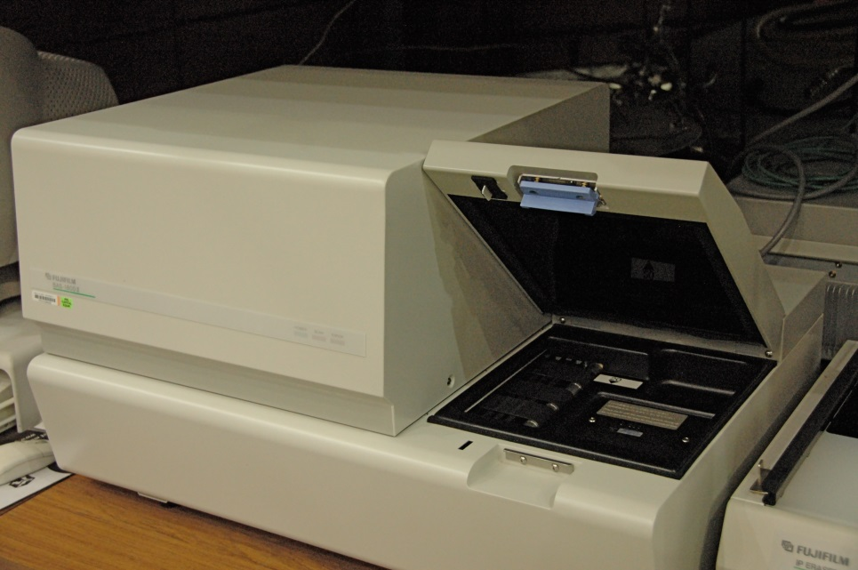
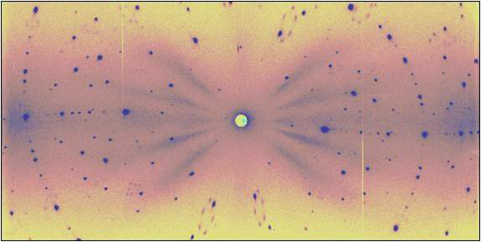
Neutron Image Plates

