Slide 1
Neutron Optics and Instrumentation
Lee Robertson
Instrument & Source Division
Oak Ridge National Laboratory
17th National School on Neutron and X-ray Scattering
June 21, 2015

Slide 2
What is a Neutron Scattering Instrument?
Neutron scattering experiments measure the number of neutrons scattered by a sample as a function of the wavevector change (Q) and the energy change (E) of the neutron.
What do we need to accomplish this?
A source of neutrons
A method for selecting the wavevector of the incident neutrons (k_{i})
A very interesting sample
A method for determining the wavevector of the scattered neutrons (k_{f})
A neutron detector
Detector
Scattered Wavevector
k_{f}
Source
Incident Wavevector
k_{i}
Sample

Slide 3
Why Not Just Build a Universal Neutron Scattering Instrument That Can Do Everything We Need?
Detector
Scattered Wavevector
k_{f}
Source
Incident Wavevector
k_{i}
Sample
Two types of sources (continuous and pulsed)
Two methods for determining the neutron wavevector, k (time-of-flight and diffraction)
Two types of scattered neutrons (elastic and inelastic)
Two types of interactions between the neutrons and the sample (nuclear and magnetic)
Wide range of length scales driven by the science
The energy of the neutron is coupled to its wavelength and velocity:
λ²(Å²) ~ 81.81/E(meV) and v²(m²/s²) ~ 191313×E(meV)
S(Q,E) the scattering properties of the sample depend only on Q and E, not on the neutron wavelength(λ)
Message: Many different types of neutron scattering instruments are needed because the accessible Q and E ranges depend on the neutron energy and because the resolution and detector coverage have to be tailored to the science for such a signal-limited technique.

Slide 4
Pulsed vs Continuous Apples vs Oranges
Spallation Neutron Source (pulsed)
The peak neutron production of the SNS is about 10x that of the HFIR
The HFIR neutron production is about 15x the time averaged production of the SNS
Neutrons Produced (n/s)
High Flux Isotope Reactor (continuous)
Time (μs)

Slide 5
Neutron Scattering Instruments at Continuous Sources Are Typically Based on Diffraction Techniques
Monochromator
Crystal
“White” Beam
Transmitted Beam
Source
k_{i}
Monochromatic Beam
Analyzer
Crystal
Transmitted
Beam
Bragg’s Law
Scattered Beam
Sample
Detector
$$nλ=2d\sin{θ}$$
k_{f}
Scattering
Angle
Momentum Transfer
$$\vec{Q}={\vec{k}}_{i}−{\vec{k}}_{f}$$
Transmitted Beam
$$ΔE=\frac{h^{2}}{2m}\left({\left|k_{i}\right|}^{2}−{\left|k_{f}\right|}^{2}\right)$$
Detector

Slide 6
Neutron Scattering Instruments at Pulsed Sources Are Typically Based on Neutron Time-of-Flight Techniques
Fermi
Chopper
Source
Sample
Detectors
Time and Distance
v(1.8Å) = 2187m/s
TOF(s) = D(m)/v(m/s) = [D(m)×λ(Å)]/3956.0339
D=20m, TOF(1Å)=0.005s, TOF(2Å)=0.010s, ΔTOF=0.005s
λ(Å) = (3956.0339 * TOF(s)) / D(m)

Slide 7
Neutron Optics
The following neutron optical components are typically used to construct a neutron scattering instrument
Monochromators / Analyzers: Monochromate or analyze the energy of a neutron beam using Bragg’s law
Choppers: Define a short pulse of neutrons or select a small band of neutron energies
Guides / Mirrors: Allow neutrons to travel large distances without suffering intensity loss
Polarizers / Spin Manipulators: Filter and manipulate the neutron spin
Collimators: Define the direction of travel of the neutrons
Detectors: Neutron position (and arrival time for TOF) is recorded. Neutrons are typically detected via secondary ionization effects.

Slide 8
Liouville's Theorem
In the geometrical-optics the propagation of neutrons can be represented as trajectories in a six-dimensional phase space (p, q), where the components of q are the generalized coordinates and the components of p are the conjugate momenta.
Simply stated, Liouville's Theorem says that phase space volume is conserved.
Translation: It costs flux to increase resolution and it costs resolution to increase flux.
There is no way to win!
Parallel
Converging

Slide 9
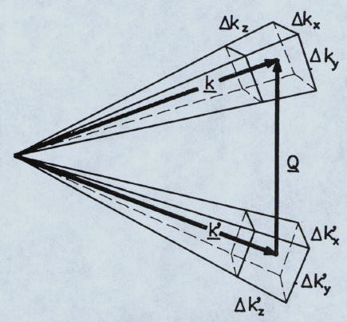
Instrument Resolution
Uncertainty in the neutron wavelength and direction limit the precision that Q and E can be determined
For scattering, the uncertainty comes from how well k_{i} and k_{f} can be determined
For TOF, the uncertainty primarily comes from not knowing the exact start time for each neutron
The total signal observed in a scattering experiment is proportional to the phase space volume within the elliptical resolution volume – the better the resolution, the lower the count rate
Figure borrowed from Roger Pynn

Slide 10
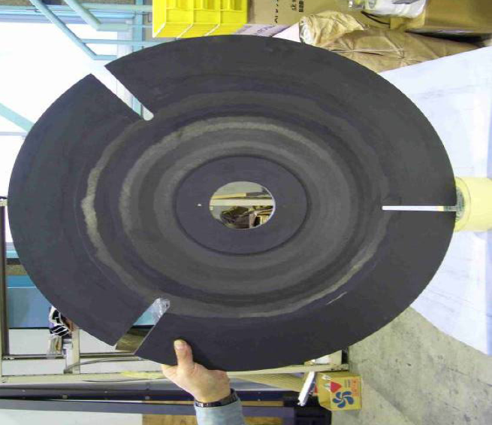
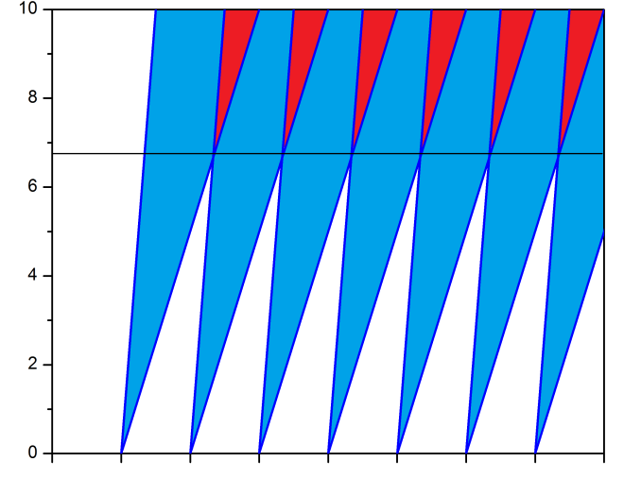
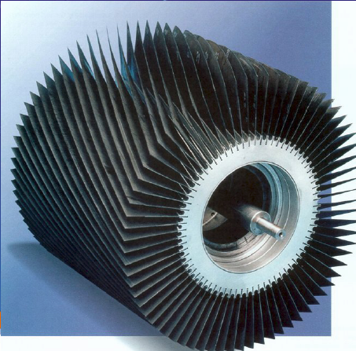
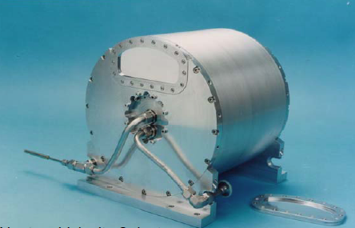
Choppers and Velocity Selectors
Disk Chopper
Fermi Chopper
J-PARC
TOF Timing Diagram
Velocity Selector
Distance
1
2
3
4
5
6
7
Astrium
Frame

Slide 11
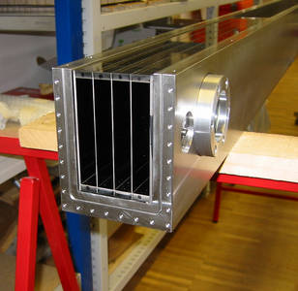
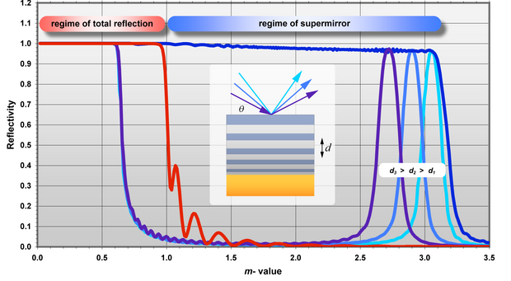
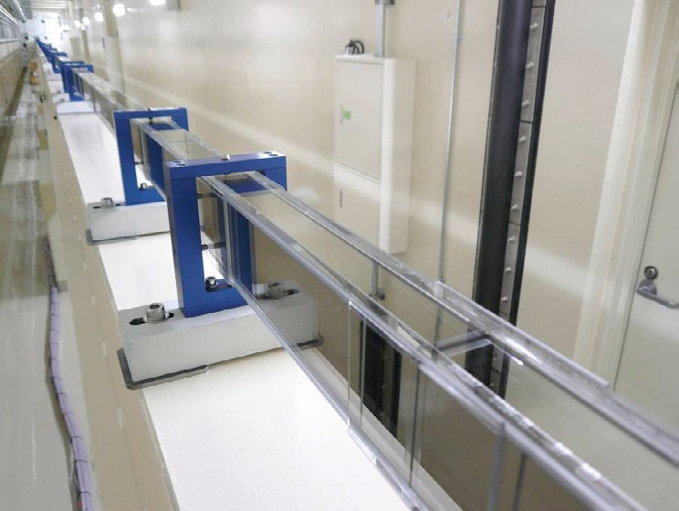
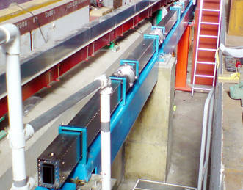
Neutron Guides
m=0.1 deg/Å
Multichannel Curved Guide
Fabricated by Swiss Neutronics
Guide Installation at ISIS
80m Guide for HRPD at J-PARC
Fabricated by Swiss Neutronics

Slide 12
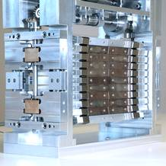
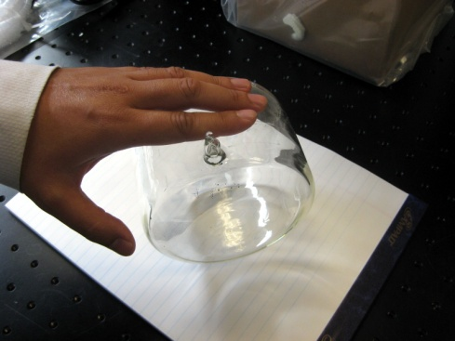
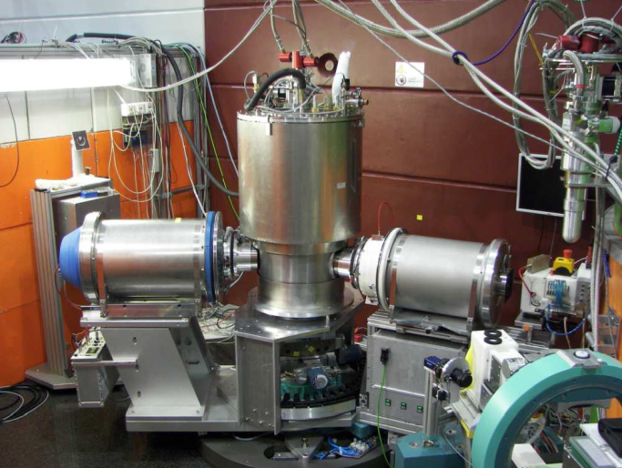
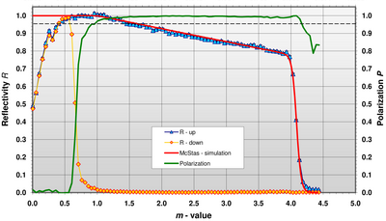
Polarizers and Spin Manipulators
³He Cell
Heussler Monochromator
AlCuMn
Unpolarized
Neutron Beam
Polarized
Neutron Beam
³He Spin
Filters
Larmor Precession
Flipper
Spherical Neutron Polarimetry
Polarizing Supermirrors
POLI-HEiDi at FRMII

Slide 13
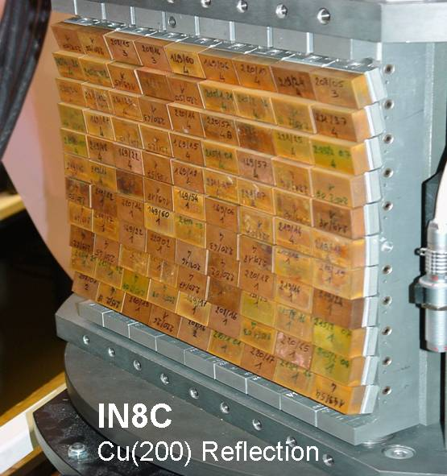
Neutron Optics: Focusing
Doubly focusing Cu monochromator at the ILL
Double focusing “Popovici” monochromator. The vertical curvature is fixed while the horizontal curvature is variable by bending stacks of thin silicon wafers. The gain is achieved both by spatial focusing and ‘wavelength focusing’.
Virtual Source
Mono
Small
Aperture
Sample

Slide 14
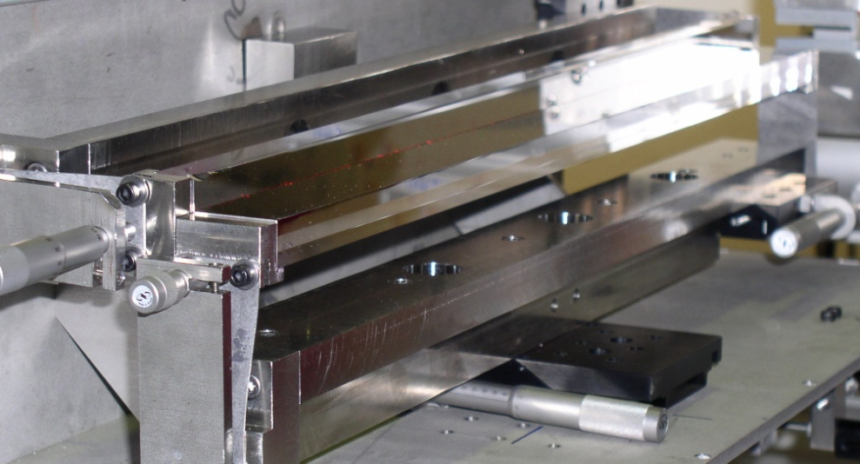
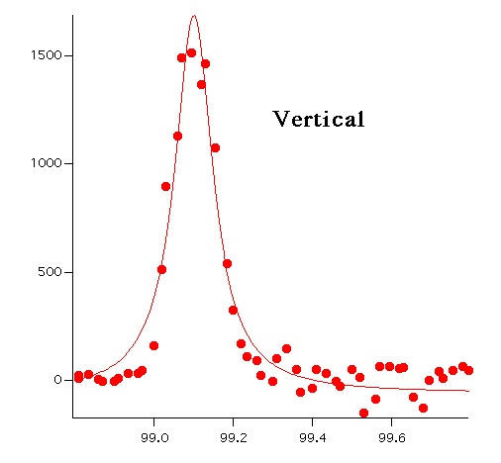
Neutron Optics: Focusing
Focusing Mirrors :
Develop a nested advanced KB mirror system to make a more compact assembly and to achieve the highest performance.
Identify applications where focusing optics can replace neutron guides and offer better performance.
90 μm

Slide 15
Elastic Neutron Scattering Instruments
Longer Length Scales
Elastic instruments include:
Powder diffraction
Single Crystal diffraction
SANS (typical)
Reflectometry
Biological Structure
Viruses
Small Proteins
REFLECTOMETERS
SANS
Critical Phenomena
Micelles Colloids Vesicles
Polymers and
Metals Alloys Zeolites
Magnetic Films
and Domains
Used to determine the average structure of materials (i.e. how the atoms are arranged)
Membranes
Liquids and Glasses
Crystal,
Fiber,
and
Magnetic
Structures
DIFFRACTOMETERS
Based on diagram by Roger Pynn

Slide 16
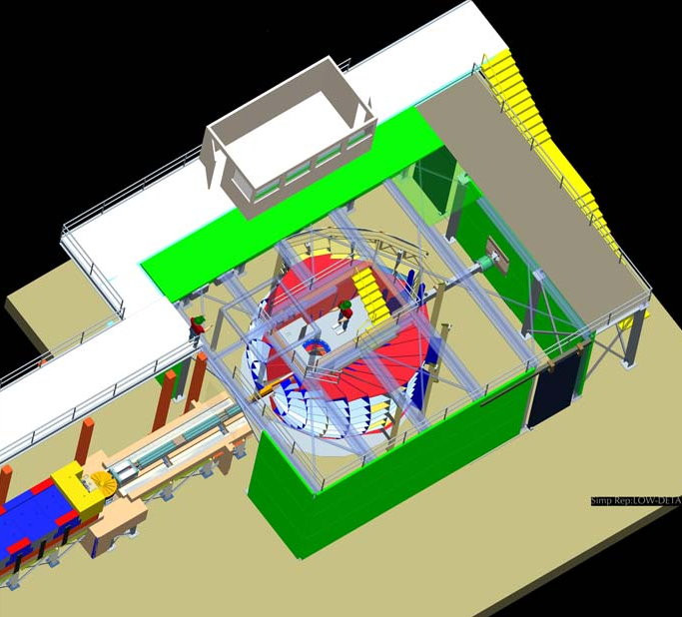
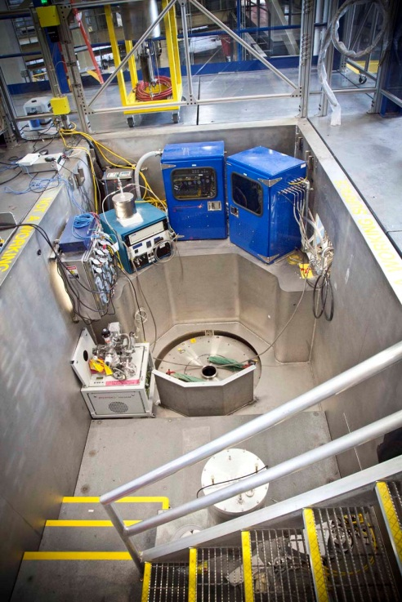
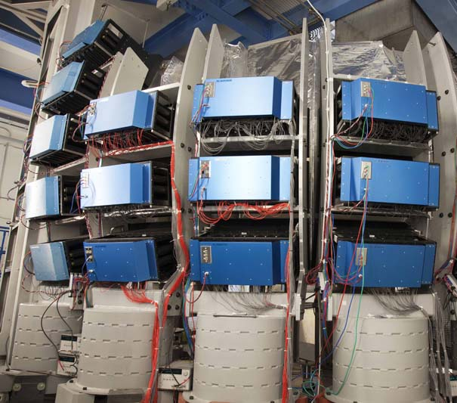
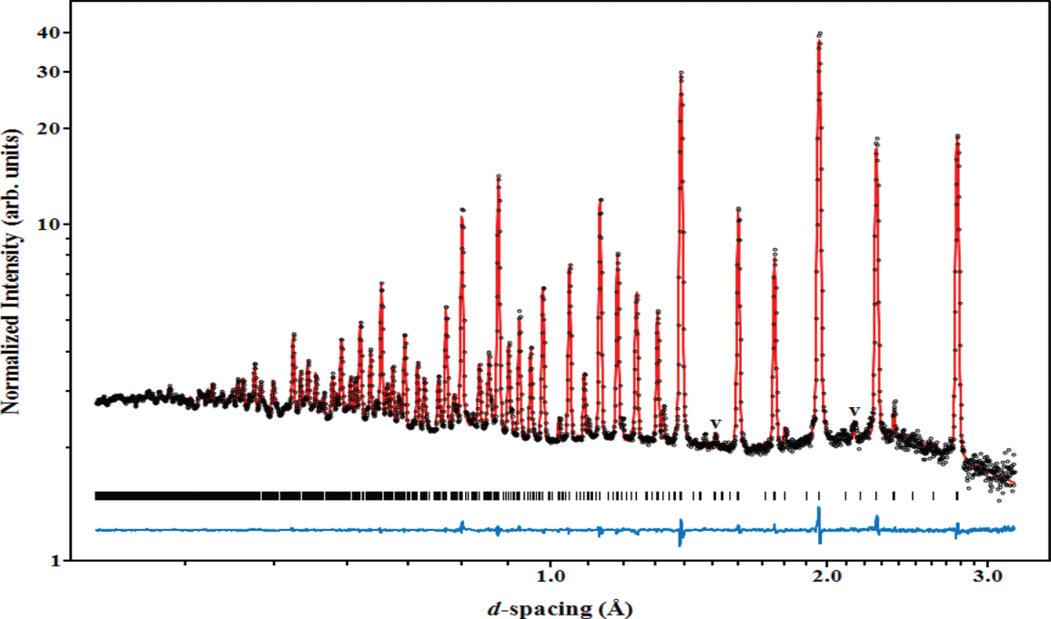
TOF Powder Diffractometer: POWGEN (SNS)
Sr₂Fe_{1.5}Mo_{0.5}O₆, Electrode Material for Solid Oxide Fuel Cells
$$\text{d}\text{=}\frac{\text{λ}}{\text{2}\text{sin}{\text{θ}}}\text{=}\frac{\text{2}\text{π}}{\text{Q}}$$
J. Am. Chem. Soc., 134, p6826 (2012)
$$\text{λ}\left(\text{Å}\right)\text{=(3956.0339∗}\text{TOF}\text{(}\text{s}\text{)/}\text{D}\text{(}\text{m}\text{)}$$
$$\text{d}\text{=}\frac{\text{(3956.0339∗}\text{TOF}\text{)/}\text{D}}{\text{2}\text{sin}{\text{θ}}}$$
For POWGEN D = 64.5m

Slide 17
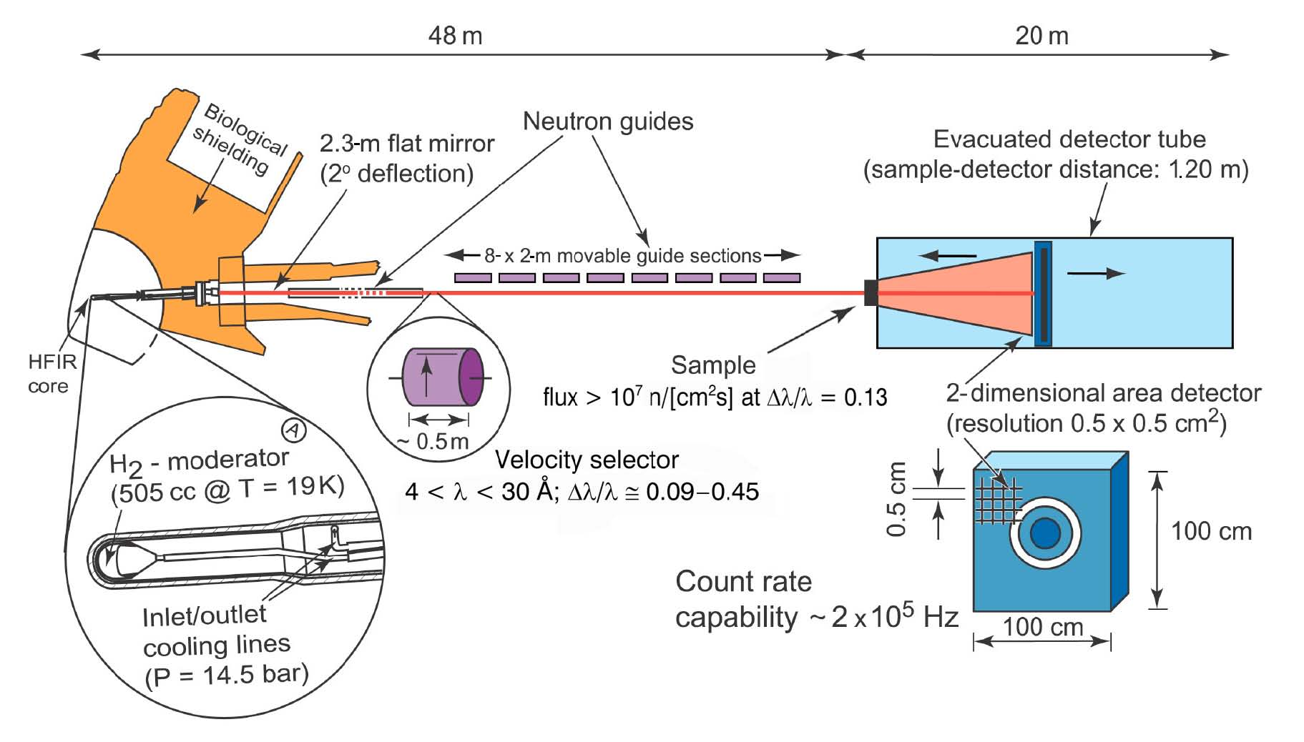
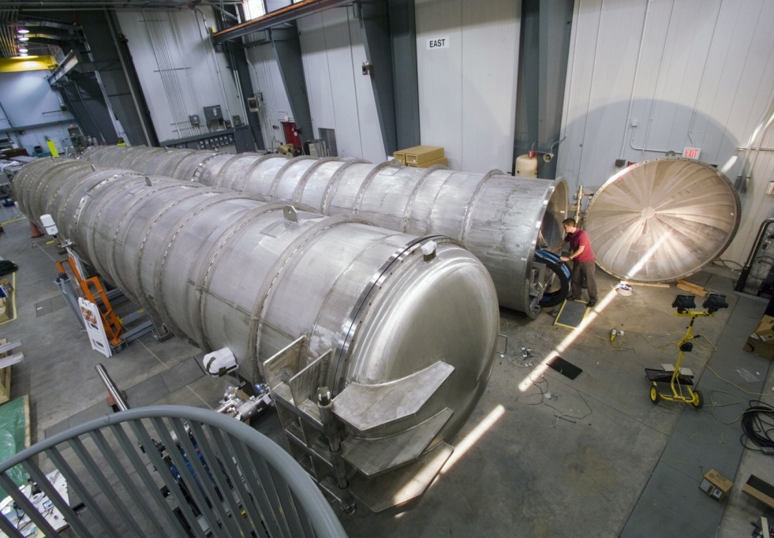
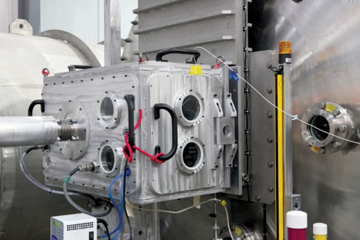
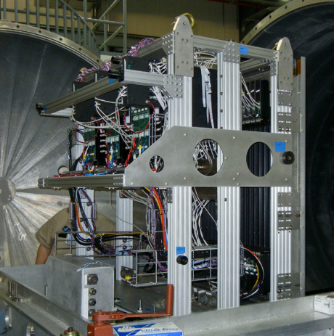
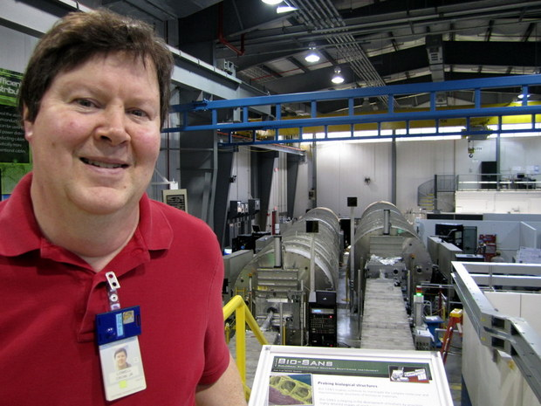
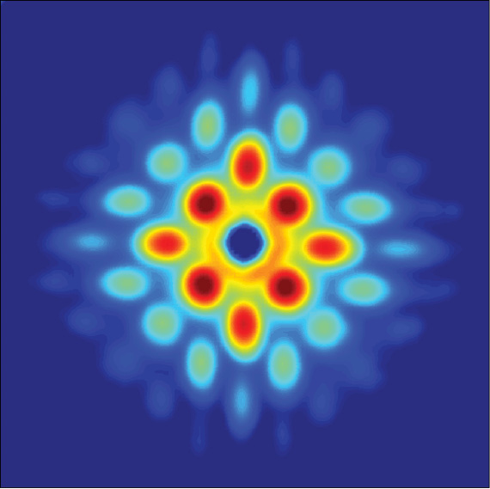
Small Angle Neutron Scattering (SANS)
TmNi₂B₂C Vortex Lattice
PHYS REV B 86, 144501 (2012)

Slide 18
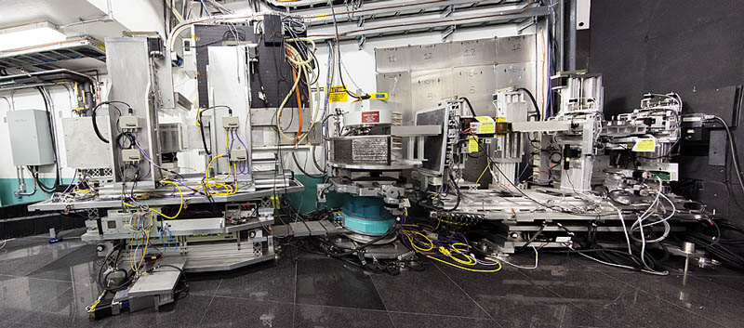
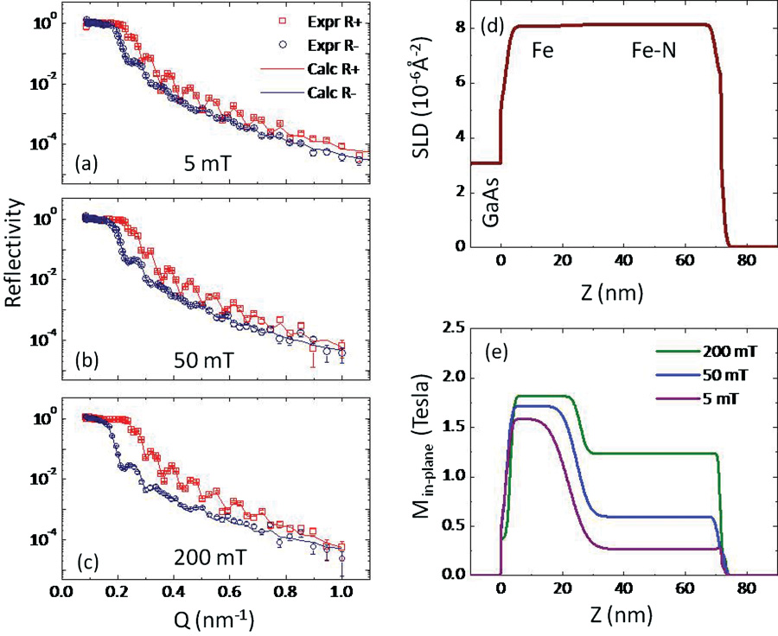
Magnetism Reflectometer (SNS)
PHY REV B 84, 245310 (2011)

Slide 19
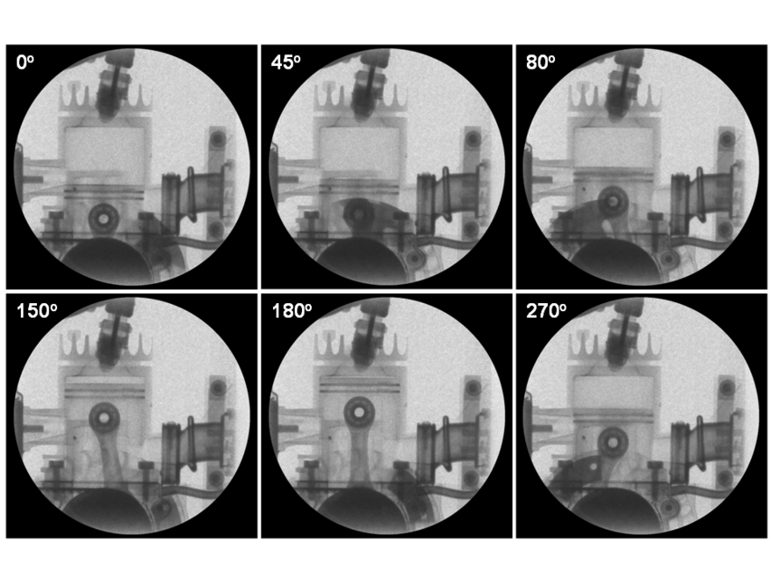
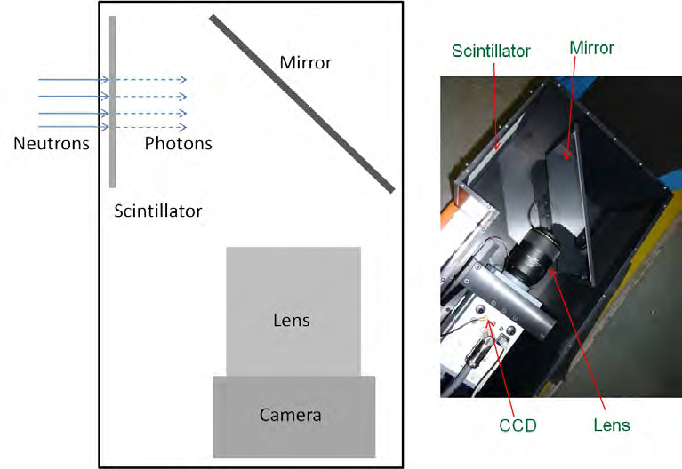
Neutron Imaging
Carbon foam matrix in a Li battery
(H. Bilheux and S. Voisin)
X-ray image
Neutron Image

Slide 20
Inelastic Neutron Scattering Instruments
Inelastic instruments include:
Longer Length Scales
d(Å)
Direct Geometry TOF Spectrometers
Indirect Geometry TOF Spectrometers
Triple-Axis Spectrometers
Backscattering Spectrometers
Neutron Spin-Echo Spectrometers
100
10
1
0.1
Neutron Induced
Excitations
Hydrogen
Modes
Intenerate
Magnets
Crystal
Fields
Molecular
Vibrations
Spin
Waves
Coherent
Modes
Lattice
Vibrations
Electron-Phonon
Interactions
Molecular
Motions
Slower
Motions
Used to study dynamics such as phonons, magnons, and diffusion (i.e. what the atoms are doing)
Critical Scattering
Diffusion
Molecular
Reorientation
Aggregate Motion
Polymers and Biological Molecules
Based on diagram by Rex Hjelm

Slide 21
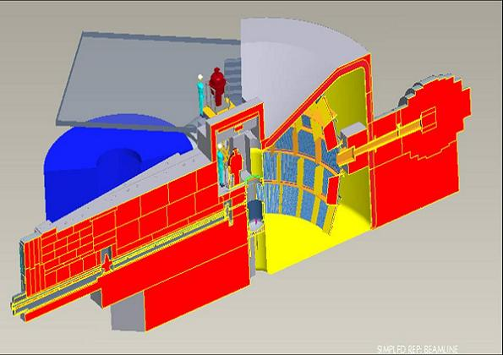
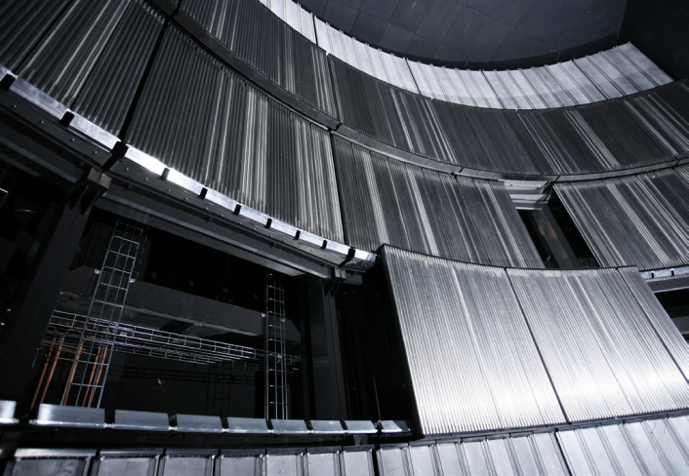
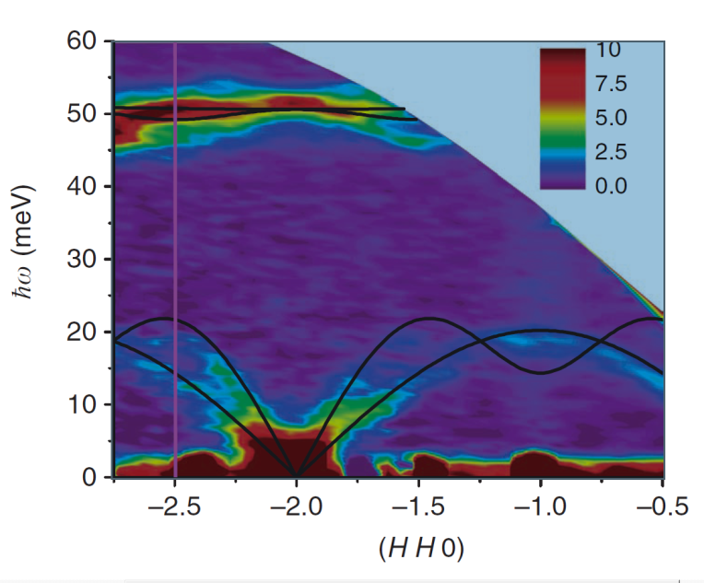
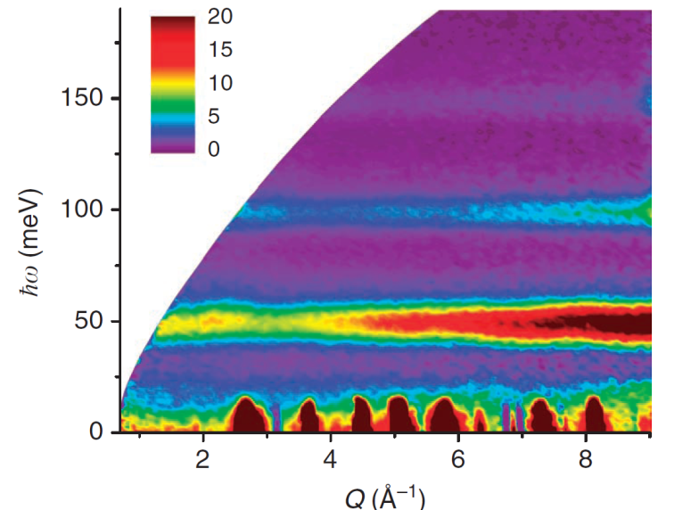
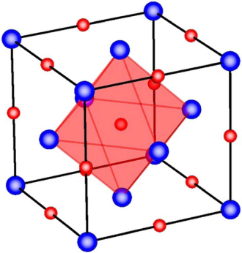
SEQUOIA: A Direct Geometry TOF Spectrometer at the SNS
Quantum oscillations of nitrogen atoms in uranium nitride
Nature Communications v3, p1124 (2012)

Slide 22
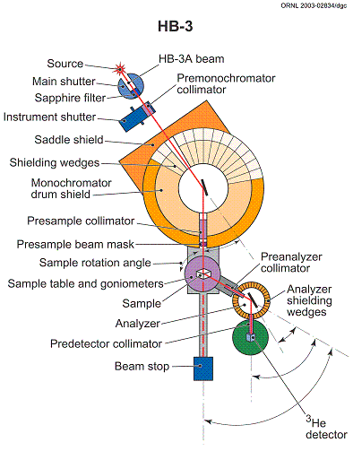
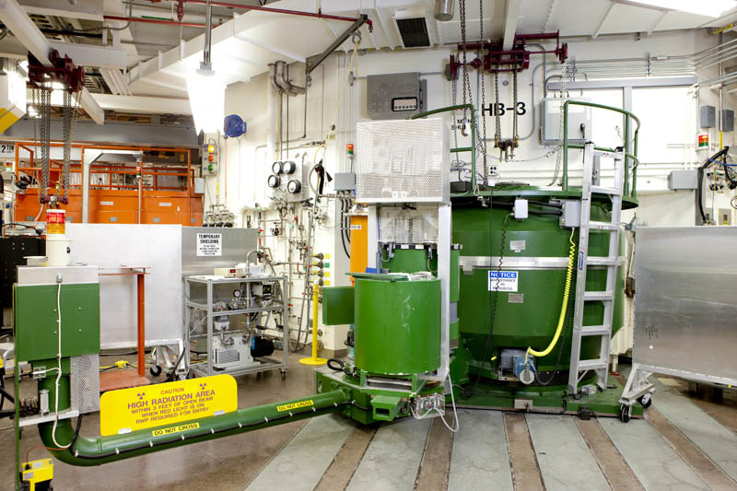
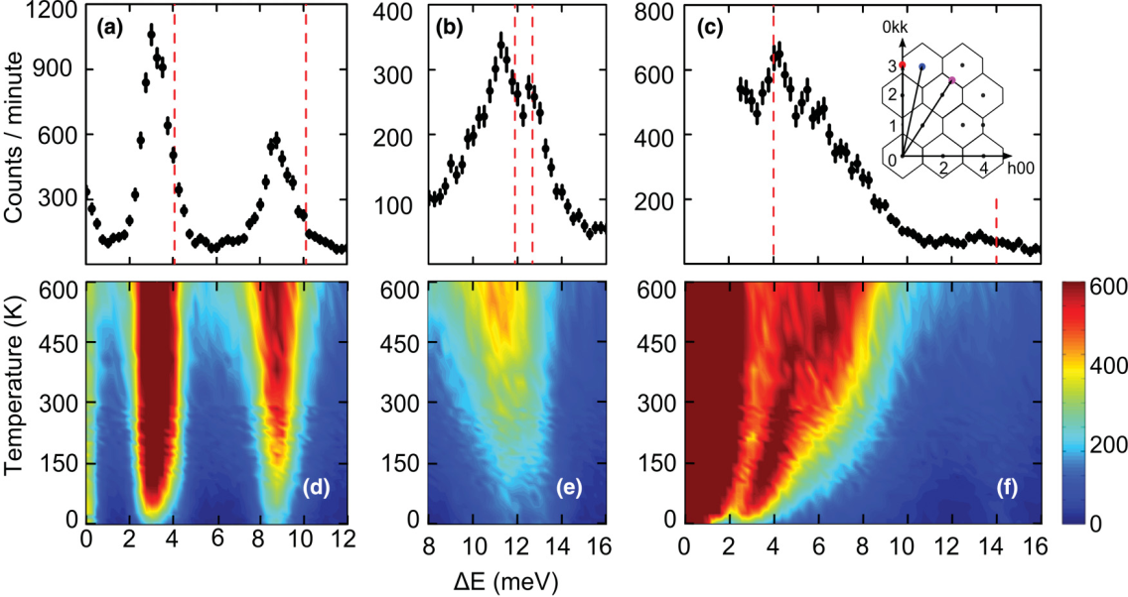
Triple-Axis Spectrometer
Lattice Dynamics of PbTe
PHYS REV B 86, 085313 (2012)

Slide 23
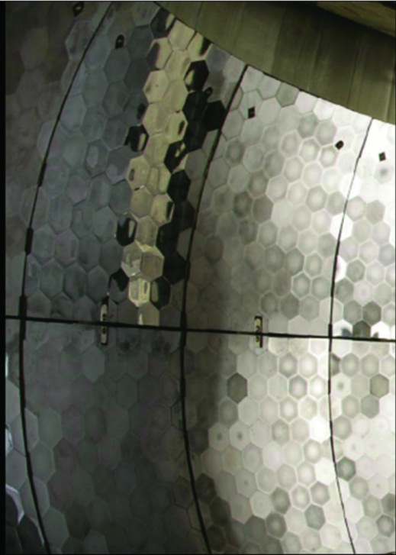
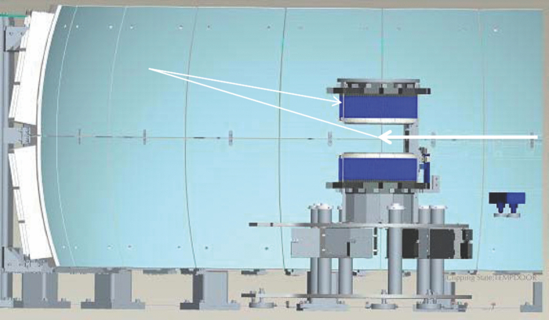
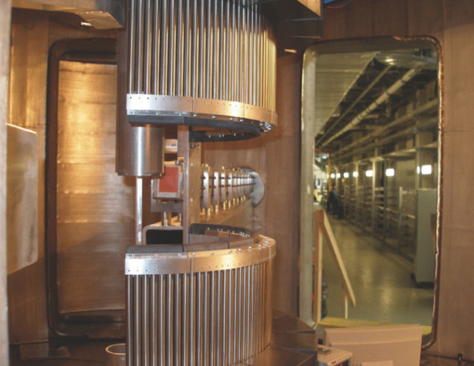
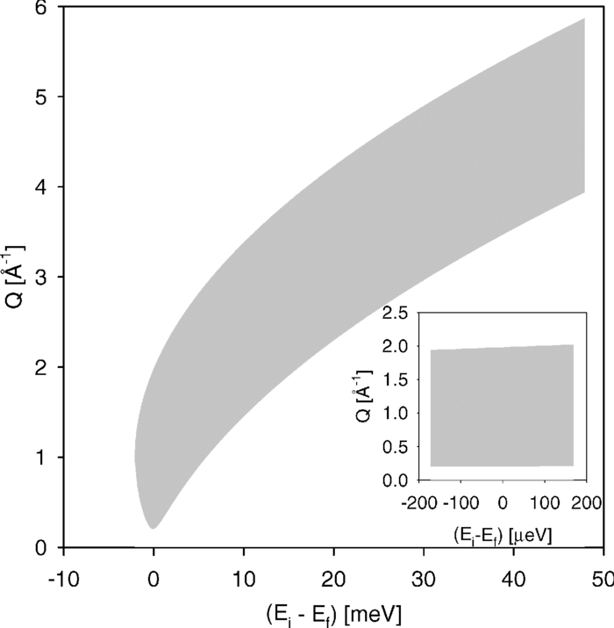
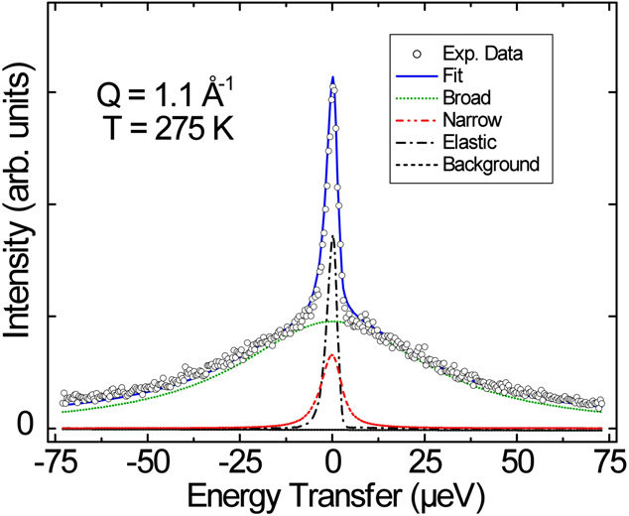
BASIS: An Inverted Geometry Backscattering Spectrometer
Study of water diffusion on single-supported bilayer lipid membranes by QENS
Bai M., EPL 98, 48006 (2012)

Slide 26
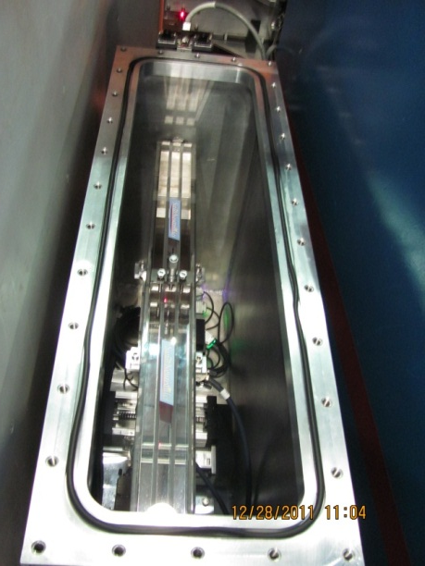
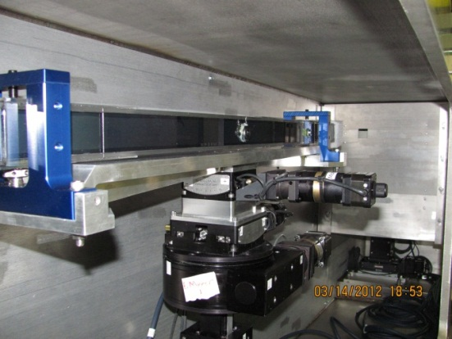
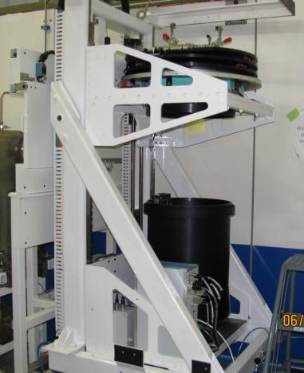
Advanced Neutron Optics: IMAGINE
Entrance Slit 1
Flight Tube
Entrance Slit 2
Flat Mirror
Multimirrors
Beamstop/Slit
Drop-In Apertures
CG-4 Guide
Elliptical
Mirror 1
CTAX
Mono
Elliptical
Mirror 2
Monitor
Diffractometer
Beamstop/Slit
INSTRUMENT ENCLOSURE
Short wavelength filter @ 2.0, 2.78, and 3.33 Å
Long wavelength filter @ 3.0, 4.0, and 4.5 Å
Elliptical mirrors for focusing the beam
4 mm
2 mm
beam focus at sample position

Slide 27
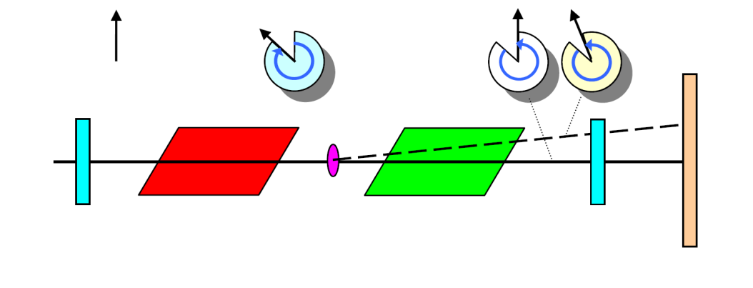
Future Instruments: SESANS/SERGIS
Spin-Echo Scattering Angle Measurement:
The neutron spin precesses through two parallelogram-shaped magnetic fields in opposite directions. For scattered neutrons the path-length through the two parallelograms is different resulting in a net change in the spin angle.
Using SERGIS the specular
and off-specular scattering
can be distinguished
θ
λ
specular
detector
off-specular
polarizer
+B
sample
-B
analyzer
horizon
sample
Real space correlation lengths up to 20 microns (and beyond?)
Does not require tight collimation for high resolution
Can be used to probe the in-plane correlations of thin films and interfaces.

Slide 28
Concluding Remarks
Instrument design is driven by the needs of the scientific community coupled with the source capabilities along with advances in neutron optics and detectors.
In the near term instrument development will be primarily focused on:
Focusing optics
Polarization
Detectors
Instrument development infrastructure (computer simulations)
New techniques and applications

